Slide 1
Measuring Response Latency Using Text Analysis of Interview Transcripts from the Consumer Expenditure Survey: A Work in Progress
Victoria R. Narine¹, Erica Yu¹, Brett McBride², & Erin Boon¹
Bureau of Labor Statistics
Office of Survey Methods Research¹
Division of Consumer Expenditure Surveys²
April 17, 2024
FedCASIC 2024

Slide 2
Computer Audio-Recorded Interviewing
CARI uses laptops or phones to record interviewer-respondent interactions
  At start of interview, interviewer asks respondent to consent to recording
  Recordings initiate when interviewer gets to screen with prespecified question/variable

Slide 3
CARI in the Consumer Expenditure Survey
CE collects data on expenditures (e.g., vehicles, property, rent) that the respondent recalls over 3 months
Ongoing research within BLS using CARI focuses on interviewer behaviors (e.g., major changes to question stem) and respondent behaviors (e.g., signs of burden, confusion)
Research uses behavior coding techniques
  Require researcher to listen to individual CARI cases and manually code features of interviewer-respondent interaction

Slide 4
Response Latency
Response latency: time it takes a respondent to process and answer a question
Can be considered a proxy measurement for cognitive processing and question difficulty (Draisma & Dijkstra, 2004)
  Research suggests a positive relationship between question difficulty and response error (e.g., Krosnick, 1991)

Slide 5
Measuring Response Latency
In past research, response latency measured by coders pressing a button at offset of question and onset of definitive answer by respondent (e.g., Draisma & Dijkstra, 2004)
  Can be time consuming and prone to error
Transcripts generated from AWS’s Amazon Transcribe provide timestamps

Slide 6
Current Research
Use data science techniques to:
  Identify whether an interviewer makes a major change to question wording
  Identify if question wording predicts respondent behaviors related to data quality (e.g., amount estimation, requests for clarification)
  Identify if a major change predicts response latency
  Identify if response latency predicts respondent behaviors related to data quality

Slide 7
Current Research
Targeting 2 survey items previously evaluated in CARI team:
  Weekly expenditures for groceries – GREXPWX
How much (do/does) (you/your household) USUALLY spend each week for groceries, including food and non-food items? Please include in-person and online grocery shopping and delivery. Include items like prepared meal kits, personal health and wellness items, diapers, pet food, and home cleaning supplies but do NOT include prescription drugs, alcohol, cigarettes, or other tobacco products.

Slide 8
Current Research
Targeting 2 survey items previously evaluated in CARI team:
  Weekly expenditures for groceries – GREXPWX
  Business screener and follow-up item – BUSCREEN and BUSEXPNSE (asked if BUSCREEN = 1 ‘Yes’)
BUSCREEN - Since the first of (reference month), have (you/you or any members of your household) had any expenses that will be reimbursed or deducted as business expenses?
BUSEXPNSE - For certain topics, such as housing, utilities, or vehicles, I will ask you to estimate how much of the expense was or will be deducted as a business expenses.

Slide 9
Step 1: Can We Do This?
Census currently produces CARI recordings of CE interviews
  Accessed via CARI Interactive Data Access (CIDA): Census-created app used to evaluate recordings, on Census’s VPN
Learned CIDA team could generate interview transcripts
Members of CARI research team met with CIDA team to discuss format of transcripts and level of detail possible in transcripts

Slide 10
Step 1: Get the Data
Learned transcribed interviews stored in Amazon S3 bucket in the cloud
2 questions:
  Can data be “pulled” from cloud to be analyzed on local computer or Census VPN?
  How much will this cost?

Slide 11
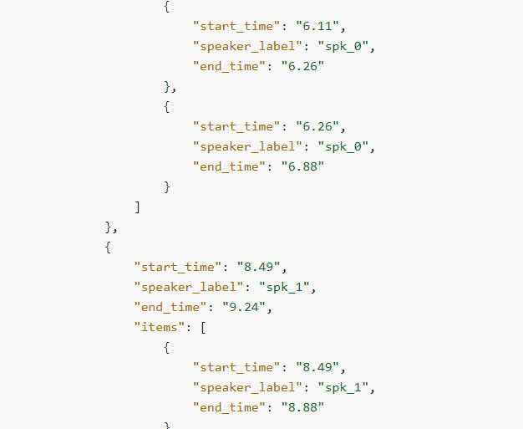
Step 1: Get the Data
Data requested include
  Labels for speakers
    Diarization
  Transcript text with as much detail as possible, specifically a word-for-word breakdown with timestamps
  Timestamp accuracy at millisecond level (or as precise as possible)
SPEAKER 0
SPEAKER 1

Slide 12
Step 2: Building a Team
Research question at intersection of survey methodology and data science
  2 survey methodologists
  1 subject matter expert
  1 data scientist

Slide 13
Step 3: Get Started
Build the model
  Measure frequency of major change to question stem
    GREXPWX = omission of “usually”; BUSCREEN/BUSXPNSE = TBD
    Compare interviewer question reading in transcripts to exact question wording using distance measures
  Identify paralinguistic expressions (e.g., “ummmm”) and other signs of verbal hesitations (e.g., “let’s see…)
    Regular expression rules
  Measure response latency
    Calculate time elapsed from offset of interviewer question reading to onset of first definitive response (if possible)

Slide 14
Project Status
Submitting Scope of Work to Census
  Scope of Work will help Census generate an estimate for cost of “pulling down” the data from the cloud

Slide 15
What We’re Still Working Through
What should we keep in mind when measuring response latency?
  Should requests for clarification and other meaningful dialogue that may lead to a definitive response be included in response latency?
  How do we handle rate of speech?
Does anyone have experience using distance measures with text data?

Slide 16
Contact Information
Victoria R. Narine
Research Statistician
narine.victoria@bls.gov
Erica Yu
Research Psychologist
yuwright.erica@bls.gov
Brett McBride
Senior Economist
mcbride.brett@bls.gov
Erin Boon
Data Scientist
boon.erin@bls.gov

Slide 17
Takeaways
Talk early in the process to the people who hold the data
Use existing vehicles to share data between agencies
Gain familiarity with common conversational scenarios
Ask for all the data you think you may want
COLLABORATION IS KEY!

