Slide 1
Automated Identification
of Unit-Level Interviewer Falsification
using Machine Learning
A Work in Progress
Jerry Timbrook, Kirsty Weitzel, and Peter Baumgartner
FedCASIC 2024

Slide 2
Interviewer-Administered Surveys
Expectations for administering a standardized instrument
  Conduct a genuine interview (e.g., no unit-level falsification)
    Compromise data quality
  Read consent statement exactly as worded
    Compliance issues
  Ask each applicable question in the instrument (e.g., no item-level falsification)
    Compromise data quality
  Read each question exactly as it is worded in the questionnaire
    Ensures all respondents receive the same question wording
    Reduces interviewer effects on measurement

Slide 3
Interviewer-Administered Surveys
Expectations for administering a standardized instrument
  Conduct a genuine interview (e.g., no unit-level falsification)
    Compromise data quality
  Read consent statement exactly as worded
    Compliance issues
  Ask each applicable question in the instrument (e.g., no item-level falsification)
    Compromise data quality
  Read each question exactly as it is worded in the questionnaire
    Ensures all respondents receive the same question wording
    Reduces interviewer effects on measurement

Slide 4
Interviewer-Administered Surveys
Paradigmatic interviews traditionally have two speakers:
  An interviewer, and a respondent
Deviations from a two-speaker paradigm can potentially affect data quality
  < 2 speakers:
    Potentially falsified (i.e., curbstoned) interviews
    Potential technical errors in interview equipment
  > 2 speakers
    Potential presence of third parties (e.g., respondent’s partner, child, parent)
      Third parties can affect respondents’ answering behaviors

Slide 5
Determining the Number of Speakers per Interview
Manual review
  A random subsample of interviews are selected for review (e.g., 10%)
  Trained Quality Assurance (QA) staff listen to selected interviews (e.g., in-person, recordings) and note the number of unique voices present
Review by QA staff can be expensive and time consuming
  Training time for QA staff
  Time required to listen to all of each assigned interview
  Naïve sampling of cases
    We don’t know the quality of cases in our random 10% subsample

Slide 6
The Present Research
Is there a better way? Can machine learning help us be more efficient in our selection of cases for interviewer monitoring?

Slide 7
Potential Approaches
Speaker Diarization
  Pulling apart the conversational turns that each individual utters in a recording
    Identifies when each actor speaks, allowing for an educated guess at the number of speakers
  Potential drawbacks:
    Long processing times
    Requires an extra step to map speaker identities to conversational turns
      Agnostic to the expected number of speakers

Slide 8
Potential Approaches
Speaker Diarization
  Pulling apart the conversational turns that each individual utters in a recording
    Identifies when each actor speaks, allowing for an educated guess at the number of speakers
  Potential drawbacks:
    Long processing times
    Requires an extra step to map speaker identities to conversational turns
      Agnostic to the expected number of speakers
Speaker Count Verification (SCV)
  A new approach that reduces processing time by starting with the assumption that there are n speakers (two for our purposes)

Slide 9
Speaker Count Verification Process
Identify portions of audio recording with speech
Speech embeddings
Dimension reduction
Clustering
Cosine Similarity

Slide 10
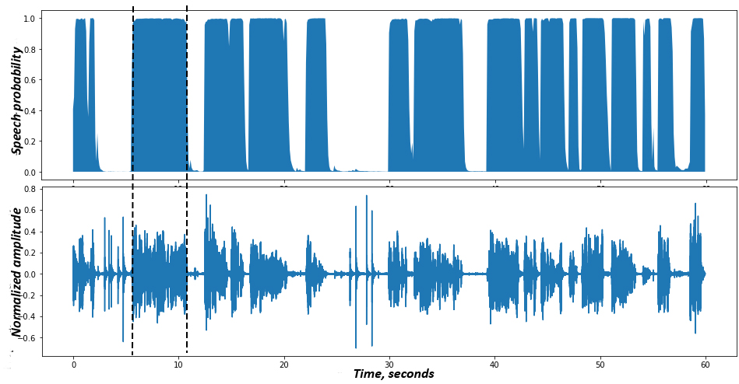
Silero VAD: pre-trained enterprise-grade Voice Activity Detector
Source: https://thegradient.pub/one-voice-detector-to-rule-them-all/

Slide 11

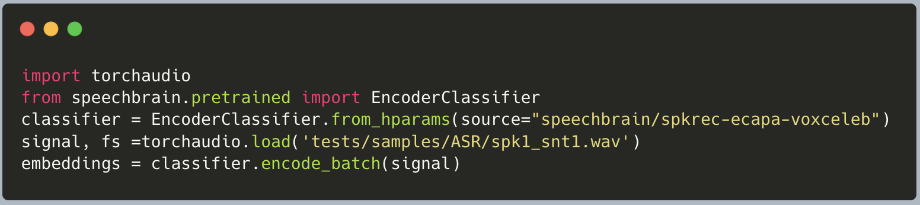
Calculate Speech Embeddings
Pretrained model for embedding of speech audio: "spkrec-ecapa-voxcelab"

Slide 12
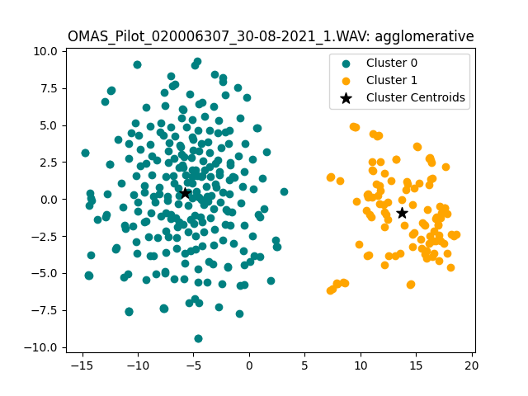
Clustering
Reduce dimensions of speech embeddings via TSNE
Clustering
  n = 2, since we assume two speakers in the audio files
  Methods implemented:
    k-means, agglomerative
Identify speech embedding closest to cluster centroid

Slide 13
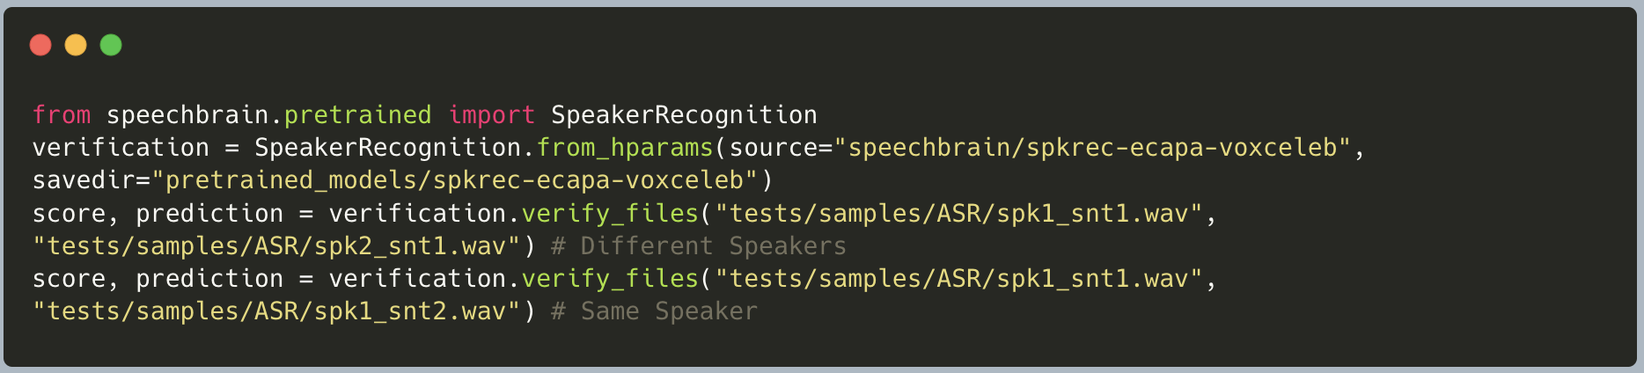
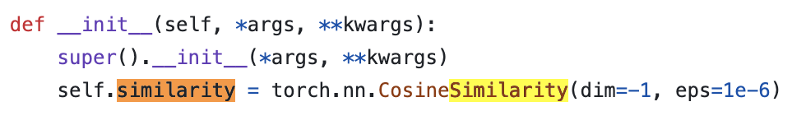
Speaker Verification: Speech Brain

Slide 14
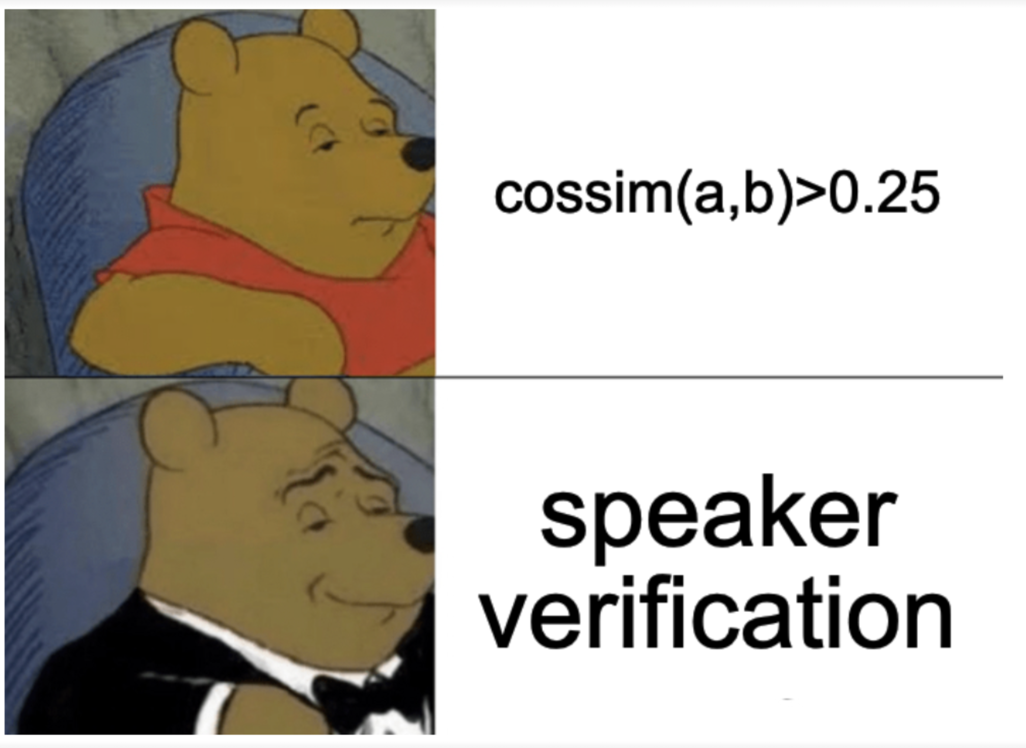
Speaker Verification = Cosine Similarity
Cosine similarity measures similarity of vectors
If cosine similarity of speech embeddings closest to cluster centroids > .25, flag as one speaker

Slide 15
Speaker Count Verification
Pros
  Allows us to assert that 2 voices are present, enabling a meaningful test of cosine similarity across clusters
Cons
  Uninvestigated (to our knowledge)
  There may be many cons!

Slide 16
Two-Speaker Recordings - Data
Data:
  920 recordings from a single-state CATI study about health
    Full and partial interviews
    English and some Spanish interviews

Slide 17
Two-Speaker Recordings - Results
Number of Voices Counted | Clustering Algorithm
 | Agglomerative | k-means
Two voices counted | 817 (88.8%) | 821 (89.2%)
One voice counted | 103 (11.1%) | 99 (10.8%)

Slide 18
One-Speaker Recordings - Data
Data:
  n=6 cases randomly selected from sample
    Actual interview recordings used for 6 (e.g., two voices expected)
    Using the transcript of these same 6 cases, one woman (3 cases assigned) and
    one man (3 cases assigned ) recorded themselves reading the entire transcript

Slide 19
One-Speaker Recordings - Data
 | # Cases with Correct Detection | # Cases with Incorrect Detection
Actual interview recording (two voices expected; n=6) | 6 (100%) | 0 (0%)
Female voice only (one voice expected; n=3) | 3 (100%) | 0 (0%)
Male voice only (one voice expected; n=3) | 1 (33.3%) | 2 (66.6%)
Overall accuracy = 83.3%

Slide 20
Next Steps
Vary cosine similarity threshold
Trying additional clustering methods
Review calculation/reduction of embeddings
What are your ideas?

Slide 21
Audience Discussion
What have been your main pain points when applying machine learning technologies to real world data?
  What have you tried?
  What lessons have you learned?

Slide 22
Questions?
Thank you!
Jerry Timbrook
jtimbrook@rti.org

