Slide 1
Geographic Update Partnership Software (GUPS) Web - Streamlining Geographic Data Collection at the U.S. Census Bureau FedCASIC April 17, 2024 Maria Panaccione Geography Division U.S. Census Bureau

Slide 2
Geographic Update Partnership Software (GUPS)
GUPS is a no cost geographic update software that provides participants the ability to update geospatial data and attributes for Census Bureau geographic partnership programs.
GUPS consists of a core system with 12 individual program interfaces.
GUPS provides the user tools to load, display, and edit geospatial data pertinent to the geographic program they are participating in, and then generates output files for submission to the Census Bureau.
Notes:
The Census Bureau and the geographic partnership program participants have been utilizing GUPS since 2015.
Allows user to:
Update addresses, address lists, features and feature attributes.
Update legal, statistical, administrative boundaries.

Slide 3
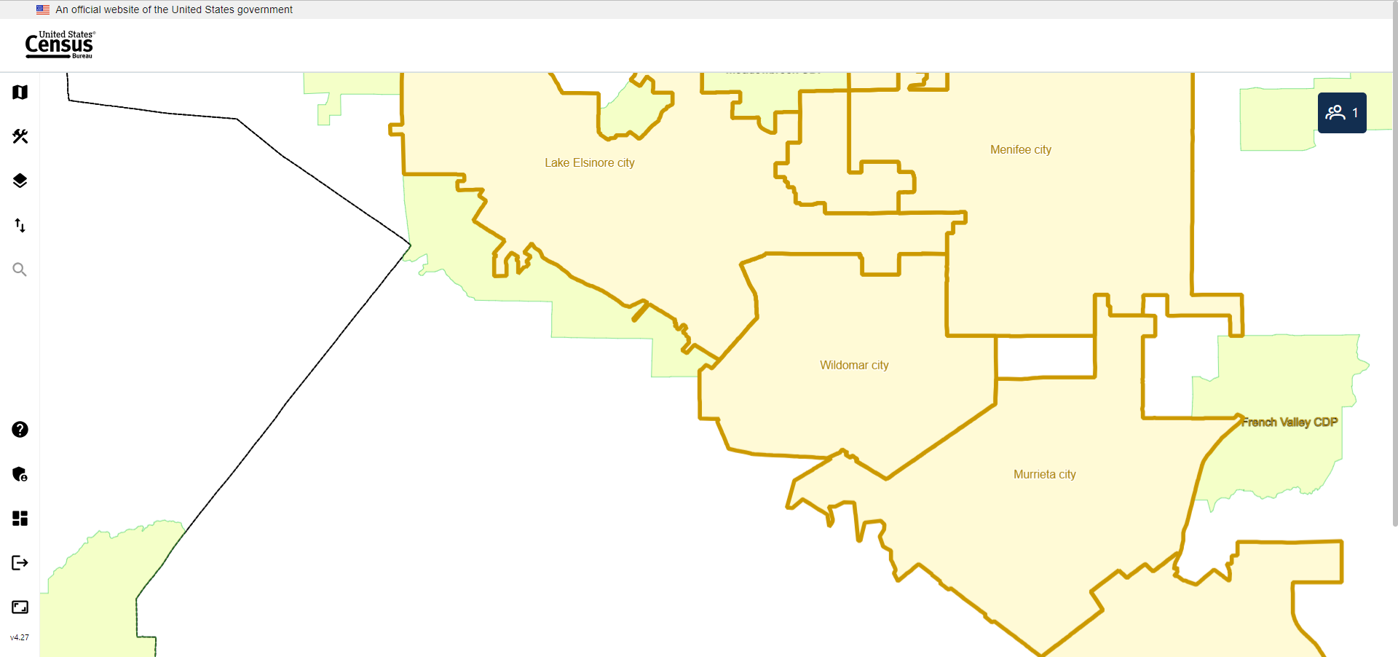
Introduction to GUPS Web
Notes:
Just like the standalone version built on the Quantum Geographic Information System or QGIS, GUPS Web is built using open source software.
GUPS Web is a new system designed to the support to the geographic update needs of geographic participant programs.
GUPS Web is a cloud-native containerized application that was released to participants as a pilot program in 2023.
A live demo will be conducted at the end of this presentation.

Slide 4
Benefits of GUPS Web to Partners
Real-time collaboration with program colleagues on submissions.
All materials are available online.
No required download of software or materials.
More processing power.
Application scales up or down based on user load or processing load.
Utilization of automated change detection principles.
Integration with Partner Portal.
Streamlined communication and submissions with the integration of GUPS Web and Partner Portal.
Notes:
Multiple users can be in the same project at once, making simultaneous updates.
The application is fully accessible online for users.
Additional Innovations in GUPS Web
The GUPS web application ingests participant geographic datasets and compares them to Census datasets to automatically create change files.
The changes are analyzed using business rules and algorithms to determine if a change is a legal change requiring additional information.
These automated quality checks allow the users to focus their work in the areas that need the most attention and shorten their response time.
This transformative process allows for a more automated methodology, which reduces the time for manual updates.
Partner Portal – still in development
One stop shop for all geography partner program needs – a web-based application serving as the foundation to participating in Census Bureau Geography Programs.

Slide 5
GUPS Web Open Source Tools
Notes:
As mentioned on previous slides, GUPS is built on open source. We’ll discuss the specific tools that were used to built GUPS Web.
What is open source?
Software that is publicly accessible for modification, collaboration, and community-oriented development.
Open source guarantees access to the source code for audit and modification and the ability to redistribute the software with no additional costs.
Alleviates need for proprietary software.
Allows the Geography Division to provide our participants with a no cost GIS application for our participant programs.
QGIS – The main platform of our standalone application and GIS libraries that are reused for GUPS Web.
OpenLayers - An open source JavaScript library for generating interactive maps and performing geospatial analysis in a browser.
GeoServer - An open source web mapping server for publishing and editing geospatial data.
Django - Python-based web framework in conjunction with Python libraries provided by QGIS.
PostgreSQL - A database management system as the spatial database extension for geographic objects.
Apache Tomcat - An open source implementation of the Java Servlet, Java Server Pages, Java Expression Language and Java WebSocket technologies.
Ubuntu - A modern, open source operating system on Linux for the enterprise server, desktop, cloud, and Internet of Things (IoT).
Angular - A modern web development platform.

Slide 6
Benefits of Open Source
Allows for updates, enhancements, and extensions of the features in the source code.
Enables security scans of source code.
Allows for flexibility in software updates.
Access to no-cost support from a large user community.
Use and redistribution without licensing costs.
Access to leading-edge innovations in the community.

Slide 7
GUPS Web Architecture
Cloud Native
GUPS Web is the first cloud-native Census Bureau application to utilize a container.
Application Technologies
Frontend
HTML, CSS, JavaScript, Angular framework, and OpenLayers library.
Middle Tier
Python and Django framework.
Backend
PostgreSQL database with the PostGIS extension and GeoServer.
Editing Tools
Utilize OpenLayers with Python libraries and PostGIS which provides the ability to display and interact with the map.
Notes:
Bubble in a network​
The container in the AWS Cloud creates a more secure environment for our participant programs and meets rigorous federal IT security requirements .​
We’ve taken a modern IT approach for the GUPS Web application.
GUPS Web is a full agile project. We use GitLab to track the lifecycle of our user stories, from creation to integration. ​
​
System Design
OpenLayers
Generating interactive maps and performing geospatial analysis.
Django
Python-based web framework for GUPS.
GeoServer
Web mapping server for publishing and editing geospatial data.
PostgreSQL
Database management system together with PostGIS as the spatial database extension for geographic objects.
Sibboleth
Shibboleth is included for single sign-on to the Census Bureau identity management system.

Slide 8
GUPS Web Demo

Slide 9
Thank You
Feedback & Questions:
geo.gups@census.gov
Notes:
As you can see, we’ve brought a lot to the table to help centralize partner interaction and participation in geography programs through updates to the GUPS, but this is only the beginning. We have many more features planned for the future and are awaiting partner feedback to expand that list. If you have any questions about anything you've seen today, we are available now, or you may contact the appropriate staff at the following emails.

