Slide 1
Some Novel Algorithms for Record Linkage
Sanguthevar Rajasekaran
University of Connecticut
J. Basak, A. Soliman, N. Deo, S. Sahni, K. Haase, A. Mathur,
K. Park, R. Steorts, D. Weinberg, and J.L. White

Slide 2


Acknowledgement
NSF: BIGDATA: F: DKA: DKM: Novel Out-of-core and Parallel Algorithms for Processing Biological Big Data
Census Bureau: Efficient Techniques for Record Linkage and Entity Resolution (2021-2026)

Slide 3
Record Linkage
Large amounts of duplicated data across data sets
Usually from more than two data sets
Given multiple datasets, the Record Linkage Problem is to cluster the records such that each cluster contains all the records of only one entity and no other records.
Applications: Congressional apportionment, redistricting, distribution of public funds, entrepreneurs’ decisions about where to locate their businesses, monetary policy; etc.

Slide 4
What is a Record?
A record can be viewed as a collection of attributes.
For example a medical record might contain:
  First name
  Last name
  Date of birth
  Height
  Gender
  Blood group
  Address
  etc.

Slide 5
An Example
Data Set 1 | Data Set 2
Ahmed Soliman | Veejay Shankar
Cathy Wu | Liz Johnson
Li Liao | Elan Musk
Vijay Shanker | Kristin Carpet
Joyanta Basak | Kathy Woo
Elizabeth Johnson | Joyanta Basket
Kristin Corbett | Jon Little
Elan Musk | Li Liao
Notes:
identify records that probably pertain to the same person

Slide 6
Record Linkage Problem: An Example
File 1
First Name | Last Name | Date of Birth
John | Doe | 12-31-1900
Jonathan | Husky | 01-01-1931
Joyanta | Basak | 03-14-1592
File 2
First Name | Last Name | Date of Birth
Jon | Dow | 31-12-1900
Joyant | Ba3ak | 03-14-1592
Jonathan | Husk | 01-01-1931
Linked Records File
Cluster 1 | {John, Doe, 12-31-1900}, {Jon, Dow, 31-12-1900}
Cluster 2 | {Jonathan, Husky, 01-01-1931}, {Jonathan, Husk, 01-01-1931}
Cluster 3 | {Joyanta, Basak, 03-14-1592}, {Joyant, Ba3ak, 03-14-1592}

Slide 7
Record Linkage Problem: Challenges
Lacks unique entity identifiers and additional information about entities.
Noisy Data:
  Data entry & OCR errors
  Missing values, nicknames, and different encoding scheme in different files.
  Swapping attribute values (such as reversal of first name and last name).
Scalability:
  Naive all pair comparison of records requires quadratic time !
  Requires clever techniques to remove non-matches as much as possible.
Many real-world applications demand real-time or near real-time record linkage.

Slide 8
Record Linkage: A General Approach
There are two steps in any record linkage algorithm:
  Define rules for deciding if two given records match.
  Implement the rules efficiently.
Rules typically are based on the notion of a distance. Any distance measure such as Edit distance, Hamming distance, Euclidean distance, etc. can be used to define the rules.
A rule could say: Two records match if their edit distance is less than a threshold.
Implementing the rules and finding all the matches in a reasonable time for large number of records could benefit from Blocking.

Slide 9
Record Linkage: Performance Metrics
Performance is evaluated by Runtime and Linkage Quality.
We need ground truth to evaluate the linkage quality. F1-score is the most popular quality metric.
A records pair can be:
True Positive (TP) if a true matching record pair is classified as matching
False Negative (FN) if a true matching record pair is classified as non-matching
False Positive (FP) if a true non-matching record pair is classified as matching
True Negative (TN) if a true non-matching record pair is classified as non-matching
F-1 Score = | 2TP
 | 2 TP + FN +FP

Slide 10


Blocking
The idea of blocking is to group the records such that for any two matching records, there will be at least one group in which they are placed together. In this case, distance computations have to be performed only among the pairs within the individual groups.
These groups are called Blocks. Blocks may or may not be disjoint!
Let the input consist of n records and let the Blocks be G₁, G₂, ..., G_{m.}
We need to do perform only distance computations instead of of them.

Slide 11
Standard k-mer Blocking
Key Intuition: If two records belong to the same entity then they should share a reasonably large substring.
We generate a string from the record r referred to as the blocking key corresponding to the record r.
For some relevant k, we generate all the k-mers of the blocking key of r.
There will be a block corresponding to each distinct k-mer. If the alphabet size of the characters is α, there will be α^{k} blocks in total.
The record r will be placed in the blocks corresponding to all the k-mers in its blocking key.

Slide 12
Standard k-mer Blocking: An Example
Block ID “hus”
{Jonathan, Husky, 01-01-1931}
{Jonathan, Husk, 01-01-1931}
Record | Blocking Key
{Jonathan, Husky, 01-01-1931} | husky
{Jonathan, Husk, 01-01-1931} | husk
Standard
3-Mer Blocking
Block ID “usk”
{Jonathan, Husky, 01-01-1931}
{Jonathan, Husk, 01-01-1931}
Block ID “sky”
{Jonathan, Husky, 01-01-1931}

Slide 13
A Summary of our Approach
Given a set of records, identify identical clusters and select only a representative per cluster. Further processing is only on these representatives.
Perform blocking on the records. Records are placed in blocks. A record might be in multiple blocks.
Perform clustering within the individual blocks.
Define a graph G(V, E) where there is a node per record. There is an edge between two nodes if they are placed in the same cluster in at least one of the blocks. Find and output the connected components of G(V, E) as final clusters.

Slide 14
A Novel Blocking Idea
When the alphabet size is s and if we employ k-mer based blocking, the number of blocks will be s^{k}.
Call the set of these blocks as a superblock.
Blocking is done with respect to one or more of the attributes (such as last name, first name, etc.)
Call the collection of these attributes the blocking attribute.
The idea of superblocking is to have a superblock for every starting character of the blocking attribute.

Slide 15
SuperBlocking
Key Idea: Have a superblock for every starting character of the blocking key. Then proceed with standard k-mer blocking in every superblock.
Superblock ID: “A”
Keys: Annan
Do Standard k-mer blocking on keys in each superblock separately
Blocking Key
Kannan
Krista
Cannan
Crista
Annan
SuperBlocking
Superblock ID: “C”
Keys: Cannan, Crista
Superblock ID: “K”
Keys: Kannan, Krista

Slide 16
A Novel Blocking Idea
Within every superblock there will be at most s^{k} nonempty blocks.
For example, assume that k=3. Johnson and Jackson will share a block in superblock J. Crista and Crystal will share a common block in superblock C.
Even though Annan and Cannan share a 3-mer, they will not share a block. Also, Crystal and Krista will not share a block even though they share a 3-mer.

Slide 17
Experimental Results: Datasets
Social Security Death Master File Datasets (SSDMF): We collected deceased real people data from SSDMF and generated synthetic datasets by copying and edit operations (insert, delete, exchange).
Each record in this dataset has 5 attributes : Social Security Number(SSN), Last Name, First Name, Date of Birth, and Date of Death.
North Carolina Voter Dataset (NCVD): We collected the NCVD dataset used by Saeedi, Peukert, and Rahm*. This dataset is generated from real person data in the North Carolina Voters Registry and synthetically generated duplicates. The dataset has 5 million records. Each record has 5 attributes.
*A. Saeedi, E. Peukert, and E. Rahm, Using link features for entity clustering in knowledge graphs. The Semantic Web: 15th International Conference, ESWC 2018, Heraklion, Crete, Greece, June 3–7, 2018, Proceedings 15. pp. 576-592 (2018).

Slide 18
Experiment 1: RLA-CL vs RLA-CL+
Algorithm | Blocking Method | Dataset | Reduction Ratio | Run Time (s) | F1 Score
RLA-CL | Standard K-mer | SSDMF_{0.4 Million} | 98.04% | 398.29 | 99.99%
RLA-CL+ | Standard K-mer | SSDMF_{0.4 Million} | 98.07% | 285.67 | 99.99%
RLA-CL+ | SuperBlocking | SSDMF_{0.4 Million} | 99.81% | 34.31 | 99.99%
RLA-CL | Standard K-mer | SSDMF_{1 Million} | 98.11% | 2381.52 | 99.98%
RLA-CL+ | Standard K-mer | SSDMF_{1 Million} | 98.12% | 1675.25 | 99.98%
RLA-CL+ | SuperBlocking | SSDMF_{1 Million} | 99.81% | 199.56 | 99.97%

Slide 19
Experiment 2: North Carolina Voter Dataset
We sampled 5% of true matches to set the parameters (blocking key, record distance, and k-value)
We employed a shared memory multi-threaded implementation of PRLA-CL+ with SuperBlocking method and Jaro similarity as distance function for record linkage
Our algorithm achieves a better F1-score (87.34%) than CLIP algorithm (87%).
Our algorithm completes faster (2489 seconds) than the CLIP algorithm (5477 seconds) and utilizes lesser resource.

Slide 20
An Optimal Algorithm for
Jaro distance Computation

Slide 21
Preface
Several domains in science and engineering have to process string data.
A general problem in analyzing strings is that of computing the similarity between a pair of strings.
For instance, in biology, quite frequently scientists have to measure how similar two given genomic sequences are.
Similarities can be characterized as a function of the distance between the pair of strings.
Numerous distance metrics can be found in the literature for strings such as edit distance (also known as the Levenshtein distance), q-gram distance, Hausdorff distance, etc.

Slide 22

Preface

Slide 23
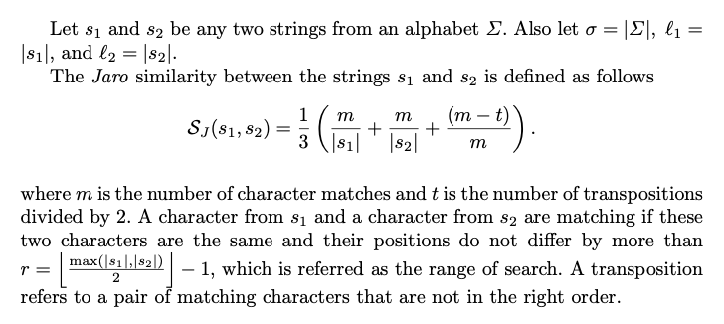
Problem Definition

Slide 24

An Example

Slide 25
Experimental Results
We have evaluated our algorithm in two different applications: record linkage of real people data and computing the similarity among genes of Escherichia Coli bacteria.
All the experiments were carried out in a server machine with 6 Intel(R) Core(TM) i5-8400 2.80GHz CPU cores, 32GB DDR4 RAM, and 1TB of local storage running on Ubuntu 22.04.1 LTS. The programs were written in standard C++17.
The programs can be downloaded from the Github.

Slide 26
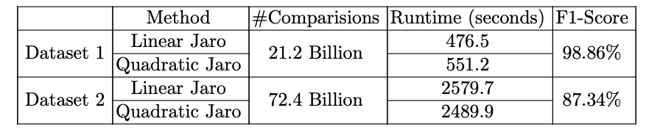
Performance on Record Linkage
Two datasets have been used. The first dataset is collected from Soliman, et al. [9]. It contains 1 million records of deceased persons. Each record in this dataset contains 5 attributes – id, first name, last name, date of birth, and date of death. The second dataset is collected from Saeedi, et al. [8]. This has been created from the NC Voter Database.
Average lengths of the records ranged from 25 to 30.

Slide 27
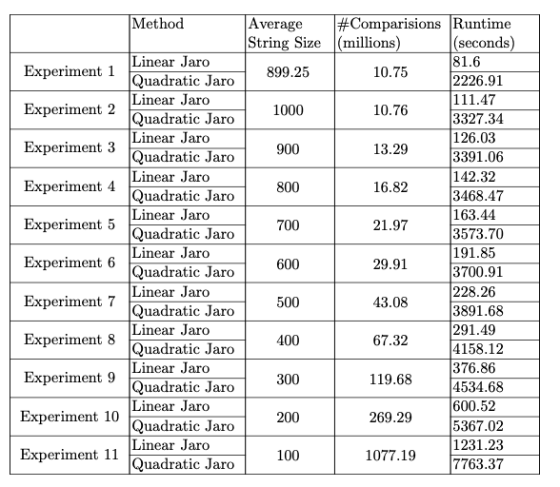
Performance on Gene Sequence Similarity
We collected the E. Coli bacteria K-12 substrain genome from NCBI website (Genbank ascension no: U00096) and conducted several experiments on this genome. This genome has 4,639 annotated genes of varying sizes.

Slide 28
Conclusions
In this talk, we have presented a new blocking scheme called SuperBlocking. This idea offers the potential to speed up record linkage algorithms by an order of magnitude.
In this talk we have also presented a linear time algorithm for the computation of the Jaro similarity between two given strings. Experiments on two applications reveal that our algorithm outperforms the prior best algorithm.

Slide 29
References
J. Basak, S. Sahni, and S. Rajasekaran, SuperBlocking: An Efficient Blocking Technique for Record Linkage, Proc. IEEE International Conference on Big Data, 2023.
J. Basak, A. Soliman, N. Deo, K. Haase, A. Mathur, K. Park, R. Steorts, D. Weinberg, S. Sahni, and S. Rajasekaran, On Computing the Jaro Similarity Between Two Strings, Proc. 19th International Symposium on Bioinformatics Research and Applications (ISBRA 2023), October 9-12, Wroclaw, Poland.

