Slide 1

OmniTrustAI: Revolutionizing AI with the Train Once, Apply Anywhere Framework
Xiaowei Xu
University of Arkansas at Little Rock
OmniTrustAI.com

Slide 2

Large Language Models (LLM)
A LLM is a probabilistic model of languages.
LLM is trained using zillions of data and spend billions of $.
LLM can generate human-like text, answer questions, write creative content and many more

Slide 3
Problems of Using LLM Directly
01
02
03
Safety and Privacy issues.
Suboptimal Domain-specific tasks
Too big and too expensive.

Slide 4



Knowledge transfer for a trustworthy Customized LLM (CLLM)
Domain
Knowledge
CLLM
Organization-specific
Knowledge
Domain-tuning data
Org. specific data
General Knowledge
Foundation LLM

Slide 5



TOAA
Train Once,
Apply Anywhere Framework
We first train CLLM only once using a single dataset.
Then we directly apply the trained model to data across various domains without any additional training.
TOAA empowers a universally applicable and trustworthy AI for businesses of any scale.

Slide 6
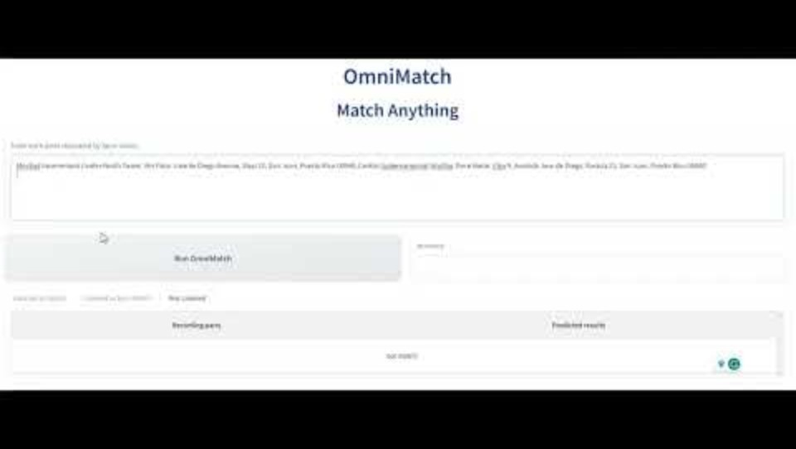
Let's watch a video about OmniMatch

Slide 7
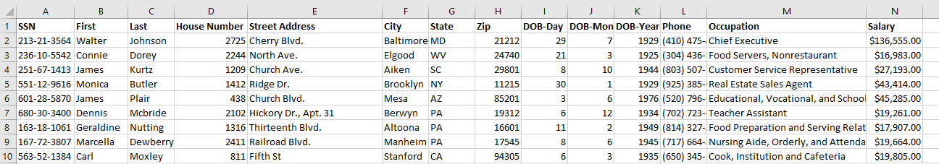
OmniMatch - Match Anything Without Pain
OmniMatch is an out-of-the-box tool designed for effortless data linkage across various domains.
We deployed OmniMatch on 2 million record pairs of Pseudo people data, simulating a most challenging scenario for the US Census.
  1 million record Truth file.
  1 million record “Hard to match” file, characterized by 20% missing values and additional noise factors.
Sample
Pseudo People Data

Slide 8
OmniMatch Performance Metrics – Pseudo people data
Accuracy | Precision | Recall | F1 Score | Run Time⁺
97.02% | 100% | 94.05% | 96.93% | 9.5 Hours 59 pairs/s 1.7 ms/per Pair
+ Note: Runtime is measured on one A-100 Nvidia GPU server with 40 GB memory to process 2 million pairs of records.

Slide 9
OmniMatch - Zillow’s PR Real Estate Data Preparation
2600 record pairs, from Zillow's Puerto Rico Real Estate data, another challenging scenario for the US Census.
  1300 Match Record with noise introduced as below.
    50% Address fields with Language Noise
    92% Living Area attributes modified
    35% Bathroom attributes modified
    19% Bedroom attributes modified
  1300 Non-Match Record Pairs.
Sample
Real Estate Data

Slide 10
OmniMatch Performance Metrics –
Zillow's PR Real Estate Data
Accuracy | Precision | Recall | F1 Score | Run Time⁺
88.71% | 99.80% | 77.58% | 87.30% | 79.7 Seconds
+ Note: Runtime is measured on one A-100 Nvidia GPU server with 40 GB memory to process 2600 pairs of records.

Slide 11

Conclusion
Train Once, Apply Anywhere (TOAA) framework is revolutionary.
OmniMatch is a powerful tool of data linkage.
Universally applicable and Trustworthy – Omni Trust AI.

Slide 12

Team
Dr. Xiaowei Xu
Vivek Gunasekaran
Xingqiao Wang

Slide 13


Visit OmniTrustAI.com
OmniMatch Trial

