Slide 1
Transforming the Labour Force Survey in the UK
David Freeman
Head of Labour Market & Households
Office for National Statistics, UK

Slide 2

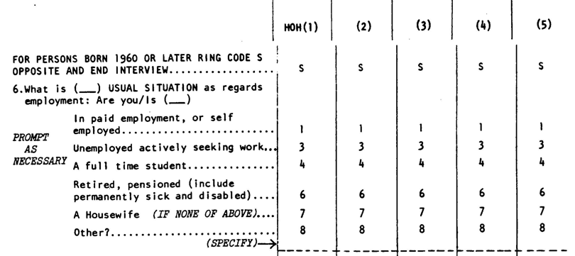
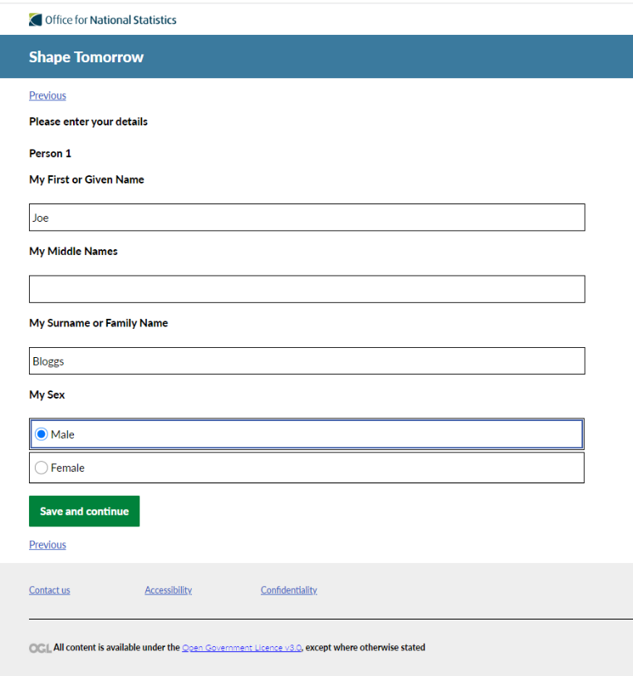
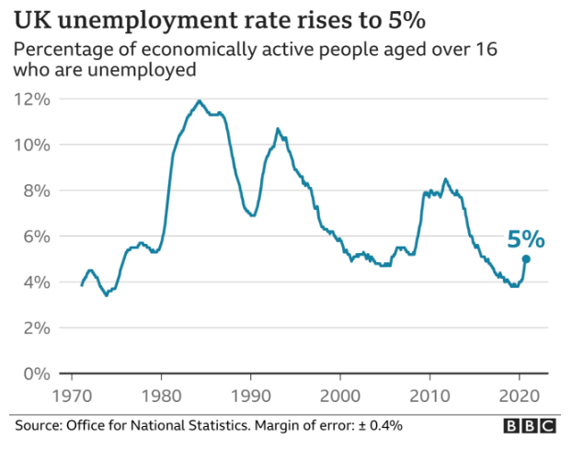
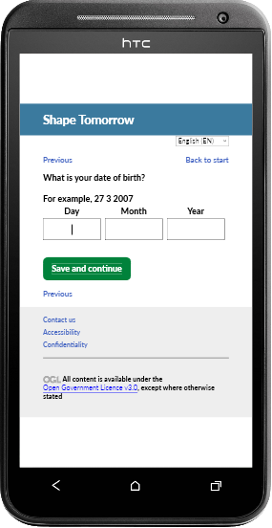
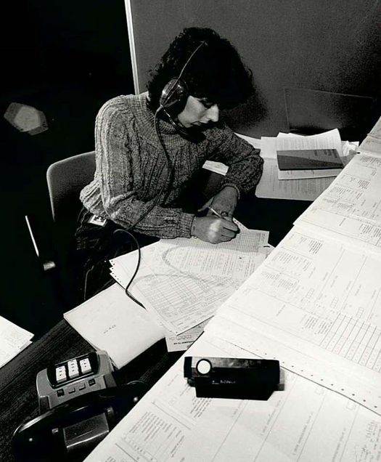

Celebrating years of the LFS
We have consistently evolved data collection on the LFS over the last 50 years to meet the changing needs and shape of society. We are now transforming the LFS to ensure we meet user needs into the future
Notes:
Introduction – the LFS has been running for 50 years, this is why, and this is what’s happening to it

Slide 3
Impetus to transform the Labour Force Survey
We’ve continually adjusted the design of the survey accounting for changes in the population, economy and political environment without significantly reviewing the questionnaire structure, flow and content
We have seen a steady decline in response rates over the last 20 years, for a variety of reasons including:
  confidentiality concerns
  mistrust in government
  increase in gated communities
  increasing single person, temporary households
Increasing industry-wide complexities including:
  difficulty recruiting interviewers and high turnover
  public fatigue with taking surveys and calls
  increasing use of rental properties and second homes
  global move to online interactions

Slide 4
Transformed Labour Market Statistics vision
ONS Statistical Transformation
Integrating surveys, census and administrative data
Deliver statistics for the public good
Produce labour market statistics that are:
More coherent
More granular
More timely
Responsive to user needs
Reduce costs and burden on businesses and households
Use administrative data to replace or supplement survey data
(e.g. real-time tax data)
Move to “on-line first” data collection
Notes:
Leigh

Slide 5
Objectives of transforming the LFS
More representative data
More efficient operation
Reduced bias
Taking an online-first approach with an adaptive and responsive design to target resources where most efficient to maximise response rates, quality and representativeness through:
Larger overall sample size
More robust processing systems
Modular design to integrate more question blocks
More flexible and able to respond faster to change
Updated and upgraded questions and responses
Future aims include integrating administrative data, increasing timeliness and potentially adding new survey requirements

Slide 6
Survey design example
Original
Did you do any paid work in the week ending Sunday the [date], either as an employee or self-employed?
‘Paper work?’ ; “No, just my normal job”
v.1
Did you do any work for payment or profit (including in self-employment) in the week ending Sunday [date], even for as little as one hour?
National account definition; “I would have said yes because they still get holiday pay”
v.2
Did you have a paid job or business in the week Monday [date] to Sunday…?
Job easy concept; do not have to be present in Ref, or paid in Ref;
v.3
Did you have a paid job, either as an employee or as self-employed, in the week Monday [date] to Sunday [date], [year]?
Better captures different self-employed types;
“I was paying myself a wage but nobody was paying the company… the question is are you talking about it as a business or not?” – Sole traders
“but if it had been ‘self-employed’ that would have been a yes”
“Well I was on holiday so I was paid”
2015 onwards
Core LM block solely to produce key labour market statistics
Focus on labour market status
22 focused rounds of testing over 3 modes

Slide 7
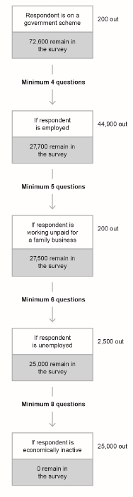
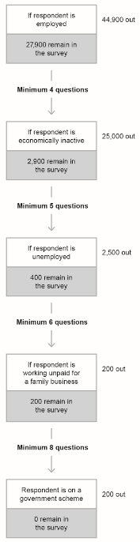
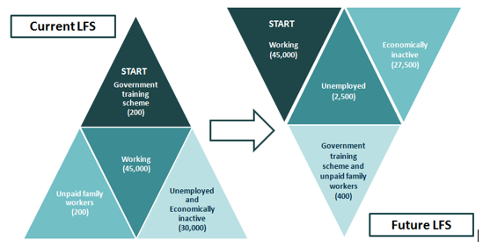
Routing
72,800 sample in
"I'm sorry but I do have to ask these questions so please bear with me"

Slide 8
Timeline of development activities
July 2017 – Communications test
September/October 2017 – Incentives test
October 2018 to April 2019 – Mixed-mode test
Testing effectiveness of communication strategies
Included letter content, envelope colour, postal days, envelope branding
Unconditional vouchers
Conditional vouchers
Canvas tote bag
Online first approach
Follow-up with face-to-face interview if no response
Collected demographic data, labour market status and highest qualification

Slide 9
COVID

Slide 10
Impact of COVID-19 on LFS
Immediate decision to stop face-to face interviews
Move to telephone only collection
  Telephone number matching
  On-line portal
However…..
…drop in response rate…
….and increase in bias of responses
  Fewer responses from rented properties
  Fewer responses from non-UK nationals

Slide 11
Mitigation of impacts
Sample boost
  Doubled initial sample
  Maintained number of responses despite lower response rate
Weighting changes
  Calibration for housing tenure (owner, mortgage, rental etc.)
  Adjustments for nationality using analysis of income tax data
Put transformed survey live into the field
  Test survey used in 2018
  Not complete but could be used for headline indicators
  Could act as a back-up if we couldn’t maintain LFS
Sample boost

Slide 12
Transformation progress - questions
Pandemic
2015 - 2019
2020
2021
2022
2023
2024
Household
Sociodemographic
Labour Market Core
Expanded Core
Majority of remaining LFS content
Education
Passports
Earnings
Health
Benefits
Quality of Work
Unemployment
Sickness Absence
Interstitial pages
Asylum seekers
Veterans
Self-employment routing
NEETs
Interviewer
guidance
DoB/ age moved
Data rotation
Multiple smaller improvements

Slide 13
Collection changes through 2022
Plus…
Redesigned questionnaire
Increased sample
Improved management information
Improved adherence to accessibility standards
Improved materials
Changes to processing
Survey issued
  Feb
  2022
Transition State 2
Promoted Telephone capture
Response or refusal achieved
Online response
Online response
Telematched contact
  Nov
  2022
Transition State 5
Telephone capture
Online response
Knock-to-nudge
Telephone capture

Slide 14
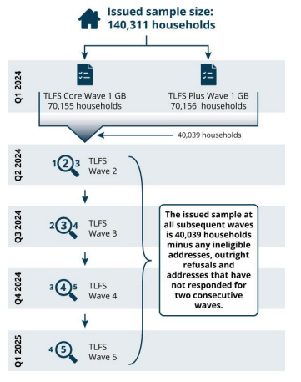
Introducing the Transformed LFS
Randomised sample of private households, with boosts in Scotland and Wales
TLFS Core – 50% sample get shorter survey
TLFS Plus – 50% get extra questions
All households get Notepad at Wave 1 and then £10 eVoucher as conditional incentive
Online-first with other modes to optimise inclusivity and response and reduce bias:
Invite all to take part online
Promote telephone capture for those who haven’t responded
Follow-up on doorstep (knock-to-nudge), targeted at under-represented areas
30% of Wave 1
moves into
longitudinal
Sample
Optimising inclusivity and response

Slide 15
Learning from dual run

Slide 16
Headline employment data
Issue
New survey results show lower levels of employment and self-employment compared with both LFS and admin data
Cause
Fewer self-employed people answering initial employment question
Resolution
Question added to better identify people who indicate they did not have a 'paid job' in the reference week but are self-employed because they operate a business.

Slide 17
Missing data
Issue
New survey results show approximately 10% of responses for disability status questions are “don’t know/prefer not to say” (cf. 1% for LFS)
Cause
Increased number of people selecting “don’t know” option
Resolution
The placement of ‘don’t know/prefer not to say’ is no longer an upfront option, and early results indicate this has reduce some missingness

Slide 18
Household data
Issue
Increase in the number and proportion of single person households
Cause
Respondents dropping off survey before they provide information about other people in the household
Resolution
Moved collection of household information closer to start of the survey
Allows imputation for “missing” household members

Slide 19
Moving towards transition

Slide 20
Key intended quality targets
1. Reducing Bias
Achieve representative sample
2. Reducing Attrition
Reduce drop-off in response between waves
Reduce impact of attrition on bias (especially by wave 5)
3. Improving Response
Sufficient response in each area to meet quality targets
Focus on both national and local improvements
Regions
Design to achieve proportional samples by age, sex, disability, tenure, ethnicity
Operational complexity
Increased response should reduce:​
Drive to maximise inclusivity
Minimise variability in response across
Output Area Classification
Ensure sufficient sample size in wave 5
Increased response must not introduce new bias
Respondent burden
Overall cost
Index of Multiple of Deprivation

Slide 21
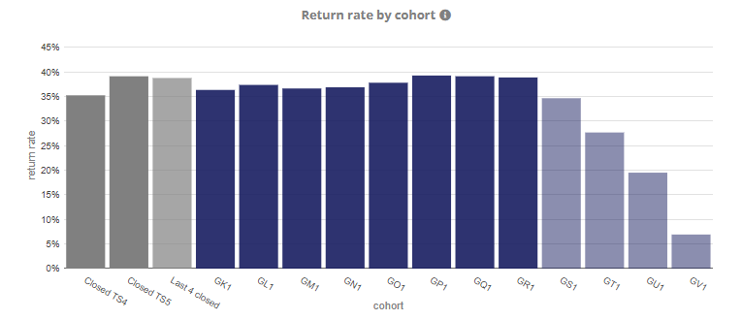
Current levels of response
Latest cohorts still being collected
Overall return rate ~39%
(30% full + 9% partial)

Slide 22
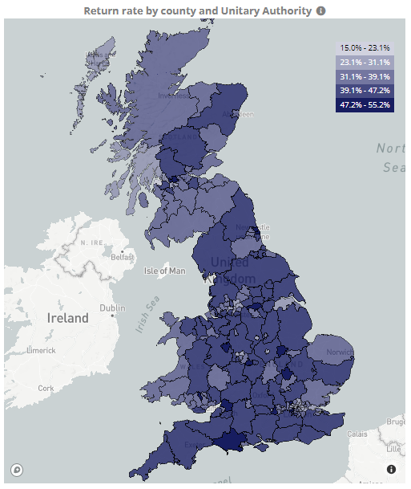
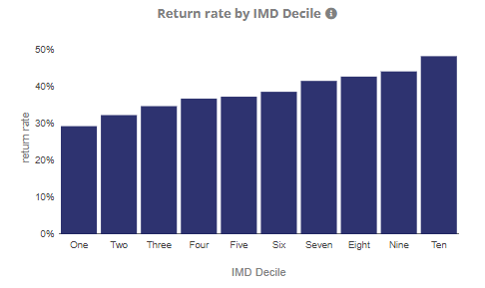
Current levels of response

Slide 23
Next steps
Further quality assurance
  Levels and changes
  Flows data
  Annual data
Time series analysis
  Linking with existing survey
  Seasonal adjustment
Explaining the changes

Slide 24
Future developments
Survey development
Enhanced outputs
Administrative data
Modularisation
Quality of work
Health
Monthly series
More detailed information
Currently publish employment and earnings aggregates from income tax data jointly with UK tax office (HMRC)
Working to access person level data
Potential to match with labour force survey

Slide 25
Thank you!
Questions

