Slide 1
Optimizing blocking strategies for record deduplication
Theodore Charm
Center for Optimization and Data Science, U.S. Census Bureau
FedCASIC
April 22, 2025
Any opinions and conclusions expressed herein are those of the author and do not reflect the views of the U.S. Census Bureau. This presentation does not contain sensitive information including Title 13, Title 26, Title 5, other controlled unclassified information, or administratively restricted information.

Slide 2
Overview
Objective
Data and Methods
Findings
Next steps

Slide 3
Objective
Investigate new blocking strategies to optimize de-duplication of records on a nationwide scale
Research Locality Sensitive Hashing as a blocking strategy for efficient person matching and linkage

Slide 4
Legacy blocking in record linkage
Blocking partitions data into “blocks” of records according to a set of attributes
Record linkage is only applied “within” blocks
Scalability issue in record linkage: Blocking reduces computational complexity

Slide 5
Example of legacy blocking
Pass 1: ZIP + 1st letter FN + 1st letter LN
Pass 2: 1st letter FN + 1st letter LN + DOB-Month + DOB-Day
Pass 3: state + city + ZIP + first 2 letters FN + first 2 letters LN

Slide 6
Locality Sensitive Hashing (LSH) as blocking strategy
Find Approximate Nearest Neighbor (ANN) in high-dim spaces: Closer data points in high-dim spaces are mapped to the same hash buckets in low-dim projected space
LSH enhances scalability in privacy preserving record linkage for big data
Previous research find that LSH typically outperforms legacy blocking methods: ANN vs exact match
Reference: Jafari et al. 2021; Karapiperis and Verykios 2015; Zhang et al. 2016; Dasgupta et al. 2011; Steorts et al. 2014

Slide 7
Data and Methods
Synthetic datasets of 1.1M records (White 2010)
Easy dataset includes 100k duplicate pairs; Medium & Hard: 199,859 duplicate pairs
Duplicated records are indicated by the same ID
Blocking strategy: Locality Sensitive Hashing (LSH)
Hyperparameter tuning: compare performance metrics
Reference: White, J. (2010). Creating Personally Identifiable Honeytokens. In: Sobh, T. (eds) Innovations and Advances in Computer Sciences and Engineering. Springer, Dordrecht. https://doi.org/10.1007/978-90-481-3658-2_39

Slide 8
Applying LSH to Synthetic Datasets
Concatenate the following variables to form strings: “First Name”, “Last Name”, “DOB-Month”, “DOB-Day”, “DOB-Year”, “House Number”, “Street Address”, “State”, “City”, “Zip”
k-shingling: length k = 4
One-hot encoding -> sparse vectors
Minhashing: MinHash functions (Permutations) to generate signature matrix
k-shingling: moving through a string and adding k characters at a time to a “shingle set”

Slide 9
Applying LSH to Synthetic Datasets
LSH: Split MinHash signature into bands, process each band through a hash function, then map each record to a hash value (bucket) within each band
Records that share a bucket -> Candidate pairs
MinHashLSHForest: For each bucket, retrieve the top k candidate pairs that have the highest Jaccard similarities
Reference: Toshniwal 2024; Zhu 2024

Slide 10
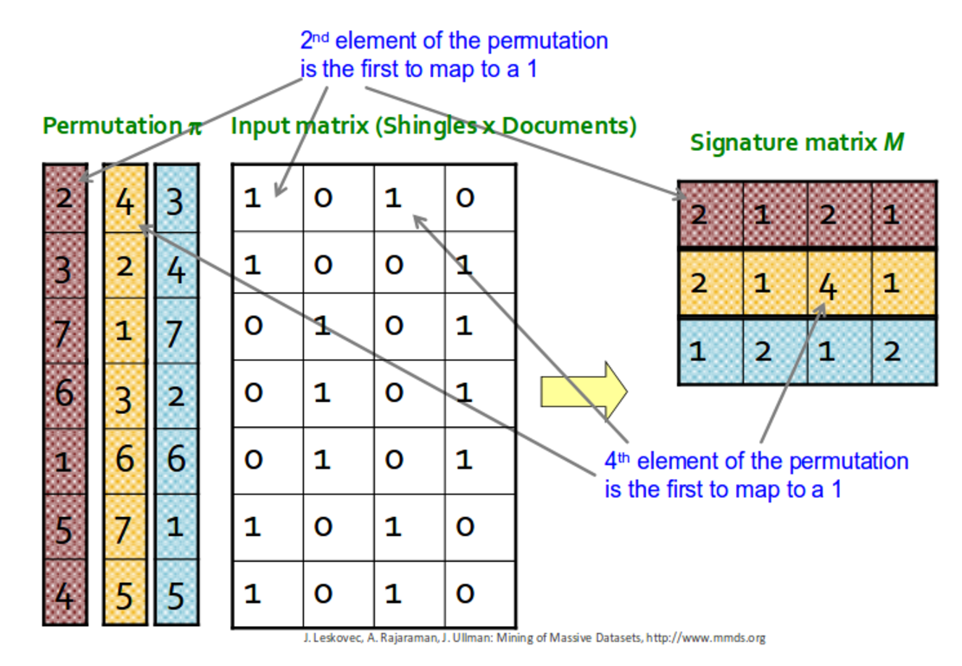
https://hyunyoung2.github.io/2018/10/11/Min_Hashing/

Slide 11
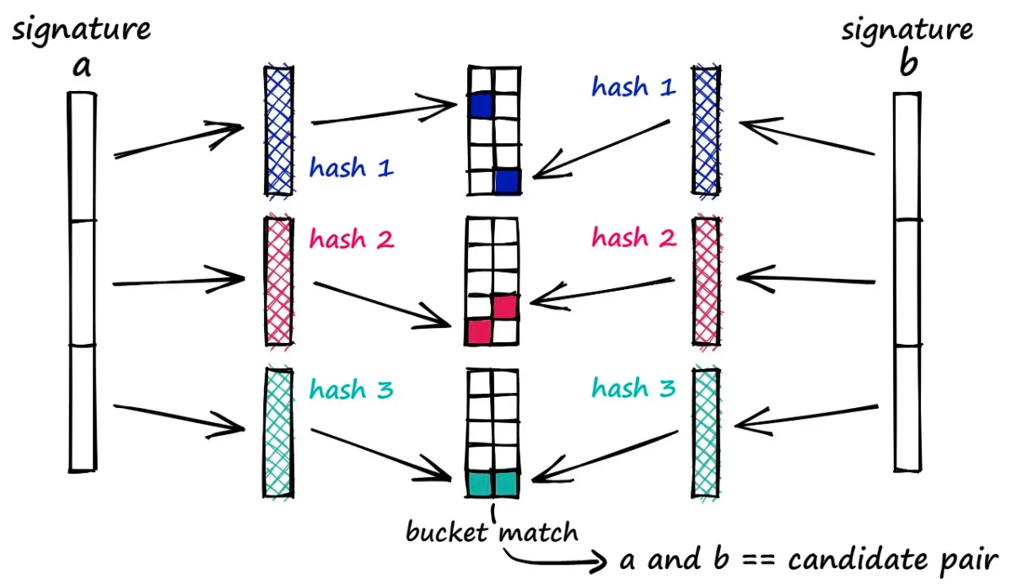
https://www.pinecone.io/learn/series/faiss/locality-sensitive-hashing/

Slide 12
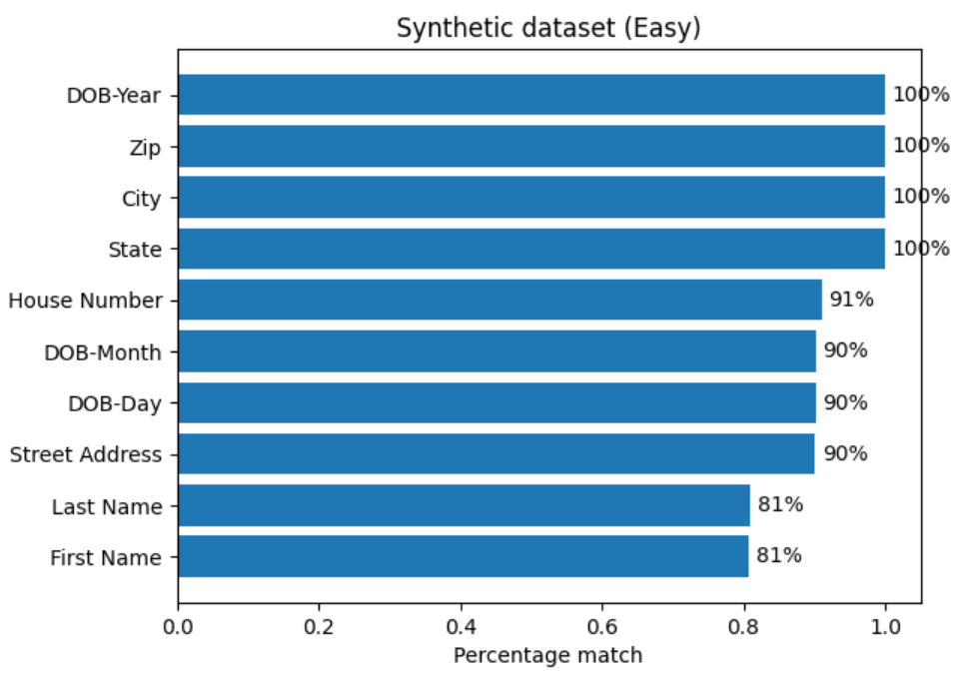
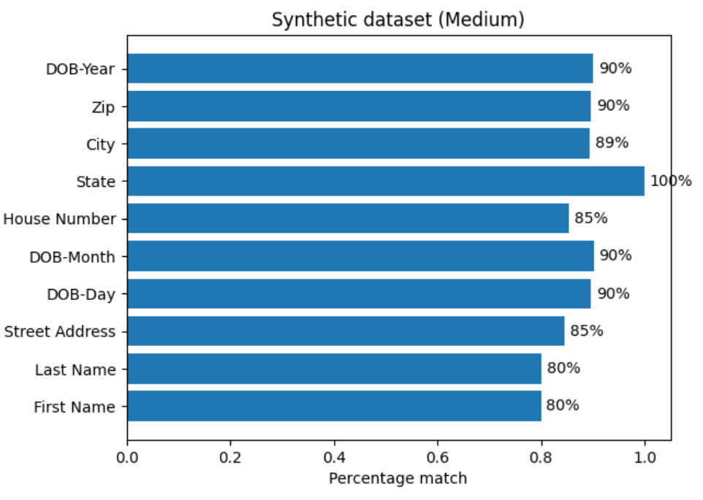
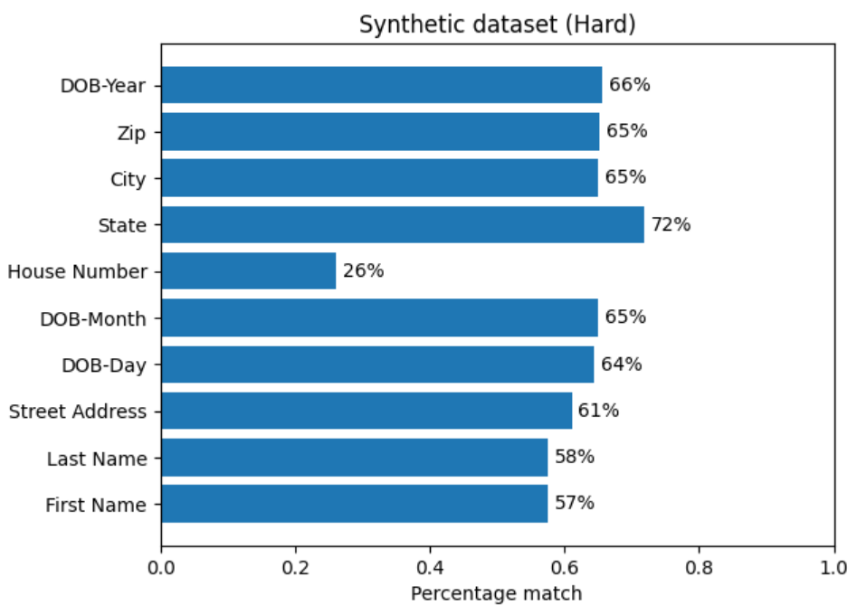
Summary Statistics
Feature Match Rates for Duplicate Pairs

Slide 13
LSH: Hyperparameter tuning
Number of permutations = {50, 80, 100, 200}
Top-k similar pairs = {2, 5, 10, 100}
Performance metrics
- Number of candidate pairs
- Coverage of real duplicates (%)
- Runtime
Coverage: Number of duplicate pairs that occur within the same block

Slide 14
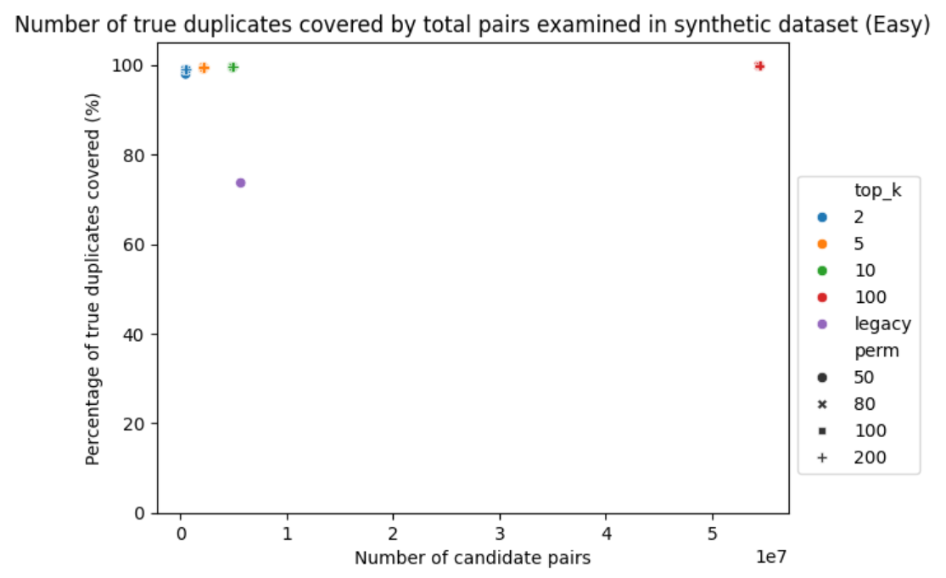

Slide 15
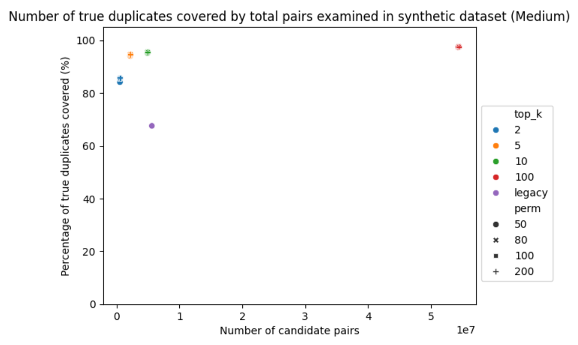

Slide 16
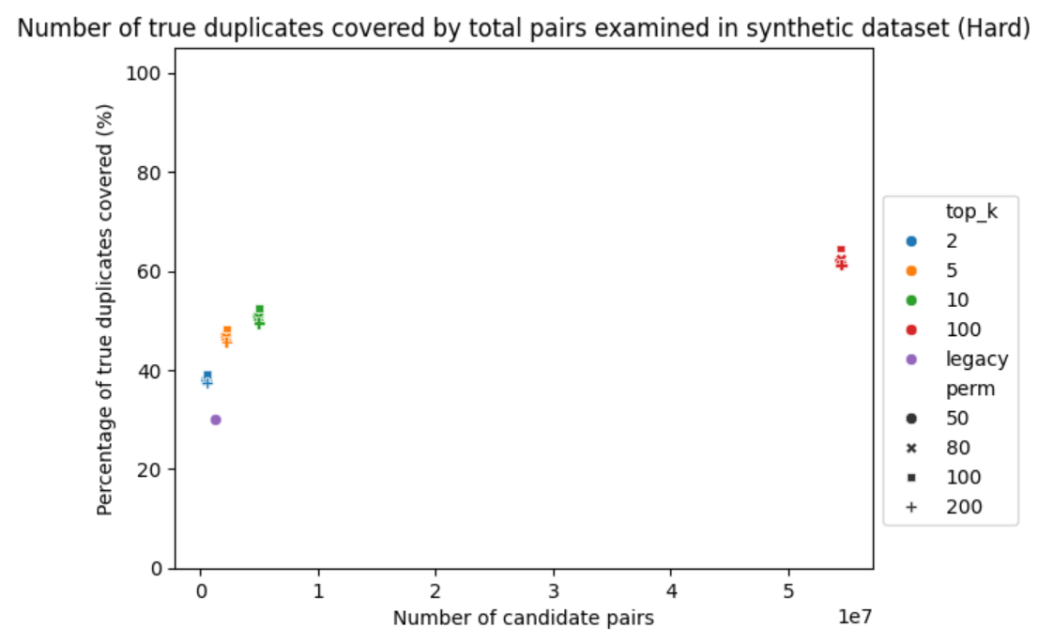

Slide 17
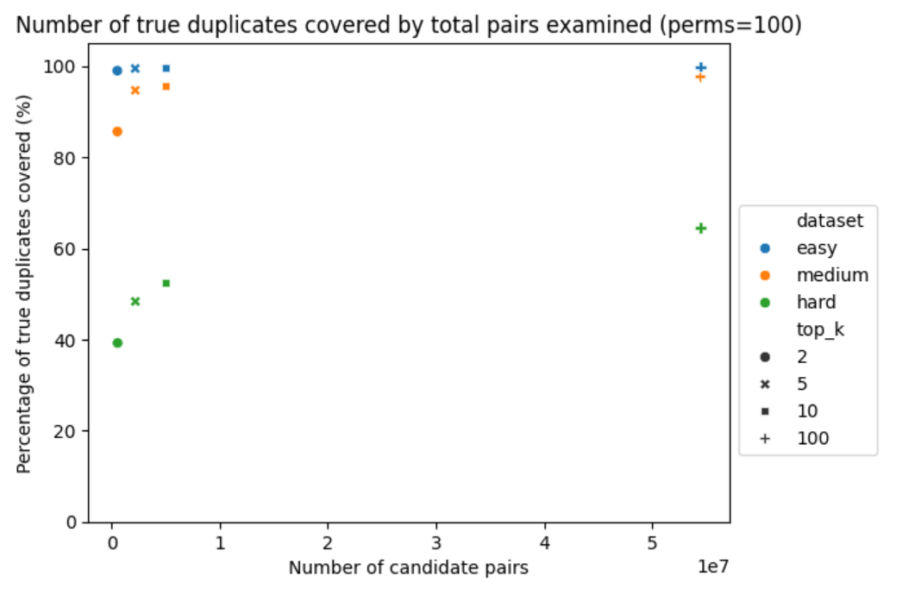

Slide 18
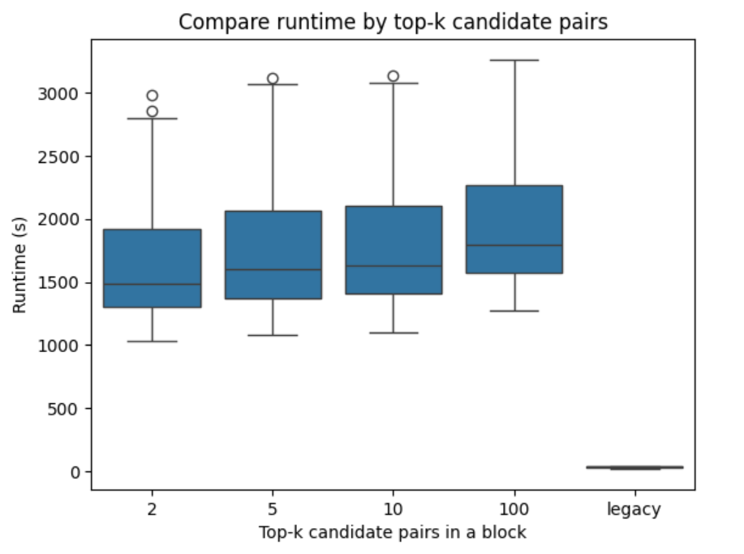

Slide 19
Conclusions
This study conducts record de-duplication on synthetic datasets with duplicates
Locality Sensitive Hashing (LSH) outperforms legacy blocking approach in identifying true duplicates for the synthetic datasets: ANN vs exact match
LSH takes substantially more time to compute
Performance is optimized when # permutations = {100}; top-k = {100}, but this could differ on real datasets
High coverage of true duplicates, but high number of candidate pairs
Trade-off between # candidate pairs and # coverage of true duplicates

Slide 20
Next steps
Explore the LSH blocking approach for record deduplication on a nationwide scale
Apply the LSH method to real Census datasets, specifically the 2020 Decennial Census and Post-enumeration survey datasets

Slide 21
Acknowledgement
Haley Hunter-Zinck
Jennifer Hutnick
Krista Park

Slide 22
kai.yue.charm@census.gov

