Slide 1
Triple A: AIES Ad Hoc Address Matching for Large Companies
Clayton Knappenberger
Data Scientist – U.S. Census Bureau
04/22/2025

Slide 2
Background on AIES
The Annual Integrated Economic Survey (AIES) is a re-engineered survey designed to integrate and replace seven existing annual business surveys into a streamlined single survey.
AIES focuses on collecting data via spreadsheets.
Asks companies to verify a list of addresses Census has on file
Compare their internal list of locations to Census’
Marked closed locations
Add newly opened locations

Slide 3
Can We Make Step 1 Easier for Respondents?
Asking companies to match locations is too burdensome!
Just acquired another business? – need to add lots of new locations
Sold off part of their business? – need to close lots of old locations
Simply have a lot of locations
Companies want to send Census a spreadsheet of their locations
Shifts the burden to Census, but Census has tools for doing this!
Can we streamline the address matching process for Census staff?

Slide 4
High Level Overview
2. Analyst converts into AIES format
3. Analyst runs validation
4. Analyst reviews output
5. Analyst runs matching
1. Census receives location spreadsheet
6. Analyst reviews output
Iterative process of:
Preparing data
Validating data
Reviewing/correcting errors
Matching
Reviewing output
Requires company knowledge and research

Slide 5
Validating Address Information
The quality of the matches is directly related to the quality of the address data.
The Validation step aims to:
Flag data quality problems with an input file
Automatically correct problems where possible
Standardize inputs into a single address field
Analysts are a critical part of this process because they’re the ones who understand the company best and can work with respondents.
Output files flag:
Invalid zip codes/state abbreviations
Missing address components
Duplicate addresses
Split out duplicates
Standardize/flag invalid zip codes
Standardize/flag invalid state abbreviations
Impute missing address components
Standardize the full address

Slide 6
Address Matching - Overview
Input Addresses
State Matches
Candidate Matches
Initial Filter
Record Linkage Model
Possible Closes
Exact Matches
Possible Adds
Possible Matches
Non-State Matches
Store Number Matches
Remaining candidates are passed to a record linkage model for final prediction
Use blocking to find candidate matches
Keep only the minimum edit distance candidate pairs
Addresses with no matching state are output for analyst review

Slide 7
Record Linkage Model
Similarity Score (0 – 1)
Siamese Neural Network: trained to predict whether two addresses are the same
Weights are shared across the two networks and learned using binary cross-entropy loss
Networks are Bidirectional Long Short-Term Memory (LSTM)
Binary Cross-Entropy Loss
Tower A
Tower B
LSTM A
- Shared weights -
LSTM B
Pretrained Word Vectors
Pretrained Word Vectors
100 East Main Street
100 e. main st.
Notes:
Now to get into some more of the weeds of our record linkage model. For this project we used what’s called a Siamese Neural Network, and hopefully as I’m describing it you’ll agree that this kind of model feels like it was created with record linkage in mind.
At a high level the model works through what’s called a two tower approach where you have towers (A and B). And the inputs to each tower are addresses in this case 100 East Main Street goes through Tower A and 100 e. main st. goes through tower B.
As a researcher you have a lot of flexibility in how you construct these two towers, but for our project we used a pretty simple architecture of:
A word embedding layer that converts the individual words of each address into an array of numbers; followed by
A Bidirectional Long Short-Term Memory Neural network.
We’ll get into some more detail about LSTMs soon, but at this point I just want you to think about how data is flowing through the network. We start with addresses, the words in those addresses are then converted into arrays of numbers. Those arrays are then transformed into a single array. And then the arrays from each tower can then be concatenated together.
So each address passes through its tower and then the outputs are combined together.
As you train the model, the network will learn to place addresses that are the same very close to each other in this numerical space, and addresses that are different will be pushed farther apart in the embedding space. So when you finish training you’ll end up with a model that’s able to tell you whether two addresses are similar to each other or not.

Slide 8
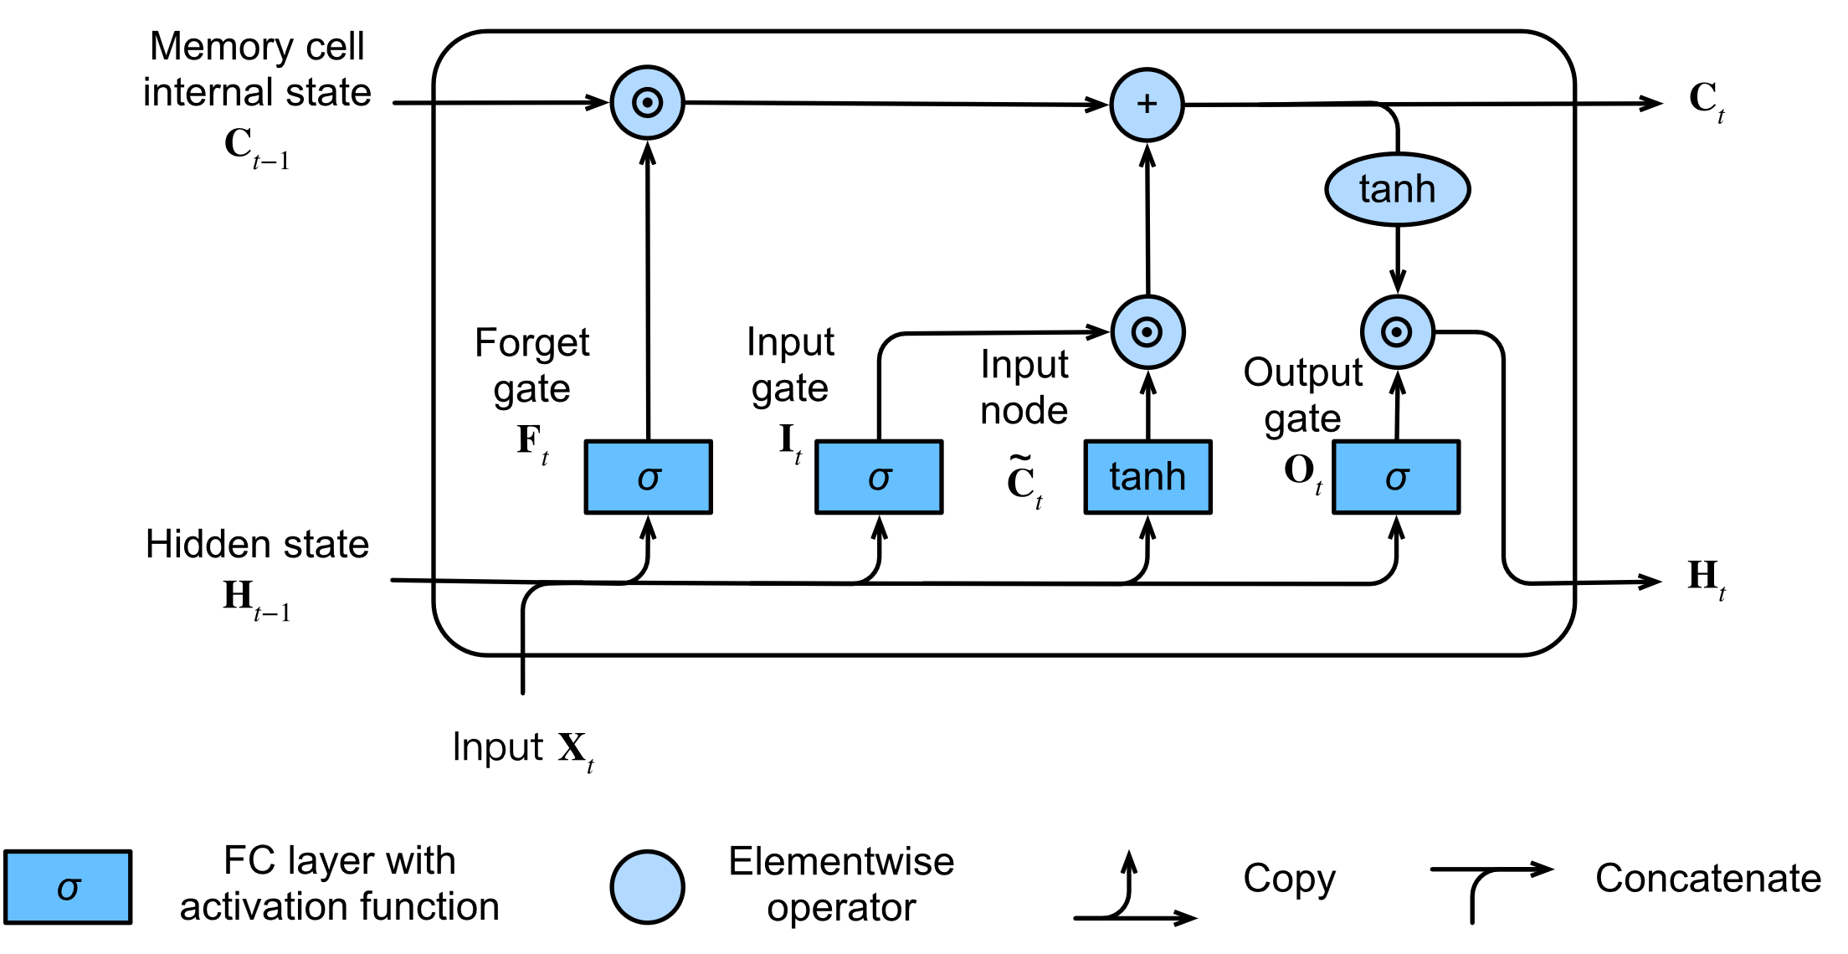
Bidirectional LSTM
Long Short-Term Memory (LSTM) network reads one word at a time
A bidirectional LSTM:
First reads from left to right and
Then from right to left
Concatenates hidden states from both
Computationally harder to train but usually more accurate
Network learns from words left and the right of the current word
Zhang et al. (2023)
Notes:
Now I promised we’d talk a bit more about LSTMs so that’s what we’re going to look at next.
We’re going to keep this at a high level though and start by just focusing on a regular LSTM before building up to bidirectional LSTMs.
These models work by reading one word at a time from left to right. The way you would typically read a sentence in English. This means that as the model is reading an address it’s only able to look at the words to the left of the current word. If you think about addresses though, whether or not two addresses are the same place depends on the words to the right as well as to the left. So for instance, imagine a street that runs all the way through a city. Two addresses on that street might look very similar if you’re only able to look at things to the left of the city. But if you’re able to look to the right of the city name you’d see that they’re in different zip codes.
To get around this limitation of only being able to look at words to the left of the current word, we use what’s call a Bidirectional LSTM which essentially combines two LSTMs – one that reads left to right and one that reads right to left. Understandably, that makes the model more difficult to train, but it does tend to be more accurate than just a single LSTM because now the model is able to learn from words to the left and to the right of the current word.

Slide 9
Why use a Siamese Network?
Goldilocks zone!
More flexible than traditional methods (Fellegi & Sunter, 1969)
No need to hand-craft features (i.e. tuning the Jaro-Winkler similarity)
Leverages transfer learning (i.e. uses pretrained word vectors)
Learns synonyms from context (East vs e.)
Less expensive than transformers (no GPUs)
Trained on on-prem server CPUs
Run on an analyst’s laptop CPUs
Notes:
Now that I’ve talked in enough detail about how the model we used works, I think it’s worth discussing a bit why we went with this approach. In many ways this Siamese Network felt like a Goldilocks zone between two alternatives:
Traditional methods like Fellegi and Sunter and
More cutting edge LLMs
Fellegi Sunter is still a workhorse in record linkage, but for this project we wanted something a little more flexible. Traditionally while working with a Fellegi Sunter model, the researcher has to spend some time hand crafting the similarity measures that get used by the model, and potentially has to spend a lot of time cleaning text to do things like convert every instance of the word street into the letters st.
We wanted to avoid that kind of work and instead take advantage of some of the work that’s been done to train word embedding models on massive amounts of data. Those models tend to already know that st is just an abbreviation for street so by using them we can save some researcher time.
On the other hand, we didn’t want to just jump straight into using an LLM because we needed something that would be easy to share with coworkers and that would run on a laptop. This Siamese Network was trained entirely on an on-premise server using CPUs and so it can run on my laptop in a few minutes just using the laptops CPUs. So that really felt like a happy medium.

Slide 10
Training the Record Linkage Model
Training Data: about 285,000 address pairs
Labeled by prior record linkage projects
Split 85/15 into training & validation
Final Training Accuracy: 100%
Validation Accuracy: 96%
Parameter | Value
N. LSTM Layers | 3
Dropout | 0.1
Embedding size | 300
Pretrained Weights | word2vec-google-news-300
LSTM hidden state size | 100
Batch size | 128
Initial Learning Rate | 1e-3
Learning Rate Scheduler | Exponential
Training Epochs | 30
Notes:
To train this model, we were able to take advantage of some prior work that my team had done in training larger scale record linkage models. From that prior project, we had about 285,000 labeled address pairs that we could use as training data. We split those into 85% for training and held out 15% for validation. I won’t go into too much detail about the model parameters but you can see them on the right. A few things I will mention though are that we used the google news word2vec embeddings so these are really easy to find if you want to try something similar and we trained the model for 30 epochs. While training the model we monitored the validation accuracy and noticed that it converged very quickly around 96% and didn’t really budge from that point so we stopped training at 30 epochs. Our final validation accuracy was that 96% which we were pretty happy with.

Slide 11
…But does it work?
Runs on a laptop
Four companies sent us locations to match
Ranging from around 400 to 1,700 locations
Found exact matches for 76.9% of these locations
Not perfect, but promising!
Still requires manual review
Notes:
The real test though of any model is how does it perform in the field on real data. The results for this are still pretty preliminary, but so far they look pretty good. In the first year of AIES 4 companies sent us spreadsheets that we tested this process on and these companies ranged between 400 and 1,700 locations. After using the model we found exact matches for almost 77% of the locations they sent us. This isn’t perfect, but it’s promising and more importantly it reduces the amount of manual work that Census staff have to do to assist these companies with responding to Census surveys.

Slide 12
Next Steps
Incorporate Feedback
Use on new Companies
Improve Process
Train Staff
Train Census staff to use
Incorporate their feedback
Expand use in AIES Year 2
Combine with direct company feeds?
Notes:
For our next steps with this project we want to continue iterating on an improving the process. As we prepare for AIES year 2 we’re training more staff on how to use this address matching process with the goal of trying it on more companies and incorporating what we learn.
Longer-term though Census has a goal of getting more data from direct company feeds. This would allow companies to just send us their data with the click of a button instead of needing to fill out a survey. So, we’re continuing to improve this address matching process with the aim of making it work within that broader goal of getting data from direct company feeds.

Slide 13
Questions?
Clayton Knappenberger (Clayton.G.Knappenberger@census.gov)

