Slide 1
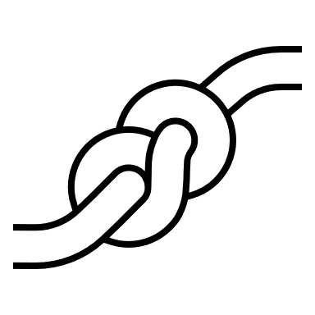
Close Enough:
A Python Package for Advanced String Comparisons
Neeka Sewnath and Clayton Knappenberger
Data Scientists, U.S. Census Bureau
04/22/2025
Any opinions and conclusions expressed herein are those of the author(s) and do not reflect the views of the U.S. Census Bureau. The Census Bureau has reviewed this data product to ensure appropriate access, use, and disclosure avoidance protection of the confidential source data (Project No. P-7504847, Disclosure Review Board (DRB) approval number: CBDRB-FY25-EWD001-007).

Slide 2
Record Linkage
Essence of record linkage -> linking records that refer to the same entity across datasets
Main goal -> connect fragmented information together to build a robust dataset
Text 1 | Column ID
A | 1
B | 2
C | 3
Column ID | Text 2
1 | D
2 | E
3 | F
Column ID | Text 1 | Text 2
1 | A | D
2 | B | E
3 | C | F

Slide 3


Existing Challenges in Record Linkage
Challenges when common keys are absent
  No unique IDs!
Greater reliance on specialized code for string similarity
Text 1 | Text 2
A | D
B | E
C | F
Text 1 | Text 2
a. | G
“B” | H
(C) | I
Notes:
Maybe add image?

Slide 4
Existing Options
Existing options
  High efficiency packages with limited methods
  Less efficient packages with wider sets of methods
  Poorly maintained packages
Need for a balanced approach
Notes:
Addresses bugs in existing string comparator tools, – 30+ string comparison algorithms
-mention febrl, text distance, jellyfish

Slide 5
Close Enough
Python package for fast and accurate string comparisons
Built upon
  FEBRL (Freely Extensible Biomedical Record Linkage)
  Jellyfish (string comparison library)
Improves upon existing methods

Slide 6
Key Features of Close Enough
Compiled with Cython for speed
Utilizes multiprocessing for scalability
Optimized for larger datasets
Supports interagency collaboration with open-source methods

Slide 7
Benchmarking Performance
Test Data A – Restaurant dataset (Köpcke & Rahm, 2010)
  Name and Address fields available
  Cross Joined: 175,000 rows
Test Data B – Business dataset (Konda et al., 2016)
  Name and Address fields available
  Subset to 1 million rows for large scale analysis
Test Packages – 2 Python packages
  FEBRL
  TextDistance
Vectorizing functions
  Close Enough includes vectorized functions utilizing multiprocessing
  We implement np.vectorize() to vectorize other functions

Slide 8
Benchmarking String Comparison Overview
  Bag
  Cosine
  Edit Similarity
    Levenshtein
    Damerau-Levenshtein
  Jaro-Winkler
  LCS (Longest Common Substring)
  We ensured that within each string comparison test, the packages calculated similar results.

Slide 9
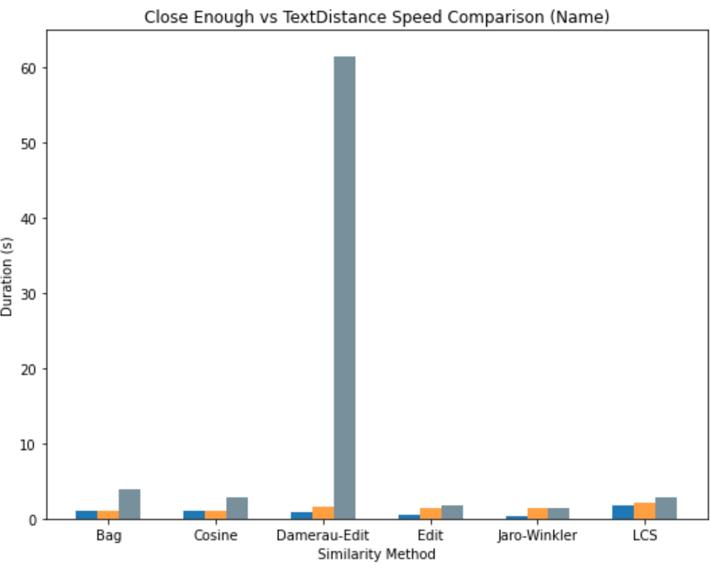
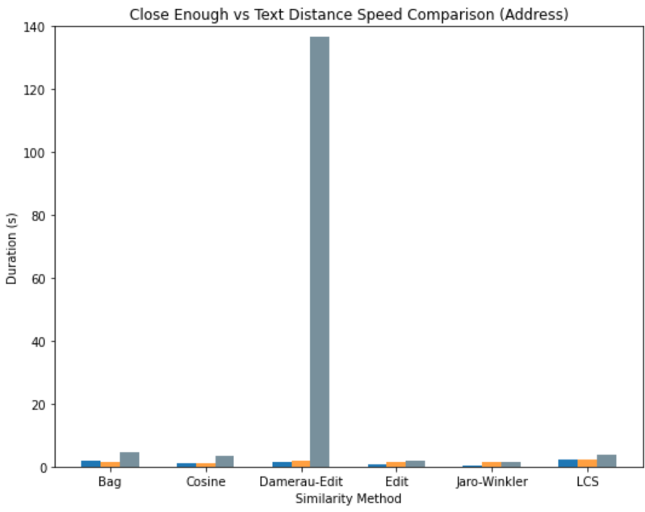
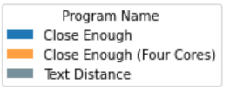
Close Enough vs TextDistance – Test Data A (175k rows)

Slide 10

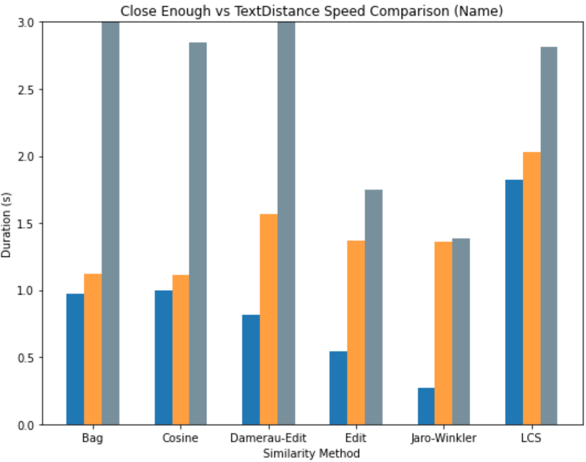
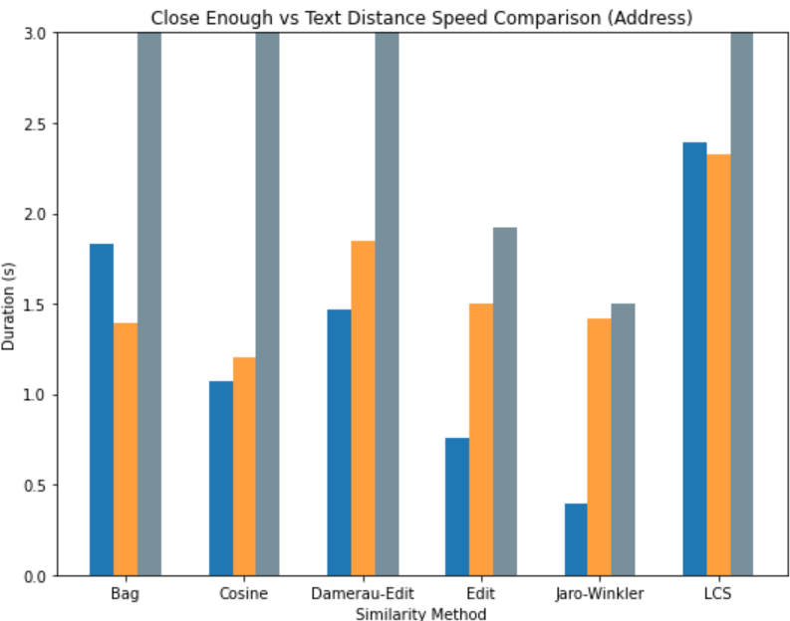
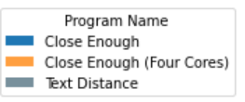
A Closer Look: Close Enough vs TextDistance

Slide 11
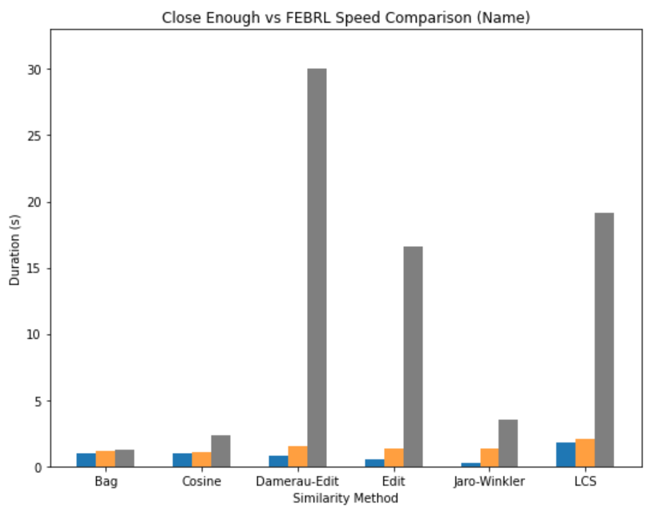
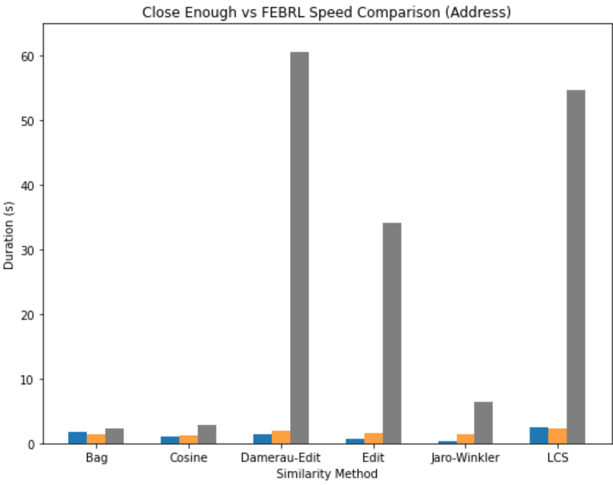
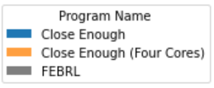
Close Enough vs FEBRL – Test Data A (175k rows)

Slide 12
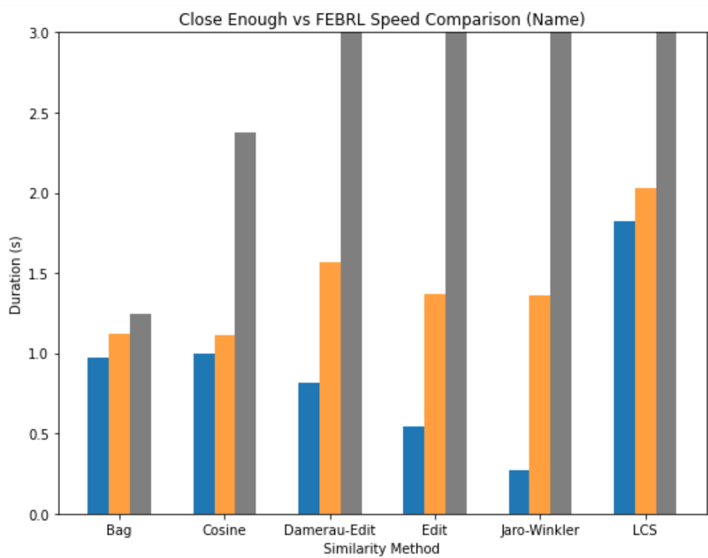
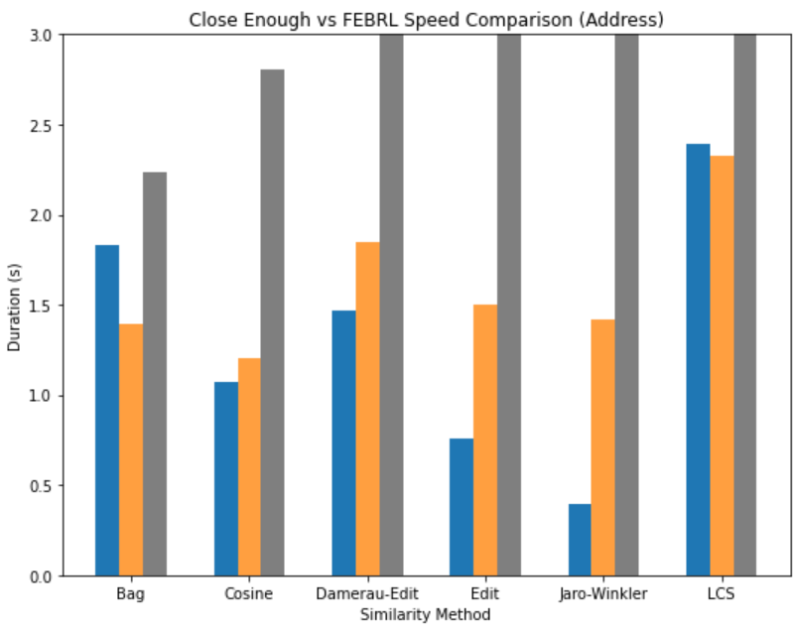
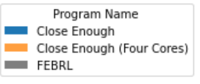
A Closer Look: Close Enough vs FEBRL

Slide 13
Close Enough Performance on Test Data A
Trade-off between using multiprocessing techniques and dataset sizes
Will still get a faster calculation than FEBRL or Text Distance
  Regardless of cores

Slide 14
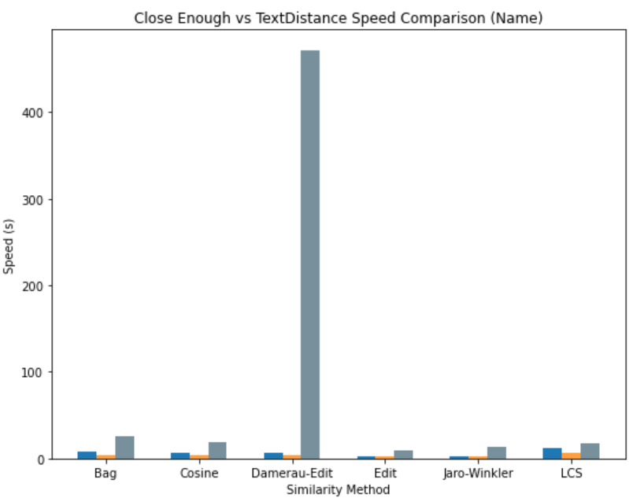
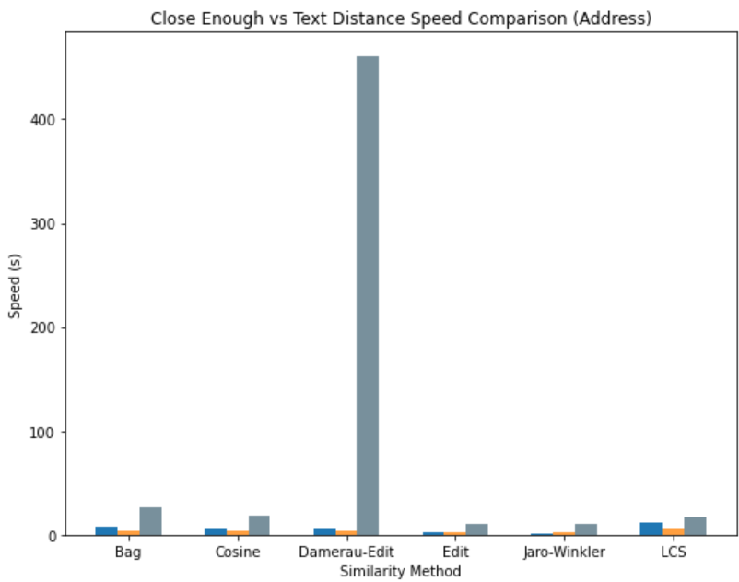
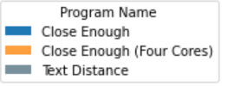
Close Enough vs TextDistance – Test Data B (1 mil rows)

Slide 15
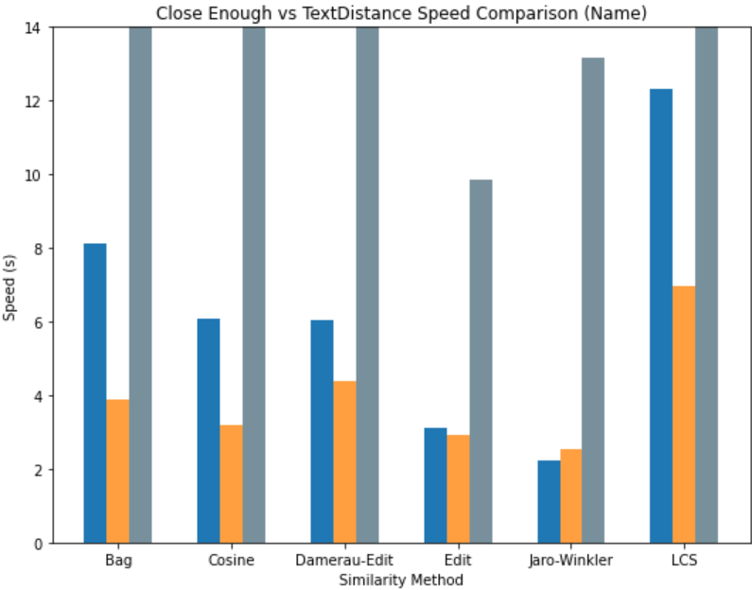
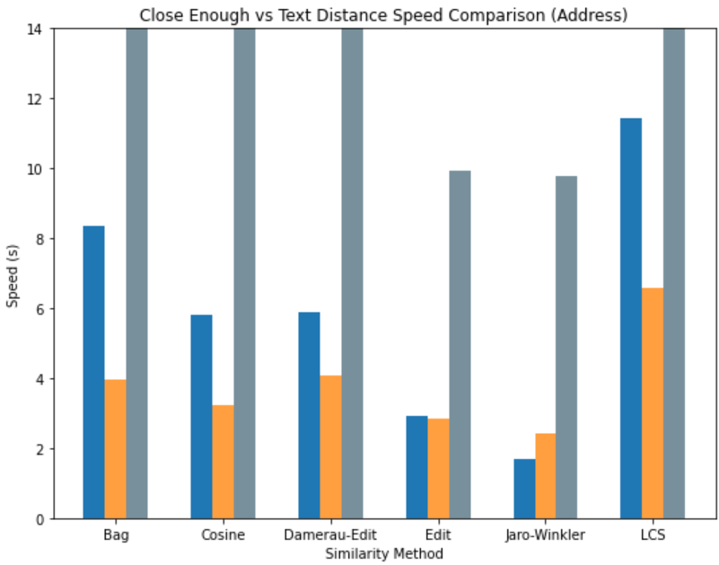
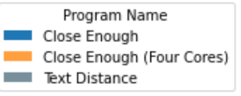
A Closer Look: Close Enough vs TextDistance

Slide 16
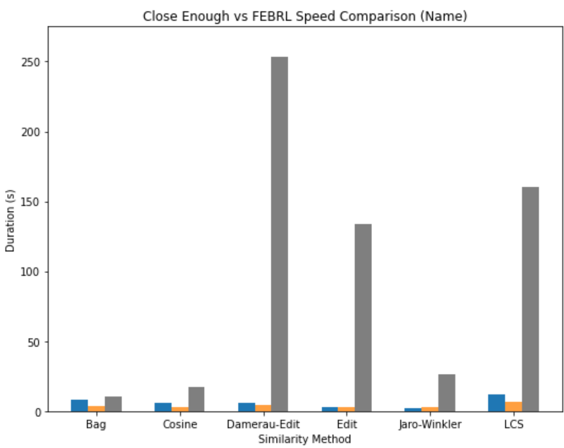
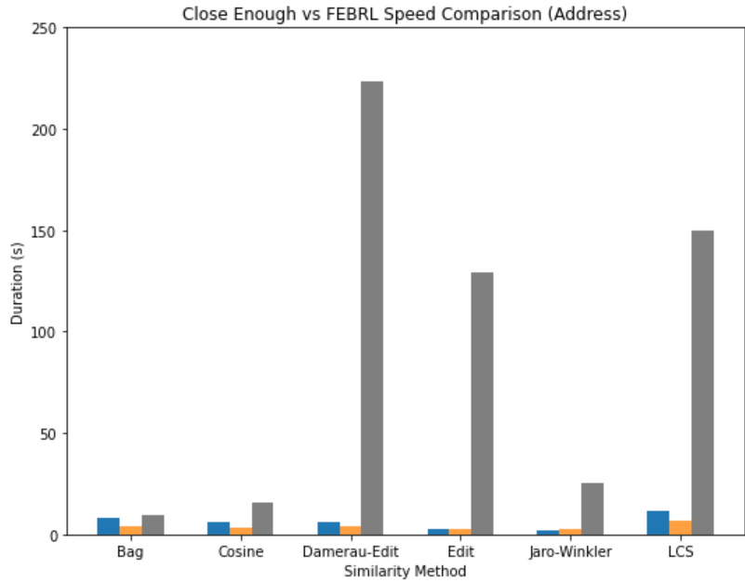
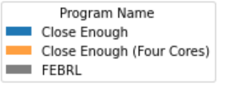
Close Enough vs FEBRL – Test Data B (1 mil rows)

Slide 17
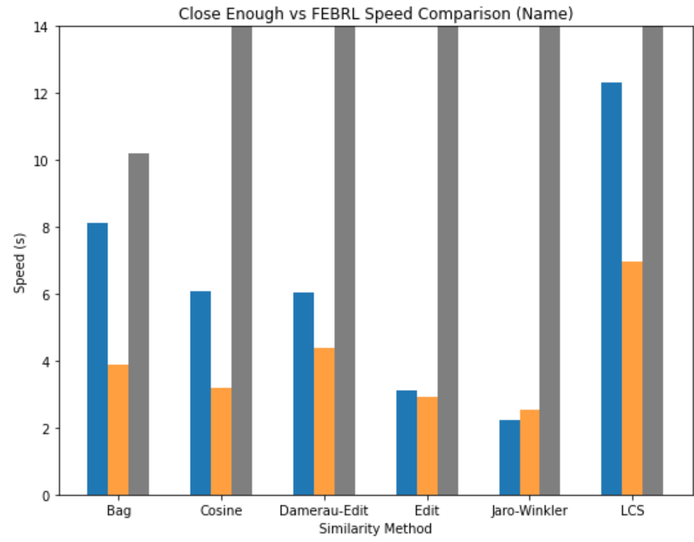
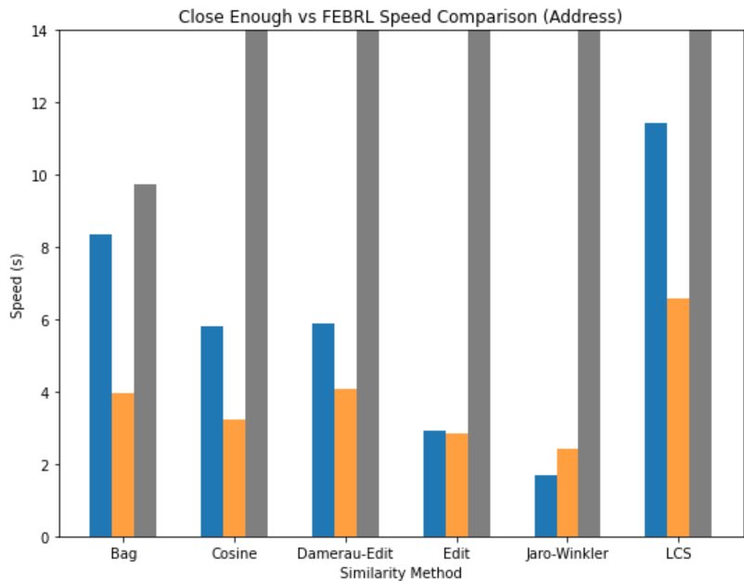
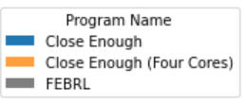
A Closer Look: Close Enough vs FEBRL

Slide 18
Close Enough Performance On Test Data B
For most tests, multiprocessing is slightly faster than single core
Will still get a faster calculation than FEBRL or Text Distance
  Regardless of cores
Time saved adds up as data size scales upwards

Slide 19
Takeaways
Improved performance and speed
  Especially amongst large scale datasets
Easy to integrate in existing pipelines
Interested?
Github: https://github.it.census.gov/COSMIC/close_enough
Notes:
Github link

Slide 20
Questions?
You can also reach out to us!
Neeka.Sewnath@census.gov
Clayton.G.Knappenberger@census.gov

