Slide 1
Leveraging images to improve School Pulse Panel data quality: Lessons learned from cognitive testing
2025 Federal Computer Assisted Survey Information Collection
Caitlyn Keeve, Kristen Kohm, Alexandra Piccirillo, Jennifer Pace, Kelyvette Ortiz Fontanez
Jonathan Katz, and Erin Tanenbaum
U.S. Census Bureau, CBSM
National Center for Education Statistics, NCES
Any views expressed are those of the authors and not those of the U.S. Census Bureau.

Slide 2
Background
The School Pulse Panel (SPP), conducted by the Census Bureau for NCES, is an online self-response questionnaire that surveys public K-12 schools on high-priority, education-related topics (e.g., school safety, learning recovery, tutoring, etc.)
Respondents are front office school staff like Principals, APs, Deans, etc.
SPP questions can use highly technical terminology: 2 new school transportation questions were suspected to be hard to answer; inaccurate answers
In fall 2024, we used cognitive testing to assess the use of images to assist in answering the highly technical transportation questions

Slide 3
Research Objectives
Document the methodology, design, and qualitative results of using images
Highlight differences among participants’ (Ps) reactions to the images
Review cognitive and usability findings useful for future fielding of images
Discuss what other online self-response surveys should consider when deciding to use images

Slide 4
Data Collection
20 participants: Public and charter K-12 front office staff
Incentive: $75 cash
Videoconference: Microsoft Teams
Device: Desktop/laptop (user’s personal equipment)
Recording software: Snagit

Slide 5
Procedures and Interview Protocol
Testing occurred in fall 2024.
Session duration: 90 minutes
Documents/activities completed by participants:
  Consent form
  SPP questionnaire (57 questions across 10 modules, including topics like mental health, crime and safety, and learning recovery)
    The two transportation questions with images were tested as a part of the 19-question Transportation module
Think-aloud protocol: spontaneous comments about the questionnaire

Slide 6
Think-aloud, Probes and Debrief questions
Retrospective probes
If participants found the included images to be helpful in answering the questions
If the images were not provided, did they think their answers would have changed?
  If so, they were asked which answers would have changed if the images were not provided
Debrief
Ps were debriefed at the end of the session so researchers could clarify any responses or answer questions about the survey

Slide 7
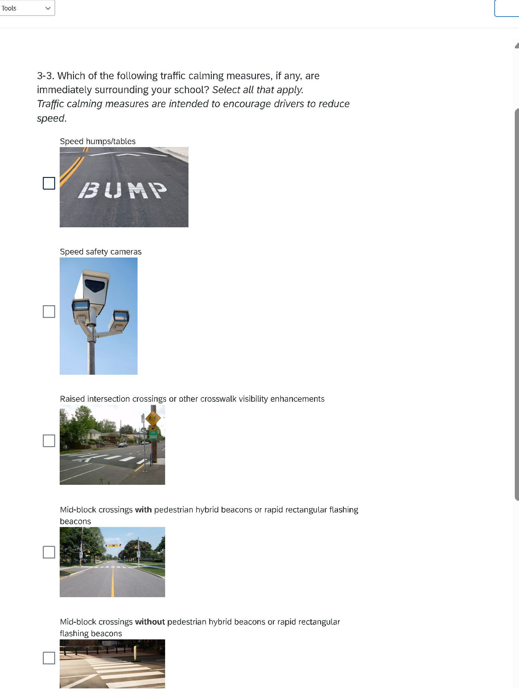
Question 1: Traffic Measures.
Traffic Measures. Which of the following traffic calming measures, if any, immediately surround your school? Select all that apply.
Traffic calming measures are intended to encourage drivers to reduce speed.
Speed humps/tables
Speed safety cameras
Raised intersection crossings or other crosswalk visibility enhancements
Mid-block crossings with pedestrian hybrid beacons or rapid rectangular flashing beacons
Mid-block crossings without pedestrian hybrid beacons or rapid rectangular flashing beacons
Curb extensions
Chicanes (diversions or shifts in vehicle travel lanes in order to reduce vehicle speeds)
Other, please specify:
There are no traffic calming measures immediately surrounding our school

Slide 8
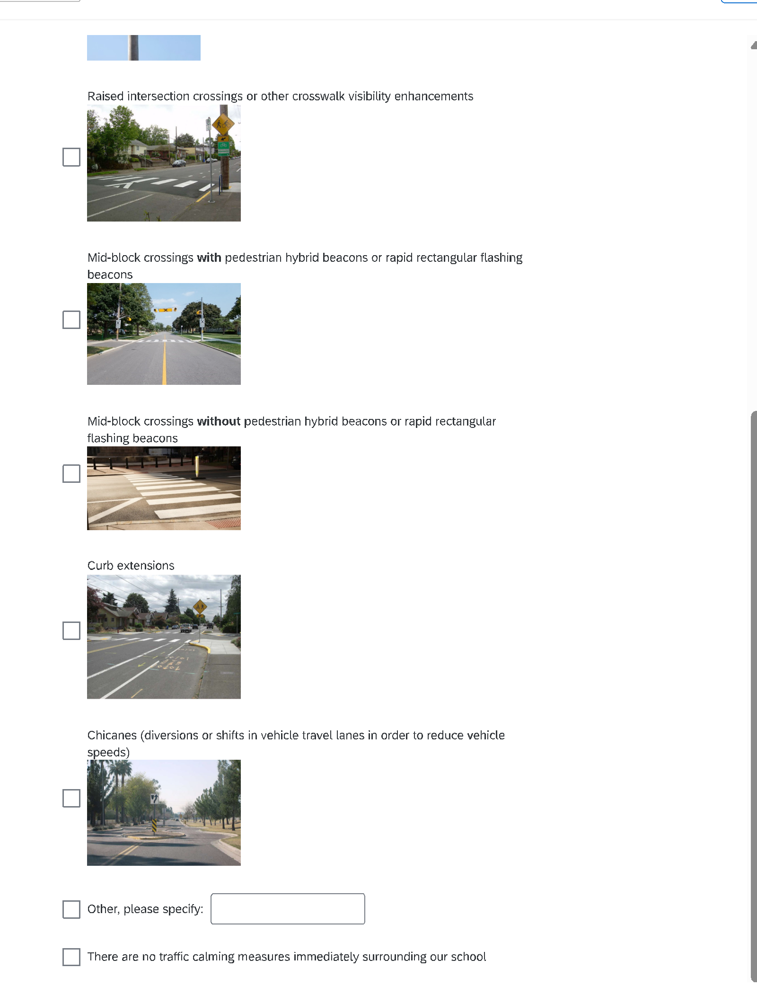
Question 1: Traffic Measures.
Traffic Measures. Which of the following traffic calming measures, if any, immediately surround your school? Select all that apply.
Traffic calming measures are intended to encourage drivers to reduce speed.
Speed humps/tables
Speed safety cameras
Raised intersection crossings or other crosswalk visibility enhancements
Mid-block crossings with pedestrian hybrid beacons or rapid rectangular flashing beacons
Mid-block crossings without pedestrian hybrid beacons or rapid rectangular flashing beacons
Curb extensions
Chicanes (diversions or shifts in vehicle travel lanes in order to reduce vehicle speeds)
Other, please specify:
There are no traffic calming measures immediately surrounding our school

Slide 9
Question 1: Traffic Measures.

Slide 10
Cognitive Interview Findings

Slide 11
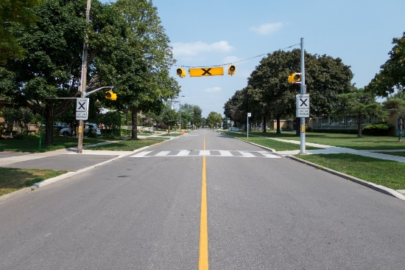
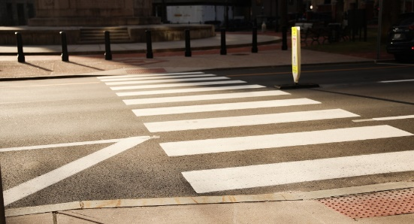
Cognitive Interview Findings: Images
19 Ps said traffic calming images were helpful
Especially helpful to confirm the term they already had in mind
The image for “flashing beacons” was not helpful and a little “confusing” because they could not see the flashing beacon well in the photo. .
Figure 1: Mid-block crossings with pedestrian hybrid beacons or rapid rectangular flashing beacons.
Figure 2: Mid-block crossings without pedestrian hybrid beacons or rapid rectangular flashing beacons.

Slide 12
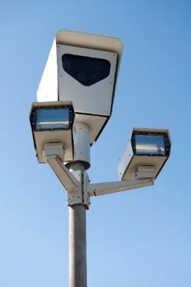
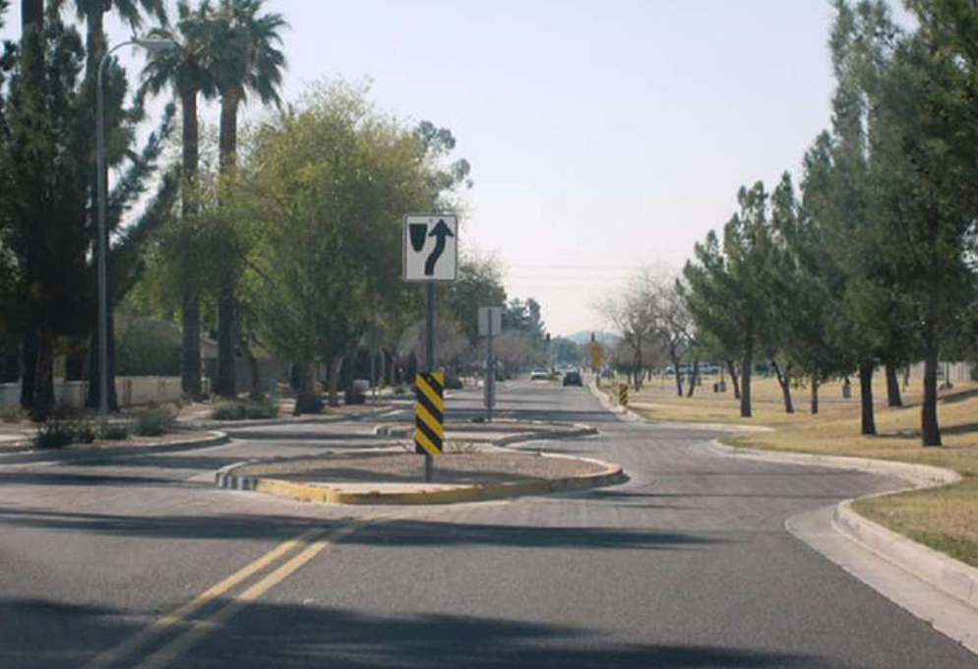
Cognitive Interview Findings: Images (cont.)
Multiple Ps expressed that they were not familiar with certain terminology used
  “Chicanes” were largely unknown.
Images weren’t helpful for all the answers
All Ps knew what a “Speed Camera” was
Suggestions to add more answer options
Spontaneously mentioned “bus lanes” or “school driveways” are also traffic calming measures because those features help prevent cars from blocking the school bus loading area
Retrospective Probes
If the images were not there, five Ps said their answers would stay the same. Four Ps said their answers would be different; would not choose a response or would need to read more closely
Figure 3. Chicane (diversions or shifts in vehicle travel lanes to reduce vehicle speeds)
Figure 4. Speed
camera

Slide 13
Cognitive Interview Findings: Images (cont.)
Ps changing their answers after looking at the images
Two Ps had initially selected responses for “mid-block crossings” but changed after noticing the minor differences between the two answer options in the images
Images helping make a more accurate choice
These Ps’ revised answers appeared to be more accurate according to interviewer observations of them expressing more confidence in their answer and Ps remarks
  “Actually, that’s a better fit”
  “It took me a second, but I think that’s closer to what we have at our school”.
Figure 1: Mid-block crossings with pedestrian hybrid beacons or rapid rectangular flashing beacons.
Figure 2: Mid-block crossings without pedestrian hybrid beacons or rapid rectangular flashing beacons.

Slide 14
Cognitive Interview Findings: Images (cont.)
Skipping vs Answering with uncertainty
Two Ps said they would have skipped this question altogether if there were no images; would not want to read all the options
Half indicated that they were unsure about some, but would still try to answer
  After seeing the images, they were able to better understand the terminology and make an informed selection
Others said it depended on the image

Slide 15
Question 2: Bike Infrastructure
Bike Infrastructure. What, if any, types of bike infrastructure immediately surround your school? Select all that apply.
Sharrow (painted line marking indicating that bicycles and vehicles share a travel lane)
Bike lane with a painted stripe
Buffered bike lane (i.e., painted buffer, bollard buffer)
Protected bike lane (i.e., median/curb separated, parking separating car and bike lanes)
Shared use path, off-street bike lane, or other trail
Raised/grade separated intersection crossings
Bike light (time separated crossing)
Other, please specify:
We have no bike infrastructure surrounding our school

Slide 16
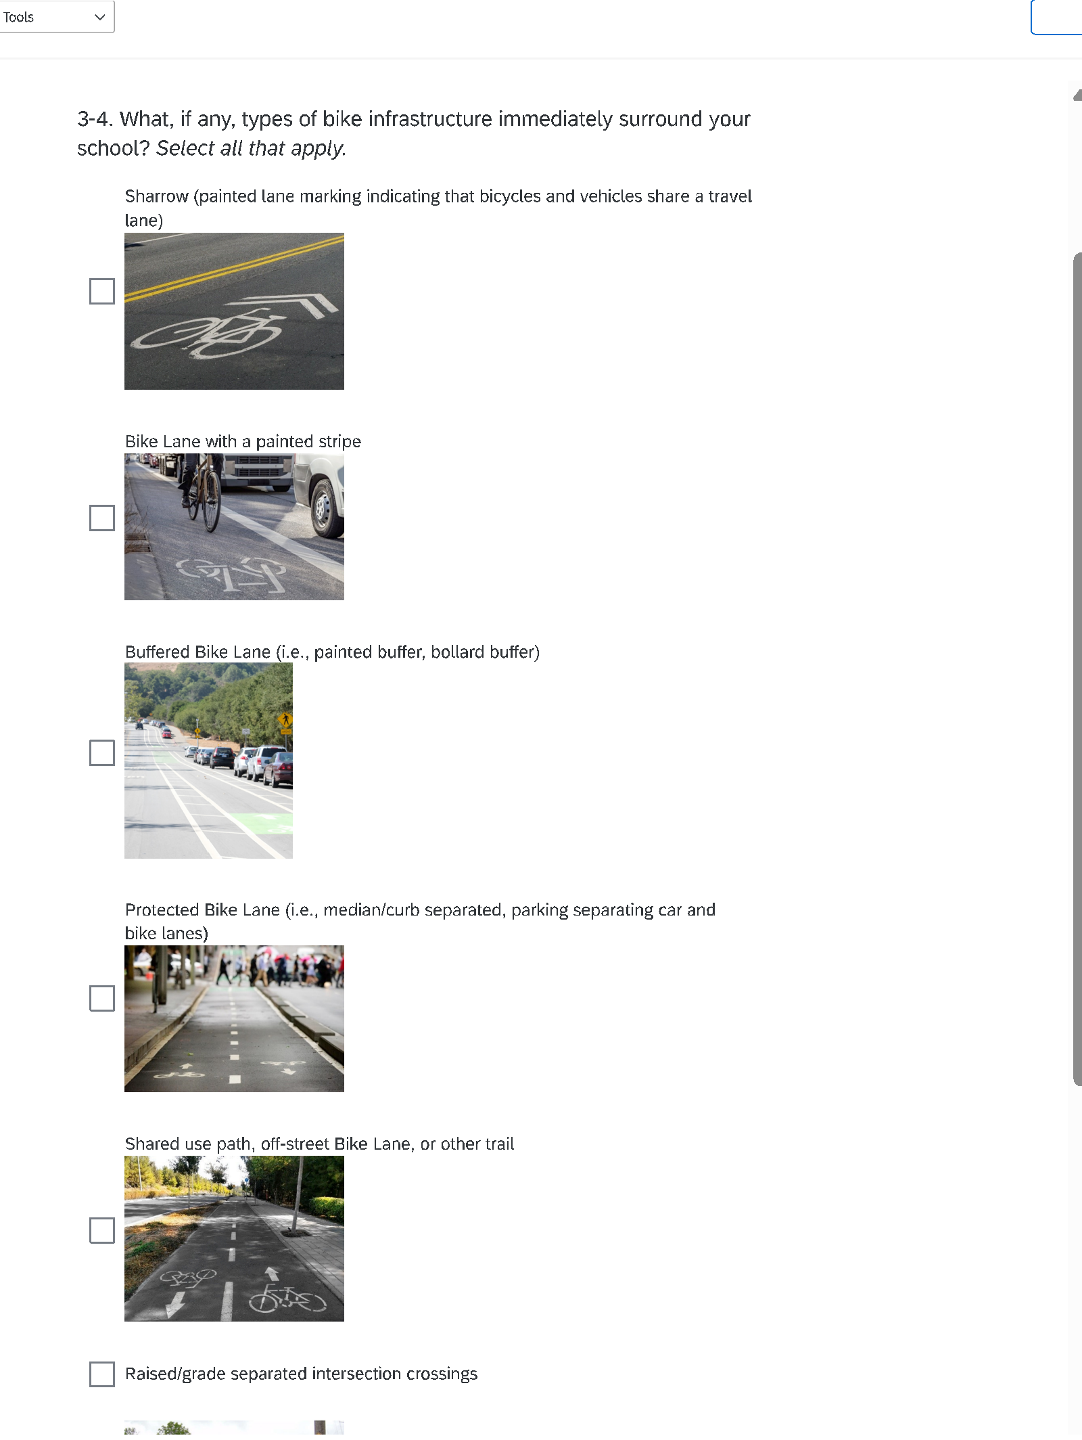
Bike lane with a painted stripe
Buffered bike lane (i.e., painted buffer, bollard buffer)
Protected bike lane (i.e., median/curb separated, parking separating car and bike lanes)
Shared use path, off-street bike lane, or other trail
Sharrow (painted line marking indicating that bicycles and vehicles share a travel lane)

Slide 17
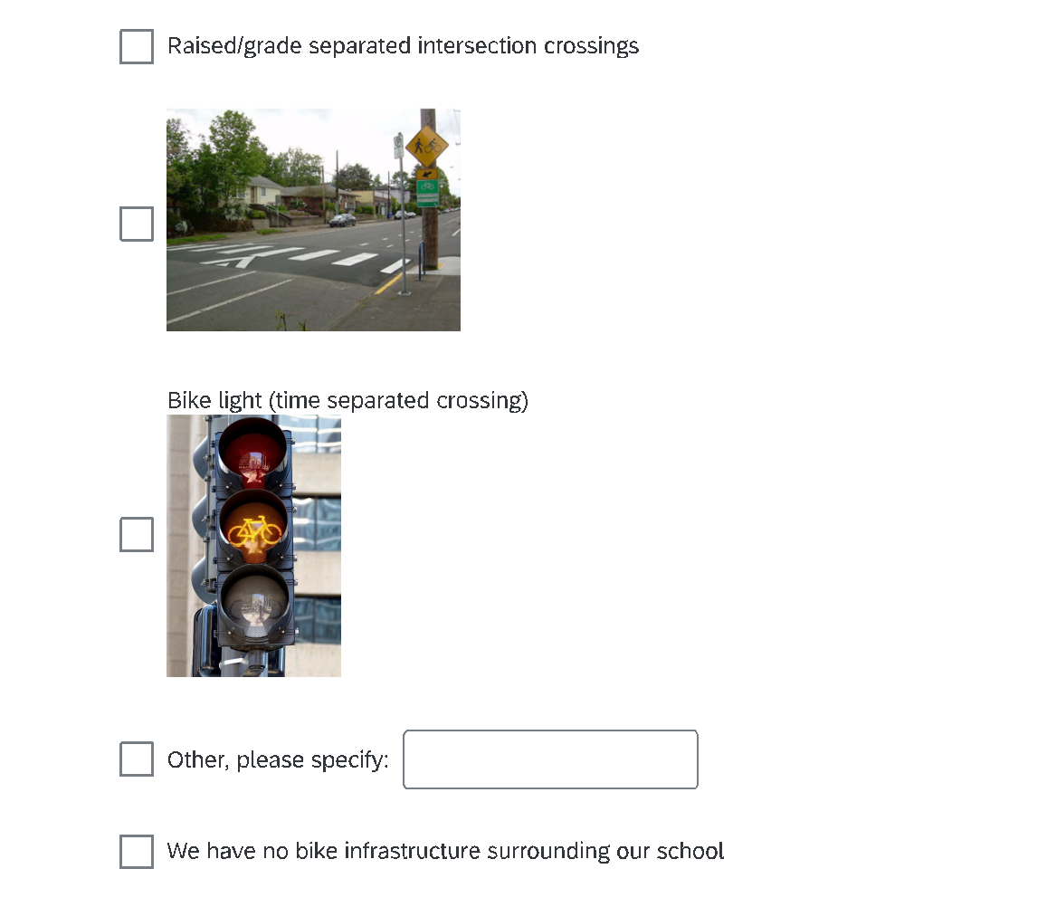
Question 2: Bike Infrastructure.

Slide 18
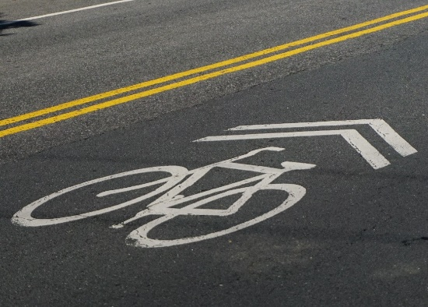
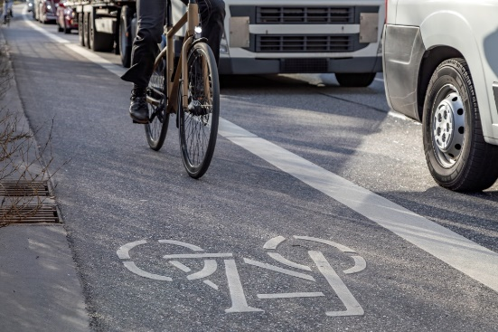
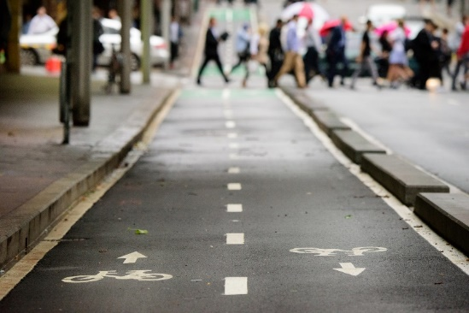
Cognitive Interview Findings: Images
Ps did not struggle to answer; tended to pause only for a few seconds to view the image
Almost half selected that they had no bike infrastructure surrounding their school
  No one selected protected bike lane, raised/grade separated intersection crossing, or bike light.
“Sharrow” was largely unknown
Some Ps said that without the images, they would not know the difference between the types of bike lanes
Overall, most said the images were helpful
Figure 5. Sharrow (painted lane marking indicating that bicycles and vehicles share a travel lane)
Figure 6. Bike Lane with stripe
Figure 7. Protected Bike Lane

Slide 19
Usability Findings

Slide 20
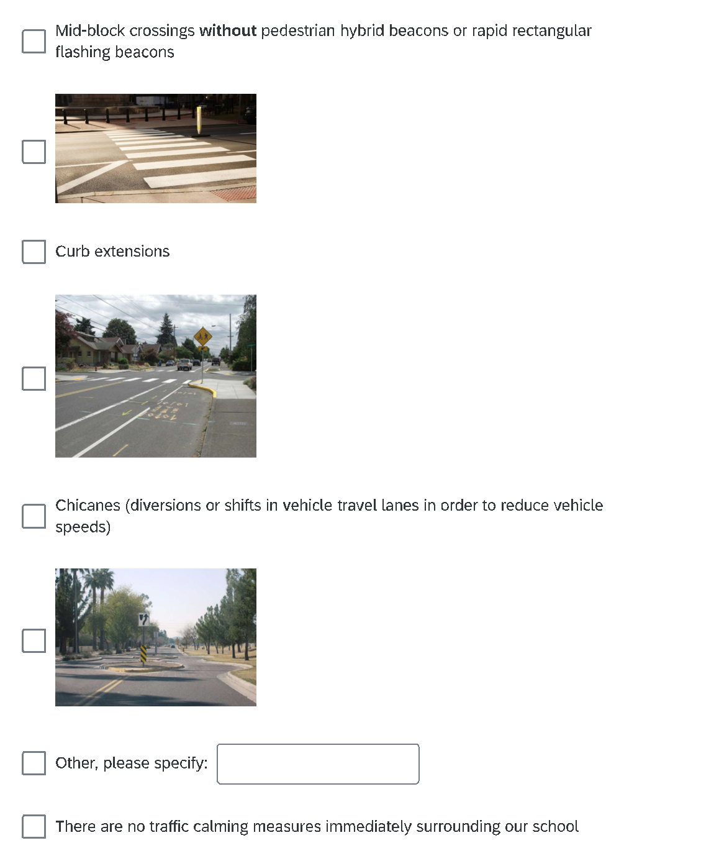
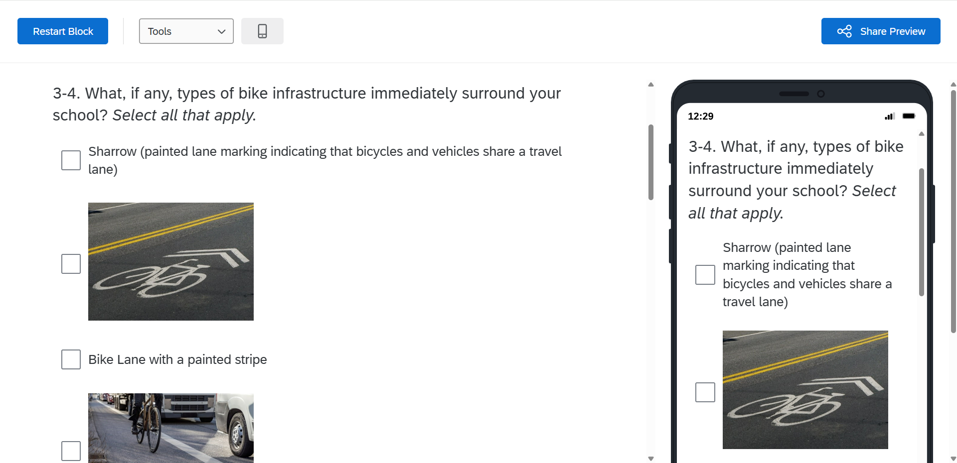
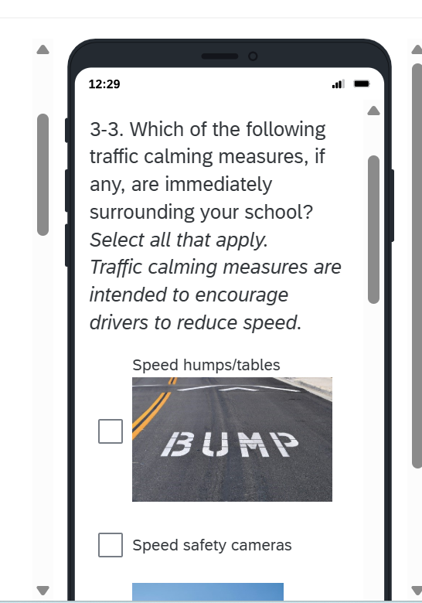
Usability Findings: Number of images per page
Seven images per page did not appear to be an issue
Design did require scrolling up or down the page to see the images
All used a PC to test these questions; none said scrolling was burdensome
Perhaps if these questions were tested on mobile devices, scrolling to revisit an earlier image on a small screen may have shown to be a usability issue.
No one attempted to zoom in on the images
  Sizing and resolution quality were adequate
Figure 9. Mobile Display

Slide 21
Mobile Version
Figure 9. Mobile Display

Slide 22
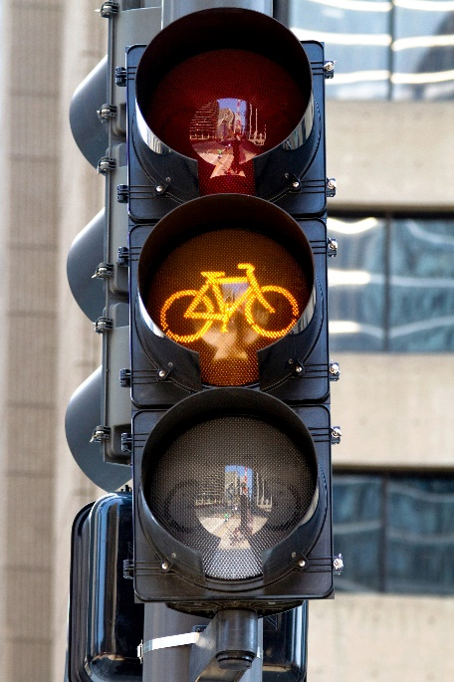
Usability Findings: Short item description
The succinct item description with the image appeared to work well
Provided enough detail, while not overburdening them with excess text on screen.
One P suggested a detailed definition for each would help improve their understanding of the terminology; CBSM did not recc. this
Walls of text have not been received positively
  “Wordy” and “unclear” response options: increase in cognitive burden (Horwitz et al., 2020).
Bike light (time separated crossing)

Slide 23
Usability Findings: Image choice
Most images were well received
One P did not like the image of the “Mid-block crossings” because they could not see the flashing beacons clearly in the image
Images were taken in the daytime, with full brightness and with signage clearly in view
Chose images without weather, pedestrian, or building obstructions allowed respondents to view the version of the transportation item in a “best-case scenario” environment

Slide 24
Recommendations
Select images that are high resolution, bright, and that accurately depict the item.
Design should be consistent in showing images; do not display some images and not all.
  A pop-up, unfolding, or embedded link (less real estate on the page)
  Alt: consider providing images for response choices only when those items are not well known.
Images should be unique and clearly distinguish key features which may assist respondents in distinguishing between similar items.
Consider offering a brief video if the item changes (such as the flashing lights).
Test images with participants (mobile and PC) and watch for issues with scrolling due to the number of images on a page or the image size.

Slide 25
Caitlyn Keeve
caitlyn.keeve@census.gov
Jonathan Katz
jonathan.m.katz@census.gov
Kathleen Kephart
kathleen.m.kephart@census.gov

Slide 26
Timing Data
Timing data and how images contribute to overall burden in surveys
Generally, highly technical survey questions may lead respondents who are unfamiliar with terminology to spend excess time thinking about their answer or trying to imagine what the question is asking
  These respondents may also prefer to select “don’t know” or skip the question, rather than provide a substantive answer.
A study that compares timing and non-response data between respondents who receive images and those who do not may provide insight into how using images may affect response efficiency and data quality in an online self-response survey

