Slide 1
Online question design for fixed-length data
Elizabeth Nichols
U.S. Census Bureau
2025 FedCASIC - April 22, 2025
This presentation is released to inform interested parties of research and to encourage discussion. The views expressed are those of the authors and not those of the U.S. Census Bureau.
The disclosure review number for this presentation: CBDRB-FY22-CBSM002-007.

Slide 2
Research questions
What is an optimal input field design when the expected data are fixed length and standard format (such as time, telephone number, or date) such that
accuracy of the data collected is maximized
respondent burden as measured by time-on-task is minimized
user satisfaction is maximized

Slide 3
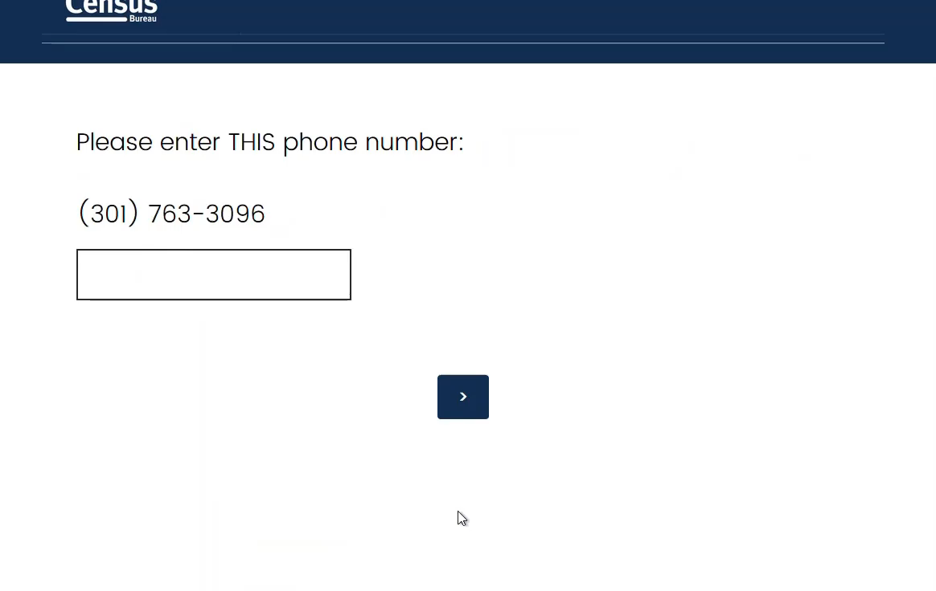
Optimal design tested

Slide 4
Methodology
Conducted 2 independent split-panel experiments
Studies ran in November 2020 and May 2021
Tested 4 designs
Between-subjects design - Participants assigned to one condition
Nonprobability panel quota sample
Measured accuracy; time-on-task; satisfaction

Slide 5
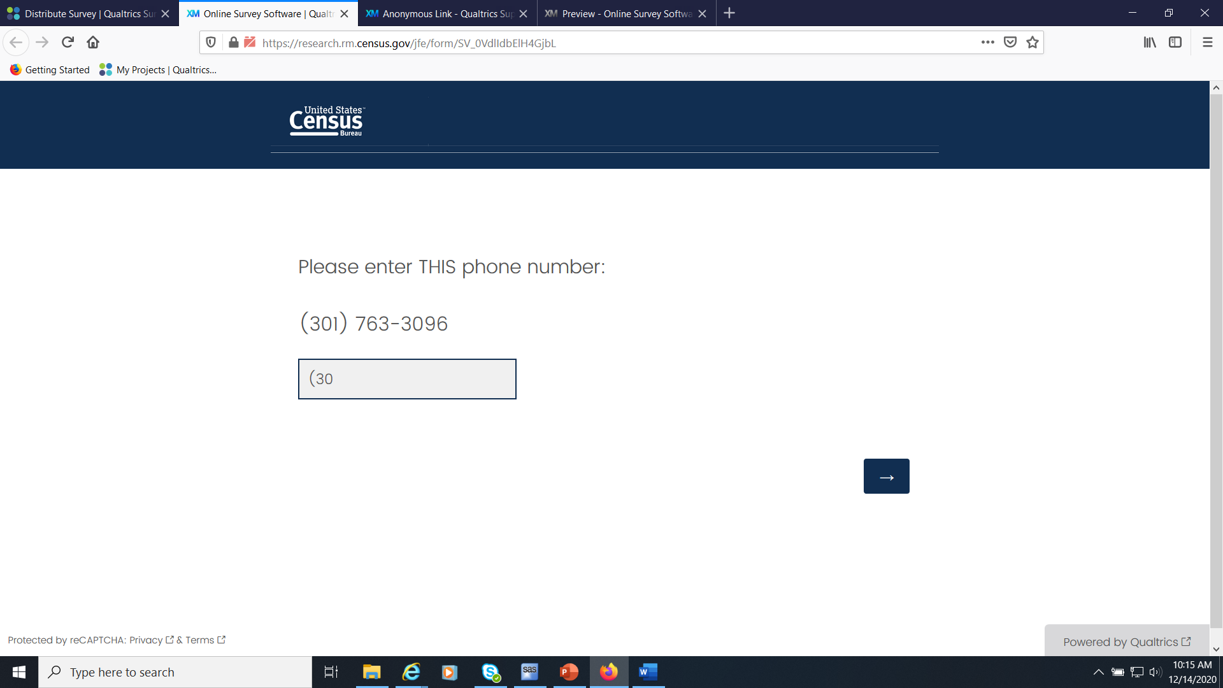

Format as typing

Slide 6


Format on focus (clip)

Slide 7

No format

Slide 8
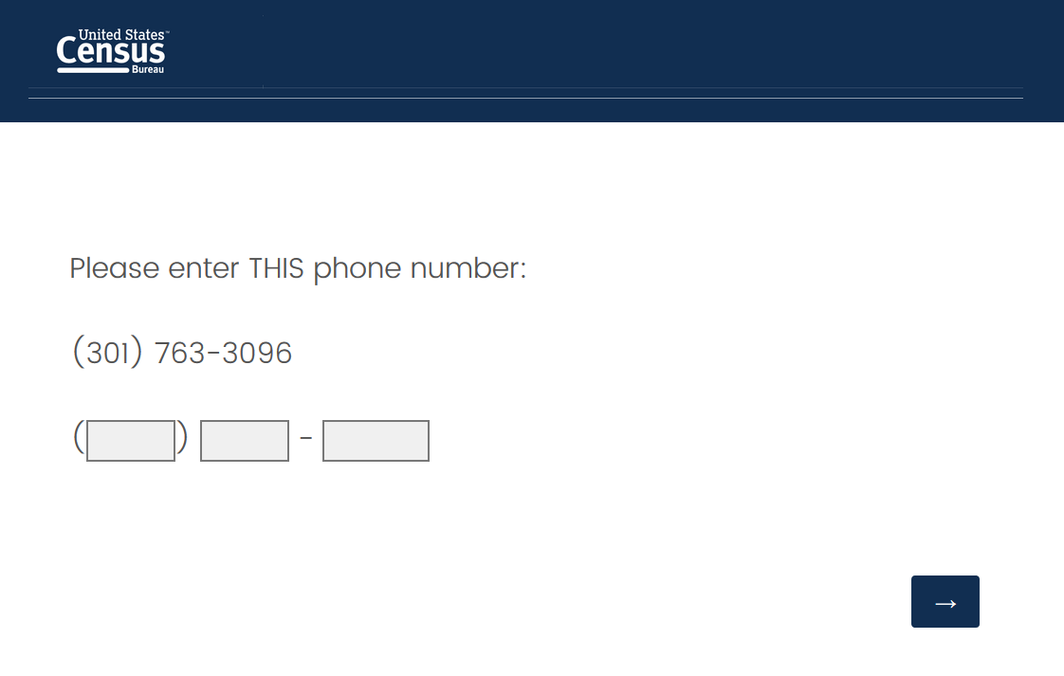

Auto tab
As soon as the “1” in 301 was entered, the cursor jumped to the next field.

Slide 9
Experimental Design
Input field experiment at the end of the survey
Participant randomly assigned to 1 condition
Participants interacted with 5-6 screens
Example question – instructed to enter 1998
Telephone number question – (301) 763-3096
Time question – shown an analog clock face with 7:45
Date question – shown a calendar – with September 14, 2020 selected
Access code (Study 2 only)
Details on these 4 screens
Instruction given on the data to enter
Questions not randomized.
Example – had to enter the correct number
Participants had to answer remaining questions, but answer was not checked
Answered an easy/difficult rating question

Slide 10
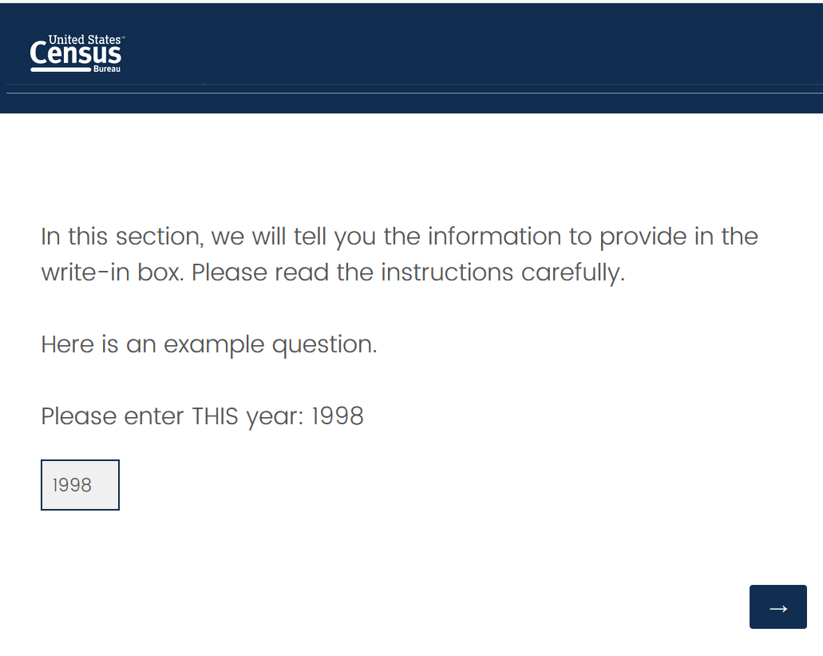
Stimuli Design– Example question – the same across all conditions

Slide 11
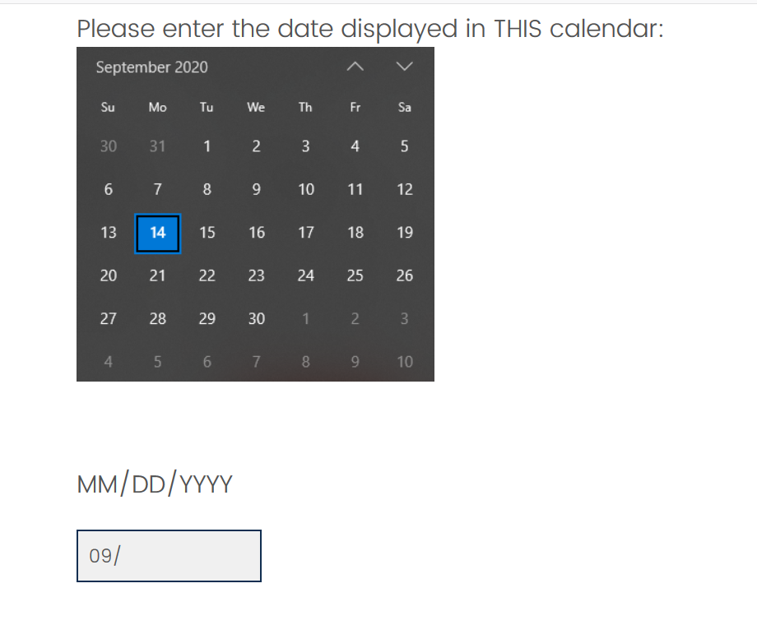
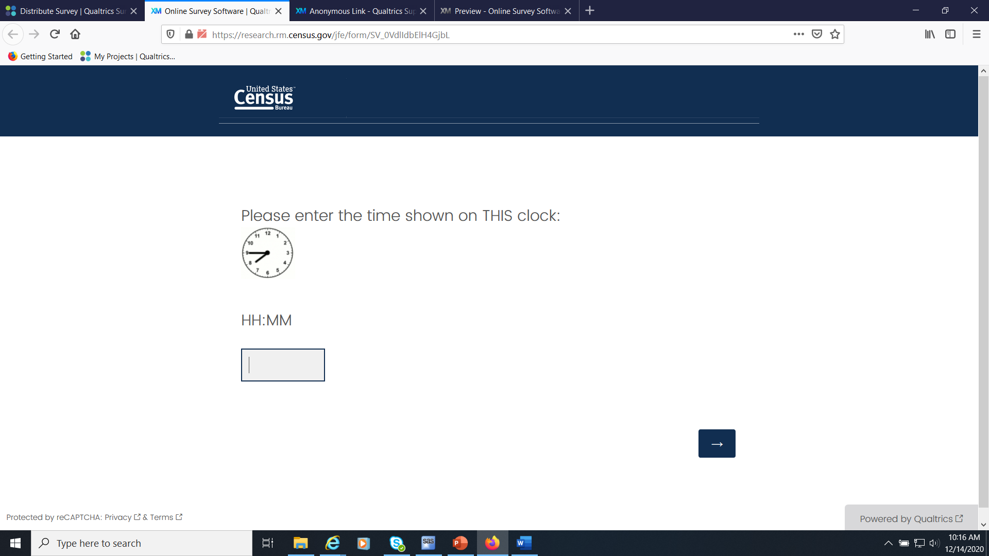
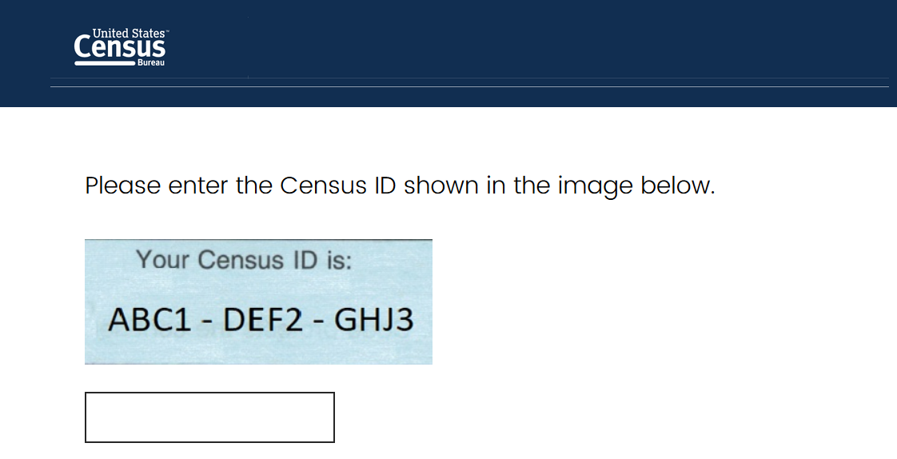
Questions
Study 2 only

Slide 12
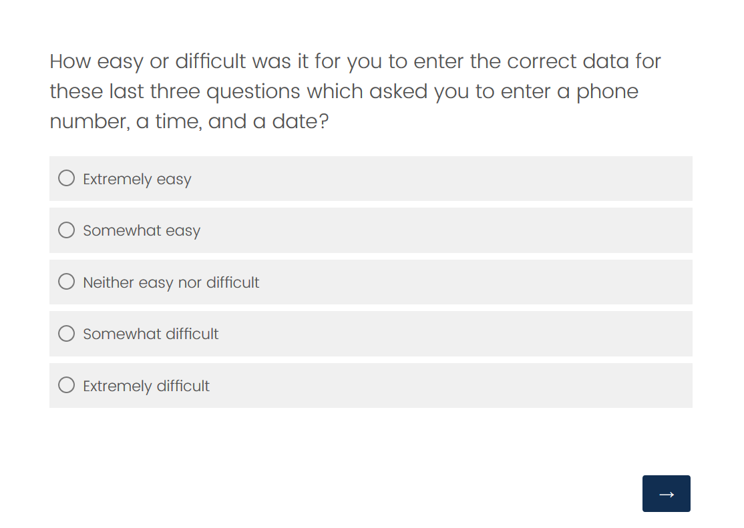
Stimuli Design– Easy/Difficult question – the same across all conditions

Slide 13
Participant characteristics
Study 1
Study 2
500 participants
49% Male/51% Female
Age (mean=37 years old; range 18-77)
15% Hispanic origin/85% not of Hispanic origin
77% White only/23% nonwhite only
No educational level collected
63% Mobile/ 37% PC
500 participants
44% Male/ 56% Female
Age (mean=46 years old; range = 18-96)
9% Hispanic origin/91% not of Hispanic origin
76.5% White only/ 23.5% nonWhite only
34% High school or less / 66% more than high school
.5% Mobile/99.5% PC or Mac

Slide 14
Data Collected
Study 1
Study 2
1,500 observations (500 participants x 3 questions)
Time on the screen and the data entered for each question
Questions
Phone
Time
Date
500 easy/difficult ratings
2,000 observations (500 participants x 4 questions)
Time on the screen and the data entered for each question
Questions
Phone
Data error – timing data was not collected for no format condition
Time
Date
Access Code
500 easy/difficult ratings

Slide 15
Analysis
Accuracy
Percent
Mixed logistic model
Efficiency or time-on-task
Mean
Mixed linear models
Satisfaction
% distribution
Chi-square

Slide 16
Accuracy of data
Study 1
Study 2
*
*
Notes:
Mixed logistics model
Study 1: Auto tab design results in more data errors compared with other input field designs
Study 2: No formatting results in more data errors compared other three formats

Slide 17
Time-on-task
Study 1
Study 2
*
*
Notes:
Mixed model
Study 1:
The least amount of time on average was the Format on focus. While no formatting takes on average longer to use than the other designs; however, it is usually not significantly more time. It approaches significance compared with masking with the Format on focus.
Study 2:
Autotab and Format on focus are fast to use.
No formatting takes longer to use than autotab
Format as typing takes longer to use than autotab

Slide 18
Ease/difficulty of use No significant difference in ease/difficultly of use between the formats
Study 1
Study 2
Χ²(6)=9.2 p=.2
Χ²(6)=8.7 p=.2

Slide 19
Examining the format for date and time It is critical to enter the correct format so that the data can be interpreted correctly.
Format on focus
DATE
Output data should have been 09/14/2020
100% of participants who entered a correct entry, entered it in the correct format
TIME
Output data should have been 07:45 or 08:45
100% of participants who entered a correct entry, entered it in the correct format
Auto tab
DATE
Output data should have been 09142020
86% of participants who entered a correct entry, entered it in the correct format
The other Rs entered 9142020.
TIME
Output data should have been 0745 or 0845
45% of participants who entered a correct entry, entered it in the correct format
The other Rs entered the data without the leading zero.

Slide 20
Summary
Limitations with these designs…
No formatting in the field
Resulted in longer data collection times and more errors
Masking as you type
Generated slightly longer entry times compared to auto tab in one study
Auto tab
Appears to be quick to use, but resulted in more errors in Study 1
Many users don’t enter leading zeroes during data entry

Slide 21
Recommendation
Use Format on focus for fixed input types
Consistent findings across two studies
No data were in the incorrect format
Produced accurate data
Quick completion times
No difference in user satisfaction

Slide 22
Thank you

