Slide 1
Automating Offense Text Standardization for Criminal Justice Data
Anthony Berghammer
Peter Baumgartner

Slide 2


Presenters
Anthony Berghammer
Research Data Scientist
Peter Baumgartner
Sr. Research Data Scientist

Slide 3





Agenda
Background & Problem Statement
RTI’s Approach
Results & Output
Impact
Next Steps

Slide 4



Our Autocoder Improves Offense Coding Efficiency
Accurate text classification for standardizing offense codes into the NCRP Taxonomy
Easy to use Python package and user interface to enhance research efficiency
Enables future research to better understand state and national level processing of felony defendants

Slide 5
Background

Slide 6



What is the National Pretrial Reporting Project (NPRP)
Goal:
Gain an expanded understanding of case processing of felony defendants in state criminal courts
What it is:
Compiles data on processing of persons charged with felony offenses in state courts
Black Box of Pre-Trial Populations
Populations are Largely Unknown
Focus on pretrial release and detention
Questions related to process (admitted, detained, released populations, etc.)
Demographics and charges
Limited Knowledge & Visibility
No Current National Study
Populations Move Quickly

Slide 7




Data Collection Process
Inform Agencies of Opportunity
Establish Partnership
Intake Pretrial Information
Combine Information

Slide 8
Approach

Slide 9
Why Build an Autocoder?
Unstandardized offense text across multiple agencies makes reporting and further analysis impossible
78 Categories
Auto Theft
Example Offense Text
POSSESS STOLEN VEHICLE
ALTERATION OF VIN NUMBER
ATT POSS STOLEN VEHICLE
VEHICLE THEFT
ILLEGAL POSSESSION OF A VIN PLATE
THEFT OF MV
Property Crime
Auto Theft
…
Fraud
Other/General

Slide 10
Initial Data Source – NCRP Crosswalk
Data Source: National Corrections Reporting Program Crosswalk (BJS)
Overview:
Publicly available offender-level data on admissions and releases from state & federal prisons. Contains offense codes mapped onto 78 categories
Many items in the NCRP crosswalk have potential label errors when only looking at the text description field.
State Description | Category
cut down or possess branded timber | DRUG OFFENSES - VIOLATION/DRUG UNSPECIFIED
trespassing | PUBLIC ORDER OFFENSES - OTHER
pos marij vop | POSSESSION/USE - OTHER CONTROLLED SUBSTANCES
institutional vandalism | MORALS/DECENCY - OFFENSE
extortion | LARCENY/THEFT - VALUE UNKNOWN
perjury | PUBLIC ORDER OFFENSES - OTHER
sale marijuana first | POSSESSION/USE - DRUG UNSPECIFIED
Possible Label Issues

Slide 11


Initial Modeling Approach - ROTA
Rapid Offense Text Autocoder
Subset of NCRP crosswalk used to train model, but data not fully reviewed
3 proprietary datasets included in model training (can’t release these)
Predicted categories aligned with prior NCRP coding scheme (no HUMAN/SEX TRAFFICKING)
Developed in 2021 using methods from 2018-2019

Slide 12
Data Quality Assessment
Many items in the NCRP crosswalk have potential label errors when only looking at the text description field.
State Description | Category
cut down or possess branded timber | DRUG OFFENSES - VIOLATION/DRUG UNSPECIFIED
trespassing | PUBLIC ORDER OFFENSES - OTHER
pos marij vop | POSSESSION/USE - OTHER CONTROLLED SUBSTANCES
institutional vandalism | MORALS/DECENCY - OFFENSE
extortion | LARCENY/THEFT - VALUE UNKNOWN
perjury | PUBLIC ORDER OFFENSES - OTHER
sale marijuana first | POSSESSION/USE - DRUG UNSPECIFIED
Possible Label Issues
Process:
Use confident learning methods to identify potential label errors and exclude them
With human review, curate a set of examples from the large set that likely do not have label errors

Slide 13



Data Processing & Training Split
Data Processing
78 Categories without attempted/conspiracy distinctions
Federal offenses & general “Other” codes out of scope
Training Split
Core Training
Core Evaluation
Trained on sample of NCRP data
~200 examples per category
Evaluated on manually labelled data
~30 examples per category

Slide 14
Results & Output

Slide 15
Initial Model Development & Selection
Trained 3 Models:
Evaluation Notes:
FastText: Fast, character-level
SetFit: “Sample Efficient” (requires few examples per class)
RoBERTa: Large model fine-tuned on classification task
N = 2,039
~30 per category
78 Categories

Slide 16


Why SetFit?
SetFit (Sentence Transformer Fine-tuning) is an efficient few-shot framework for fine-tuning Sentence Transformers
Why we Selected SetFit:
Comparable performance to Transformers
Easier & quicker to train (fewer hyperparameters & optimization requirements)
Better performance when adding new categories with low-volume

Slide 17

Iterative Process
As we get new data from agencies, we start our iterative process:
Obtain New Data
Predict
Label
Evaluate
Repeat
Top-5 Predictions assist in labeling process
Manual Labelling Ensures Data Quality
Use new data for model evaluation
Model Improvement Strategy:
Re-sample from source NCRP data for categories with low performance
Train model on re-sampled data with volume adjustments

Slide 18
Top-5 Results Overview Across Datasets
We use the Top-5 predictions from our model (based on probability) to measure model performance and as the output in our application
Top-5 Accuracy Across Datasets

Slide 19
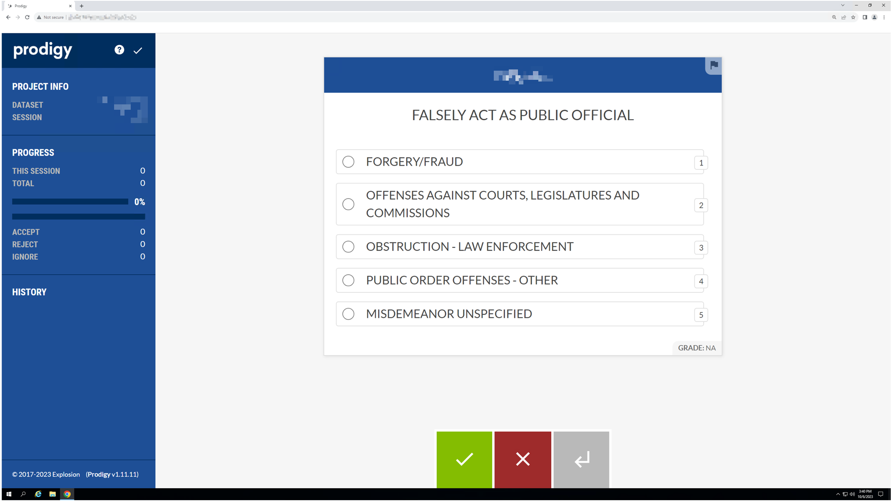
We Operationalized this Process using Prodigy
Prodigy is a tool that provides an easy-to-use GUI for labelers to easily code data.
We provide our top-5 predictions to enhance coding efficiency
Prodigy integrates easily into our downstream modeling and analyses

Slide 20
Impact

Slide 21



Impact
Our solution allows teams to easily work with our model to create standardized analyses and reporting across jurisdictions
Saves Time for Coders & Researchers
Improves Reporting
Easily Expandable to More Agencies

Slide 22
Next Steps

Slide 23



Next Steps
Deployment & Further Testing on BJS Infrastructure
Continued Use for NPRP Coding in Newly Ingested Datasets
Further Research & Analysis on Newly Coded Datasets

Slide 24
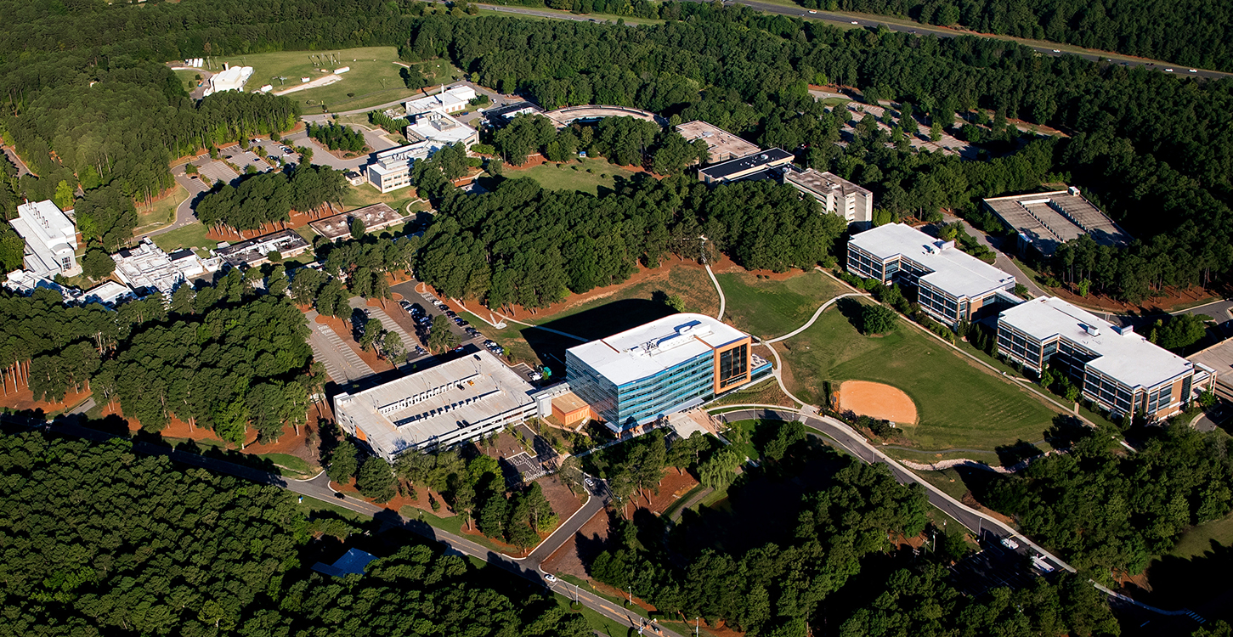
Thank you!
Contact:
Anthony Berghammer | email: aberghammer@rti.org
Peter Baumgartner | email: pbaumgartner@rti.org

