Slide 1
Leveraging LLMs and Semantic Search to Enhance the Industry and Occupation Autocoding Process in the American Community Survey
2025 FedCASIC
Collaborators: Jackson Chen (Presenter), Nicole Cabrera, Jiahui Xu, Yezzi Angi Lee, Lynda Laughlin, Ana J. Montalvo, and Julia Beckhusen
United States Census Bureau
April 22, 2025
Disclaimer: The presentation is released to inform interested parties of ongoing research and to encourage discussion. Any views expressed are those of the authors and not those of the U.S. Census Bureau. The Census Bureau has reviewed this data to ensure appropriate access, use, and disclosure avoidance protection of the confidential source data used to produce this product (Data Management System (DMS) number: P-7535299, Disclosure Review Board (DRB) approval number: CBDRB-FY25-POP001-0065).
Notes:
Disclosure Review Board (DRB) approval number: CBDRB-FY25-POP001-0065).

Slide 2
Agenda
Introduction
1.1 American Community Survey
1.2 Industry and Occupation (I&O) Autocoding
Improvements to Autocoding
2.1 Utilizing Large Language Models
2.2 Implementing Semantic Search
2.3 Optimizing Through Fine-Tuning
2.4 Evaluating Model Performance
Autocoder Quality Control
3.1 Challenges in Autocoding
3.2 Measuring the Quality of the Autocoder
3.3 Metrics we Analyze
3.4 How Quality Check Improves the Autocoder
Conclusion
4.1 Future Work
Notes:
I will cover the agenda for today’s presentation. First, I will introduce the American Community Survey as well as an overview of the existing Industry and Occupation Autocoding Process. Next, I will discuss new preprocessing techniques that we implemented to improve the data quality of the write-ins before moving on to the autocoding process. These techniques involve managing NA values, string matching, lemmatization, and removing stop words. Then, I will talk about the new improvements to the autocoding process, where we used Retrieval Augmented Generation (RAG), which involved using large language models, semantic search, and fine-tuning. I will compare the results from these new techniques to the results of the old process. Lastly, I will touch on our plans for future work, and I will answer any questions.

Slide 3
1. Introduction

Slide 4
1.1 American Community Survey
Introduction
The American Community Survey (ACS) is a continuous, nationwide survey conducted by the U.S. Census Bureau, collecting detailed demographic, social, economic, and housing data from U.S. households monthly.
This research focuses on the two open-ended industry questions and the two open-ended occupation questions in the ACS.
Problem Statement
How can the industry and occupation descriptions from the ACS be more accurately and efficiently autocoded with the official Census codes, further reducing manual effort and advancing the existing autocoding process?
Industry Questions
What is the name of your employer, business, agency, or branch of the Armed Forces?
Example Response: United States Census Bureau
What kind of business or industry is this?
Example Response: Statistical Federal Agency
Occupation Questions
What is your main occupation?
Example Response: Data Scientist
Describe the most important activities or duties of your occupation.
Example Response: Building Machine Learning Models
Notes:
The American Community Survey (ACS) is a continuous, nationwide survey conducted by the U.S. Census Bureau, collecting detailed demographic, social, economic, and housing data from U.S. households monthly. This research focuses on the two open-ended industry questions and the two open-ended occupation questions in the ACS. The two industry questions are as follows: "What is the name of your employer, business, agency, or branch of the Armed Forces?" with an example response being "United States Census Bureau." The second question is "What kind of business or industry is this?" with an example response being "federal agency." The two occupation questions are as follows: "What is your main occupation?" with an example response being "Data Scientist," and the second question is "Describe the most important activities or duties of your occupation," with an example response being "building machine learning models." The problem statement of this work is the following: How can the industry and occupation descriptions from the ACS be more accurately and efficiently autocoded with the official Census codes, further reducing manual effort and advancing the existing autocoding process? I will discuss solutions to this problem in the following slides.

Slide 5
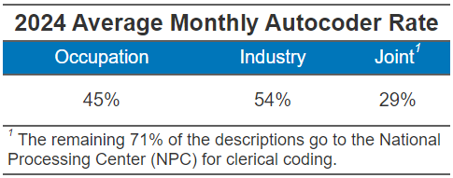
1.2 Industry and Occupation (I&O) Autocoding
Current Process
The existing autocoding process uses two supervised machine learning models that incorporate logistic regression, n-gram frequencies, and various demographic explanatory variables.
The autocoder also incorporates data dictionaries that shows the relationship between certain words to specific occupation and industry codes.
The industry model assigns the most appropriate of the 271 Census industry codes, while the occupation model assigns the most appropriate of the 570 Census occupation codes to the responses.
Both machine learning models have a predicted probability cutoff of 88%.
Notes:
The existing autocoding process uses two supervised machine learning models that incorporate logistic regression, n-gram frequencies, and various demographic explanatory variables. The industry model assigns the most appropriate of the 271 Census industry codes, while the occupation model assigns the most appropriate of the 570 Census occupation codes to the responses. Both machine learning models have a predicted probability cutoff of 88%. In Table 1 on the slide, the average monthly autocoding rate is displayed. The joint autocoding rate is 29%, and the remaining 71% of the descriptions go to the National Processing Center for manual coding. Our main goal with this work is to improve the joint autocoding rate, reduce the workload for the NPC, and allow them to spend more time manually coding the most difficult cases.
DATA dictionaries are snap shot of coded data; meaning they were made once from a snap shot of coded data
-Average coding rate of 2024 response data

Slide 6
2. Improvements to Autocoding

Slide 7
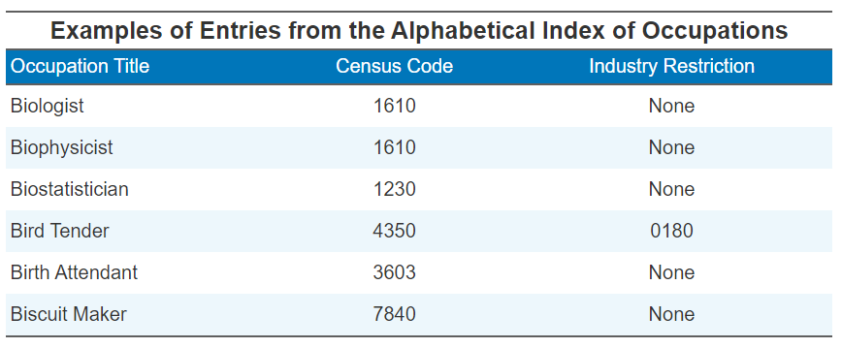
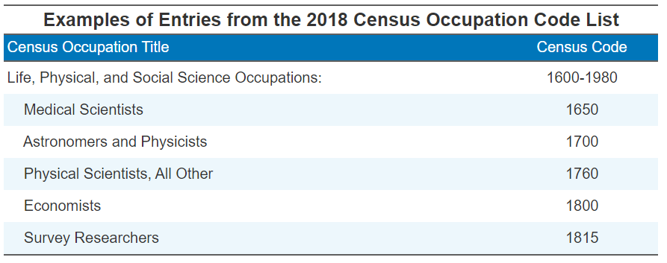
2.1 Utilizing Large Language Models
Understanding Responses
Large language models (LLMs) represent sentences as vectors, capturing semantic information that helps them understand the meaning of sentences.
Consequently, census codes can be assigned without relying on historical data to train a machine learning model.
With numerous models available, optimization is focused on both size and performance to maximize efficiency.
Retrieving Data
The large language model "gte-large" was selected and augmented with the Census's Alphabetical Indexes, referenced in Table III, and the Census’s Occupation Code List, referenced in Table IV, to ensure that only relevant codes and titles are retrieved.
Notes:
We used Retrieval Augmented Generation to improve the existing autocoding process described earlier. With RAG, instead of using term frequencies to convert the text into a numerical form, large language models (LLMs) were utilized to vectorize the responses using sentence embeddings, capturing semantic information that helps in understanding the meaning of sentences. Through this process, Census codes can be assigned without relying on historical data to train a machine learning model. With numerous LLMs available, optimization focuses on both size and performance to maximize efficiency in choosing the best LLM for our autocoding task. The large language model "gte-large" was selected and augmented with the Census's Alphabetical Indexes, referenced in Table III, and the Census’s Occupation Code List, referenced in Table IV, to ensure that only relevant codes and titles are retrieved. Tables 3 and 4 display examples of the data used in the modeling process to build the knowledge base of the RAG process.

Slide 8
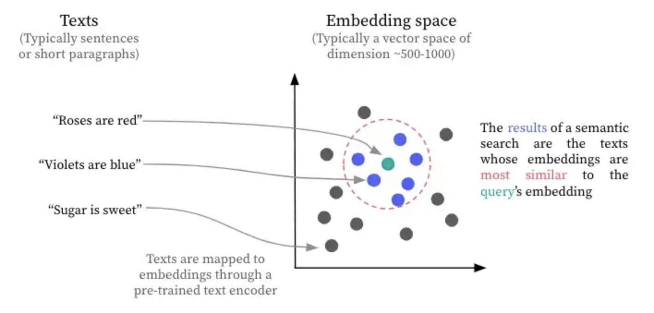
2.2 Implementing Semantic Search
Functionality
Semantic Search utilizes vectors to capture the meaning of a sentence, using a large language model to generate vector embeddings.
Cosine similarity is applied to compare different vector embeddings, calculating similarity and providing a similarity score. Results are then ranked by this score.
While cosine similarity helps us find similar terms for a query, there are cases where there are multiple codes for an occupation title.
Vector embeddings are stored in a vector database for efficient retrieval, reducing the time needed to generate embeddings.
Example of Semantic Search
“Firefighter”
“Fireman”
“Firewood Cutter”
Notes:
I will now explain semantic search and how it was implemented in our new autocoding process. Semantic search utilizes vectors to capture the meaning of a sentence, using a large language model to generate vectorized sentence embeddings. Cosine similarity is applied to compare different vector embeddings, calculating similarity and providing a similarity score. Results are then ranked by this score. Lastly, these vector embeddings are stored in a vector database for efficient retrieval, reducing the time needed to generate embeddings. Figure 4 shows an example of semantic search, where we see “firefighter” and “firewood” in close proximity as expected, while “firewood cutter,” which differs in its semantic meaning from the other two phrases, indicates why it is further away in the two-dimensional plane.

Slide 9






2.3 Optimizing Through Fine-Tuning
Improving Performance
Although large language models are powerful, performance can still be improved by fine-tuning the chosen model to better understand the occupation and industry domain.
Fine-tuning involves changing the weights in the chosen model to adapt to the provided data.
The model was fine-tuned using the Census’s Alphabetical Indexes of Industries and Occupations, and this technique provided the most significant improvement in performance compared to any other techniques tested.
LLM Autocoding Process
Industry and Occupation Data
Fine-Tuned Large Language Model (Industry)
Semantic Search
Assign Industry Code
Pre-Trained Large Language Model
Supervised Fine-Tuning
Fine-Tuned Large Language Model (Occupation)
Semantic Search
Assign Occupation Code
Notes:
Although large language models are powerful, their performance can still be improved by fine-tuning the chosen model to better understand the occupation and industry domain. Fine-tuning involves changing the weights in the selected model to adapt to the provided data. The model was fine-tuned using the Census’s Alphabetical Indexes of Industries and Occupations, and this technique provided the most significant improvement in performance compared to any other techniques tested. In Figure 5, the new autocoding process is displayed, where we see, to the far left, the LLM being selected, in our case “gte-large.” Then, the industry and occupation data are supplied, and adjustments to the selected LLM are made through fine-tuning. After that, semantic search takes place, and the appropriate 4-digit Census code is given for the description.

Slide 10
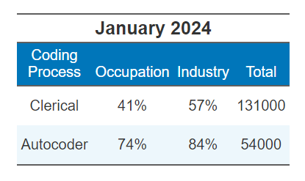
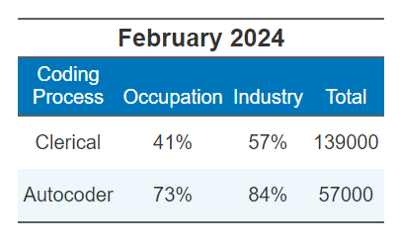
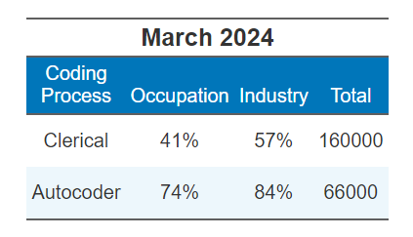
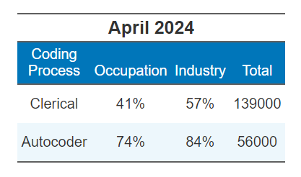
2.4 Evaluating Model Performance
Results
The current ACS process sends roughly 70% of the write-in responses to clerical coders to manually code the responses to the best occupation and industry codes.
We subset the write-in data between clerical and autocoder to give us a direct comparison between the two different coding processes.
With the new autocoding process, our match rate with the clerical coder hovers around 40% for occupation and 57% for industry.
LLM autocoder compared against clerical coding and current autocoder
Notes:
-Add k1 to k5 metrics and

Slide 11
2.4 Evaluating Model Performance
Current Autocoder vs. New Autocoder performance in January to March 2024 monthly data
*n is the total number of responses in those months, rounded to the nearest thousands
Notes:
-Add k1 to k5 metrics and
- N (total number of cases is rounded)

Slide 12
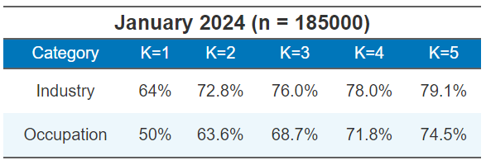
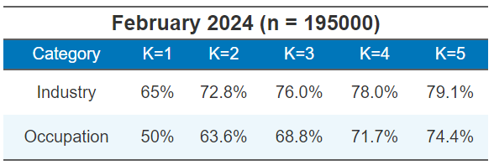
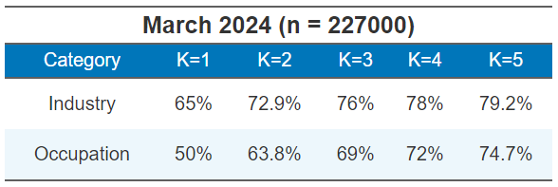
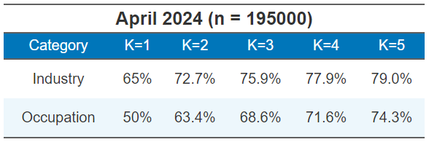
2.4 Evaluating Model Performance
New Autocoder performance on assigning the correct code within the top 5 assignments between January to March 2024, before industry restriction and hardcoding
*n is the total number of responses in those months, rounded to the nearest thousands
Notes:
-This is an area for improvement as we see big jumps k=1 to k=2 and k=5 is where we can reach the highest

Slide 13
3. Quality Check

Slide 14
3.1 Challenges in Autocoding
Challenges
Complex responses can be hard to code as some responses may include misspellings, provide more than one occupation title, or not enough information is given.
Examples: “none of ya business”, “manfacting”, only providing “agent” as job title with no job description.
Challenges in current autocoder
Relies on data dictionaries that are not frequently updated resulting in a lower assignment rate of industry and occupation as write-in responses shift and evolve over time.
With the new autocoder, transitioning to Python ensures long-term sustainability and ease of maintenance for the years ahead.
Notes:
Data dictionary was only updated once after 2012 in 2023

Slide 15
3.2 Measuring the quality of the Autocoder
Need for Quality Check
Job titles and industry descriptions change and the autocoder will have to adapt to them.
Although clerical coders are highly trained, they may still introduce human errors, such as biases in code assignment. Additionally, write-in responses can include mistakes like misspellings or insufficient information.
At different points of where the data is processed, potentially new errors are introduced, and we want to capture those errors as quick as possible in the data lifecycle.
Examples of cases we want to capture
New emerging job titles such as influencer, prompt engineer, and AI Engineer.
Write-in response with the same occupation and/or industry but different codes were assigned to each.
Notes:
Add more to this slide;
-data lifecycle
-npc and open responses are human errors, Biases-ness in the data
-our QC metrics capture error so that it can help analysts
PHAT value represents the probability of the industry code returned
from the dictionary match agreeing with the code assigned by a clerk.

Slide 16

3.3 Metrics we Analyze
Current Autocoder
Matching rate measures how often an assigned code matches the code assigned by clerical coders.
Edit rate measures the proportion of autocoded codes that require NPC review or correction.
Probability score
New Autocoder
Most common false pairs outputs two codes: the best code and the code that was incorrectly assigned.
Individual response matching rate measures how often we assign the correct code to these job titles and industry descriptions
Overall
Matching rate by occupation and industry sectors measures the best rate the autocoder assigns the code but grouped by occupation and industry sectors.
Notes:
-Matching rate measures how often an assigned code matches the code assigned by clerical coders. This metric ensures that our autocoder is performing like the clerical coders.
-Edit rate measures the proportion of autocoded codes that require NPC review or correction. This metric allows us to see if the autocoder isn’t performing as expected and needs to be configured to ensure the correct code is being assigned.
Most common false pairs outputs two codes: the correct code and the code that it gets wrongly coded. These pair shows that there is a pattern of where one code gets wrongly assigned to a specific code and this helps diagnose any potential patterns of misclassification
Overall
Matching rate by occupation and industry sectors measures the rate the autocoder assigns the correct code but grouped by occupation and industry sectors. This helps us identify and underperforming sectors that we need to look at.

Slide 17

3.4 How Quality Check Improves the Autocoder
Continuous Improvement
Identify and analyze any unusual results.
We aim to address errors before they become recurring issues and go unnoticed for an extended period.
Sector Performances
Analyzing different sectors performances informs us of any trend changes with occupation and industry descriptions.
We want to aim for consistent performances each month in each sectors.
Reducing Clerical Load
We want to continuously improve the autocoder to optimize performance and minimize cost associated to clerical coding.
Let clerical focus on more complex write-in responses.
*n is the total number of responses in those months, rounded to the nearest thousands
Notes:
-Helps understand the sectors which one is performing the best and which one is worst
-Check consistency over different sectors
-capture every error in any stage of the area; error is introduced in the data lifecycle and react to the error before it goes public
-add the graph from nicky’s presentation on 70% autocoder vs autocoder
-Also it is expensive with clerical coder
With a quality check in place, the autocoder will get continuous improvements as the QC identifies and exposes any peculiar results.
Different sectors have different match rates.

Slide 18
4. Conclusion

Slide 19
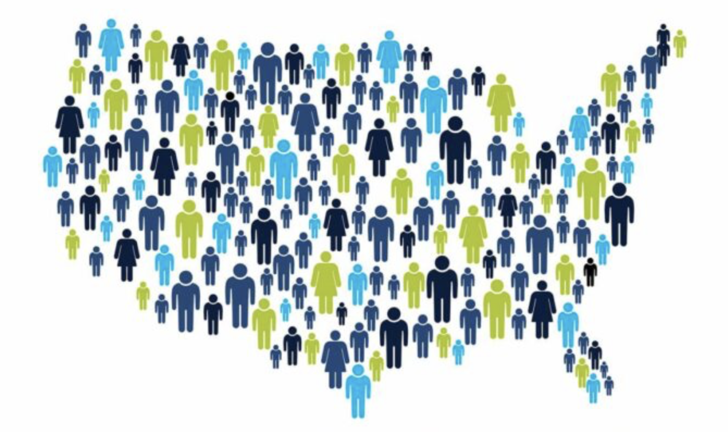
4.1 Future Work
Improvements
Potentially leverage previous data to enhance assignment match rate and identify whether code assignments have been previously encountered.
Additional fine-tuning will be incorporated, as it has proven effective in significantly improving assignment match rate.
Develop additional quality check metrics to give more perspective to how the autocoder is performing.
Identify insufficient information in write-ins and send complex cases to clerical coding.
Create a reward scoring system. Similarity score is hard to interpret.
Exploring more powerful models such as LLaMA.
Notes:
Lastly, I’m going to discuss our plans to further improve upon all the work we have done in order to make the new autocoding process even better. Some of these strategies include leveraging previous data to enhance assignment accuracy and identify whether code assignments have been encountered before. Next, a new quality control process will be established to evaluate the autocoder's performance. Finally, additional fine-tuning will be incorporated, as it has proven effective in significantly improving assignment accuracy; fine-tuning specific to occupation and industry groups will also be explored to further enhance the model.
Reward score is similar to probability score like PHAT. Trying to identify how well each k fits the query.

Slide 20
Questions

Slide 21
Presenter Contact Information
Jackson Chen –
Jackson.chen@revealgc.com
Jackson.chen@census.gov
Notes:
Lastly, I’m going to discuss our plans to further improve upon all the work we have done in order to make the new autocoding process even better. Some of these strategies include leveraging previous data to enhance assignment accuracy and identify whether code assignments have been encountered before. Next, a new quality control process will be established to evaluate the autocoder's performance. Finally, additional fine-tuning will be incorporated, as it has proven effective in significantly improving assignment accuracy; fine-tuning specific to occupation and industry groups will also be explored to further enhance the model.

