Slide 1
Evaluating Impacts of Mischievous Reporting in Customer Satisfaction Survey Results
Andrew Caporaso
Jean E. Fox
Office of Survey Methods Research (OSMR)
Presented at FedCASIC
April 22nd, 2025

Slide 2
Background
Insincere/problematic/mischievous respondents are prevalent in web surveys, negatively impacting data quality
Different attitudes & prevalence rates and across online samples (Kennedy et al, 2020); More extreme reports (Litman et al, 2023)*
We saw many such responses to a Customer Satisfaction survey from visitors to the BLS Occupational Outlook Handbook (OOH)
ID’d through open-ended responses; no other methods available for us to ID cases
No clear motivation to report mischievously
Voluntary survey, no incentives
*Litman L., et al. (2023) Did people really drink bleach to prevent COVID-19? A guide for protecting survey data against problematic respondents. PLoS ONE, 18(7): e0287837. https://doi.org/10.1371/journal.pone.0287837.
Kennedy, C. et al. (2020). Assessing the risks to online polls from bogus respondents. Pew Research Center.

Slide 3
Research Questions
Do respondents who provide mischievous responses to open-ended questions respond differently to other questions than those who provide “valid” responses?
What is the impact of the mischievous responses on the survey results?
What should you do about mischievous respondents?

Slide 4
Research Questions
Do respondents who provide mischievous responses to open-ended questions respond differently to other questions than those who provide “valid” responses? Yes!
What is the impact of the mischievous responses on the survey results? Not substantial in our case!
What should you do about mischievous respondents? Let’s discuss!

Slide 5
The BLS Customer Satisfaction Survey & Data
11 Questions administered using GSA’s Touchpoints tool
Two ways to respond:
Sampled: Random website pop-up (appx. 1% of page visitors)
User-Initiated: Always-on “Help improve this site” button
8,829 responses from OOH visitors 4/4/2024 - 10/25/2024
77% through random pop-up
23% user-initiated

Slide 6
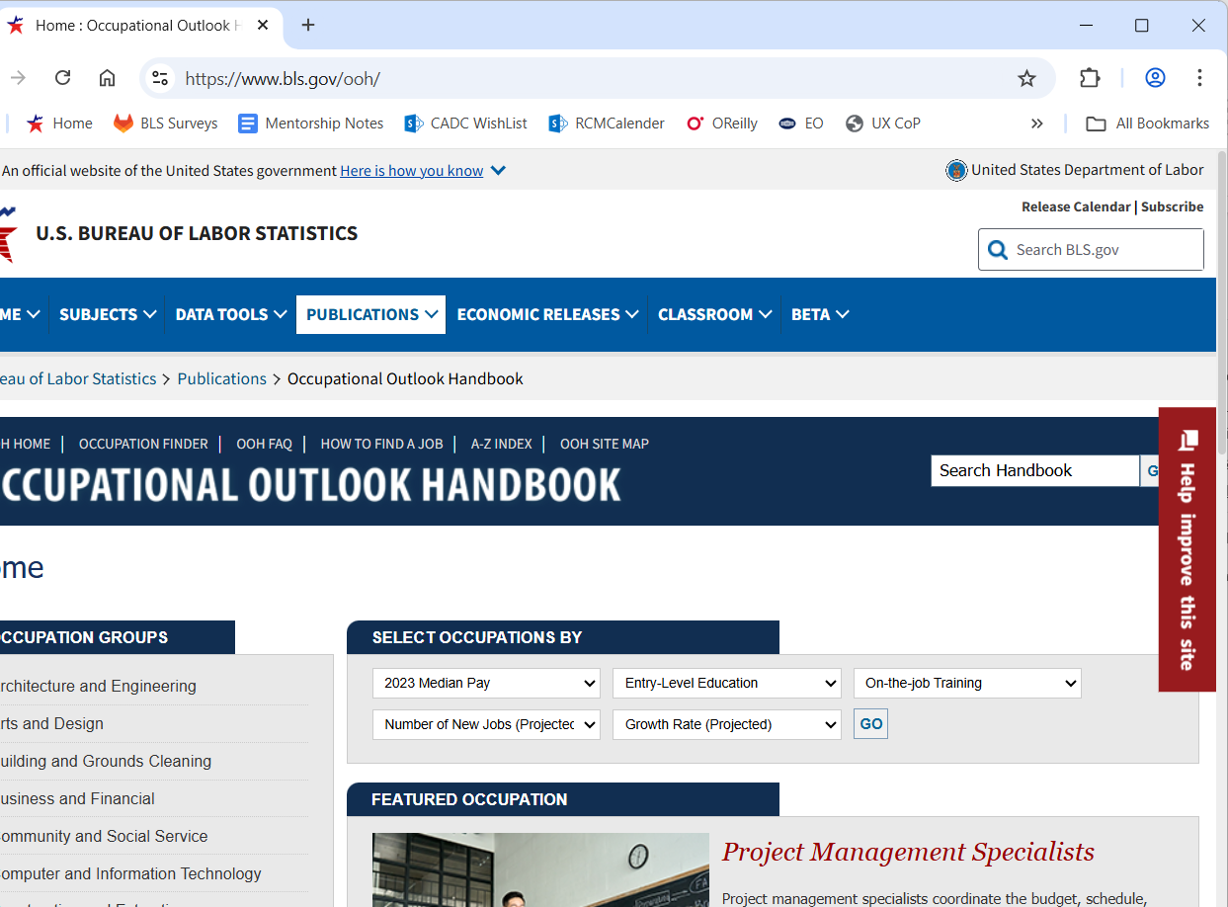
“Help improve this site” button

Slide 7
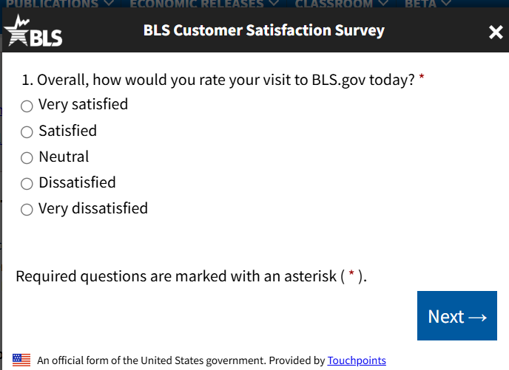
Relevant Survey Questions
Open-ended question (Q11): “Do you have any suggestions for improvements to the BLS.gov website?” [open ended]
5 Attitudinal rating scales
Q1: Overall satisfaction
Q2: Ease of use
Q4: Ease of navigating
Q6: Relevance of search results
Q10: Trust in BLS data
All ratings use a 5-point Likert-type scale, except Q6, which is 4-point unipolar scale

Slide 8
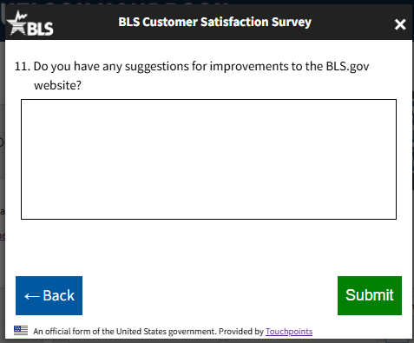
Coding Respondent feedback
Goal: find actual feedback among all non-blank responses to Q11
Each author coded ½ of ~2600 responses
10 categories
6 valid, 4 ‘mischievous’ categories
70% agreement double-coding 200 responses
Weighted kappa prior to reconciliation (ns)
We refined our approach following double coding

Slide 9
Summary of open-ended coding results by sample source: Do you have any suggestions for improvements to the BLS.gov website?
 | Comment Category | Example | Sampled | User-Initiated | Total (N)
Valid | Blank |  | 85% | 15% | 6,158
Valid | “No Comment” / “NA” | Not at this time | 70% | 30% | 841
Valid | Relevant + actionable | Search by pay, highest to lowest | 55% | 45% | 785
Valid | Relevant + positive/neutral, not actionable | Keep up the good work | 63% | 37% | 294
Valid | Relevant + negative, not actionable | Fix the site | 25% | 74% | 87
Valid | Comments about the timing of the survey request | Don't give a customer satisfaction as soon as they go on the site | 95% | 5% | 80
Mischievous | Short random text | Hb. FhSFhfmg | 59% | 41% | 219
Mischievous | Long random text | SDTf grxgnfhmggukhmuv… | 26% | 75% | 96
Mischievous | Irrelevant, benign comments | Chicken sandwich | 37% | 63% | 219
Mischievous | Irrelevant, negative comments | Loser | 30% | 70% | 50
 | TOTAL |  | 77% (6,801) | 23% (2,028) | 100% (8,829)

Slide 10
Summary of open-ended coding results by sample source: Do you have any suggestions for improvements to the BLS.gov website?
 | Comment Category | Example | Sampled | User-Initiated | Total (N)
Valid | Blank |  | 85% | 15% | 6,158
Valid | “No Comment” / “NA” | Not at this time | 70% | 30% | 841
Valid | Relevant + actionable | Search by pay, highest to lowest | 55% | 45% | 785
Valid | Relevant + positive/neutral, not actionable | Keep up the good work | 63% | 37% | 294
Valid | Relevant + negative, not actionable | Fix the site | 25% | 74% | 87
Valid | Comments about the timing of the survey request | Don't give a customer satisfaction as soon as they go on the site | 95% | 5% | 80
Mischievous | Short random text | Hb. FhSFhfmg | 59% | 41% | 219
Mischievous | Long random text | SDTf grxgnfhmggukhmuv… | 26% | 75% | 96
Mischievous | Irrelevant, benign comments | Chicken sandwich | 37% | 63% | 219
Mischievous | Irrelevant, negative comments | Loser | 30% | 70% | 50
 | TOTAL |  | 77% (6,801) | 23% (2,028) | 100% (8,829)
Notes:
First thing to note is the 10 categories we coded, the first 6 are considered valid responses and the bottom 4 are considered mischievous.

Slide 11
Summary of open-ended coding results by sample source: Do you have any suggestions for improvements to the BLS.gov website?
 | Comment Category | Example | Sampled | User-Initiated | Total (N)
Valid | Blank |  | 85% | 15% | 6,158
Valid | “No Comment” / “NA” | Not at this time | 70% | 30% | 841
Valid | Relevant + actionable | Search by pay, highest to lowest | 55% | 45% | 785
Valid | Relevant + positive/neutral, not actionable | Keep up the good work | 63% | 37% | 294
Valid | Relevant + negative, not actionable | Fix the site | 25% | 74% | 87
Valid | Comments about the timing of the survey request | Don't give a customer satisfaction as soon as they go on the site | 95% | 5% | 80
Mischievous | Short random text | Hb. FhSFhfmg | 59% | 41% | 219
Mischievous | Long random text | SDTf grxgnfhmggukhmuv… | 26% | 75% | 96
Mischievous | Irrelevant, benign comments | Chicken sandwich | 37% | 63% | 219
Mischievous | Irrelevant, negative comments | Loser | 30% | 70% | 50
 | TOTAL |  | 77% (6,801) | 23% (2,028) | 100% (8,829)
Notes:
On the right are the proportion of each type of comment that came from each sample source.
You can see at the bottom that overall, 77% of responses come from the sampled group and 23% of responses came from the user-initiated group. If the 2 groups were the same, we’d expect all the rows to reflect this distribution. However, this is not the case.
The user-initiated group was over-represented in the three categories constituting relevant feedback as well as the mischievous categories. They were even more likely to write ‘no comment’ than leave the item blank.
The one exception is that the sampled group was much more likely to complain about the survey being offered too early. Not surprising!
Two other things to note—most of the respondents left this question blank (6,158), and 785 of the comments were relevant and actionable – the kind of comments that are most useful.

Slide 12
Percent of Responses to Q11 that are Valid / Mischievous
Notes:
Here are the overall proportions of mischievous response by sample group. About 17% of the user-imitated group was flagged as mischievous based on their open-ended response compared with just under 4% in the sampled group.
The difference is very significant and suggests mischievous respondents are exploring the opt-in button we showed a few slides ago.
For the rest of the presentation, we will combine these groups
The overall rate of mischievous responses is 6.6%

Slide 13
Research Question 1
Do respondents who provide mischievous responses to Q11 respond differently to other questions than those who provide “valid” responses?

Slide 14
Satisfaction Ratings by comment category
Valid Responses
Mischievous Responses
Notes:
Here are the distributions of the overall satisfaction rating by the quality of their open-ended response. The distributions vary significantly by comment category and the same is true for the other 4 attitudinal items we reviewed.
A few interesting observations:
-good to see that negative feedback correspondents with lower satisfaction scores, and positive feedback with positive scores
-blank and no comment are similar distributions
-people who felt the survey came early are most often selecting neutral

Slide 15
Satisfaction Ratings by comment category
Valid Responses
Mischievous Responses
Notes:
-

Slide 16
Satisfaction Ratings by comment category
Valid Responses
Mischievous Responses
Notes:
We also see that the mischievous reporters’ distributions look different from the valid ones; these groups were more likely to choose the most negative option, particularly if they said something negative.

Slide 17
Ease of Use and Ease of Navigation Response Distributions
Valid Responses
Mischievous Responses
Valid Responses
Mischievous Responses
Notes:
The patterns are similar with the other questions

Slide 18
Relevance of Search Results and Trust in BLS ratings
Valid Responses
Mischievous Responses
Valid Responses
Mischievous Responses

Slide 19
Average Ratings by Validity of Q11 Response
Notes:
Here are the differences in overall means for each of the attitudinal items by “mischievous status.” As you can see, the people providing mischievous responses have substantially and significantly lower means than non-flagged respondents.

Slide 20
Reporting patterns in scale-based questions
Mischievous respondents more likely to choose extreme negative responses on scales (p < .001); less likely to choose extreme positive (p < .001)
No differences in frequency of
mid-point reporting or
straight-lining
Notes:
We also looked for evidence of problematic reporting patterns like extreme reporting, mid-point reporting and straight-line. Of these, just extreme reporting varied significantly by mischief status.
Mischievous respondents were significantly more likely to use the extreme negative response option on the attitudinal scales. Conversely, non-mischievous were significantly more likely to use the extreme positive response.

Slide 21
Research Question 2
What is the impact of the mischievous responses on the survey results?

Slide 22
Impact of Mischievous Responders on Mean Attitudinal Ratings

Slide 23
Q1 distribution by Quality of Q11 response
Because there were so many more valid responses, the impact of the mischievous responses was minimal

Slide 24
Research Question 3
What should we do about mischievous respondents?

Slide 25
What to do with Mischievous Respondents
Consider sample source, methods and topic
Do these invite mischievous respondents?
Find & quantify them
Proportion of problematic responses likely to vary with survey characteristics
Use multiple detection methods when possible: open-ended responses were very helpful but time consuming to review.
Consider research objectives:
Cross-sectional/point estimate?
Longitudinal/surveillance?
Qualitative analysis?

Slide 26
What Did We do?
We kept mischievous respondents in our estimates
Noted that mean ratings are marginally higher without them
Open-ended responses naturally eliminated from review of their qualitative feedback/suggestions
We considered:
Purpose of the survey: summarize open-ended feedback from users in advance of updating the website
Effort required to classify the responses: substantial to distinguish feedback that looked good (not gibberish)
Impact of the mischievous respondents: limited!
Notes:
The goal here was to accumulate useful feedback for the project team to consider, not precisely measure the population.
For population estimates, the decision to drop people for bad responses is more substantial.

Slide 27
Final Thoughts
For our customer satisfaction survey, the mischievous respondents showed a different pattern of responding from “valid” responders, but the overall impact was negligible
It takes a lot of effort to identify mischievous respondents
LLM, advances in AI will make it possible to more accurately classify responses

Slide 28
Thank You
Andrew Caporaso
Caporaso.Andrew@bls.gov
Jean Fox
Fox.Jean@bls.gov

