Slide 1


Use of MTurk samples in the development and validation of U.S. Census personnel selection tool
Jack "Peter" Leeds, PhD., Human Resource Specialist
Troy Brightson, PhD., Assistant Division Chief, HCSA
Kyana Beckles, M.P.S., Human Resource Specialist

Slide 2




Human Resource Division

Slide 3
Agenda
Purpose and Rationale
Our Relevant Concerns
Hypothesis
Methods (Multi-Stage Design)
Results and Findings
Novel Features of this Research
Questions

Slide 4
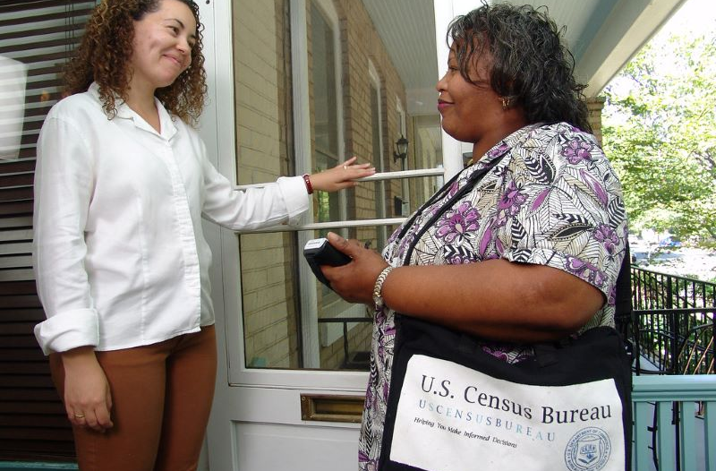

Purpose and Rationale
Occupational Questionnaires
Notes:
Census use occupational questionnaires as part of the selection process to select Decennial census taker (enumerator) supervisors including Census Field Supervisor (CFS) and Office Operations Supervisor (OOS)
Work Experience
Total Years of Work Experience: _________________________
List your previous jobs, starting with the most recent:
Job Title: _________________________
Employer: _________________________
Start Date: _________________________
End Date: _________________________
Briefly describe your responsibilities and accomplishments: _________________________________________________
Skills and Abilities: Please rate your proficiency in the following areas using the scale:
1 - No experience
2 - Limited experience
3 - Some experience
4 - Proficient
5 - ExpertWork Experience
Total Years of Work Experience: _________________________
List your previous jobs, starting with the most recent:
Job Title: _________________________
Employer: _________________________
Start Date: _________________________
End Date: _________________________
Briefly describe your responsibilities and accomplishments: _________________________________________________
Skills and Abilities: Please rate your proficiency in the following areas using the scale:
1 - No experience
2 - Limited experience
3 - Some experience
4 - Proficient
5 - Expert

Slide 5
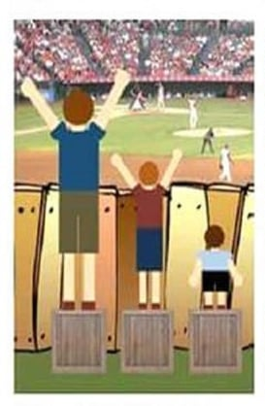
"Adverse Impact" in Selection Testing occurs when ethnic groups have Substantially Different passing rates
Definition
Notes:
Prior supervisor selection questionnaire showed adverse impact against protected classes
Census internal research found that some items disproportionately disadvantaged racial and ethnic minorities.
Questions about prior supervisory experience favored majority group members.
How many months’/years’ experience total do you have as a supervisor with 1 or more employees reporting to you?
A. No supervisory experience
B. Less than 6 months
C. 6 months to 1 year
D. More than 1 year but less than 2 years
E. 2 years or more
Marginalized candidates with leadership potential were under-selected.
Result: Systemic bias in supervisor selection outcomes.
Led to need to redesign the questions for fairness while preserving validity

Slide 6
Our Concerns
Fairness and Bias in Assessments
Uniform Guidelines on Employee Selection Procedures (1978) emphasize avoiding adverse impact [3]
Differential Item Functioning and Prediction analyses identify biased items (Camilli & Shepard, 1994) [4]
Behavioral Consistency and Occupational Questionnaires
Past behaviors often predict future workplace outcomes (Schmidt & Hunter, 1998) [7]
Biodata instruments can yield valid supervisory predictions (McDaniel, Schmidt, & Hunter, 1988) [8]
Fairness and Consistency
Notes:
HRD – WTO approached this effort to redesign the assessment with and eye toward…….
MTurk as a Research Platform
Efficient, diverse data pool for pilot testing large-scale instruments (Paolacci, Chandler, & Ipeirotis, 2019) [5]
Known challenges around response validity require consistency checks (Chmielewski & Kucker, 2019) [6]

Slide 7
Hypotheses
Hi
New Items
Less Bias
H2
New Items
Positive Correlation (Sig)
H3
Updated Scale
Legally Defensible
H4
Updated Scale
Mod-Sig Correlations
Notes:
H1: Selected items from among the 100 newly developed leadership measurement items will show low bias across the 11 protected classes we studied including 1) American Indian/Alaskan Native, 2) Asian, 3) Black or African American, 4) Hispanic, 5) LGBTQ, 6) Disabilities, 7) Religious Minority, 8) Rural, 9) Poverty, 10) 40+ years of age, and 11) Female.
H2: Items will have positive and significant correlations to self-reported supervisory experience/quality).
H3: Scales will show defensible measurement invariance testing across protected groups
H4: Scales (composed of sets of items) will show significant and at least moderate correlations to self-reported supervisory experience/quality). This documents the criterion-related validity.

Slide 8
MTurk Multistage Design Method
Stage 1
Screening Survey
Collect data on Race, age, supervisor status
Stage 2
Oversample minority groups
Administer Survey Items
Stage 3
Analyze the Data
Create Invite List
Notes:
Multi-Stage Panel Design using Qualtrics
Mechanical Turk (Mturk) workers solicited in two phases – What is Mturk?
Screening Survey administered between July 24, 2024 and August 30, 2024 (N = 10,781)
Collected demographic data (race, ethnicity, age, supervisor status)
Paid nominal fee for participation
Occupational Questionnaire administered between August 14th, 2024 and September 15th of 2024 (N = 2,199 usable)
Targeted Invites - Oversampled smaller protected groups (e.g., American Indian/Alaskan Native) to ensure analytic power
100 experimental items + repeated demographics + self-reported supervisory experience/quality

Slide 9
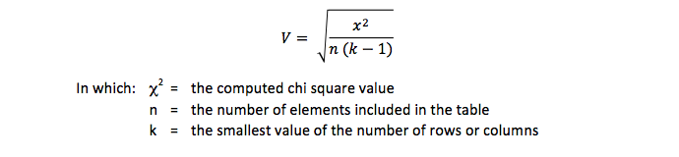
Psychometric Techniques
Differential Item Functioning (DIF)
Chi-square approach examining item response frequencies by protected groups
Effect size via Cramer’s V

Slide 10
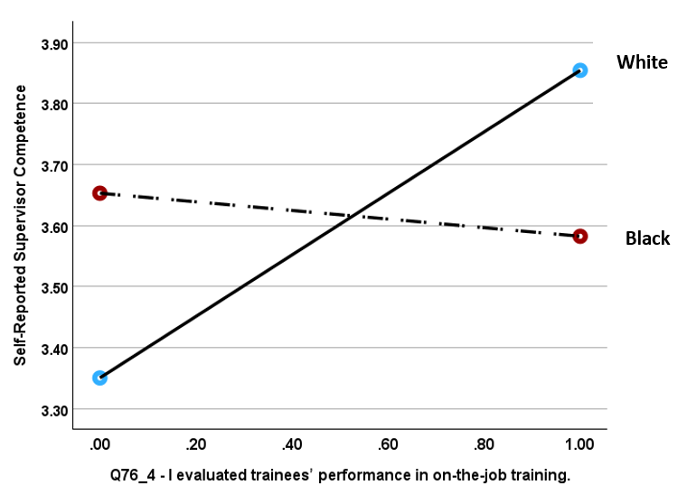
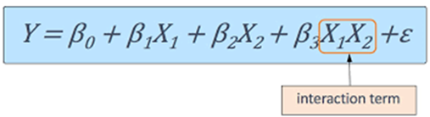
Psychometric Techniques
Notes:
DIP (Differential Item Prediction)
Cleary method: Regress supervisory performance on item scores, group membership and the item X group membership interaction term
Tested all group-by-item interactions

Slide 11

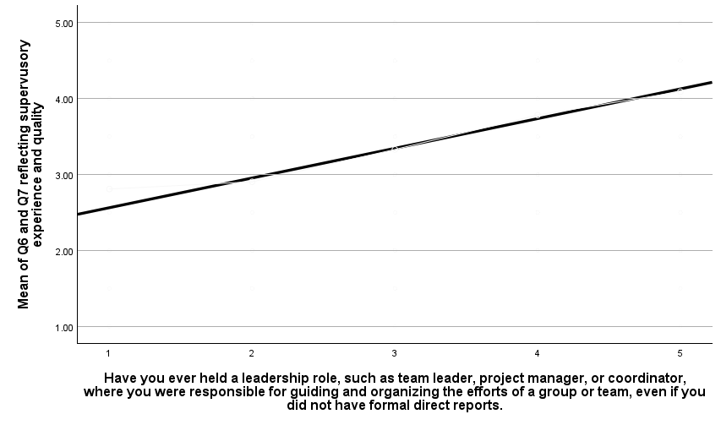
Methods - Psychometric Techniques (3)
Item Criterion-Related validity - How well does the item correlate to self-reported supervisor performance
Question 8 Have you ever held a leadership role, such as team leader, project manager, or coordinator, where you were responsible for guiding and organizing the efforts of a group or team, even if you did not have formal direct reports.
Self-Reported Performance
Very far above average, 2 or more years of supervisory experience
r = .55
1 2 3 4 5
Below average performance, no supervisory experience
1 2 3 4 5
Not at all Limited Moderate Extensive Comprehensive
Response Options

Slide 12
Results & Findings
We evaluated items based on DIF, DIP, Supervisor Advantage, and item validity for each of the 11 protected classes.
Of the 100 experimental items tested, 14 survived the above criteria evidencing low protected group bias and significant (p < .05) positive correlations to performance with r = .321, r = .113 (H1, H2)
The 14 selected items were subjected to factor analysis producing three cohesive internally consistent scales (sets of items).
Of these three scales only the Biographical Scale (with 5 items measuring innovative problem-solving, working ethic, and group leadership) showed good measurement invariance across the protected classes (H3).
The Biographical Scale showed strong relations to self-reported job performance (H4).

Slide 13
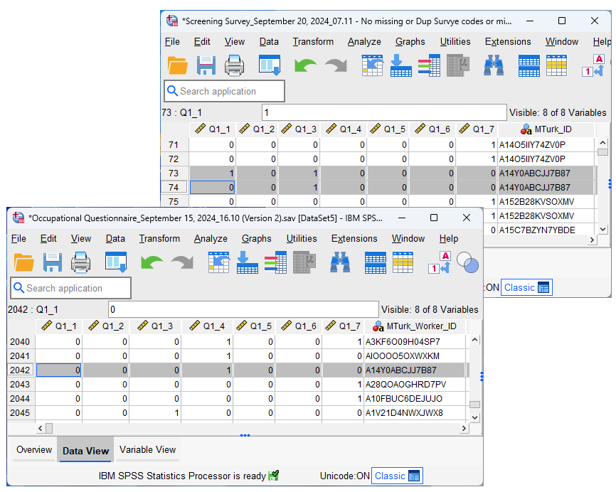
"Do you identify with any of the following groups that the federal government, in Executive Order 13985, has identified as underserved?"
Time 1
Screening Survey
Results and Findings
1 2 3 4 5 6 7
Time 2
Occupational Survey
​​American Indian or Alaska Native
Asian
Black or African American
Hispanic or Latino
Middle Eastern or North African
Native Hawaiian or Pacific Islander
White
1 2 3 4 5 6 7
Notes:
Results of self-reported demographic consistency from time one to time two.
Respondents were very inconsistent in reporting their demographic characteristic between time 1 (Screening Survey) and Time two (Occupational Questionnaire Survey) with the typical time difference between 15 and 30 days.

Slide 14
"Do you identify with any of the following groups that the federal government, in Executive Order 13985, has identified as underserved?"
 | Among those who elected one membership category on the Screening Survey
 | No Group Consistency Filters |  | With Group Consistency Filter |  | % Loss due to inconsistency
 |  | % of Total |  | % of Total
Category: Race/Ethnicity
American Indian or Alaska Native | 213 | 10.63% | 163 | 14.00% | 23.47%
Asian | 486 | 24.25% | 360 | 30.93% | 25.93%
Black or African American | 321 | 16.02% | 241 | 20.70% | 24.92%
Hispanic or Latino | 100 | 4.99% | 73 | 6.27% | 27.00%
Middle Eastern or North African | 5 | 0.25% | 1 | 0.09% | 80.00%
Native Hawaiian or Pacific Islander | 2 | 0.10% | - | 0.00% | 100.00%
White | 877 | 43.76% | 326 | 28.01% | 62.83%
Category: Gender
Female | 715 | 32.72% | 508 | 30.33% | 28.95%
Male | 1,462 | 66.91% | 1,167 | 69.67% | 20.18%
Transgender, non-binary, or another | 7 | 0.32% | - | 0.00% | 100.00%
Prefer not to answer | 1 | 0.05% | - | 0.00% | 100.00%
Category: Age
Over 40 | 1,636 | 74.87% | 1,329 | 79.72% | 18.77%
Not Over 40 | 549 | 25.13% | 338 | 20.28% | 38.43%
Category: Supervision*
Supervisor | 1,998 | 91.44% | 362 | 74.18% | 81.88%
Not a Supervisor | 187 | 8.56% | 126 | 25.82% | 32.62%
Results and Findings
Note: Any change in response from Time 1 to Time 2 was recorded as an inconsistency including non-responses.
*"Do you now or have you ever held the position of a supervisor with 1 or more employees reporting to you?"
Notes:
Results of self-reported demographic consistency from time one to time two.
Respondents were very inconsistent in reporting their demographic characteristic between time 1 (Screening Survey) and Time two (Occupational Questionnaire Survey) with the typical time difference between 15 and 30 days.

Slide 15
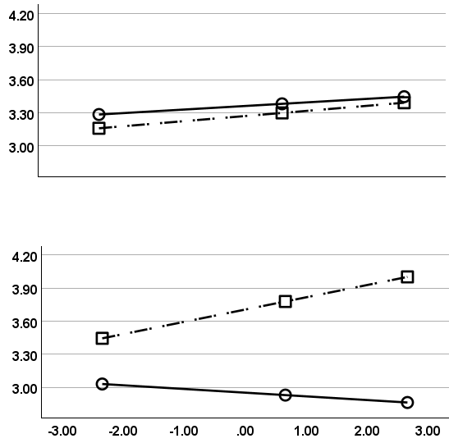
Consistent
Moderated regression of self-reported appraisal ratings on biographical scores with supervisor status consistency and supervisor performance consistency as moderators
Inconsistent
Results and Findings
Consistent Performance Rating Time 1 to Time 2
Inconsistent Performance Rating Time 1 to Time 2
Self-Report Performance Appraisal Rating
Inconsistent Identification as a Supervisor (Time 1 to Time 2)
Self-Report Performance Appraisal Rating
Consistent Identification as a Supervisor (Time 1 to Time 2)
Standardized Biographical Score
Notes:
Results show that self-reported supervisor status consistency and supervisor performance consistency moderated the relation between Biographical Questionnaire scores and self reported supervisor performance ratings.
Criterion related validity was strongest when respondents were consistent across both self disclosures.

Slide 16
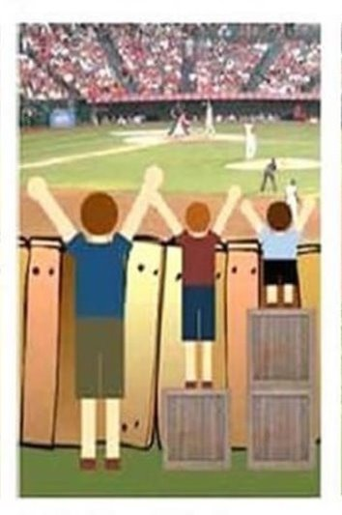
Self Report
Biographical Scores
Supervisor Performance
Ratings
Consistency
Self Disclosure
Results and Findings

Slide 17
Questions?

Slide 18
Paperwork Reduction Act of 1995, 44 U.S.C. §§ 3501-3521.
U.S. Equal Employment Opportunity Commission. (2007). Employment Tests and Selection Procedures. Washington, D.C.: EEOC.
Equal Employment Opportunity Commission. (1978). Uniform Guidelines on Employee Selection Procedures. Federal Register, 43(166).
Camilli, G., & Shepard, L. A. (1994). Methods for Identifying Biased Test Items. Thousand Oaks, CA: SAGE.
Paolacci, G., Chandler, J., & Ipeirotis, P. G. (2019). Running experiments on Amazon Mechanical Turk. Judgment and Decision Making, 5(5), 411–419.
Chmielewski, M., & Kucker, S. C. (2019). An MTurk Crisis? Translational Issues in Psychological Science, 5(1), 44–47.
Schmidt, F. L., & Hunter, J. E. (1998). The validity and utility of selection methods in personnel psychology. Psychological Bulletin, 124(2), 262–274.
McDaniel, M. A., Schmidt, F. L., & Hunter, J. E. (1988). Job experience correlates of job performance. Journal of Applied Psychology, 73(2), 327–330.
References

