Slide 1

Dr. Strangesample Or: How I Learned to Stop Worrying And Love Alias Email Addresses
Alfred “Dave” Tuttle and Casey Eggleston
U.S. Census Bureau
Federal Computer Assisted Survey Information Collection (FedCASIC) Workshop
April 22, 2025
Any views expressed are those of the authors and not those of the U.S. Census Bureau.
CBDRB-FY25-CBSM004-003

Slide 2




What is an alias email address?
Email users can hide or change their addresses.
Responses to alias addresses are forwarded to the users.
Reasons:
Protecting privacy
Improving inbox organization
Filtering spam emails
Etc.
Focus on two types:
Masked addresses
Modified addresses
me@
email.com

Slide 3
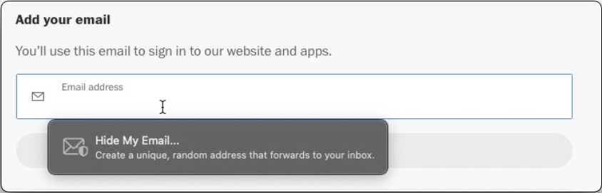
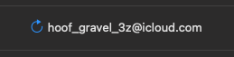
Masked address
iCloud can automatically create new addresses (Hide My Email)
Combinations of random words and characters
Keeps the real email address private.

Slide 4
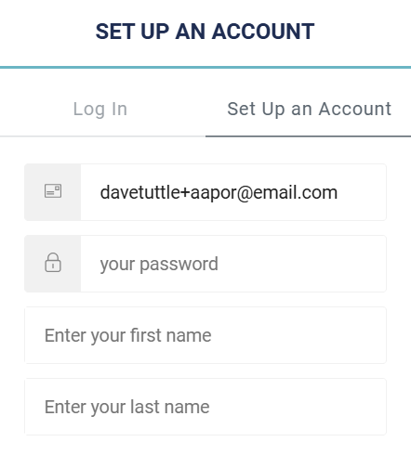
Modified address
Gmail and other services allow users to modify their existing addresses on the fly.
Add “+” and other text
Makes it easier to find emails from specific senders.

Slide 5
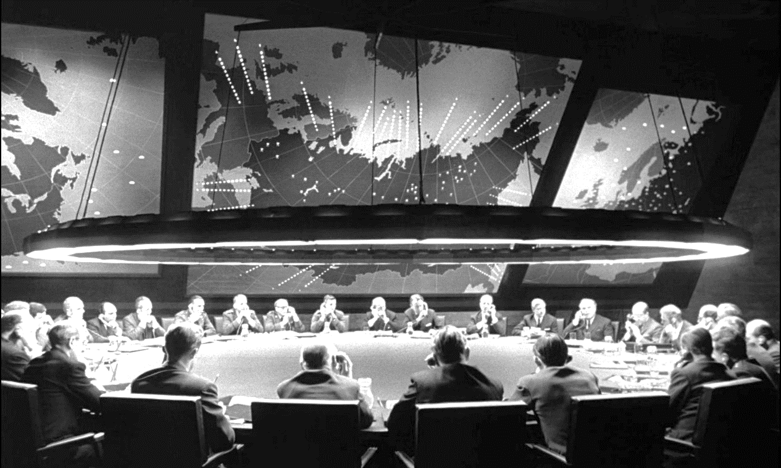
For your consideration
Should we care about alias email addresses?
What did we do?
Compared responses from alias and non-alias email addresses from two surveys
What did we learn?
Potential differences in response behaviors and demographic characteristics

Slide 6
The current study
Household Pulse Survey (HPS)
Web-based monthly household survey, n = 50K – 60K per cycle
Recruiting question: Participate in future surveys?
Census Bureau Research Panel
Voluntary panel used for methodological research
Panel members were recruited from HPS in July-Sept. 2024
Research Panel Survey (RPS) – December 2024
A/B question testing
Using time-on-page paradata to assess burden of alternative question sequences
Use of digital payments and preferences for incentive payment formats
Etc.

Slide 7

Motivation
We noticed alias addresses among our RPS respondents!
Are respondents who provided alias email addresses different from those who did not?

Slide 8

Methods
Identified RPS respondents with two types of alias addresses:
Masked addresses (iCloud)
Modified addresses (Gmail and others)
Compared alias and non-alias respondents in HPS and RPS survey
Unit and item-level response rates
Email delivery outcomes
Demographic characteristics

Slide 9
Limitations
RPS is a voluntary survey
Small numbers of self-selected, motivated respondents
Probably did not identify all alias emails
Descriptive statistics only
Also note:
Rounding rules

Slide 10
Response differences

Slide 11
RPS response rates and progress*
 |  | Complete** and partial responses |  | Average progress***
 | N | n | % | %
Masked addresses | 100 | 20 | 21.2% | 82.1%
Modified addresses | 70 | 30 | 42.4% | 97.0%
Non-alias addresses | 29,500 | 9,950 | 33.6% | 92.6%
Total | 29,700 | 10,000 | 33.6% | 92.6%
*Data are rounded. **Reached HH income question at end of survey. ***Progress through survey as defined by Qualtrics.
CBDRB-FY25-CBSM004-003

Slide 12
RPS item nonresponse and breakoffs
 |  | Item NR (HH income) |  | Breakoffs
 | n | # | % | # | %
Masked addresses | 20 | 0 | n/a | <15 | 25.0%
Modified addresses | 30 | 0 | n/a | <15 | 3.6%
Non-alias addresses | 9,950 | 100 | 1.0% | 1,100 | 11.3%
CBDRB-FY25-CBSM004-003

Slide 13
RPS invitation email delivery failures
 |  | Failures and bounce backs
 | N | n | %
Masked addresses | 100 | <15 | 0.9%
Modified addresses | 70 | <15 | 1.5%
Non-alias | 29,500 | 550 | 1.8%
CBDRB-FY25-CBSM004-003

Slide 14
Demographic differences

Slide 15
Mean age by alias status in HPS and RPS
 | Household Pulse Survey |  |  | Research Panel Survey
 | n | Mean age |  | n | Mean age
Masked address | 100 | 52.2 |  | 20 | 56.9
Modified address | 70 | 55.4 |  | 30 | 41.1
Non-alias | 29,500 | 54.6 |  | 9,950 | 56.5
CBDRB-FY25-CBSM004-003

Slide 16
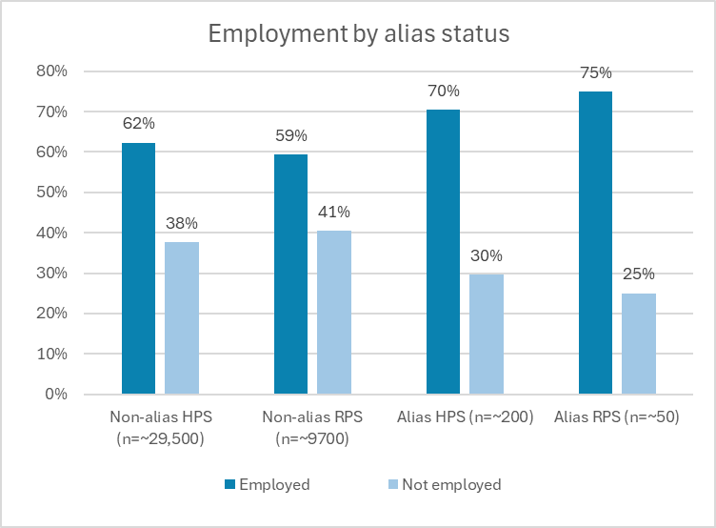
CBDRB-FY25-CBSM004-003

Slide 17
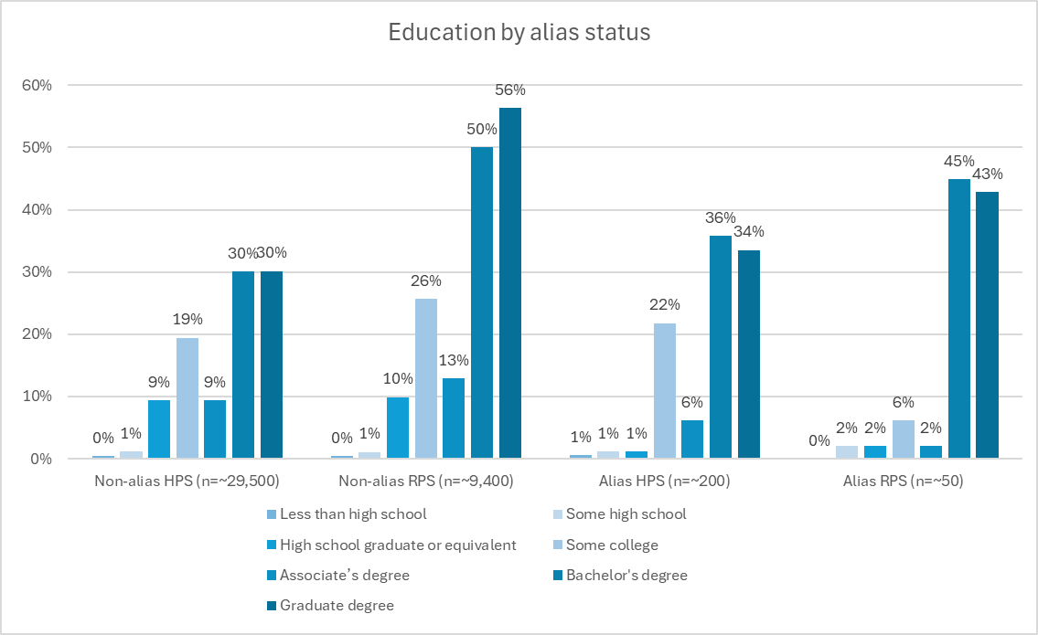
CBDRB-FY25-CBSM004-003

Slide 18
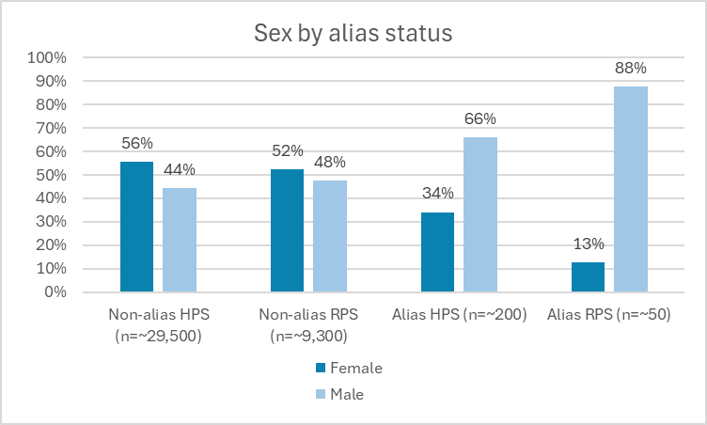
CBDRB-FY25-CBSM004-003

Slide 19
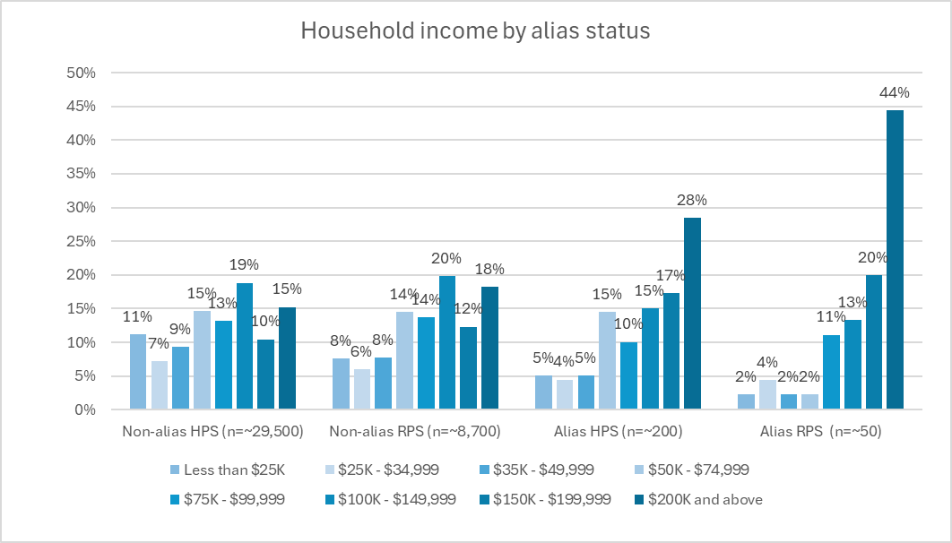
CBDRB-FY25-CBSM004-003

Slide 20
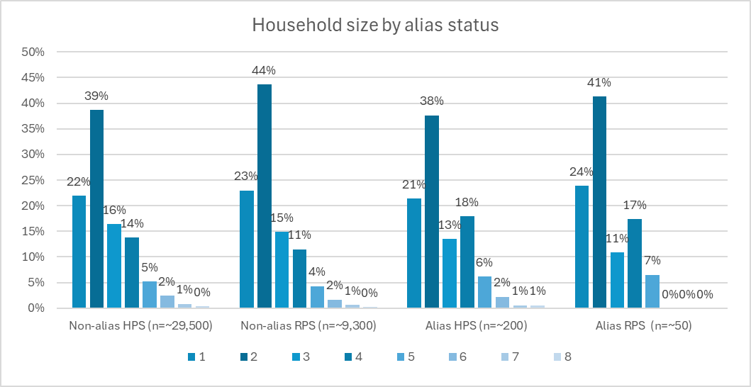
CBDRB-FY25-CBSM004-003

Slide 21

Takeaways
Overall, alias address users may be more likely to be male, higher educated, and higher income
Masked address users may be less likely* to respond but more likely to have reliable email addresses
Because privacy-minded?
Modified address users may be more likely to respond, and younger

Slide 22
Future research
Identify additional alias email addresses and replicate the analysis
Expand our sample to include email domains used for privacy/security:
Mozilla
Proton
Etc.

Slide 23

Thanks!
Please direct questions or comments to:
Dave Tuttle
alfred.d.tuttle@census.gov
Casey Eggleston
casey.m.eggleston@census.gov

