Slide 1
Understanding the Motivations for Business Participation in Voluntary Web-Based Business Surveys
Jason Kosakow: Richmond Fed
Brooke Dirtzu: Cleveland Fed
April 23rd, 2025
The views and opinions expressed herein are those of the author. They do not represent an official position of the Federal Reserve Bank of Richmond or the Federal Reserve System.

Slide 2
Text
Thank you David Tuttle at Census

Slide 3
Story
There are numerous reasons and theories for why people take surveys
Explain a few of them
But these are all for household surveys and we don’t know if they are true for businesses
To solve this, we added in two questions to our surveys to figure out why businesses participate
Here is the methodology
Method 1: Across all Banks to get a general sense of why businesses participate – understand firm demographics
Look at Richmond to assess difference in new members versus exisiting (the recruitment vs retention) – understand respondent motivation
Method 1:
Method 2:
Discussion
Next Steps

Slide 4
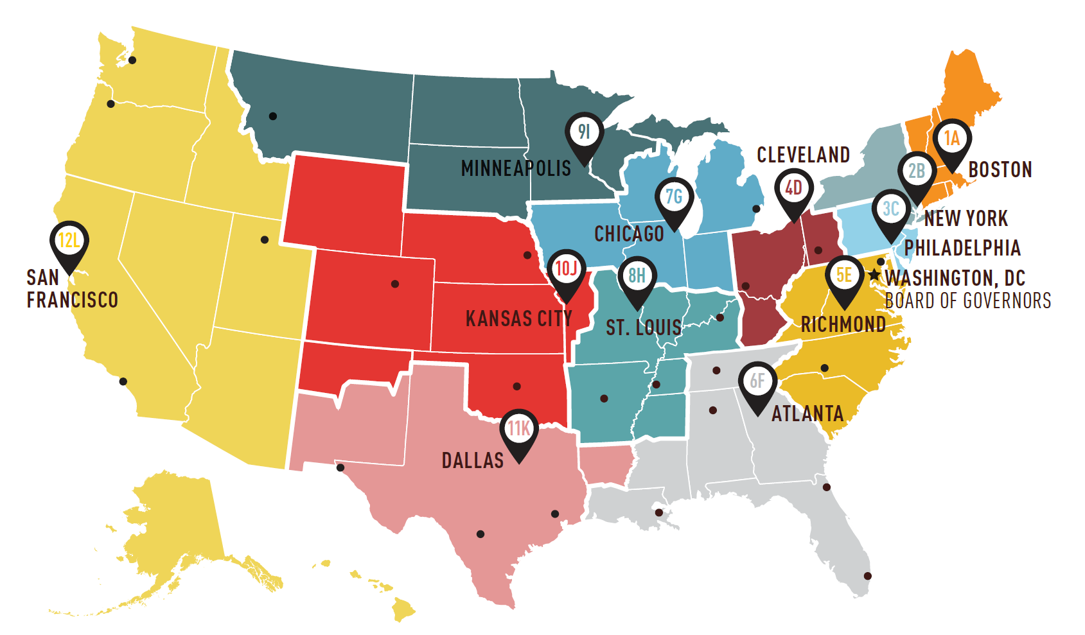


The United States Federal Reserve System

Slide 5
About the Federal Reserve Regional Bank Business Surveys
Each survey is specific to each Bank’s district.
Surveys are administered monthly.
Each Bank operates a panel of businesses.
When a Bank reaches out to a business, it is to join the panel and not necessarily to take the survey at the point of connection.
These surveys do not produce official national statistics, but information about economic data used to inform monetary policy discussions.
Survey participation is voluntary.
Mix of convenience and probability sample.
We cannot provide monetary incentives.

Slide 6
This research aims to answer a paradoxically simple question
Why Does a Person Take a Survey?
Notes:
We all have been trained on the structure an invitation to participate in a survey should follow:
But response rates are declining, so do we need to rethink our approach?

Slide 7
There are practical reasons for responding to a survey
Mandatory
Incentives
Legitimate Survey Sponsor
Contribute to Something Important
Interesting Topics
Notes:
We all have been trained on the structure an invitation to participate in a survey should follow:
But response rates are declining, so do we need to rethink our approach?

Slide 8
There are numerous theories on response behavior
Cognitive Dissonance
Reasoned Action & Planned Behavior
Adult-to-Adult Communication
Gamification
Influence
Pre-Suasion
Leverage Salience
Benefit-Cost
Social Exchange
Dillman, Don A. "Towards survey response rate theories that no longer pass each other like strangers in the night." Understanding survey methodology: Sociological theory and applications (2020): 15-44.
Notes:
We all have been trained on the structure an invitation to participate in a survey should follow:
But response rates are declining, so do we need to rethink our approach?

Slide 9
What This Experiment Is Assessing in Using the Web for Panel Recruitment
Challenge:
Response theories are based off household surveys. There is limited information about why businesses participate in surveys.
Tailored appeals in the message body will have higher response rates than a generic social exchange approach.
The effectiveness of tailored appeals in boosting response rates will mirror the salience of each appeal

Slide 10
What This Experiment Is Assessing in Using the Web for Panel Recruitment
Hypotheses:
Tailored appeals in the email subject line will lead to higher email open rates than a generic social exchange approach.
Tailored appeals in the message body will have higher response rates than a generic social exchange approach.
The effectiveness of tailored appeals in boosting response rates will mirror the salience of each appeal

Slide 11
Assumptions About Web Surveys & Online Panel Recruitment
The Internet is a convenient mode for the recruitment of survey participants and the administration of surveys.
There is oversaturation among potential respondents due to email fatigue and survey fatigue.
Web surveys are becoming more prevalent in academia, non-profits, and business settings (especially when sampling frames are available).
There is a lack of research on how different communication strategies within email surveys and recruitment influence important factors like open rates and response rates.

Slide 12
What This Experiment Is Assessing in Using the Web for Panel Recruitment
Question: Why Does a Person Take a Survey?
Why do
Why do existing panel members participate

Slide 13
Research Background

Slide 14
Creating a Framework for Understanding Appeal of Taking Business Survey
Take the Richmond Fed Business Survey
Appeal 1
Appeal 2
Appeal 3

Slide 15
Step 1: Understand Why Businesses Take Our Survey
“To stay updated on economic conditions quickly, especially inflation thoughts. Your webinar invites help me gauge other businesses against my own and also insights into variety of industry.”
“I participate because I like access to the reports and being a small part of the opinions and decisions.”
“as a small business owner I want my input to be included and I appreciate the information presented in the results.”
“First, I feel honored to be asked. Second, I enjoy staying on top of the results. I sit on the boards of several outside companies and the results are good bellwethers for future decisions.”

Slide 16
Step 1: Understand Why Businesses Take Our Survey
“To help the Fed see what we're seeing. Get inflation in check and start lowering rates to kick the economy off again.”
“I believe there is often a varying disconnect of the general market conditions and macro economy averaged out over the country and localized, main street.or small business owners.”
“Have done for years. Trying to help the FRB gather as much good data as possible. Also very easy format.”

Slide 17
Step 1: Understand Why Businesses Take Our Survey
“Good to see the results each month and also want our regional perspective to be included in the survey.”
“I am a tiny small business, and I think my input is important. Tiny small business owners are the creative soul of our economy. We are different than franchise owners or established family businesses. We make something out of nothing. That's special. That's a point of view that has value and should be heard.”

Slide 18
Step 2: Creating the Appeals Based on Participant Feedback
Take the Richmond Fed Business Survey
Access to data and other benefits
Influence economic policy
Make their communities better

Slide 19
Findings

Slide 20
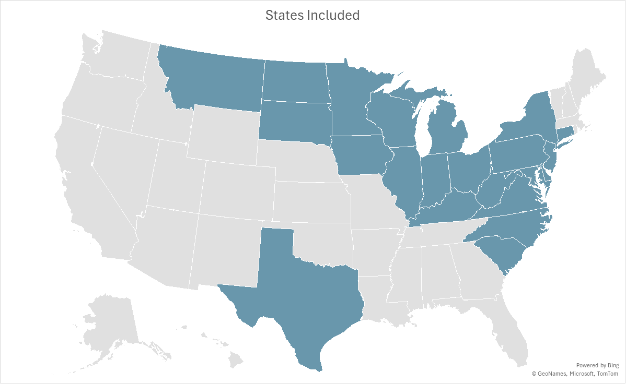
Almost 90 percent of emails “reached” the business, but only two percent converted

Slide 21
The Social Exchange Subject Line Had the Highest Open Rate
χ² (12.3631, p = 0.006)

Slide 22
Among “High Quality” Emails, Social Exchange Had the Highest Open Rate
χ² (6.6460, p = 0.084)

Slide 23
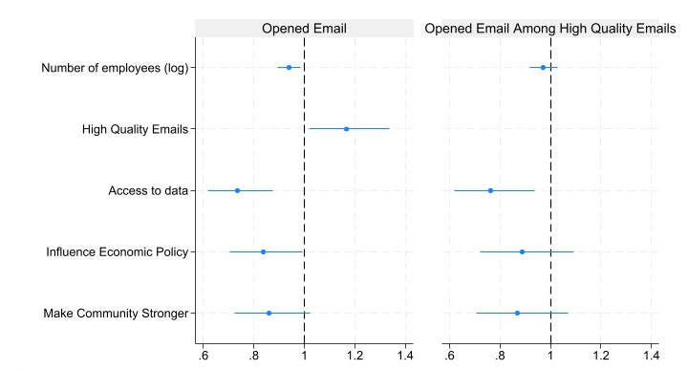
The “Access to Data” Subject Line Had the Lowest Odds of Being Opened
Odds-rations are shown.
Email segment reference is Social Exchange

Slide 24
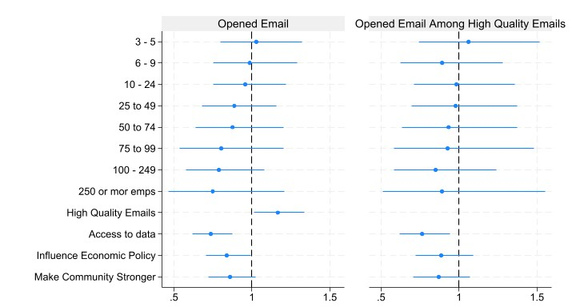
There Is A lot of Variance Among Firm Size and Email Open Rates
Sample is based off non-email failures
Odds-ratios are shown.
Number of Employee reference is 2 or fewer. Email segment reference is Social Exchange

Slide 25
Social Exchange Email Content Had Highest Conversion Rates
χ² (10.4641, p = 0.015)

Slide 26
Social Exchange Content (Among “High Quality” Contacts) Performs Best
χ² (11.4127, p = 0.010)

Slide 27
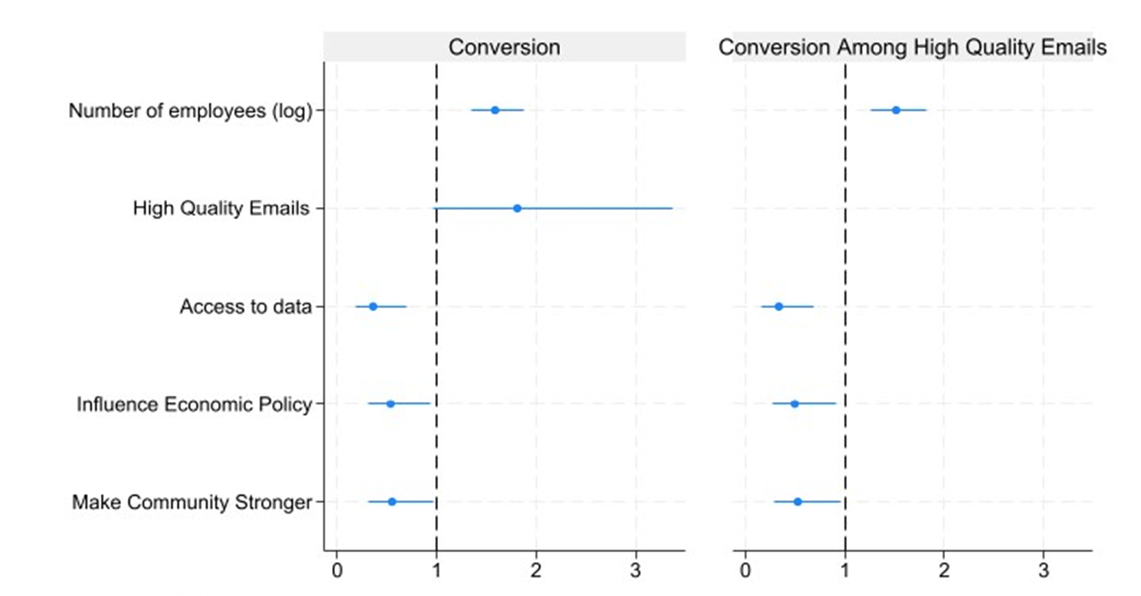
Firm Size and Social Exchange Increased Odds of Conversion
Sample is based off those who opened the email.
Odds-ratios are shown.
Email segment reference is Social Exchange

Slide 28
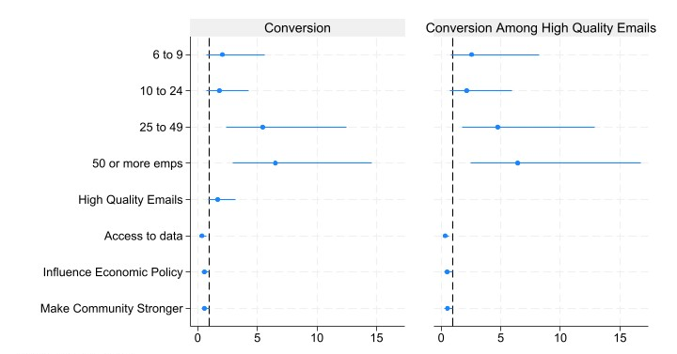
However, There Is A lot of Variance Among Firm Size and Conversion Rates
Sample is based off those who opened the email.
Odds-ratios are shown.
Number of Employee reference is 5 or fewer. Email segment reference is Social Exchange

Slide 29
Concluding Remarks

Slide 30
Findings & Hypotheses
The Social Exchange Messaging Performed Best
Hypothesis: In cold outreach, individuals prefer to know why you are contacting them early.
Clear messaging on the purpose of the email is preferred
The Explicit Incentive Messaging (Access to data) Performed Worst
Hypothesis: “Incentive-forward” communications can be considered marketing spam by recipients, thus, getting ignored
Firm Size Was Important For Conversion But Not In Driving Opens
Hypothesis: Existing research hypothesizes that smaller firms have less to gain from participating in surveys, which could explain what we found in this experiment
However, there is a lot of variance when looking at buckets of firm size

Slide 31
Why Firms Do Not Join
Establishing Trust in Email Outreach is Difficult
Incentives serve as an act of trust, and when you cannot offer a monetary incentive, building trust with a potential respondent is even more difficult
People Don’t Know the Invitation is Legitimate
Even with monetary incentives, the surveyor needs the potential respondent to trust the email is legitimate
People Can’t Differentiate Survey Emails from Marketing Emails
The volume of emails received is overwhelming and people may not know if an email from a survey company is different than an email from a retailer
Gmail and other platforms group the email in the “promotions” tab, which creates more confusion
Message Importance Varies Person-to-Person
People are complex and could have multiple fluid reasons for participating in surveys

Slide 32
Please Reach Out! Jason.Kosakow@rich.frb.org

Slide 33
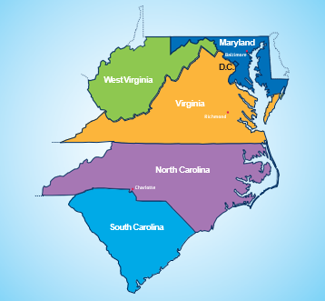
About the Fifth Federal District Business Surveys
The Fifth Federal Reserve District covers the southern mid-Atlantic states:
South Carolina, North Carolina, Virginia, most of West Virginia, D.C., Maryland.
Administered monthly.
We do not produce official national statistics.
Survey participation is voluntary.
Mix of convenience and probability sample.
We cannot provide monetary incentives.

