Slide 1
Redesigning the Census Bureau’s Contact History Instrument to Improve Survey Paradata Collection
Matt Virgile, Laura Hergert, Lee Beck, Anne Russell, & Fane Lineback
Office of Survey and Census Analytics, U.S. Census Bureau
2025 FedCASIC Workshops
April 23, 2025
*No disclosure review required for this presentation. All data displayed is fictional.

Slide 2
Background
The Contact History Instrument (CHI) is a data collection instrument used since 2004 by Census interviewers (Field Representatives, or FRs) to collect data on each CAPI contact attempt in demographic surveys
Launched automatically when FRs exit the questionnaire for a given survey, but may also be launched manually
Data collected includes:
Whether making a contact attempt or a non-attempt action
Contact mode
Date and time of contact attempt
With whom contact was made, if anyone
Outcome of contact attempt (whether interview was completed, reasons for inability to complete)
Respondent concerns
Contact strategies

Slide 3
CAPI Surveys Currently using CHI
Survey Name | Acronym
American Community Survey – Group Quarters | ACS-GQ
American Community Survey – Housing Unit | ACS-HU
American Housing Survey | AHS
Consumer Expenditures Diary Survey | CED
Consumer Expenditures Quarterly Survey | CEQ
Current Population Survey* | CPS
National Crime Victimization Survey | NCVS
National Health Interview Survey | NHIS
Rental Housing Finance Survey | RHFS
Survey of Income and Program Participation | SIPP
Survey of Construction | SOC
Survey of Market Absorption of New Multifamily Units | SOMA
*Includes Annual Social and Economic Supplement (ASEC)

Slide 4
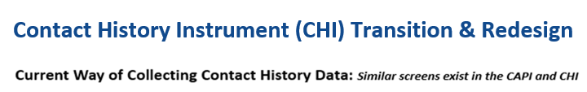
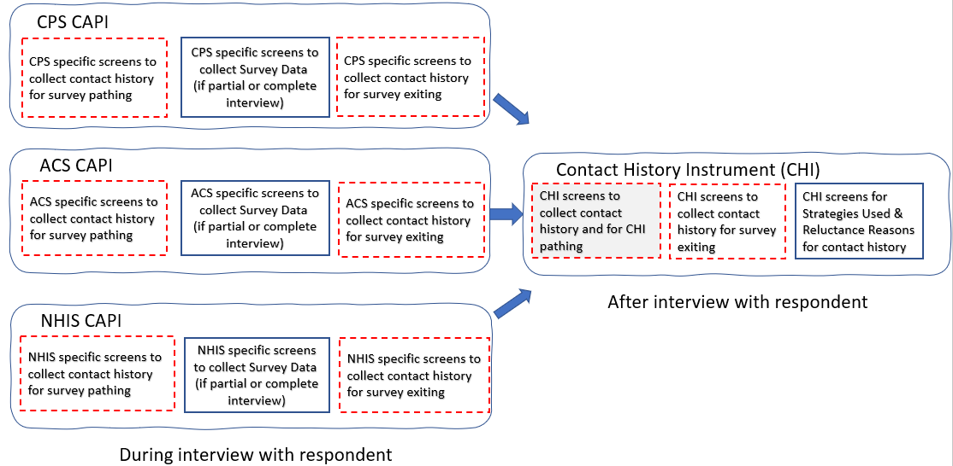

Slide 5
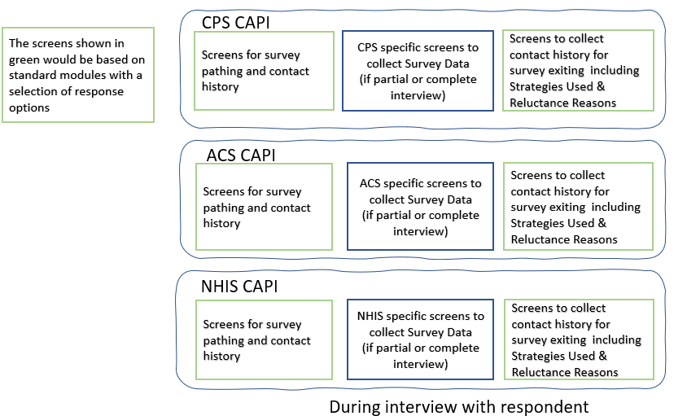

Slide 6
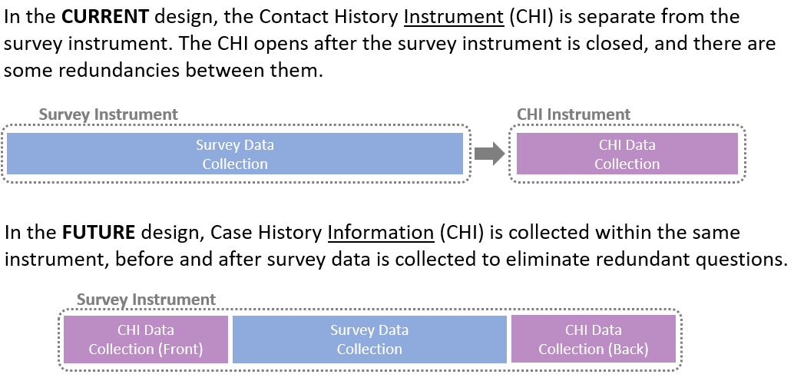
Contact History Instrument (CHI) Transition & Redesign
_________
_____

Slide 7
DICE Program
CHI is one of many data collection systems being redesigned at Census, as part of the Data Ingest and Collection for the Enterprise (DICE) program
Program goal is to simplify and modernize data collection
Anticipated benefits of CHI redesign are:
More accurate case history information
Less time/burden on FRs to enter information
Improved monitoring of contact attempts by Field Supervisors and other Census Bureau management

Slide 8
CHI Transformation Logistics (1)
New CHI design is loaded into Questionnaire Design and Metadata (QDM) system
Initial content
Block/screen/question names
Screen/question text
Answer lists/fields
Variable names and output values
Additional features
Branching logic
Validations (hard and soft edits)
Fills (address/name from input file, or text based on a prior response)

Slide 9
CHI Transformation Logistics (2)
Coordination between CHI team and other teams, to ensure seamless integration
CAPI survey sponsors/team leads
Transition from CHI to survey (and vice-versa)
Identify redundant screens (e.g., contact mode, reason for noninterview)
Account for all relevant event codes
DICE POCs for new field data collection systems/teams/programs
QDM
MOJO/Casey
Centurion
Web/CAPI standards

Slide 10
Timeline
CHI blocks currently loaded in QDM for integration with CPS
First survey for DICE onboarding
Recently completed User Acceptance Testing and Systems Test
CPS Field Test 1 in May –September 2025, Field Test 2 in 2026
Remaining CAPI surveys will have CHI blocks updated in QDM between 2025-2028
Some surveys require additional or different CHI screens from CPS, since sample unit is something other than a household (e.g., person, or Group Quarters/facility)
Some surveys require additional CHI screens, to collect neighborhood observations for personal visit attempts at sample unit

Slide 11
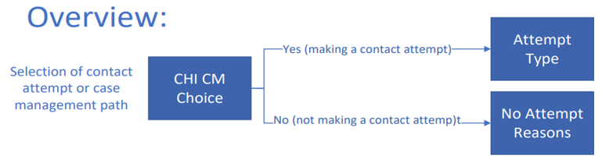
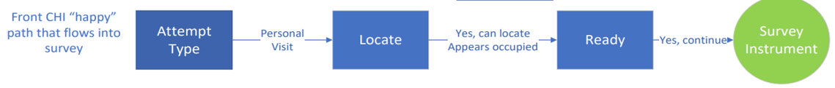
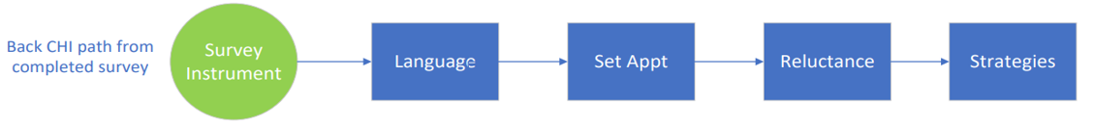
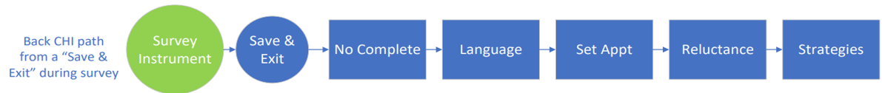

Slide 12
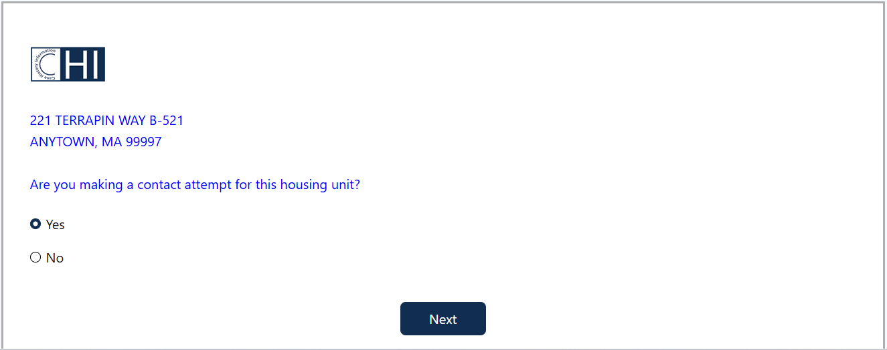
CHI Front Screen – CHI/CM Choice

Slide 13
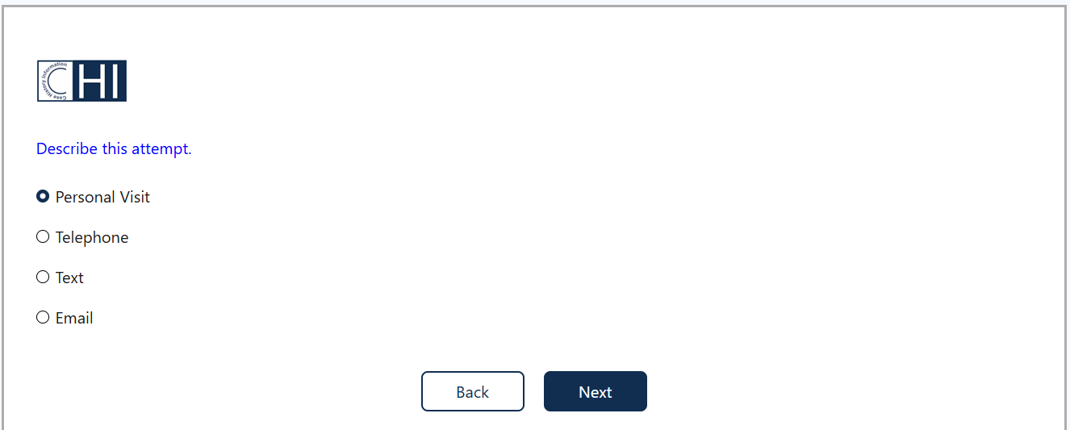
CHI Front Screen – Attempt Type

Slide 14
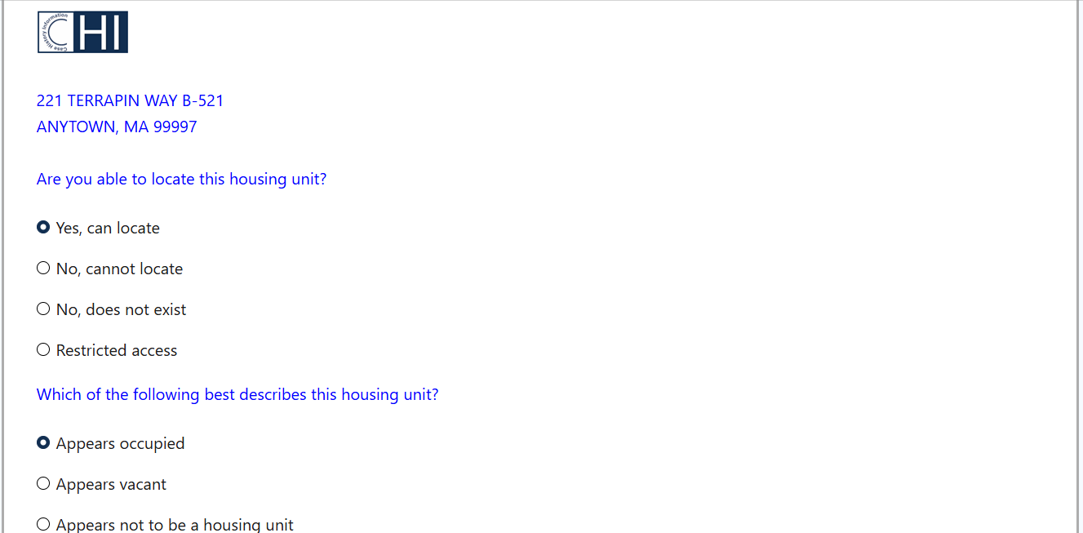
CHI Front Screen - Locate

Slide 15
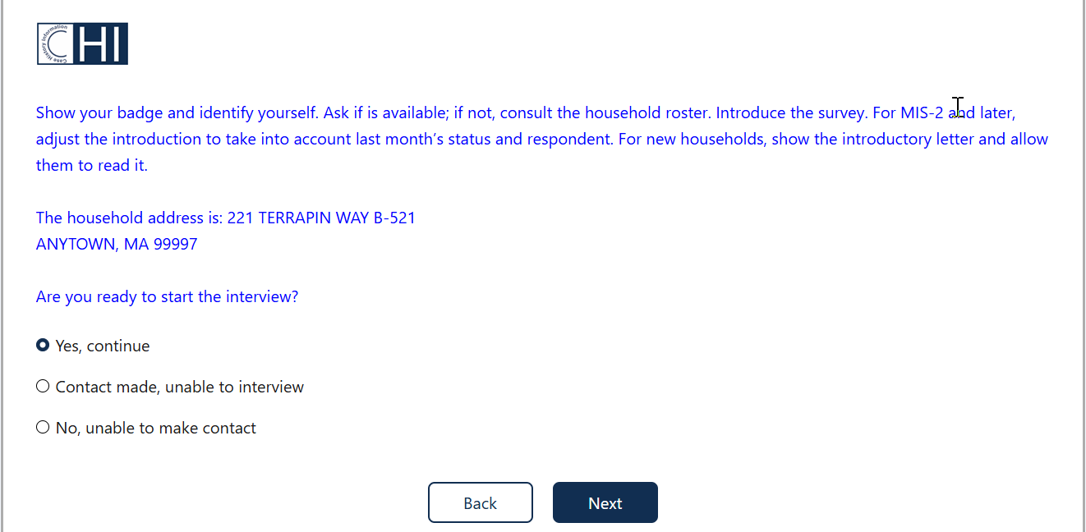
CHI Front Screen - Ready

Slide 16
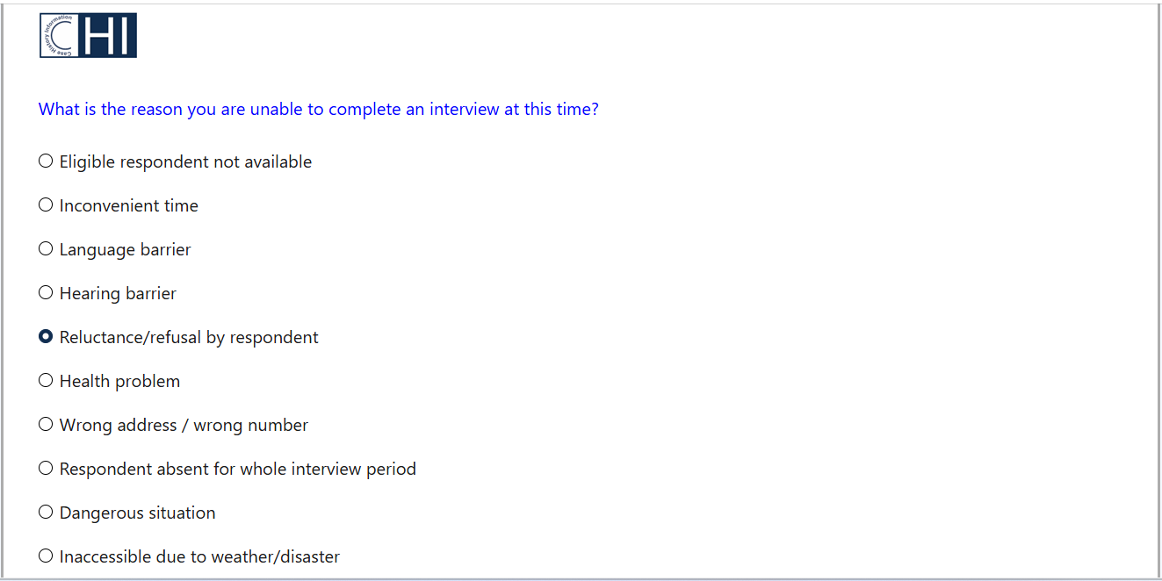
CHI Back Screen – No Complete

Slide 17
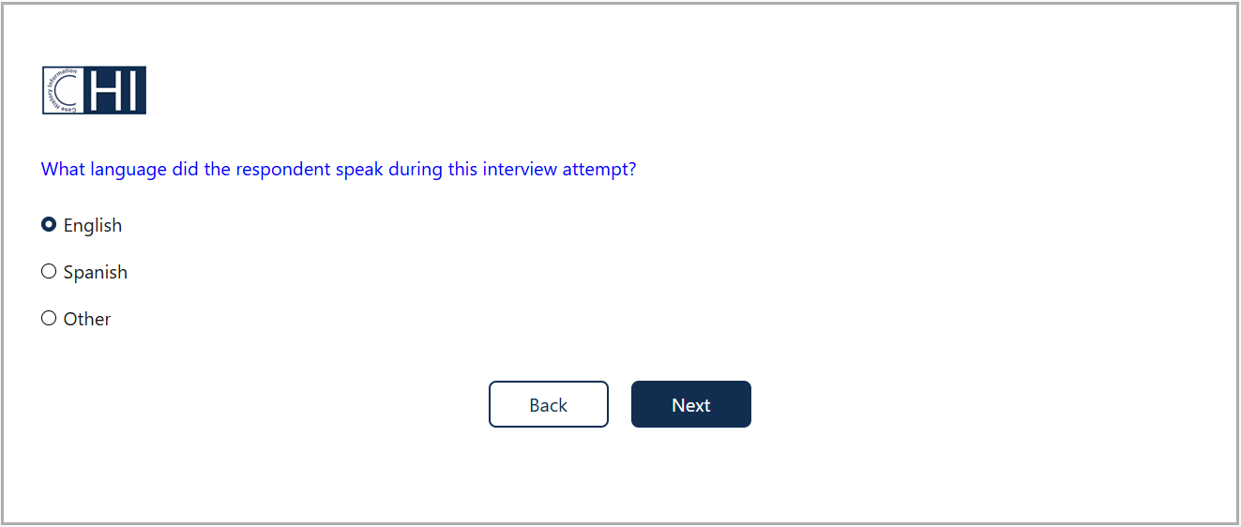
CHI Back Screen - Language

Slide 18
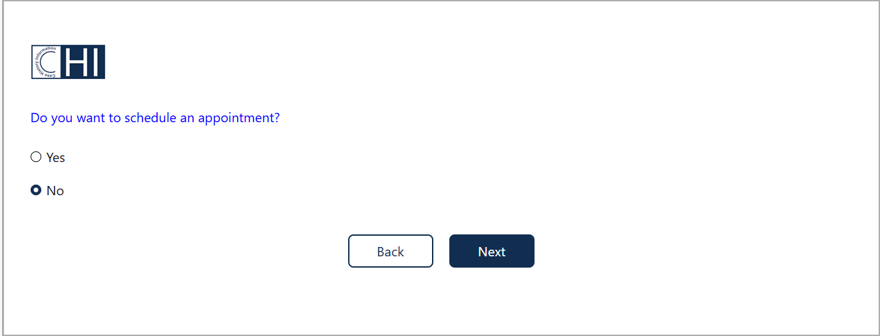
CHI Back Screen – Set Appt

Slide 19
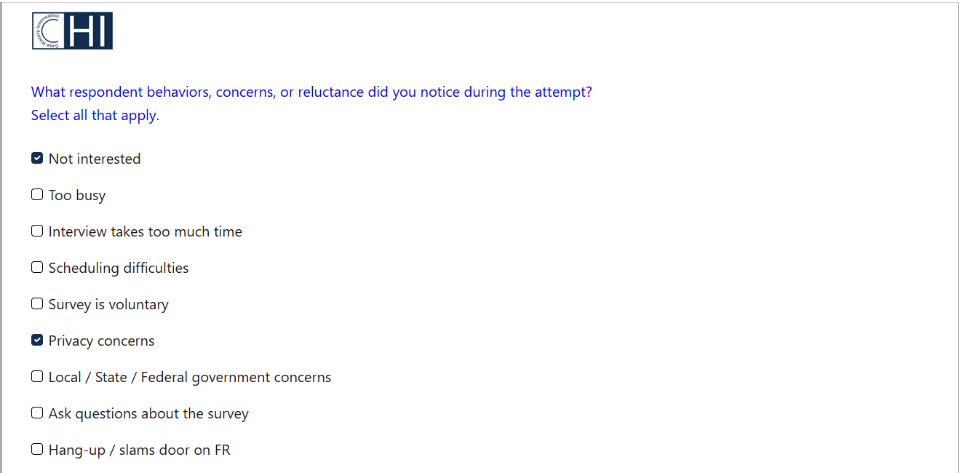
CHI Back Screen - Reluctance

Slide 20
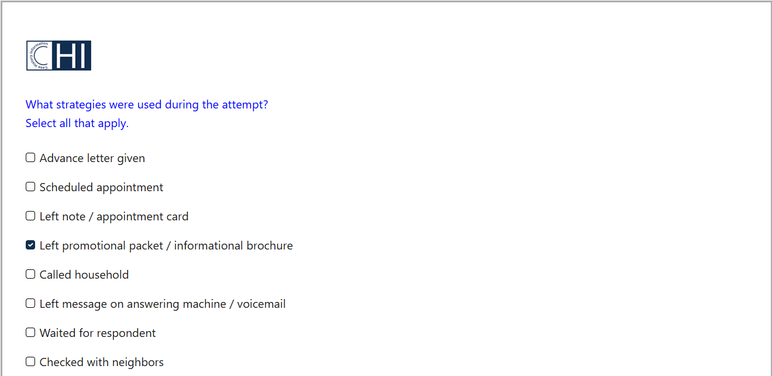
CHI Back Screen - Strategies

Slide 21
Other CHI Functions
The current CHI allows collecting data about case management functions other than contact attempts, such as:
Readying case for transmission
Reviewing or changing case information
Locating activities
Due to changes in other data collection systems, a need was identified for CHI to collect additional actions, such as:
Requesting a letter
Updating respondent contact information
Updating building management contact information
Updating case notes
The future CHI will allow capturing all of these action types for CPS

Slide 22
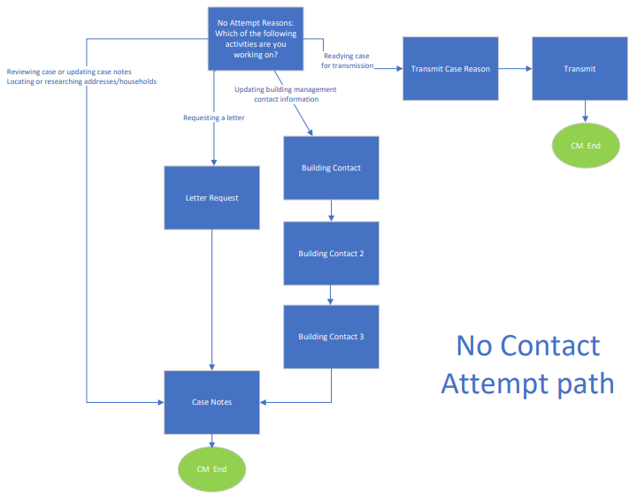

Slide 23
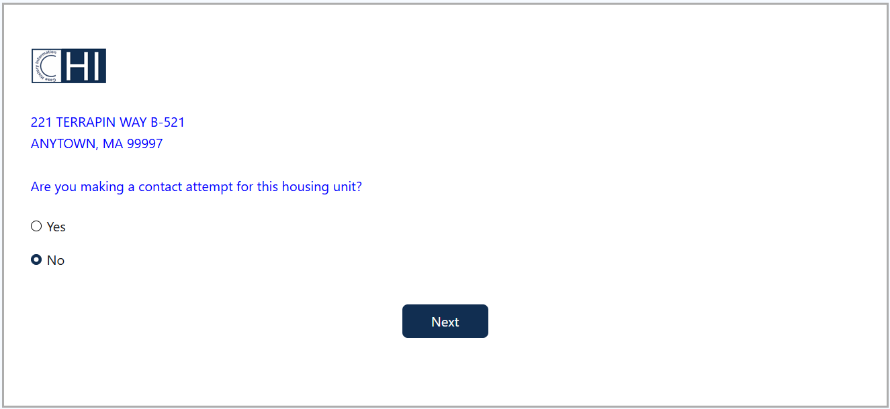
CHI Front Screen – CHI/CM Choice

Slide 24
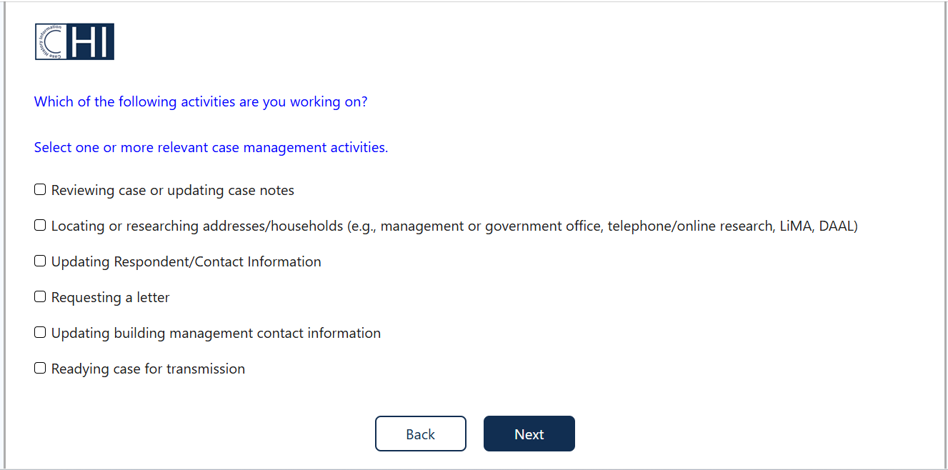
CM Screen – Non-Attempt Activities

Slide 25
Next Steps – Varying Sample Units by Survey
While CPS uses household as sampling unit, some other surveys use person within household, or Group Quarters/facility
Since NHIS samples up to two household members, CHI team will design modified or additional CHI screens/flowcharts that are compatible for NHIS, with person-level contact attempt info
These could have a single CHI Front block for the household, but may administer separate CHI Back blocks for each sampled person
Since ACS-GQ and other surveys sample Group Quarters or facilities, some CHI screens would have distinct options that apply to only these sample units, and not to households or persons

Slide 26
Next Steps – Neighborhood Observation Instrument (NOI)
Two surveys (NHIS and SIPP) require an additional block of CHI screens known as NOI
CHI team held a focus group in February 2025 with Field Supervisors from each Regional Office, to collect feedback on NOI screen mockups
Feedback was incorporated into future NOI screen design, and new draft screens have been loaded into QDM
Focus group discussion centered on new screen layout, scrolling to combine some screens, response options/orderings, and placement of NOI before or after survey questionnaire
Participants also volunteered feedback on new instrument functionality, question wordings, and their purpose

Slide 27
Current NOI Design (Blaise)
Only launched if FR is attempting a personal visit
Currently meant to be completed once and only once per unit
16 total screens, with one question per screen
Whether FR observed sample building or unit (1 screen)
If “Yes”, continue to rest of NOI; if “No”, exit NOI and go to other CHI screens
Graffiti (1 screen)
Unit or building condition (1 screen)
Select building or unit features (4 screens)
Select unit features only (5 screens)
Unit demographics (4 screens)

Slide 28
NOI Focus Group – Main Takeaways (1)
Support for new “screener” question about multi-unit address, and whether able to observe unit within building
This would allow FRs to skip some items if they indicate they are at a multi-unit building, but could not observe the sample unit
This would reduce burden from current CHI, where FR must indicate “Unable to observe sample unit” on five screens about unit features
Support for combining similar questions into one screen with scrolling
Reduces screens on select building/unit features, from 4 to 1
Reduces screens on unit features only, from 5 to 1
Reduces screens on unit demographics, from 4 to 1

Slide 29
NOI Focus Group – Main Takeaways (2)
Mixed thoughts on best placement of NOI screens (Front vs Back)
Placement in CHI Front could avoid bias of answers based on interview
Placement in CHI Back may be safer/less burden for FRs to start interview
Placement in CHI Back is also more similar to how they fill out NOI right now
Also shown possible “hybrid” placement, with NOI starting in Front but asking FR if they can complete NOI at this time
If “Yes”, continue with NOI in CHI Front
If “No”, skip NOI and fill out in CHI Back
Most FRs preferred this, over placing in only CHI Front or only CHI Back

Slide 30
Future NOI Design (Centurion)
7 total screens, with up to 19 questions
Whether FR observed sample building or unit, and whether they can complete NOI at this time (2 questions)
If “Yes” to both Qs, continue to rest of NOI
If “Yes” to first Q and “No” to second Q, skip NOI but return to it in CHI Back
if “No” to first Q, exit NOI and go to other CHI screens
Graffiti (1 question)
Unit or building condition (1 question)
Select building or unit features (4 questions)
Whether address is in a multi-unit building, and whether they observed unit (2 questions)
If “Yes” to first Q and “No” to second Q, skip to Unit demographics
Otherwise, proceed
Select unit features only (5 questions)
Unit demographics (4 questions)

Slide 31
Next Steps – Additional Differences between Surveys
QDM allows adjustment of CHI programming for a given survey, without overwriting earlier settings that are needed for another survey
Differences between surveys may require:
Adding or removing CHI screens
Adding, removing, or modifying text or response options on CHI screens
Changing branching logic between CHI screens, or to/from survey
CHI programming will take survey differences into account, including:
Procedural differences
Longitudinal vs non-longitudinal
Whether vacant units are in scope, or occupied only
Whether proxy response is permitted
Whether a self-administered mode is offered

Slide 32
Questions? Comments?
Matt Virgile
Business Analytics Branch, Office of Survey and Census Analytics (OSCA)
Matthew.Virgile@census.gov

