Slide 1
Enhancing Survey Data Quality: Integrated Validation, Auto-Edit, and Search Tool
Alice Ramey U.S. Bureau of Economic Analysis
April 23, 2025
The views expressed in this paper are those of the author and do not necessarily represent the U.S. Bureau of Economic Analysis or the U.S. Department of Commerce.

Slide 2
What is IVEST?
IVEST is short for the Integrated Validation, Auto-Edit, and Search Tool.
It is incorporated into BEA’s centralized survey processing system.
An extremely flexible “low-code” tool that helps survey editors (i.e. non-programmers) automate and prioritize microdata review.

Slide 3
What Problem Does it Solve?
Automation through auto-editing of survey data. (Edits)
Workflow/Prioritization (Checks)
  Survey editors are directed to review data that violates predefined rules.
  Funnels data violations to differing levels of approval based on the severity of the check.
Search functionality for lower-level interests that don’t rise to the level of Edits or Checks

Slide 4
What Problem Does it Solve?
  Makes the management of tools for survey validation and editing Self-Service.
    Questions can be asked in a user-friendly manner with no need to know how to code.
    Efficiency gains because the people with the business knowledge can develop and test the tools rather than communicating back and forth with developers.

Slide 5
How Does it Work?
The logic for the Edits, Checks, and Searches are maintained in metadata (Excel spreadsheets) which are loaded into the survey processing system.
IVEST generates code from the metadata, which translates rules into SQL queries and then evaluates them over data clusters grouped by anchor documents.

Slide 6
How Does it Work?
Each Edit, Check, and Search in the metadata is called an IVEST rule.
IVEST rules have two main components:
  Rule conditions
  Rule actions
Each IVEST rule has a single rule condition, and any number (including none) of rule actions

Slide 7
Rule Conditions
Syntactically, each IVEST rule condition is a logical expression written essentially as a SQL WHERE clause
IVEST is sensitive to absence of data (or, in database terminology, NULLs ), rule conditions are evaluated under 3-Valued logic regime, and result in one of three outcomes: False, Maybe and True

Slide 8
Rule Actions
Syntactically, each IVEST rule action is a labelled non-logical expression, written essentially as a SQL SELECT
Because IVEST is sensitive to absence of data, rule actions may return NULLs
Each IVEST rule action consists of IVEST items, constants, arithmetic, string operators, parenthesis, and SQL functions (both built-in and user-defined)

Slide 9
Example IVEST Metadata for a Check
Simple Example: Find all BE15 forms where Employee Compensation is greater than 0 and Employment = 0.
Rule condition:
    [BE15:2024:EmpComp]>0 Check [BE15:2024:Emp]=0
IVEST translates the Rule Condition into a SQL query and returns all forms that violate the check.

Slide 10
IVEST Expressive Power
  Rule conditions and actions can essentially employ most SQL functionality available in the WHERE clauses and SELECT expressions, respectively.
  Various arithmetic and string operators and functions (both built-in and user-defined), including passing IVEST items as parameters to functions;
  CASE expressions
  binary comparators, as well as operators BETWEEN, IN and NOT IN
  NULL values, and IS NULL and IS NOT NULL operators

Slide 11
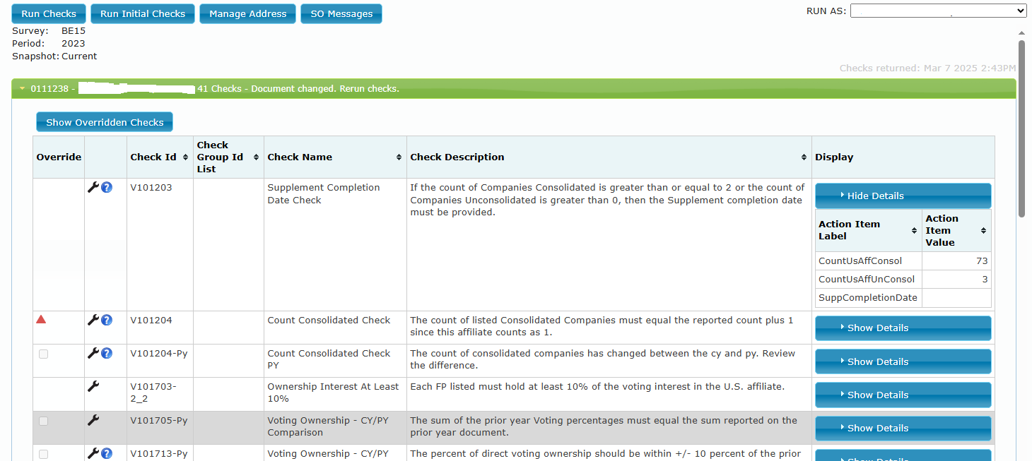
IVEST in the Survey Processing System

Slide 12
IVEST in Practice
Auto-Edits and Checks are run on all survey forms as they are submitted and incorporated into the Survey Processing System.
Survey editors prioritize their review by clearing the Checks.
All edits, including those made unrelated to Checks, require that the Checks be rerun and cleared to make a document “Accepted.”

Slide 13
IVEST
Contact Information
alice.ramey@bea.gov

