Slide 1
Dynamic Schema Modeling of Heterogeneous Data Structures
FedCASIC 2025
April 23, 2025
Christopher N. Carrino
US Census Bureau

Slide 2
Data Lives in Various Structures
Two-Dimensional Array
RDBMS Table
Excel Spreadsheet
Delimited Files (e.g. CSV, TSV, Pipe delimited, etc.)
SAS File
Data Frame
Hierarchical Data Structures (sometimes referred to as ‘nested’)
XML
JSON
Avro
RDF/OWL
How can we validate, analyze and process data in various formats in the most efficient way?

Slide 3
Option 1: Write a Schema for every underlying format.
XML: XML Schemas (XSD), RelaxNG, Document Type Definitions (DTDs)
JSON: JSON Schema, JSON-LD, OpenAPI, Avro
Platform-Agnostic: Schematron, YAML
2D Structures: Customized options.
Pros: We can use out of the box toolsets.
Cons:
We have to learn how to use each toolset.
Errors can easily be introduced into the model translation.
Not all platforms have a schema language.
Not all schema languages have the same constructs.
JSON-Schema
XSD
DTD
Model
JSON-LD
Avro
OpenAPI

Slide 4
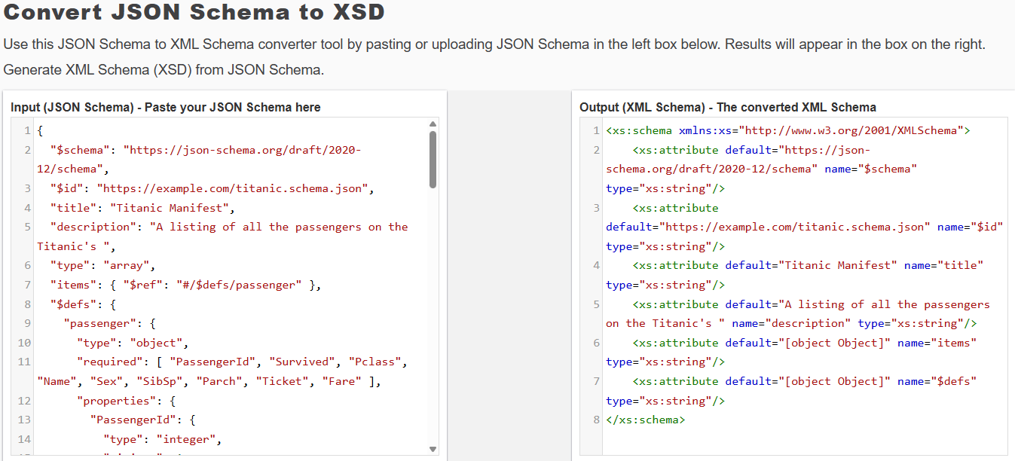

Slide 5
Option 2: Write one Schema in a selected format, Transform all Data Sets to selected format, and then use one toolset for validation.
Pros: Only one schema and one toolset needed for validation.
Cons:
Going from CSV to JSON, there is no inference of the data type, so all fields are treated as strings and all values are qualified in double quotes. This does not work well with numbers, booleans and null values.
Conversion requires tools. In many cases you need to use a different tool to convert back after converting forward.
Conversion requires analysis. You have to manually inspect the documents to make sure that a JSON file has a single root node that cleanly transforms to a well-formed XML document.
Conversion alters your data.
Some conversions require a lot of RAM to work on the entire DOM all at once.
JSON File
XML File
JSON-LD File
Avro File
CSV File
XLSX File
JSON File
JSON File
JSON File
JSON File
JSON File
JSON File
Model
As
JSON Schema

Slide 6
Option 3: Write one Schema in a selected format, and then use one customized toolset for validation.
Pros: Only one schema and one toolset needed for validation.
Cons: Our validator must logic written for each underlying format.
JSON File
XML File
JSON-LD File
Avro File
CSV File
XLSX File
JSON File
JSON File
JSON File
JSON File
JSON File
JSON File
Model
As
JSON Schema

Slide 7
Our goal: write one schema and use one toolset regardless of underlying data format.
Instead of using a generic schema format like YAML or Schematron, we are going to use JSON Schema for these reasons:
JSON has an active user base and has superseded many of XML’s use cases.
JSON Schemas are supported by the OpenAPI Specification and used natively within Avro.
There are many open source options within the JSON Schema toolset.

Slide 8
We want to operate on “records”. A record can be a line in a CSV file, a row in a database table, or an Object in a JSON file. A record can be 2D or hierarchical. See the record definition in the Avro Schema specification: https://avro.apache.org/docs/1.11.1/specification/#schema-record
We want to validate the data in streams as opposed to reading the entire data set into RAM and then validating it.
We want to validate at the Record Level and the Value Level.

Slide 9
Record Level Validations (row/column rules)
Column Count
Columns Required to be present (but not necessarily populated)*
Column Ordering (ordinal sequence)
Duplicate Columns
* In JSON Schema, this is accomplished using the "required" array for field names which requires a field to be present, but still allows the value of that field to be null. If you want to require a field to be present but allow null values, you have to add "null" to the allowable type array.
* There is a difference between a column being optional/mandatory and a value in the column on a specific row being optional/mandatory (referred to in XML as “nillable”).

Slide 10
Value Level Validations (cell rules)
Data type (string, number, date, boolean, time, uuid,etc.)
Format of value
Value optional/mandatory (does the value need to be populated)
Minimum value length
Maximum value length
Minimum value
Maximum value
Enumeration of allowable values
Regular Expression

Slide 11
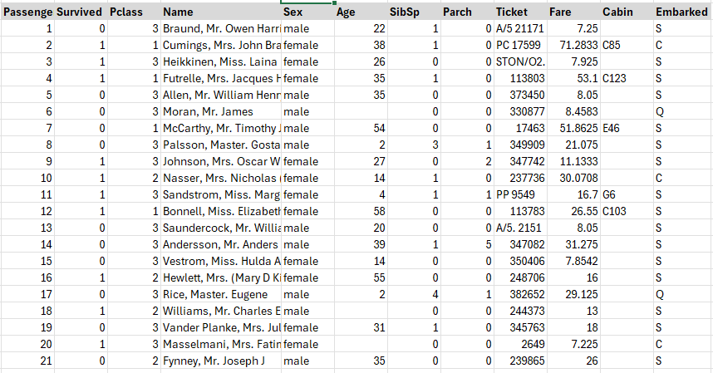
Example: Titanic Passenger Manifest (subset)
COLUMN_NAME | TYPE_NAME | COLUMN_SIZE
passengerid | int4 | 10
survived | int4 | 10
pclass | int4 | 10
name | varchar | 250
sex | varchar | 6
age | numeric | 0
sibsp | int4 | 10
parch | int4 | 10
ticket | varchar | 20
fare | numeric | 0
cabin | varchar | 20
embarked | bpchar | 1
Titanic Passenger Listing: https://www.encyclopedia-titanica.org/titanic-passenger-lists/

Slide 12
8 serialization formats of the same Data Set
Two-Dimensional Array
RDBMS Table: PostgreSQL (titanic_manifest)
Excel Spreadsheet (pre-2003 binary): titanic.xls
Excel Spreadsheet (post-2003 Open XML): titanic.xlsx
Open Spreadsheet Format: titanic.ods
Delimited File: titanic.csv
Hierarchical Data Structures (sometimes referred to as ‘nested’)
XML: titanic.xml
JSON: titanic.json
Avro: titanic.avro

Slide 13
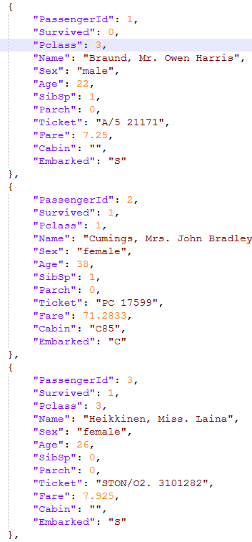
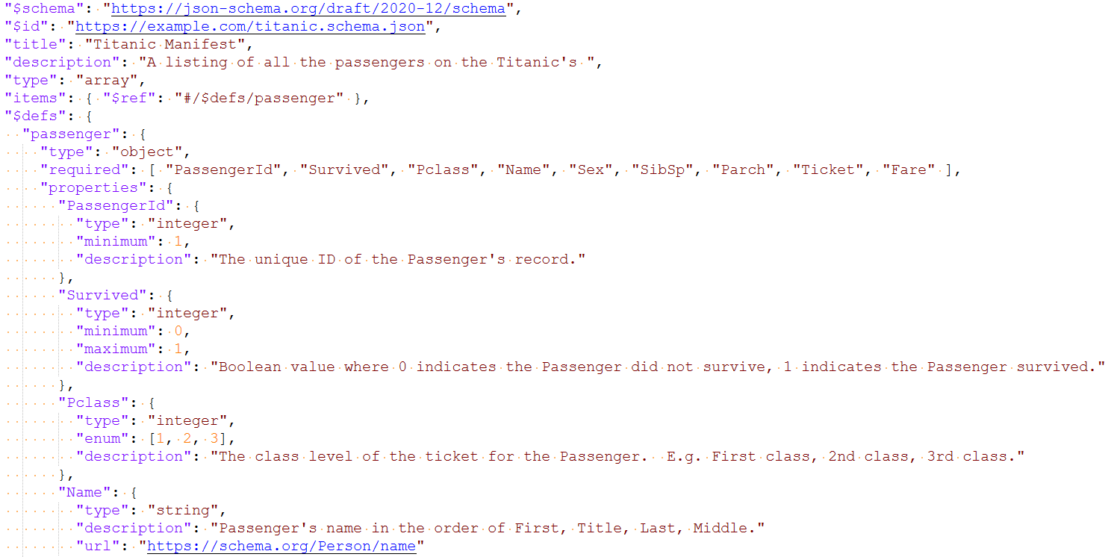
Titanic JSON Schema

Slide 14
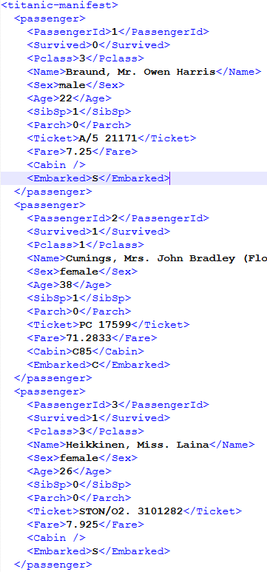
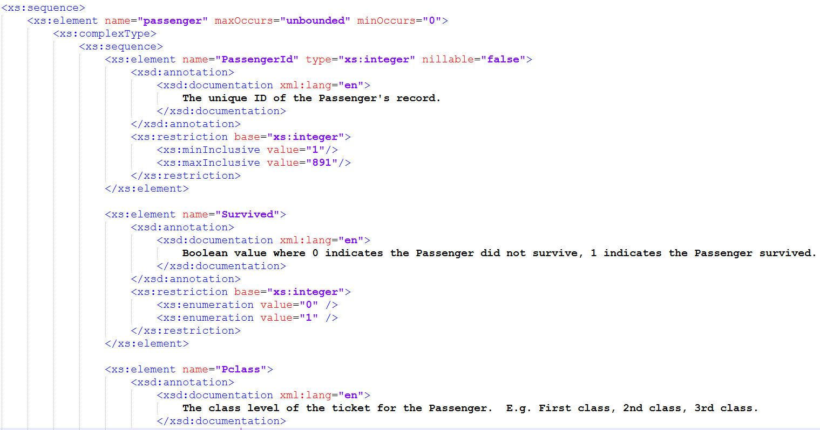
Titanic XML Schema

Slide 15





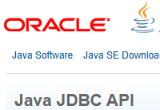
Packages Used for Implementation
XML Validation:
JSON Schema:
XLS/XLSX:
Avro:
CSV:
RDBMS:

