Slide 1

Overview and Perspectives on Data Science and Artificial Intelligence in Research
Emanuel Robinson, Ph.D., Director—Human-Systems Integration
National Academies of Sciences, Engineering, and Medicine
FedCASIC Virtual Conference April 21, 2026

Slide 2

“Created to Advise the Nation”
THE NATIONAL ACADEMY OF SCIENCES, ENGINEERING, AND MEDICINE PROVIDE INDEPENDENT, OBJECTIVE ADVICE TO SPARK PROGRESS AND ADVANCE SCIENCE, ENGINEERING, AND MEDICINE FOR THE BENEFIT OF SOCIETY.
Private, nonprofit, nongovernmental
Provides independent, objective analysis and advice to the nation to solve complex problems and inform public policy decisions
“...the Academy shall, whenever called upon by any department of the Government, investigate, examine, experiment and report upon any subject of science or art…” U.S. Congress,1863 (signed by President Abraham Lincoln)
Reports available in pdf for free at https://www.nationalacademies.org/publications/all

Slide 3
Board on Human-Systems Integration
Established in 1980—interdisciplinary with experts from academia, industry, military/federal.
Relationship of individuals and organizations to technology.
Systems approach and human factors principles applied to themes:
Technologies (e.g., AI) and users
Organizational and workforce/staffing
Health, safety, and risk
Ergonomics and the designed environment
Current Core Sponsors
American Psychological Association | National Aeronautics and Space Administration
Federal Aviation Administration | Society for Human Resource Management
Human Factors and Ergonomics Society | Society for Industrial/Organizational Psychology

Slide 4
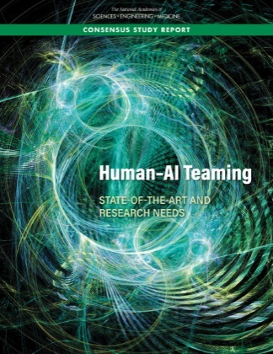
Recent AI work
Human-AI Teaming: State-of-the-Art and Research Needs
Sponsor: Air Force Research Lab
Research needs
Improving human-AI teaming models
Strengthening team processes
Increase situational awareness
Improve transparency and explainability
Strengthening interaction mechanisms and strategies
Improving trust
Reducing bias
Developing training support
Building HSI processes, measures, and testing

Slide 5

Select Additional AI Activities
AI Day for Federal Statistics 2026, 2024
AI Infrastructure to Accelerate AI Convergence and Catalyze U.S. Scientific Innovation
Foundation Models for Scientific Discovery and Innovation
AI to Assist Mathematical Reasoning
Advances in Multimodal AI to Enhance Environmental and Biomedical Data Integration
Opportunities for NAEP in an Age of AI and Pervasive Computation: A Pragmatic Vision
Notes:
Research and Application in Team Science: A consensus study with the objectives to (1) understand team science, including best practices, barriers, impacts, and the role of virtual and hybrid environments; (2) develop a contemporary understanding of best practices in team science; (3) evaluate the growing role of virtual and hybrid teams; (4) identify gaps in resources and training for team science; and (5) better understand how to measure the effectiveness of teams. The report is complete. HFES Member Erin Chiou was part of the committee. The final report, The Science and Practice of Team Science, is available at https://nap.nationalacademies.org/catalog/29043/the-science-and-practice-of-team-science
AI and the Future of Work: An Update: A study to review current workforce implications of AI and related technologies including for economic productivity and growth, job stability, equity, and income inequality, identify key open questions, and describe salient research opportunities and data needs. It builds on the 2017 Academies study, Information Technology and the U.S. Workforce: Where Are We and Where Do We Go from Here? The study was completed and report released. The report is available at https://nap.nationalacademies.org/catalog/27644/artificial-intelligence-and-the-future-of-work.
Navigating the AI Landscape: Strategies for State and Local Leaders: Collaboration with Societal Experts Action Network [SEAN]. State and local decision makers are often left without guidance and resources around new technologies at the federal level. The workshop focuses on AI needs and challenges within the rapid response framework of SEAN (given rapid AI evolution). BOHSI member (and HFES Member) Nathan McNeese co-author a Rapid Expert Consultation (REC) that followed from this activity. Strategies for Integrating AI into State and Local Government Decision Making is out along with additional materials (interactive overview and a 1-pager: Strategies for Integrating AI into State and Local Government Decision Making Webinar. This is part of a larger series of activities focused on AI and state/local leaders. The topic has garnered interest from both the AI perspective as well as policymaking at the state and local levels (given the current environment pushing more down to that level).
FAA Cabin Evacuation and Seat Pitch Design: From the FAA Re-authorization Bill: “The FAA Administrator shall seek to enter into 1 or more agreements with the National Academies to support the activities of the Aeromedical Innovation and Modernization working group described in subsection (c) of Section 411.” BOHSI member (and HFES Member) Nancy Currie-Gregg chaired the committee. The public webinar and briefings have occurred. It has also received a fair amount of media coverage and interest from Congress. The final report, Peer Review of the Federal Aviation Administration’s Study of the Effects of Passenger Seat Width and Pitch on Airplane Evacuation Performance, is available at https://nap.nationalacademies.org/catalog/29070/peer-review-of-the-federal-aviation-administrations-study-of-the-effects-of-passenger-seat-width-and-pitch-on-airplane-evacuation-performance

Slide 6
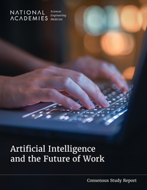
Select Additional AI Activities
AI and the Future of Work
The Impact of Artificial Intelligence on Education and Workforce Trajectories in Tech: A Workshop
Navigating the AI Landscape: Strategies for State and Local Leaders
Test and Evaluation Challenges in AI-Enabled Systems for the Air Force
Notes:
Research and Application in Team Science: A consensus study with the objectives to (1) understand team science, including best practices, barriers, impacts, and the role of virtual and hybrid environments; (2) develop a contemporary understanding of best practices in team science; (3) evaluate the growing role of virtual and hybrid teams; (4) identify gaps in resources and training for team science; and (5) better understand how to measure the effectiveness of teams. The report is complete. HFES Member Erin Chiou was part of the committee. The final report, The Science and Practice of Team Science, is available at https://nap.nationalacademies.org/catalog/29043/the-science-and-practice-of-team-science
AI and the Future of Work: An Update: A study to review current workforce implications of AI and related technologies including for economic productivity and growth, job stability, equity, and income inequality, identify key open questions, and describe salient research opportunities and data needs. It builds on the 2017 Academies study, Information Technology and the U.S. Workforce: Where Are We and Where Do We Go from Here? The study was completed and report released. The report is available at https://nap.nationalacademies.org/catalog/27644/artificial-intelligence-and-the-future-of-work.
Navigating the AI Landscape: Strategies for State and Local Leaders: Collaboration with Societal Experts Action Network [SEAN]. State and local decision makers are often left without guidance and resources around new technologies at the federal level. The workshop focuses on AI needs and challenges within the rapid response framework of SEAN (given rapid AI evolution). BOHSI member (and HFES Member) Nathan McNeese co-author a Rapid Expert Consultation (REC) that followed from this activity. Strategies for Integrating AI into State and Local Government Decision Making is out along with additional materials (interactive overview and a 1-pager: Strategies for Integrating AI into State and Local Government Decision Making Webinar. This is part of a larger series of activities focused on AI and state/local leaders. The topic has garnered interest from both the AI perspective as well as policymaking at the state and local levels (given the current environment pushing more down to that level).
FAA Cabin Evacuation and Seat Pitch Design: From the FAA Re-authorization Bill: “The FAA Administrator shall seek to enter into 1 or more agreements with the National Academies to support the activities of the Aeromedical Innovation and Modernization working group described in subsection (c) of Section 411.” BOHSI member (and HFES Member) Nancy Currie-Gregg chaired the committee. The public webinar and briefings have occurred. It has also received a fair amount of media coverage and interest from Congress. The final report, Peer Review of the Federal Aviation Administration’s Study of the Effects of Passenger Seat Width and Pitch on Airplane Evacuation Performance, is available at https://nap.nationalacademies.org/catalog/29070/peer-review-of-the-federal-aviation-administrations-study-of-the-effects-of-passenger-seat-width-and-pitch-on-airplane-evacuation-performance

Slide 7

Select Cybersecurity and AI Activities
Cyber Hard Problems
Forum on Cyber Resilience
Meeting Apr. 20 and 21
Securing AI systems: New Challenges and Research Priorities
Organizational Models for the Cyber Forces of the US Armed Services
Machine Learning for Safety-Critical Applications
Strengthening Preparedness Against Novel Biological Threat Agents Enabled Through AI and Other Emerging Technologies
Notes:
Research and Application in Team Science: A consensus study with the objectives to (1) understand team science, including best practices, barriers, impacts, and the role of virtual and hybrid environments; (2) develop a contemporary understanding of best practices in team science; (3) evaluate the growing role of virtual and hybrid teams; (4) identify gaps in resources and training for team science; and (5) better understand how to measure the effectiveness of teams. The report is complete. HFES Member Erin Chiou was part of the committee. The final report, The Science and Practice of Team Science, is available at https://nap.nationalacademies.org/catalog/29043/the-science-and-practice-of-team-science
AI and the Future of Work: An Update: A study to review current workforce implications of AI and related technologies including for economic productivity and growth, job stability, equity, and income inequality, identify key open questions, and describe salient research opportunities and data needs. It builds on the 2017 Academies study, Information Technology and the U.S. Workforce: Where Are We and Where Do We Go from Here? The study was completed and report released. The report is available at https://nap.nationalacademies.org/catalog/27644/artificial-intelligence-and-the-future-of-work.
Navigating the AI Landscape: Strategies for State and Local Leaders: Collaboration with Societal Experts Action Network [SEAN]. State and local decision makers are often left without guidance and resources around new technologies at the federal level. The workshop focuses on AI needs and challenges within the rapid response framework of SEAN (given rapid AI evolution). BOHSI member (and HFES Member) Nathan McNeese co-author a Rapid Expert Consultation (REC) that followed from this activity. Strategies for Integrating AI into State and Local Government Decision Making is out along with additional materials (interactive overview and a 1-pager: Strategies for Integrating AI into State and Local Government Decision Making Webinar. This is part of a larger series of activities focused on AI and state/local leaders. The topic has garnered interest from both the AI perspective as well as policymaking at the state and local levels (given the current environment pushing more down to that level).
FAA Cabin Evacuation and Seat Pitch Design: From the FAA Re-authorization Bill: “The FAA Administrator shall seek to enter into 1 or more agreements with the National Academies to support the activities of the Aeromedical Innovation and Modernization working group described in subsection (c) of Section 411.” BOHSI member (and HFES Member) Nancy Currie-Gregg chaired the committee. The public webinar and briefings have occurred. It has also received a fair amount of media coverage and interest from Congress. The final report, Peer Review of the Federal Aviation Administration’s Study of the Effects of Passenger Seat Width and Pitch on Airplane Evacuation Performance, is available at https://nap.nationalacademies.org/catalog/29070/peer-review-of-the-federal-aviation-administrations-study-of-the-effects-of-passenger-seat-width-and-pitch-on-airplane-evacuation-performance

Slide 8
Recent Convening and Outreach Activities
Human and Organizational Factors in AI Risk Management Framework
Generative AI and Human, Societal, and Environmental Effects
Webinars
Human-AI Teaming webinar series (future trajectories, performance optimization) (ongoing)
AI, Automation, and the Future of Work webinar series (ongoing)
Hauser seminars on AI: Navigating the Era of AI: Human-AI Harmony and the Role of the Social Sciences
Notes:
Research and Application in Team Science: A consensus study with the objectives to (1) understand team science, including best practices, barriers, impacts, and the role of virtual and hybrid environments; (2) develop a contemporary understanding of best practices in team science; (3) evaluate the growing role of virtual and hybrid teams; (4) identify gaps in resources and training for team science; and (5) better understand how to measure the effectiveness of teams. The report is complete. HFES Member Erin Chiou was part of the committee. The final report, The Science and Practice of Team Science, is available at https://nap.nationalacademies.org/catalog/29043/the-science-and-practice-of-team-science
AI and the Future of Work: An Update: A study to review current workforce implications of AI and related technologies including for economic productivity and growth, job stability, equity, and income inequality, identify key open questions, and describe salient research opportunities and data needs. It builds on the 2017 Academies study, Information Technology and the U.S. Workforce: Where Are We and Where Do We Go from Here? The study was completed and report released. The report is available at https://nap.nationalacademies.org/catalog/27644/artificial-intelligence-and-the-future-of-work.
Navigating the AI Landscape: Strategies for State and Local Leaders: Collaboration with Societal Experts Action Network [SEAN]. State and local decision makers are often left without guidance and resources around new technologies at the federal level. The workshop focuses on AI needs and challenges within the rapid response framework of SEAN (given rapid AI evolution). BOHSI member (and HFES Member) Nathan McNeese co-author a Rapid Expert Consultation (REC) that followed from this activity. Strategies for Integrating AI into State and Local Government Decision Making is out along with additional materials (interactive overview and a 1-pager: Strategies for Integrating AI into State and Local Government Decision Making Webinar. This is part of a larger series of activities focused on AI and state/local leaders. The topic has garnered interest from both the AI perspective as well as policymaking at the state and local levels (given the current environment pushing more down to that level).
FAA Cabin Evacuation and Seat Pitch Design: From the FAA Re-authorization Bill: “The FAA Administrator shall seek to enter into 1 or more agreements with the National Academies to support the activities of the Aeromedical Innovation and Modernization working group described in subsection (c) of Section 411.” BOHSI member (and HFES Member) Nancy Currie-Gregg chaired the committee. The public webinar and briefings have occurred. It has also received a fair amount of media coverage and interest from Congress. The final report, Peer Review of the Federal Aviation Administration’s Study of the Effects of Passenger Seat Width and Pitch on Airplane Evacuation Performance, is available at https://nap.nationalacademies.org/catalog/29070/peer-review-of-the-federal-aviation-administrations-study-of-the-effects-of-passenger-seat-width-and-pitch-on-airplane-evacuation-performance

Slide 9
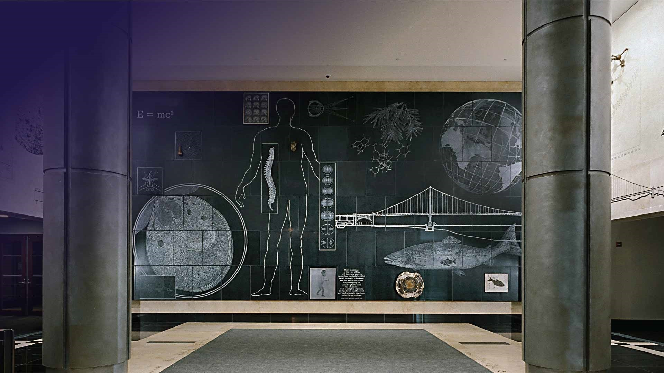
Thank you! Email for more information: aerobinson@nas.edu Reports available for free download at: www.nationalacademies.org/publications AI at the National Academies: nationalacademies.org/topics/artificial-intelligence

