Slide 1
Practice Effects on Knowledge Items and Personality Measurement
Jesus Arrue, Hanyu Sun, David Cantor

Slide 2
Acknowledgment
Data used are from a grant awarded by National Science Foundation to Dr. Ting Yan and Dr. David Cantor (NSF-2050809)

Slide 3
Practice or “Retest” Effects (1)
People tend to answer a retest more consistently than the first test.
Cognitive ability:
A meta-analysis of 50 studies in cognitive ability showed an increase in scores between the first and second administration.
Personality measurement:
Respondents are more consistent in their answers to items appearing later in the questionnaire than those at the beginning.

Slide 4
Practice or “Retest” Effects (2)
Possible explanations:
Measuring a single, unidimensional construct increases the relationship between the item response and the target construct.
Retesting reduces the influence of factors that are not related to the target construct (e.g., confusion or anxiety) at the first test.
Retesting may also improve skill unrelated to the target construct, such as test-taking skill.

Slide 5
The Study and Data (1)
NSSEHE: National Study of Social, Economic and Health Experiences.
Data collection effort designed to track changes in opinions, lifestyle and health of Americans.
Includes questions about household purchases, beliefs in public issues, health behaviors, health status, life experience.
Practice or “retest” effects is one out of six experiments embedded in the study.

Slide 6
The Study and Data (2)
Data collected across 4 rounds.
Simple random sampling of registered voters in 2 US states.
Mail push-to-web design, web only.
Prenotification letter, invitation, reminders (mail, email, and text).
Prepaid incentives and conditional incentives upon completion of each round, escalating up to $80 for all 4 waves of data collection.
Approximately 3 months between each wave.

Slide 7
Research Questions
1. Do practice effects appear in a survey interview as in a test setting?
2. Do practice effects persist beyond the second exposure?

Slide 8
Hypothesis
The proportion of correct responses is directly correlated with the number of times respondents are exposed to the knowledge items.
The responses to the personality measures are not going to be affected by the number of times respondents are exposed to the personality items.

Slide 9
Experiment
We conducted a three-condition experiment to examine the practice effects on knowledge items and personality measures in self-administered web interviews.
Respondents were randomly assigned to 1 of 3 experimental groups at Wave 1 and remained in the same group throughout the study. Knowledge and personality measures were asked in different time points by condition.
Condition | Wave 1 | Wave 2 | Wave 3 | Wave 4
Group 1 | X | X | X | X
Group 2 |  | X |  | X
Group 3 |  |  |  | X

Slide 10
Knowledge Items
Set of knowledge questions taken from NSF's Science and Engineering Indicators and CDC's "How much do you know about COVID-19" short quiz.
Questions were presented in a grid format and followed a yes/no format, including a “don’t know” option.
Examples
The center of the Earth is very hot.
All radioactivity is man-made.
There is more than one coronavirus.
COVID-19 vaccines can affect your DNA.

Slide 11
Personality Measures
Need for Cognition Scale (NCS) – 4-item version
Balanced Inventory of Desirable Responding (BIDR) – 4-item version.
Measured in a Likert Scale format, ranging from 1 (Extremely uncharacteristic of me) to 5 (Extremely characteristic of me) or 1 (Strongly disagree) to 5 (Strongly agree).
Examples
NCS-4
I would prefer complex to simple problems.
Thinking is not my idea of fun.
BIDR-4
I sometimes tell lies if I have to.
I always obey laws, even if I’m unlikely to get caught.

Slide 12
Methods
Between-groups analysis at Wave 4
Compare proportion correct responses (knowledge items)
Compare mean scores (personality measures)
Reliability: Cronbach’s alpha
Regression with covariates

Slide 13
Note for regression models
Covariates:
Sex (Female – Reference; Male)
Age (Less than 50 – Reference; 50+)
Education (Less than college graduate – reference; College graduate)
Race (Hispanic – Reference; NH White, NH Black, NH Other)
Income (Less than $75K – Reference; $75K or more)
Condition (Group 1 – Reference; Group 2, Group 3)

Slide 14
Between groups analysis: Knowledge items
There seems to be a relationship between the number of times the respondent was exposed to knowledge items and overall knowledge, but this is weak.
Knowledge differences among groups seem to be small.
Additional exposure does not lead to meaningful incremental gains in knowledge, mostly between groups 1 and 2.
Χ²: 29.54; p-value: <.05 ; φc:0.064

Slide 15
Between groups analysis: Regression models
Knowledge items – Proportion of correct answers as DV
β₀ = 0.53
Overall, there is no difference in the proportion of correct answers if respondents are assigned either 2 or 4 times to the knowledge items.
People in Group 3 (only exposed one time to knowledge items) decrease their proportion in correct answers by 0.06 (p<0.05) in comparison to Group 1.

Slide 16
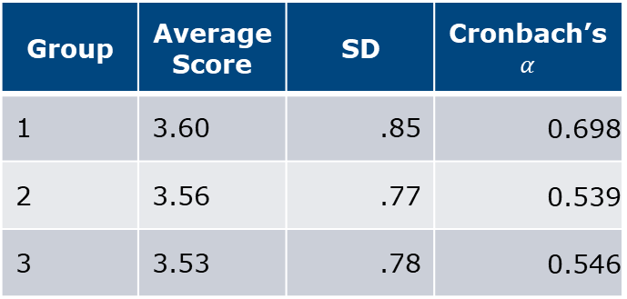
Between groups analysis: Personality items – NSC-4
Higher reliability with item exposure (Group 1 > Group 2 > Group 3).
Low alpha values could be because the low number of items per battery.
Low alpha value at first exposure (Group 3) could indicate that items are interpreted inconsistently.
ANOVA indicates that there is no difference in the mean average score between groups.
Group | Average Score | SD | Cronbach’s $α$
1 | 3.60 | .85 | 0.698
2 | 3.56 | .77 | 0.539
3 | 3.53 | .78 | 0.546
F = 0.61 (2,802); p-value = 0.54

Slide 17
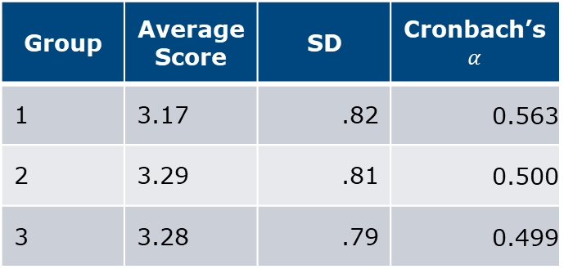
Between groups analysis: Personality items – BIDR-4
Higher reliability with item exposure (Group 1 > Group 2 > Group 3).
Low alpha values could be because the low number of items per battery.
Low alpha value at first exposure (Group 3) could indicate that items are interpreted inconsistently.
ANOVA indicates that there is no difference in the mean average score between groups.
Group | Average Score | SD | Cronbach’s $α$
1 | 3.17 | .82 | 0.563
2 | 3.29 | .81 | 0.500
3 | 3.28 | .79 | 0.499
F = 1.71 (2,802); p-value = 0.18

Slide 18
Between groups analysis: Regression models – NSC-4
Personality measures – Average scores as DV
NSC-4: β₀ = 3.21
BIDR-4: β₀ = 3.24
Overall, there is no difference in the average score obtained by respondents if assigned to any of the experimental conditions.
Exposure to the personality items 1, 2, or 4 times was not significantly associated with differences in construct scores.

Slide 19
Discussion
Practice effects for knowledge items are present but small.
Small gains, mostly after first exposure.
No effect on personality scores.
Reliability increases with exposure, likely due to:
Familiarity with items
Reduced confusion
Increased response consistency

Slide 20
Conclusions
Practice effects seem to be limited in a survey setting.
Repeated exposure:
Slightly improves knowledge.
Does not change personality scores.
Main benefit: more reliable responses.
Most gains occur after the first exposure, with little improvement thereafter.

Slide 21
Limitations
Short scales likely reduced reliability estimates.
Sample size limited the use of more advanced analyses (e.g., mixed models, Structural Equation Modeling).
Separate practice effects from changes in the underlying learning ability for the knowledge items.

Slide 22
Thank you
Jesus Arrue JesusArrue@Westat.com
westat.com
Photos are for illustrative purposes only. All persons depicted, unless otherwise stated, are models.

