Slide 1
Use of Linked Micromaps for Public Exploration of Official Statistics
Randall Powers, U.S. Bureau of Labor Statistics
Wendy Martinez, U.S. Census Bureau
2026 Federal Computer Assisted Survey Information Collection Workshops
April 21, 2026
Notes:
Just say greetings - Good morning. This is work done with my colleague Wendy Martinez.

Slide 2
Acknowledgements and Disclaimers
The authors thank John Eltinge and Darcy Steeg Morris, for helpful discussion of the topics presented today.
This presentation provides a summary of research results. The information is being released for statistical purposes, to inform interested parties, and to encourage discussion of work in progress. The presentation does not represent an official BLS statistical data product or production series.
Notes:
Just say – “Here are the usual disclaimers”

Slide 3
Outline & Goal
Introduce linked micromaps
Discuss current ways of visualizing U.S. state level data
Show examples of micromaps with data from Quarterly Census of Employment and Wages and Occupational Employment and Wage Statistics
Another FedCASIC talk
GOAL: To introduce linked micromaps and show how they can be used for improved visualization of official statistics and data exploration
Notes:
Just briefly read these bullets

Slide 4
What is a Linked Micromap?

Slide 5
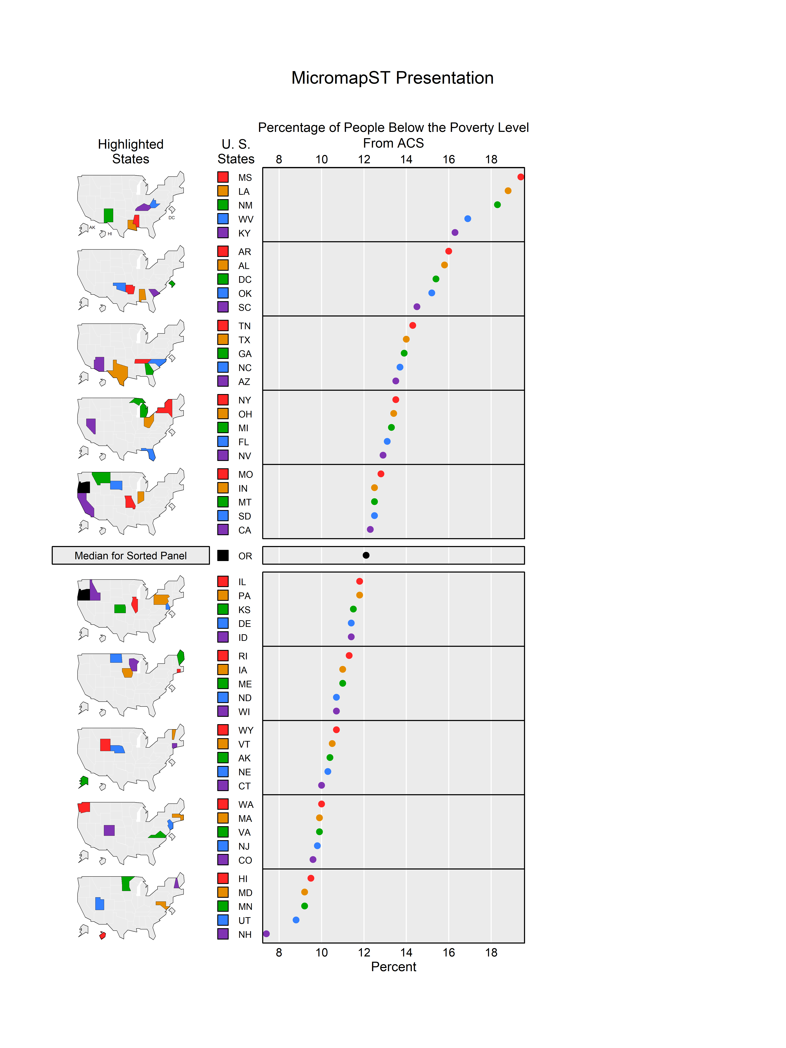
Micromaps used for geographically indexed data
Two R packages
      micromap
      micromapST
This talk uses micromapST for US state level data
Notes:
Bullets for script
Linked micromaps are used for data connected with geographic entity
Two R packages were developed in 2015
We focus on micromapST, which is used solely for US state level data
More details on the elements of linked micromaps will be provided later

Slide 6
What are some current ways we display state-indexed data?

Slide 7
Ordered by State or by Measure – Excel
Notes:
Bullets
This is a bar chart from Excel – showing ACS Response Rates
Ordered alphabetically
Default – Every other bar labeled
Hard to extract useful information regarding distribution of poverty over states

Slide 8
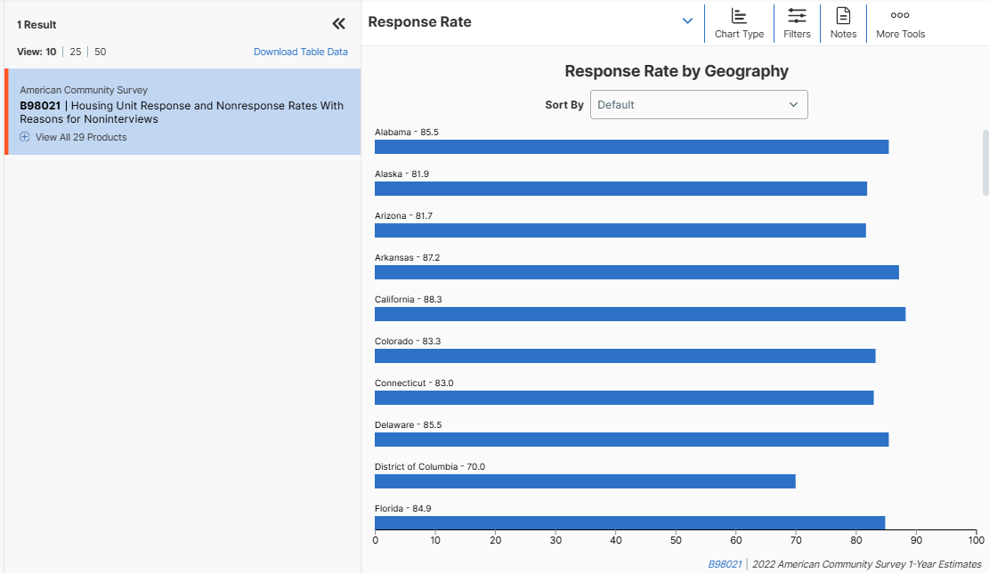
Default Plot on data.census.gov
Notes:
Bullets
Here we order by the variable of interest.
In this case, ACS response rate for 2022
We will see this later in a linked micromap
We see a nice ordering of the data, but we lose the understanding of the geography

Slide 9
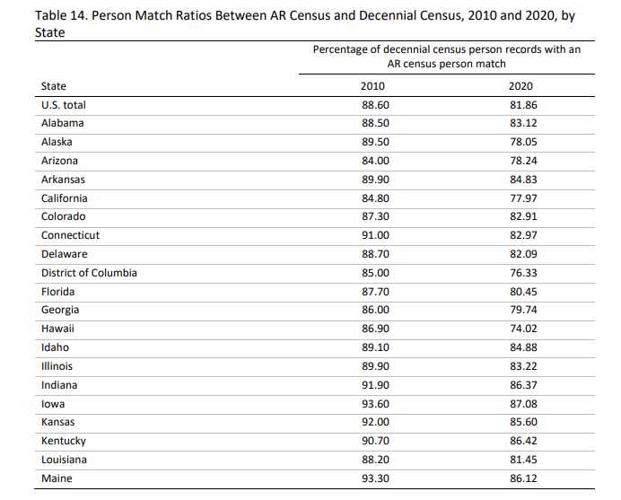
Could use a table…
https://www2.census.gov/programs-surveys/decennial/2020/program-management/evaluate-docs/EAE-2020-admin-records-experiment.pdf
Notes:
Bullets
Data are often listed in a table
Ordered alphabetically by state
Again… hard to find meaningful information
And, the reader has to mentally compare each element in the table

Slide 10
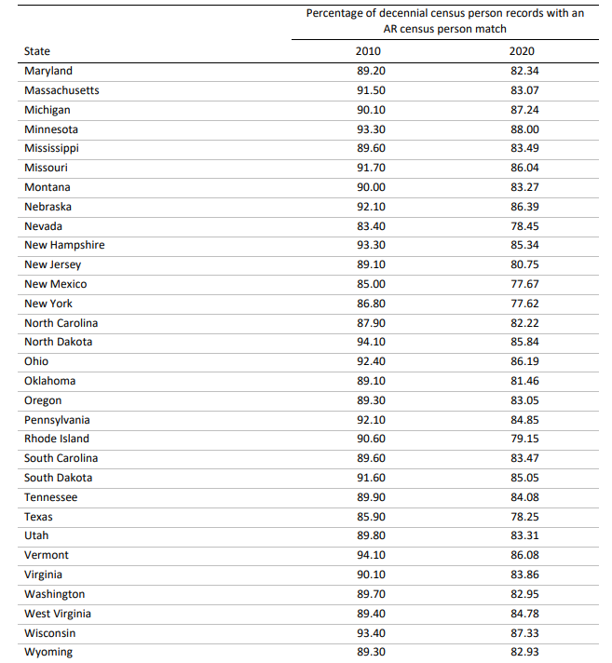
Cuts across two pages …
Notes:
Sometimes, the table cuts across pages!

Slide 11
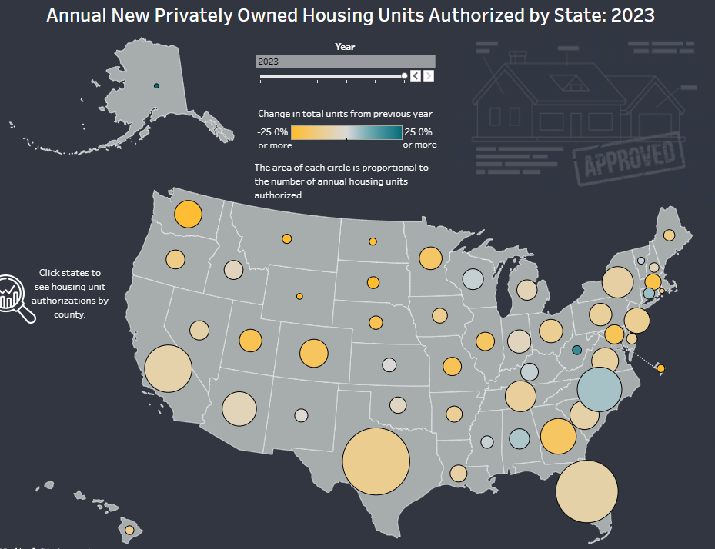
Bubble Charts
https://www.census.gov/library/visualizations/interactive/annual-new-privately-owned-housing-units.html
Notes:
Here is a bubble chart
Size of bubble represents a variable
Hard for humans to see/understand differences in the variable, unless the difference is extreme
Color can be misleading and humans have difficulty discriminating gradations/shades in color

Slide 12
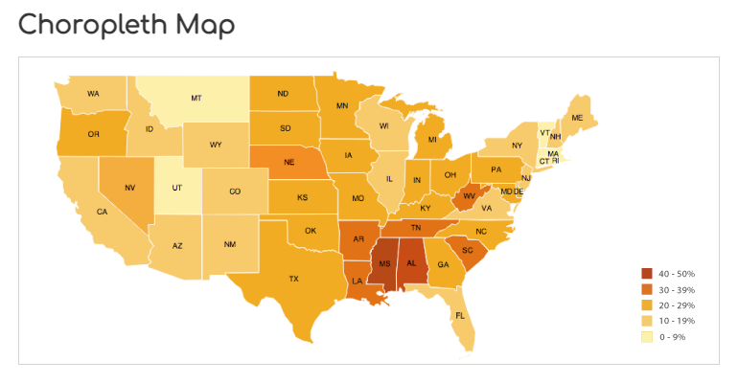
https://datavizcatalogue.com/methods/choropleth.html
Typical Method: Choropleth Maps
Color indicates value
Hard to convey additional information/statistics
No order, except through legend
Hard to distinguish values using color
Notes:
Choropleth maps are used a lot for geographic data
Color indicates one characteristic
Additional variables are not easily displayed

Slide 13
Details on linked micromapST

Slide 14
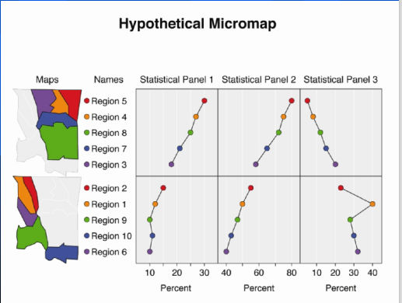
Linked Micromap Elements
Link quantities to geographical region
Color provides index connecting map region and values
Different than choropleth maps where color represents a value
Notes:
This is a notional example of linked micromap
Column of small maps
Color links geographic region to statistics shown to the right

Slide 15
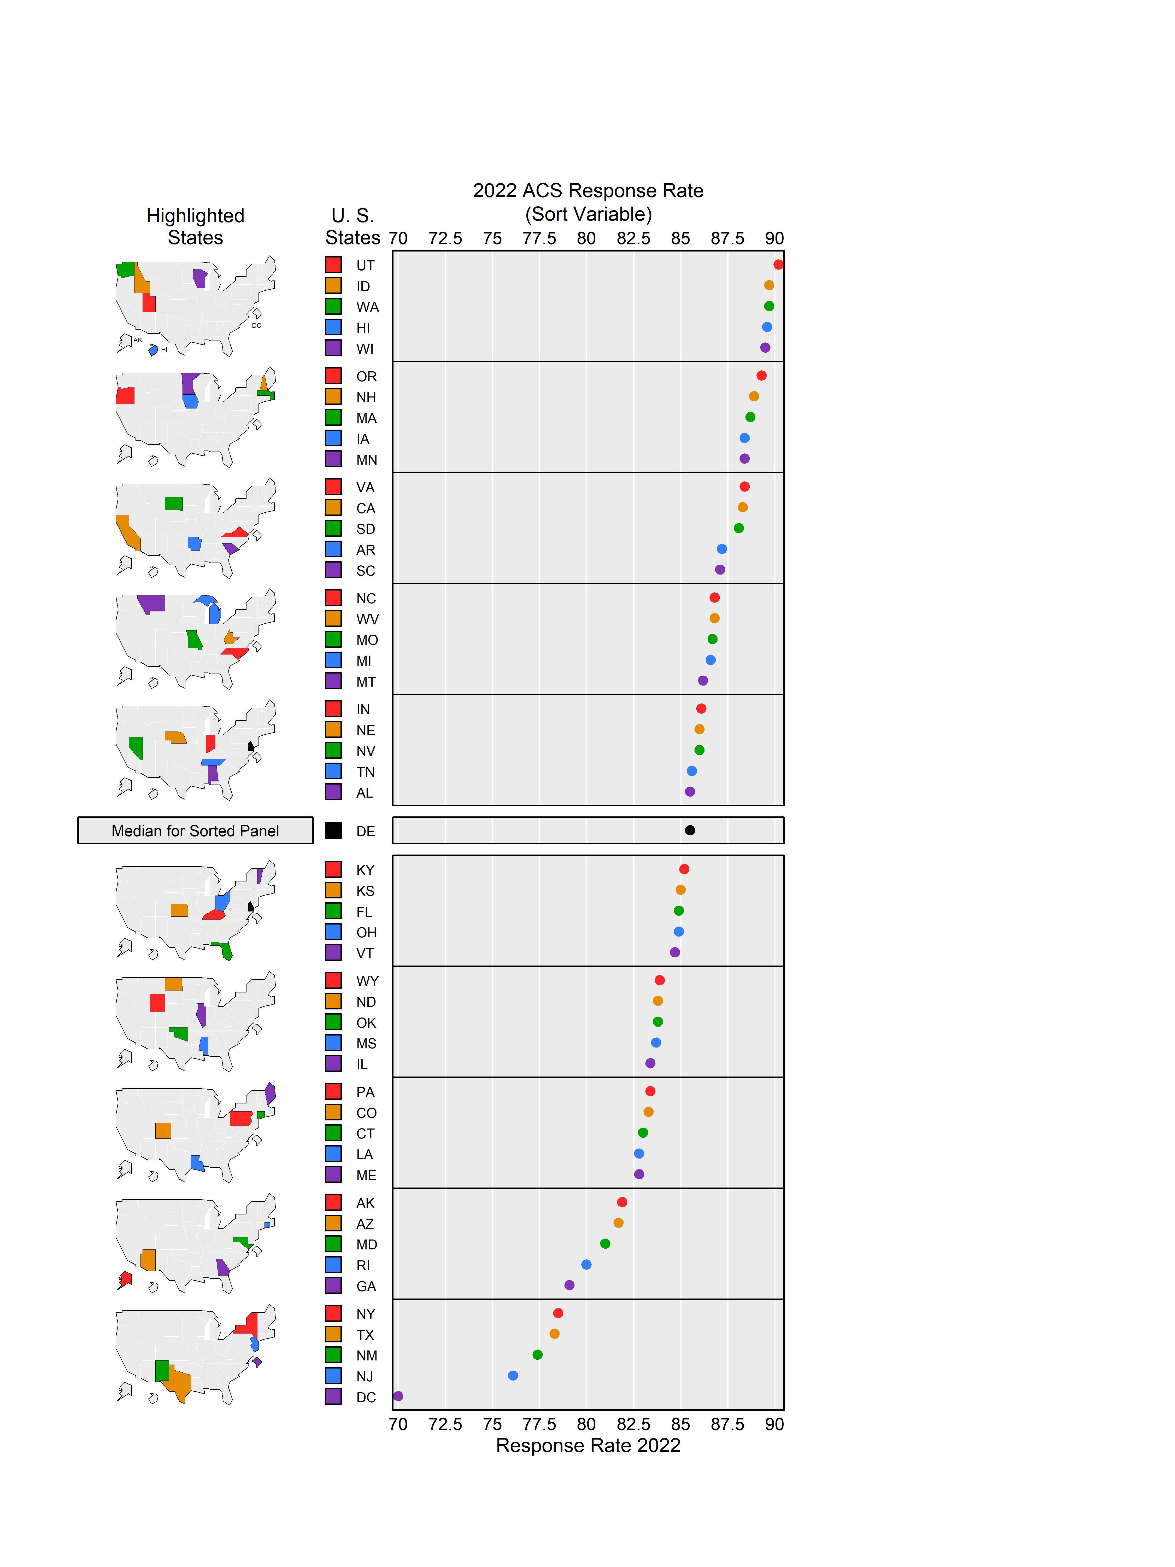
Legend & Labels
Micromaps
Perceptual Groups
Source: American Community Survey
Notes:
This is an example of a linked micromap from micromapST
First column shows US states
Second column is legend
Any number of data columns can be used
Geographic regions are organized into perceptual groups
51 states fit well: Median region, 25 state above and 25 below in groups of 5

Slide 16
Key Features of micromapST
We use micromapST package in R.
Provides an easier way to create linked micromaps for 51 U.S. states
Lots of options: Dots, Arrows, Bars, Boxplot, Scatterplots, Time series, error bars, confidence bands
Notes:
Create script for these bullets – paraphrase or briefly summarize
In this talk… all examples are from micromapST package
We show just a few of the several options available for visualizing data

Slide 17
The Datasets
Quarterly Census of Employment and Wages (QCEW) https://data.bls.gov/maps/cew/us
Occupational Employment and Wage Statistics (OEWS) https://www.bls.gov/oes/data-overview.htm

Slide 18
Application – QCEW

Slide 19
Comparisons of Subpopulations Using One Variable from QCEW
Comparison of industrial sectors across US states and across time – Improvement over choropleth maps
Comparison of employment and wages over individual counties in New York state – Shows different geographies

Slide 20
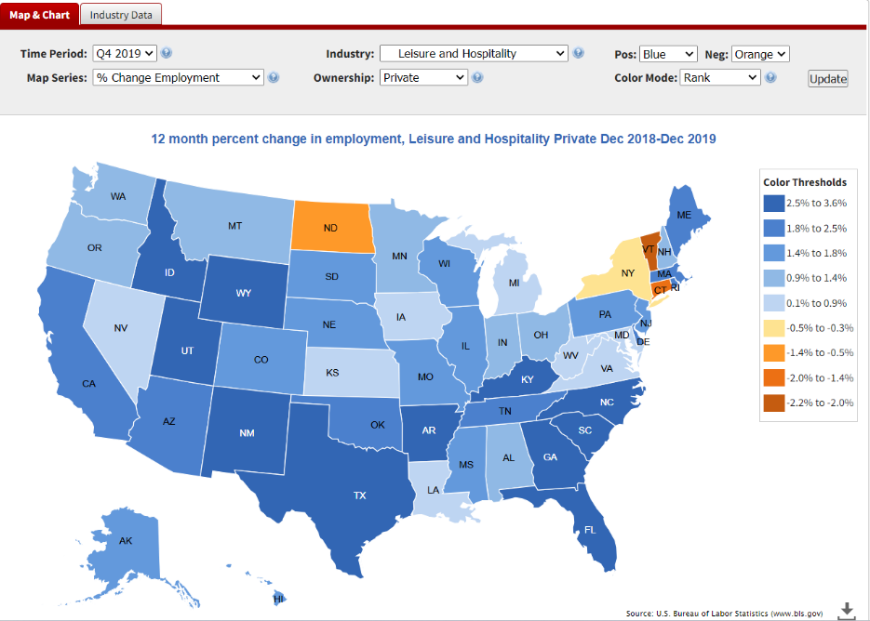
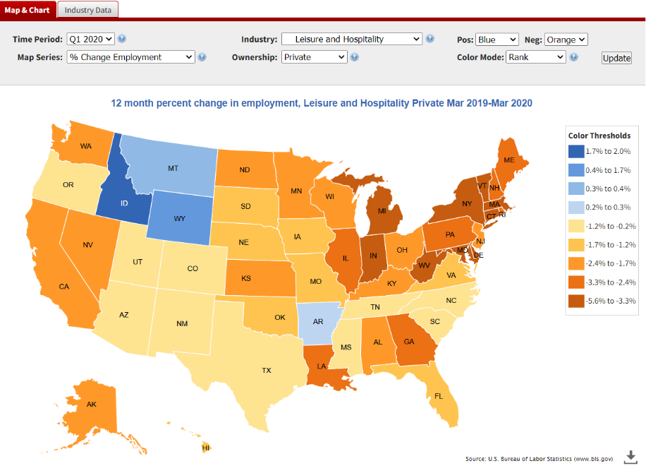
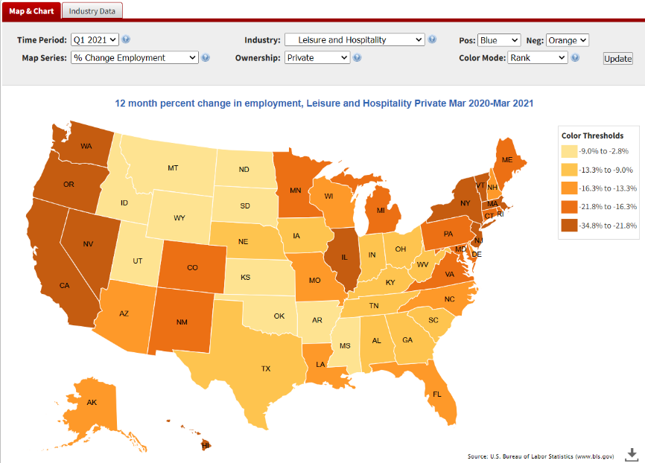
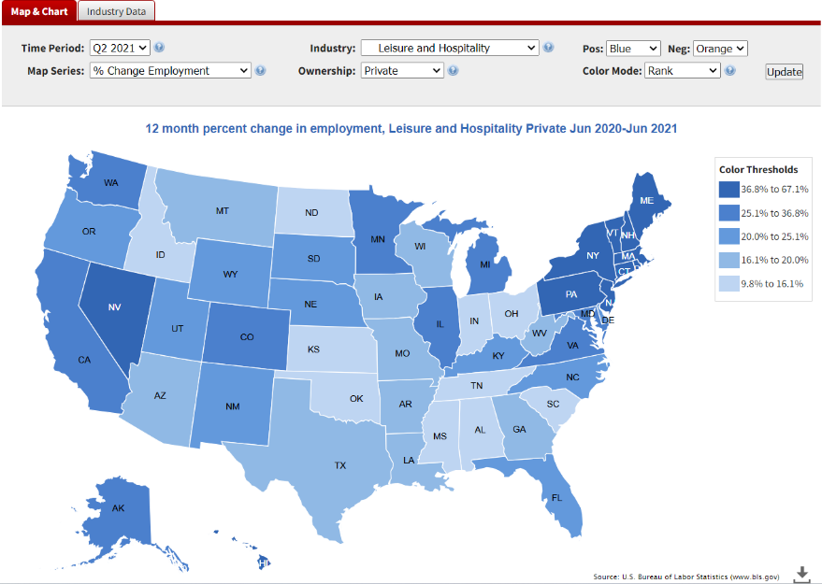
Leisure and Hospitality: Effects of the Pandemic on Employment

Slide 21
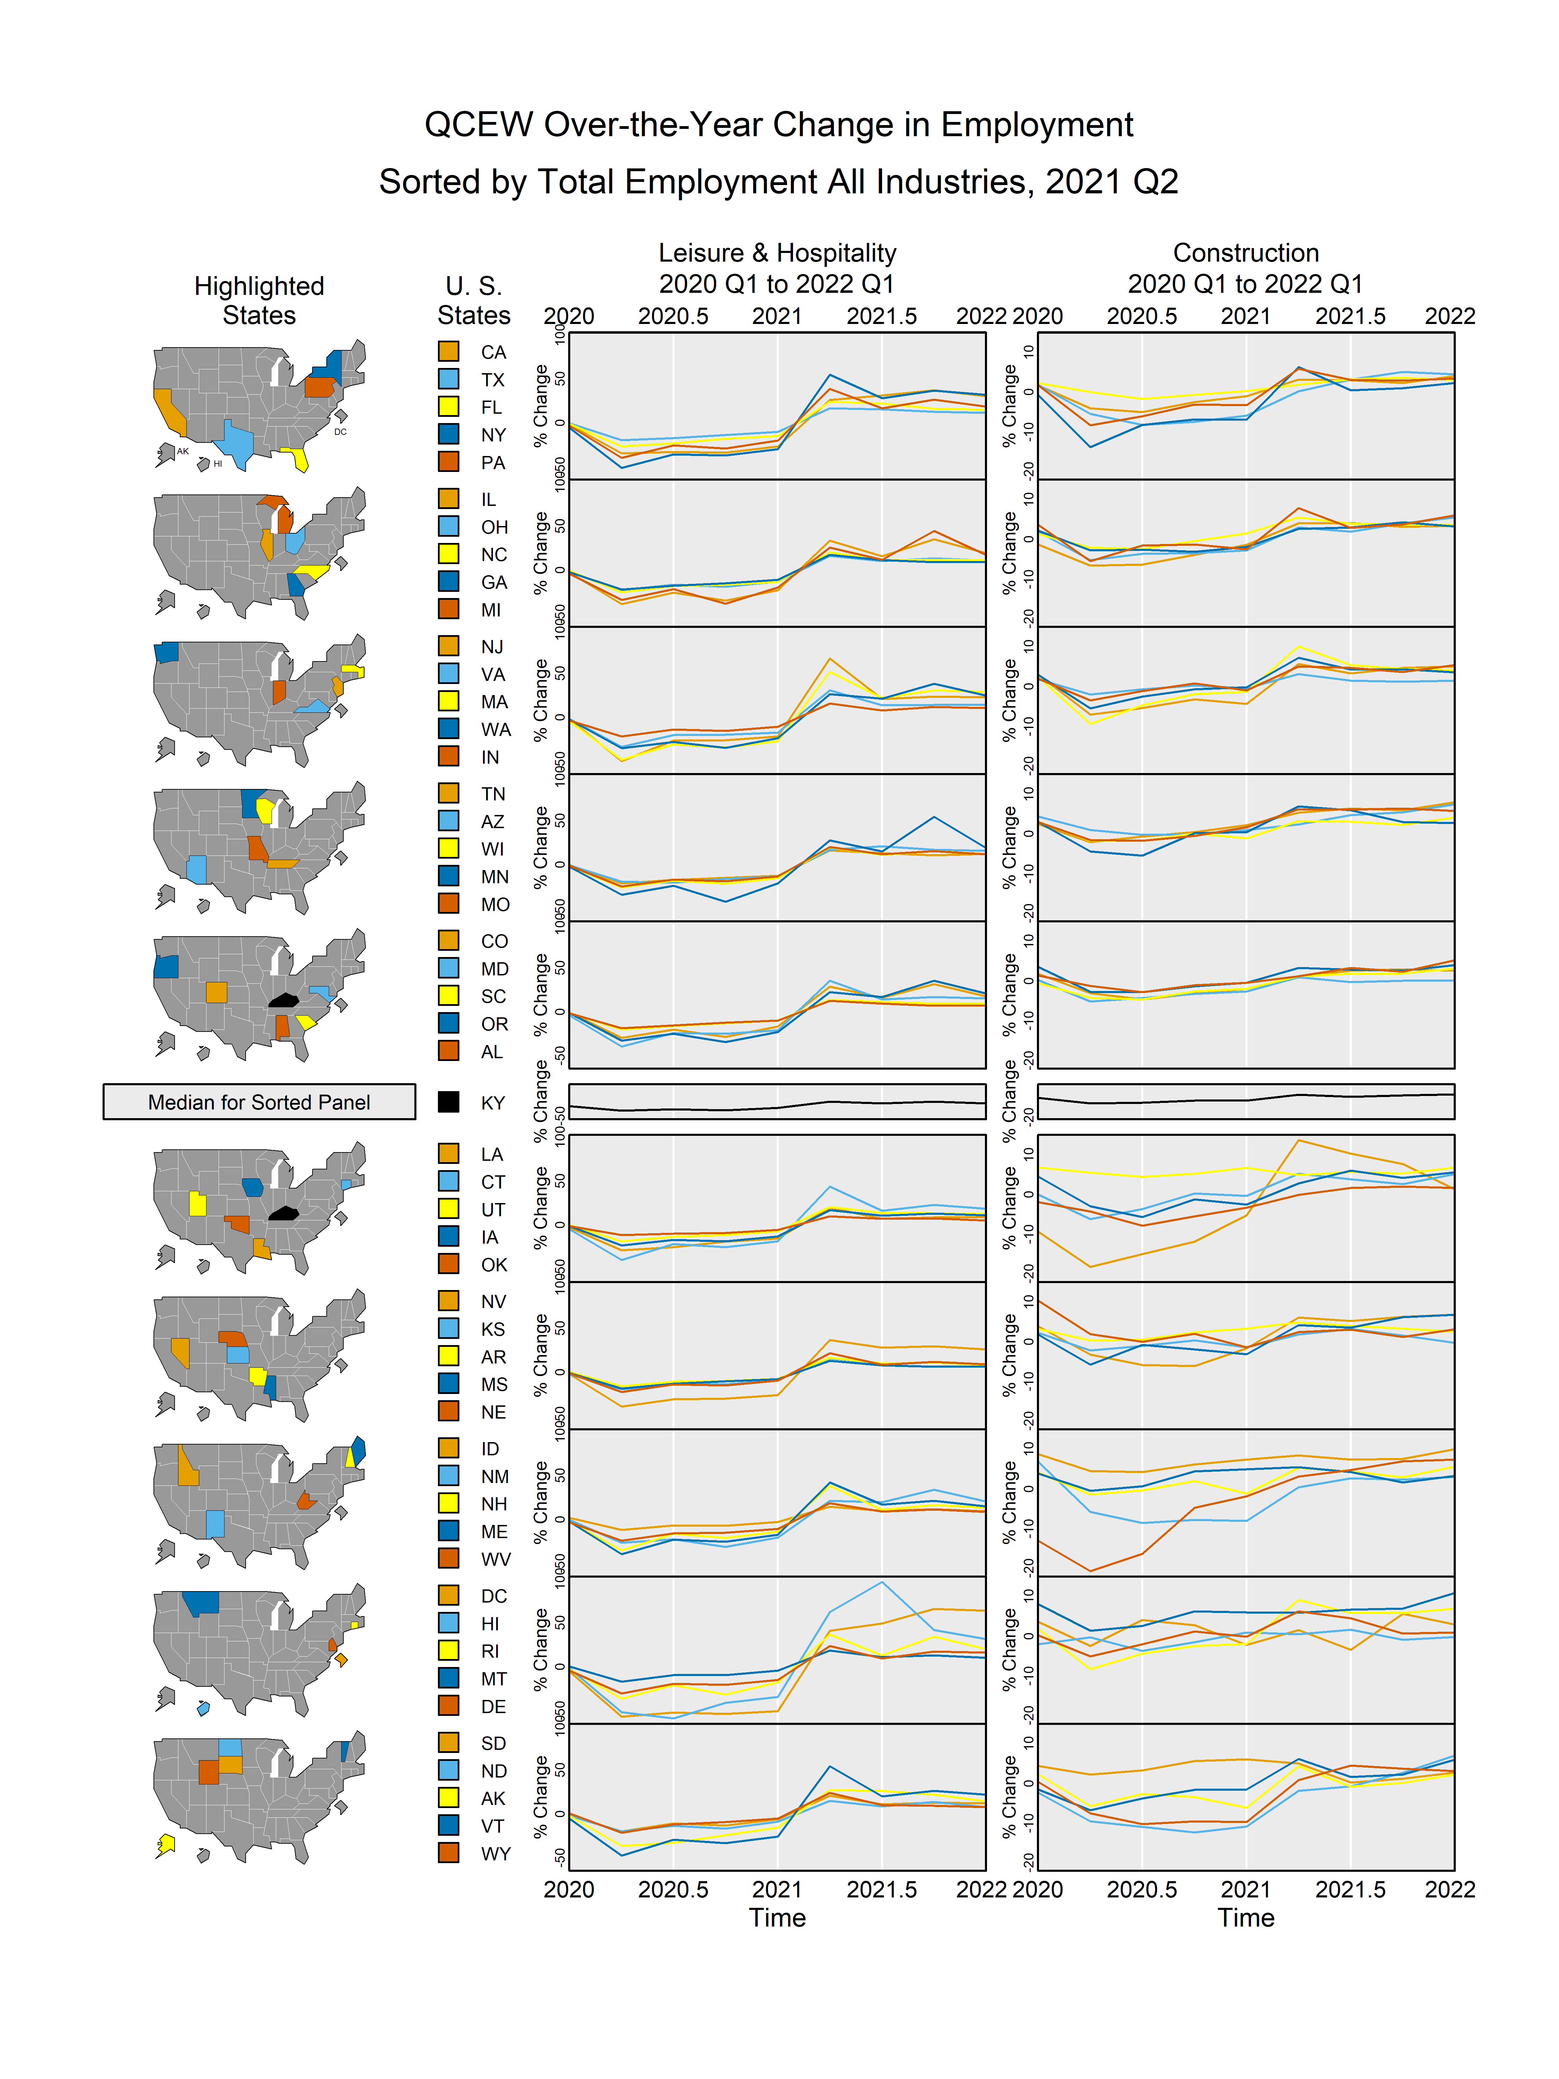
Now with Linked Micromaps

Slide 22
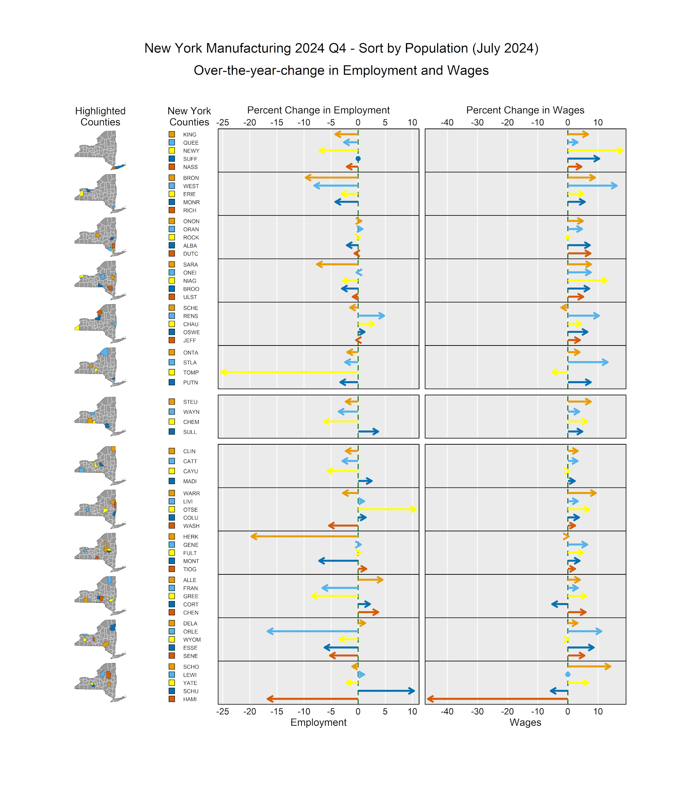
Linked Micromaps for Counties

Slide 23
Application – OEWS

Slide 24
Visualization of Multivariate OEWS Data
Visualize nine columns of tabular data in one plot – improvement over tables
Visualize multiple variables and sub-regions – see relationships between variables

Slide 25
OEWS 2023 Table of Employment & Wages
OEWS 2023 Employment and Hourly Wages for Software Developers
(Source: https://www.bls.gov/oes/2023/may/oes151252.htm.)
STATE​ | LOCATION​ QUOTIENT​ | H_MEAN​ | MEAN_PRSE​ | H_PCT10​ | H_PCT25​ | H_MEDIAN​ | H_PCT75​ | H_PCT90​
AL​ | 0.76​ | 53.19​ | 1.5​ | 29.58​ | 37.73​ | 49.39​ | 64.57​ | 81.29​
AK​ | 0.08​ | 70.01​ | 4.6​ | 41.95​ | 52.27​ | 72.79​ | 84.83​ | 93.45​
AZ​ | 1.13​ | 61.56​ | 1.6​ | 37.72​ | 45.77​ | 59.22​ | 69.85​ | 84.83​
AR​ | 0.41​ | 42.37​ | 4.8​ | 14.13​ | 27.96​ | 44.3​ | 53.97​ | 64.05​
CA​ | 1.55​ | 83.55​ | 0.8​ | 49.64​ | 65.04​ | 81.09​ | 100.92​ | 108.97​
CO​ | 1.47​ | 69.92​ | 1.1​ | 41.62​ | 50.73​ | 64.89​ | 80.44​ | 99.25​
CT​ | 1.01​ | 61.75​ | 1.5​ | 37.51​ | 47.93​ | 60.14​ | 75.69​ | 89.63​
DE​ | 0.95​ | 63.29​ | 2​ | 44.08​ | 51.97​ | 63.31​ | 73.29​ | 84.04​

Slide 26
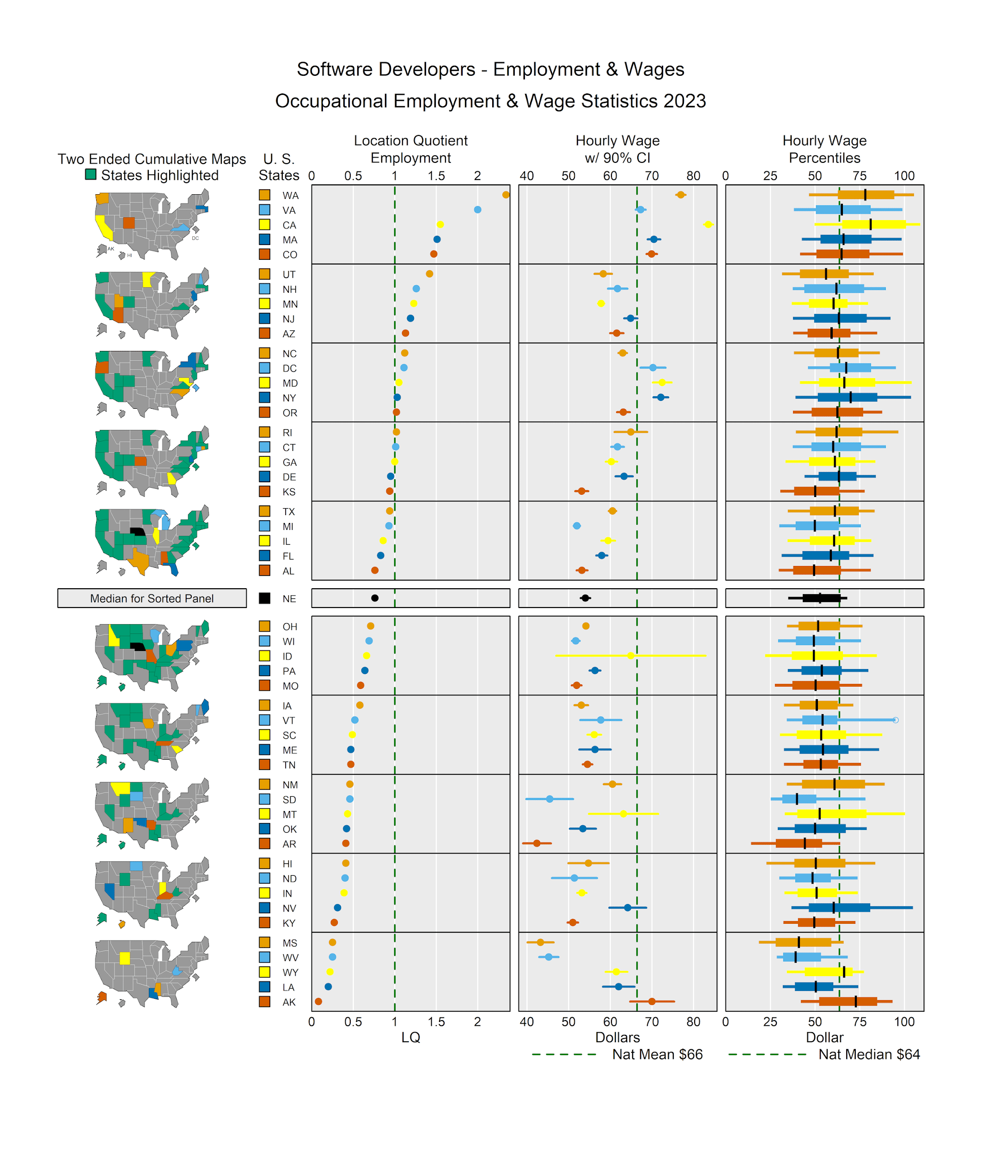
All columns and more shown with Linked Micromaps

Slide 27
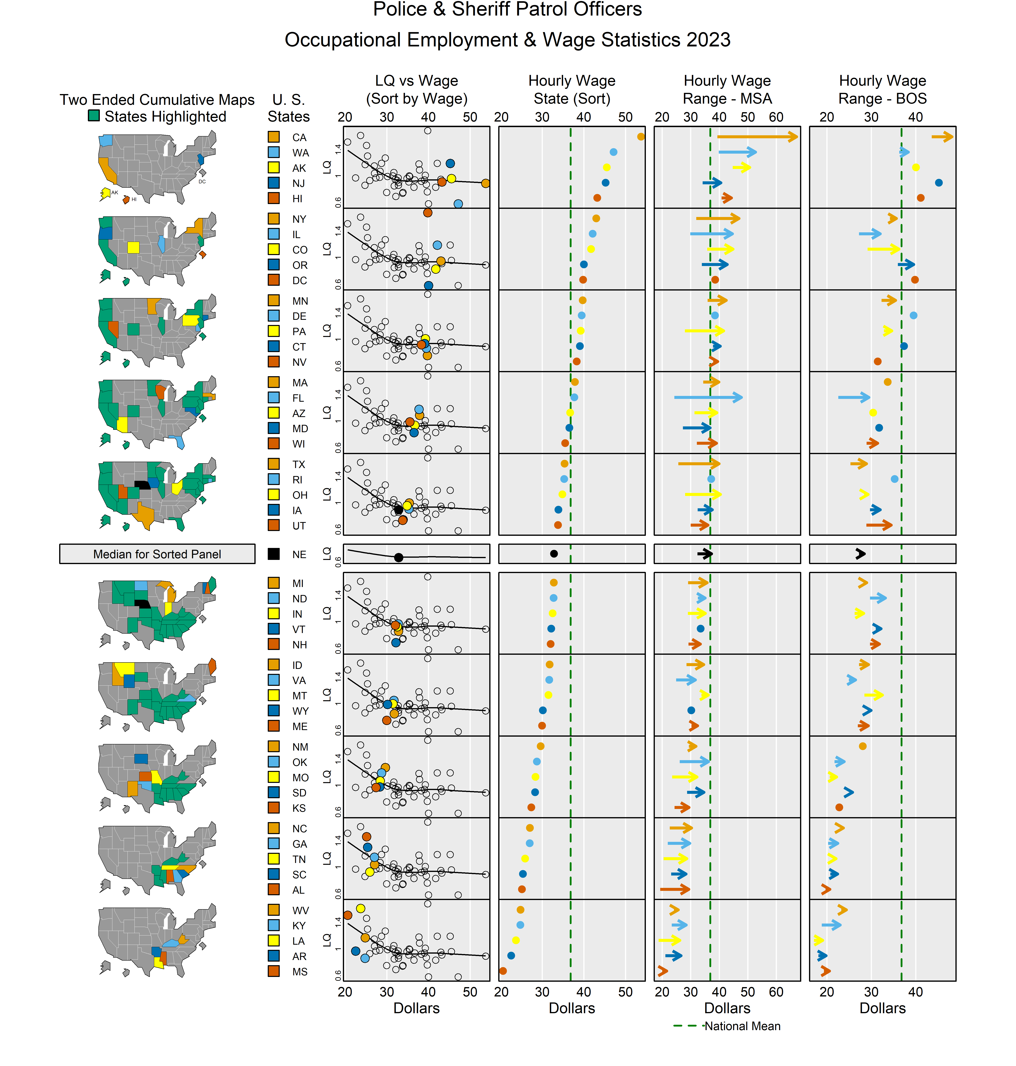
Two variables – Employment and wages
Scatterplot with lowess - local linear
Compares wages for sub-regions: Metro and Rural
Vertical dotted line: national wage

Slide 28
Summary
Demonstrated how linked micromaps are an improvement over choropleth maps and tables
R Shiny app and Shiny gadget coming soon (ease of use)
FedCASIC Wednesday at 1:00pm, Session 4A: Sampling and Response:
  Use of Linked Micromaps for Understanding Empirical Effects of Unit Nonresponse, Darcy Steeg Morris, US Census Bureau

Slide 29
Contact Information
Randall Powers
Mathematical Statistician
Office of Survey Methods Research
powers.randall@bls.gov
References – search for Randall Powers on arXiv:
[2604.12773] A Shiny micromapST App, arXiv
[2411.04211] Using Linked Micromaps for Evidence-Based Policy, arXiv

