Slide 1
Using Remote CAPI in Controlled Residential Settings
The Implementation of the Survey of Prison Inmates R&D Field and Cognitive Test
Scarlett Pucci, RTI International
Ashley Murray, RTI International
Eliza Snee, RTI International
Tim Smith, RTI International
Notes:
Acknowledge authors & BJS.
Disclaimer, “as BJS has not released the reports associated with the work I’m presenting on, I am limited on disclosing sample and statistical findings.”

Slide 2
Overview
Background (SPI & SPI R&D)
Protocol Development
Field Test
Cognitive Test
Findings
Recommendations

Slide 3
Background

Slide 4
Survey of Prison Inmates (SPI)
Funded by the Bureau of Justice Statistics (BJS), the SPI is a periodic survey of incarcerated people 18 and older.
The SPI questionnaire uses Computer-Assisted Personal Interviewing (CAPI) and has been administered by professional field interviewers on-site/in-person.
SPI 2016 Topic Areas
Sociodemographic characteristics Current offense and sentence Incident characteristics Firearm possession and sources Criminal history Family background Drug and alcohol use and treatment Mental and physical health and treatment Participation in facility programs Rule violations
Notes:
Administered to those held in a state-owned or operated prison or a federal prison.
The SPI was introduced in 1974 and last administered in 2016.

Slide 5
SPI Research & Development (SPI R&D)
Goals of the SPI Research and Design (SPI R&D) program, funded by BJS, include:
  Update and test the SPI instrument to ensure accurate collection of national data on those incarcerated in prison.
  Evaluate an alternate mode of data collection to maximize data quality while minimizing burden to facilities and respondents.
  Test consent procedures to enhance the use of administrative records that may expand on statistics that can be produced from the SPI.
  Develop a plan for the national implementation that BJS can use to conduct the SPI.
A key focus was whether (and how) remote interviewing could be conducted without sacrificing respondent privacy or data quality (while lowering costs).
  Field Test
  Cognitive Test
Notes:
The SPI R&D program was started in 2024.

Slide 6
Protocol Development

Slide 7

Remote Interviewing
Consists of a professional interviewer interviewing an incarcerated individual remotely at a private location using teleconferencing technology (e.g., Zoom)
Potential Facility Benefits
Reduced burden on facility staff
Continued maintenance of security
Potential Data Collector Benefits
Reduced travel costs
Interviewer safety
Potential Disadvantages
Increased technological disruptions
Reduced rapport
Diminished privacy
Notes:
For remote interviewing, you need two computers or laptops (one for the interviewer, one for the sampled member) along with consistent connectivity (WiFi) and audio & video capabilities. We also tested screensharing capabilities.
Facility burden = checking in interviewers and their property, escorting interviewers on-site.
However, one must account for the drawbacks, which can affect participation and data quality.

Slide 8
Remote Interviewing Protocols
Acquired various technology:
  Laptops
  Hot spots
Developed a protocol designed to mitigate potential disadvantages of remote interviewing:
    Technological Disruptions
    Conducted technological training
    Established and tested links with facilities in advance
    Provided remote or on-site support
    Developed a technology shipping/tracking system
    Monitored hot spot overages
    Diminished Privacy
    Confirmed privacy
Notes:
Utilized existing facility technology and connectivity when possible, we also offered to provide both.
Tech acquired includes: laptops for remote interviewers, laptops for facilities, and hot spots for connectivity.
In addition to our regular interviewer training:
held teleconference training with interviewers (microphones, webcams, and speakers; Screensharing; Juggling multiple windows on one screen)
hot spot training with on-site supervisors,
additional platform-specific training as needed.
Privacy: In-person interviewers confirmed private space. If remote/in-person in different areas, OS confirmed privacy for remote space. If fully remote, confirmed with facility and participants.

Slide 9
Field Test

Slide 10
Field Test Methodology
Goal
Evaluate feasibility of remote SPI interviewing by comparing participation and data quality by mode
Assignment
Mode split within facility via random assignment
Sampling
Convenience sample of federal & state, female & male facilities
Random sample of 100-135 individuals per facility

Slide 11
Field Test Logistics
Site Visits
Interview Areas
Private
Centralized or Decentralized
RTI Team
Logistics Manager
In-Person Supervisor
In-Person and Remote Interviewers
Up to 5-day facility data collection
3-month data collection period (2025)
Notes:
All sampled facilities were assigned a trained RTI Logistics Manager who held a one-hour call with staff at each facility to understand check-in and security protocols; Population characteristics; Secured housing; Available interviewing areas; and Available technology (e.g., wi-fi network).
Field Team consisted of both in-person and remote interviewers, as well as an on-site supervisor did not interview, but helped facilitate the roster, schedule, and communications.
Centralized (one large room or multiple rooms within the same area), Decentralized (rooms throughout facility).
If decentralized, supervisor was stationed in remote interviewing area to confirm privacy.

Slide 12
Field Test Technology
When possible, we utilized existing facility technology accessible to incarcerated populations.
Technology set up included one of the following:
  RTI laptops/RTI connectivity (hot spot).
  RTI laptops/facility WiFi.
  DOC/Facility technology/facility connectivity.
Notes:
Facility technology may exist that is used to facilitate telehealth visits, virtual court appearances, or attorney visits. It can be a computer, laptop, tablet, or kiosk. It can be stationary or portable. The technology needed teleconferencing capabilities including audio, video, screensharing, as well as a secure, private setting and of course, accessible by the population.
RTI provided computers and/or connectivity as needed.

Slide 13
Cognitive Test

Slide 14
Cognitive Test Methodology
Goal
Qualitative evaluation of survey content, including sensitive items, potentially impacted by mode.
Assignment
Mode split by facility
Sampling
Convenience sample of federal & state, female & male facilities
Random sample of 30 individuals per facility
Notes:
The Cognitive Test gave us further opportunity to implement and test remote interviewing.
A key difference is that mode was not split within facility, but by facility– each facilities’ data collection was conducted fully remote or fully in-person.
Additionally, the sample was smaller.

Slide 15
Cognitive Test Logistics
Site Visits
Up to 3-day facility data collection
Interview Areas
Private
Centralized or Decentralized
RTI Team
Logistics Manager
In-Person or Remote Supervisor
In-Person or Remote Interviewers
5-week data collection period (2025)
Notes:
In terms of logistics, the cognitive test was largely structured the same way as the field test.
Additionally, due to the smaller sample, there were shorter data collection periods.
However, since facilities were assigned to be conducted under one mode, the interviewer team was fully in-person or remote, including the On-Site Supervisor
Fully remote: Confirmed privacy with facility and sampled member

Slide 16
Cognitive Test Technology
Remote facilities used DOC and/or facility-provided devices and connectivity.
In-person facilities used RTI-provided technology and connectivity.
Notes:
As with the field test, we worked with agencies/facilities to determine technology and connectivity for the remote interviews.

Slide 17
Findings

Slide 18

Remote Interviewing Experience
Remote interviewing was successful across both tasks.
For the field test, in most facilities:
  RTI provided computers.
  Facilities provided connectivity.
Notes:
Successful is defined as the interviewer fully administering the SPI interview protocol, including obtaining informed consent, providing incentives to participants (if approved), administering all survey questions, and displaying response options onscreen for select questions.
We did experience some technical issues, which was to be expected, but were able to resolve. This will be discussed momentarily under Recommendations.
Most facilities used our computers and most facilities provided WiFi.

Slide 19
Field Test Feedback
RTI gathered feedback from involved facility staff.
Of facilities that provided feedback, most did not report a mode preference.
“Both modes were efficient and worked great.”
“[Staff] preferred in-person because of potential issues for Wi-Fi/data.
[Participants] preferred in-person because many do not have experience with technology and there is not a human connection with a virtual. Social interaction reasons.”
“Virtual interviews were a lot easier by allowing the inmates to go in, get on the computer, and get out without trying to have conversation with the next person.”
“Both modes appeared to meet the needs of various offenders’ preferences.”
Notes:
This is only for the field test as those facilities experienced both modes, unlike the cognitive test.
Please note all quotes are staff perception/opinion.

Slide 20
Recommendations
Notes:
Our recommendations include items that we both implemented as well as learned.

Slide 21
Technology
Challenge:
Sporadic technical issues
Technical issues were resolved but impacted timeliness, facility staff burden, and respondent burden.
Recommendations:
Use existing facility technology when possible (but be prepared to provide technology and/or connectivity).
Test connectivity within the planned interview space.
Train field staff on technology and trouble shooting.
Have technical support available, ideally on-site.
Notes:
Sporadic technical issues include: security pop ups, connectivity failures, and hot spot overages.
It is advantageous to utilize existing technology because it is established and familiar.

Slide 22
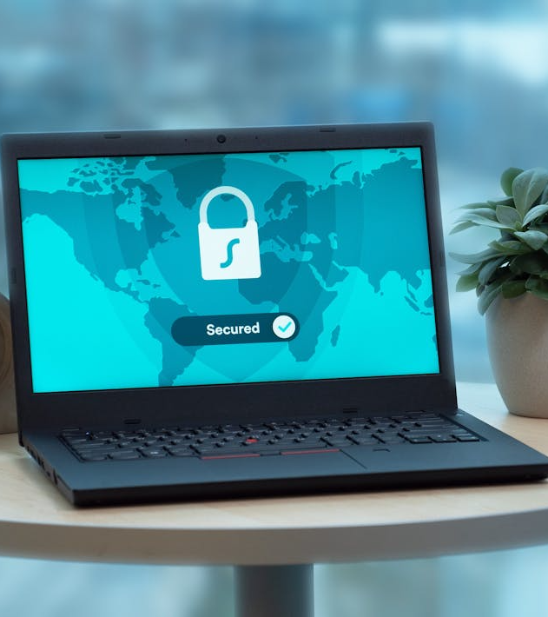
Security
Challenge:
Ensuring technological security
Recommendations:
Own the teleconferencing links, ensuring privacy and no cost.
For respondents, provide devices with locked capabilities.
Notes:
In addition to this, of course our interviewers followed basic security protocols (password protected devices, storing devices in a locked/secured environment)

Slide 23
Connectivity
Challenge:
Some facilities were unable to provide WiFi connectivity for RTI technology.
Recommendations:
Provide connectivity (e.g., hot spots).
Conduct interviewer training on connectivity devices.
Use different interview areas when connectivity is not possible.
Monitor connectivity for data overages.
Notes:
Data overages means…

Slide 24
On-Site Support
Challenge:
Communicating with facility staff was difficult without the onsite supervisor.
This can increase burden on sample members.
Recommendation:
Train supervisor on technology, trouble shooting, and connectivity.
Assign in-person supervisor, but if fully remote:
  Offer remote support.
  Train facility staff on procedures and privacy requirements.
  Confirm with respondent they were in a private location.
Notes:
Difficulties contacting staff due to No Cell Phones in most facilities. Therefore, our contact would often be away from their office (where their landline was) as they were “on-site” in the interviewing space.
This potentially added burden on sample members as we would have to communicate technological issues with them and/or ask them to summon facility staff.
Train on technology, and ideally recommend someone on-site, but if not…
Without the OS, facility staff were able to successfully perform the duties of study staff members by setting up computers, assuring the privacy of interviewing spaces, connecting to Zoom lines, and providing study materials (consent forms and contact cards).
-

Slide 25
Contacts
RTI International
  Scarlett Pucci Project Manager spucci@rti.org
  Tim Smith Project Director tksmith@rti.org
Bureau of Justice Statistics
  Melissa Cidade Project Manager melissa.cidade@usdoj.gov
  Rich Kluckow Unit Chief richard.kluckow@usdoj.gov

Slide 26
Thank you!

