Slide 1
Can We Predict Dropout?
The Predictive Power of In-Survey Burden Evaluations
Erica Yu, Robin Kaplan, & Doug Williams
Office of Survey Methods Research
Bureau of Labor Statistics
FedCASIC
April 21, 2026
Notes:
Session: Designing the Survey Collection Instrument
20 minute presentation time
Abstract Text:
The Bureau of Labor Statistics and Census Bureau are conducting research on the modernization of the Current Population Survey (CPS). The CPS is a monthly survey with a longitudinal design collected using a combination of telephone and in-person interviews. Ongoing research is being conducted on ways to improve response rates, the respondent experience, and manage survey costs. One way to address these issues is to add a web mode of collection. Currently, the CPS is interviewer-administered only and adding the web mode would add a new self-administered option. A pilot test of mixed-mode administration of the CPS was conducted in 2025. All respondents, immediately after completing a wave of the CPS either by self-response on the web or by personal interview, had the option to provide feedback about their survey experience by answering closed-ended questions, including about how burdensome the survey was, how relevant the questions felt, and how easy or difficult it was to answer the questions. The debriefing questions were repeated at the end of each monthly wave of interviews; respondents could participate in up to three waves for this pilot test. This design resulted in a dataset of more than 2,500 cases with data on response mode, demographics, debriefing responses, and whether respondents dropped out in later waves. Analysis focused on evaluating the survey experience between web and personal interview modes, whether labor force status is associated with ratings of difficulty and burden, and debriefing responses associated with survey non-response in subsequent waves. Discussion will include debriefing questionnaire design, factors related to the respondent experience, and the relationship between response mode and burden.

Slide 2
The information in this presentation is being released for research purposes only. It is to inform interested parties and to encourage discussion of work in progress. All views expressed in this presentation are those of the authors and do not necessarily reflect the views or policies of the U.S. Bureau of Labor Statistics.
Counts have been rounded to avoid disclosure, according to U.S. Census Bureau guidance.

Slide 3
Background: Respondent Feedback
Useful for evaluation of the survey
Assess question sensitivity (Miller & Davis, 1994)
Assess respondent question comprehension of survey concepts (Martin, Campanelli, & Fay, 1991; Hess & Singer, 1995)
Monitor respondent experience (Yang & Toth, 2022)
Typically collected at the end of the last interview
Concern about contaminating future response
Attrition results in a sample of only cooperative respondents

Slide 4
Background: CPS Field Test
Monthly survey, including months-in-sample (MIS) 2, 3, 4
Collection months June-September 2025
Duration ~10-15 minutes
Interviewer-administered and Web self-response modes
Feedback survey at the end of each month’s CPS questions
High-Impact Service Provider survey in web mode
Questions about the respondent experience
Analytic sample n=2,700 households

Slide 5
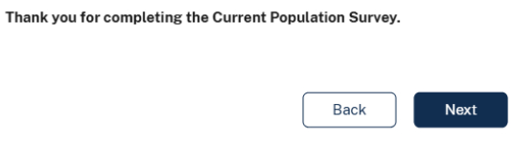
Question Sequence

Slide 6
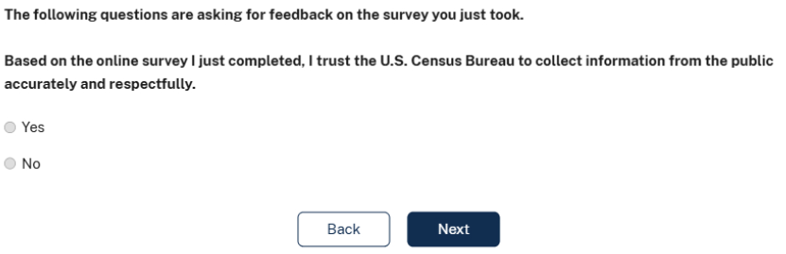
Question Sequence

Slide 7
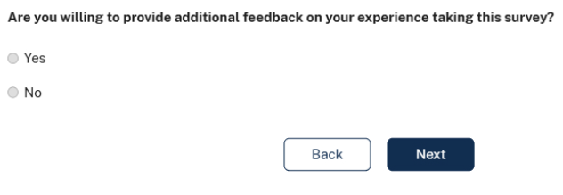
Question Sequence

Slide 8
Selected Questions
Question | Mode
How burdensome was this survey to you? | CAPI, Web
Which of the following most closely reflects your work situation? | Web
How easy or difficult was it for you to answer the questions in this survey? | CAPI, Web
Do you prefer to respond to this survey on your own on the web, or with an interviewer? [‘with an interviewer on the phone or in-person’] | Web
How likely are you to complete this survey again? | Web
Notes:
Full questionnaire for Web:
Burden
Difficulty logging in
Relevant to work situation
What is the work situation
Difficulty answering questions
Prefer web or interviewer
Contact led to response
How likely complete this survey again
Full questionnaire for CAPI:
Do you know web?
Do you recall emails texts
Did you try web
Why not complete web
Why not try web
Burden
Easy or difficult to answer questions
Why difficult

Slide 9
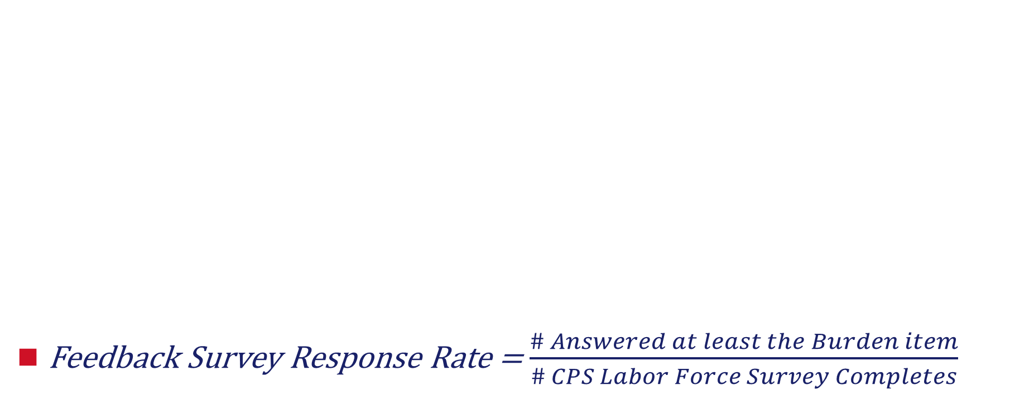
Feedback Survey Response Rate
Feedback Survey Response Rate = $\frac{\# Answered at least the Burden item}{\# CPS Labor Force Survey Completes}$
 | CAPI/CATI Completion Mode | Web Completion Mode | Difference
MIS-2 |  | 26.5% (n=300)
MIS-3 |  | 23.3% (n=250)
MIS-4 |  | 25.3% (n=250)

Slide 10

Feedback Survey Response Rate
 | CAPI/CATI Completion Mode | Web Completion Mode | Difference
MIS-2 | 40.4% (n=750) | 26.5% (n=300) | +13.9%
MIS-3 | 39.5% (n=650) | 23.3% (n=250) | +16.1%
MIS-4 | 41.4% (n=550) | 25.3% (n=250) | +16.0%
Feedback Survey Response Rate = $\frac{\# Answered at least the Burden item}{\# CPS Labor Force Survey Completes}$

Slide 11
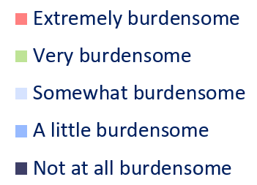
How burdensome was this survey to you?
***
Fisher’s Exact tests using Monte Carlo simulation with 10,000 replicates *** p<0.001, ** p<0.01, * p<0.05

Slide 12
How burdensome was this survey to you?
***
Fisher’s Exact tests using Monte Carlo simulation with 10,000 replicates *** p<0.001, ** p<0.01, * p<0.05

Slide 13
How burdensome was this survey to you?
***
Fisher’s Exacts test using Monte Carlo simulation with 10,000 replicates *** p<0.001, ** p<0.01, * p<0.05

Slide 14
Burden and Demographic/Labor Force Factors
Burden | MIS-2 | MIS-3 | MIS-4
Household size | ns | ns | ns
Education | ns | ns | ns
Age category | * | ns | ns
Business ownership | ns | ns | ns
Worker status | ns | ns | ns
Self/BLS worker status match | ns | ns | ns
Fisher’s Exact tests using Monte Carlo simulation with 10,000 replicates *** p<0.001, ** p<0.01, * p<0.05

Slide 15
How easy or difficult was it for you to answer the questions in this survey?
*
**
*
Fisher’s Exact tests using Monte Carlo simulation with 10,000 replicates *** p<0.001, ** p<0.01, * p<0.05

Slide 16
Difficulty and Demographic/Labor Force Factors
Difficulty | MIS-2 | MIS-3 | MIS-4
Household size | ns | ns | ***
Education | ns | ns | ns
Age category | ns | ns | ns
Business ownership | *** | * | ***
Worker status | ns | ns | ns
Self/BLS worker status match | ns | * | **
Fisher’s Exact tests using Monte Carlo simulation with 10,000 replicates *** p<0.001, ** p<0.01, * p<0.05

Slide 17
Predicting Response
Binomial logistic regression using MLE
Python statsmodels library
Dependent variable: Respond in the next MIS (1) or not (0)
Predictors limited to measures available for both CAPI and Web
MIS-2 to 3
Pseudo R²=0.05
X²(12, N=900)=41.96, p<.001
MIS-3 to 4
Pseudo R²=0.04
X²(12, N=750)=31.42, p<.002

Slide 18
Selected Predictors of Response in Next MIS
 | MIS-2 to 3
Predictor | OR | 95% CI | p
College or higher | 1.82 | [1.20, 2.75] | 0.01
Age category | 1.23 | [1.00, 1.52] | 0.05
Difficulty | 0.85 | [0.64, 1.13] | 0.27
Burden | 0.92 | [0.75, 1.14] | 0.46
Completion mode | 2.50 | [0.83, 7.53] | 0.10
Burden * Completion mode | 0.52 | [0.31, 0.87] | 0.01
Difficulty * Completion mode | 1.93 | [0.91, 4.11] | 0.09

Slide 19
Selected Predictors of Response in Next MIS
 | MIS-2 to 3 |  |  | MIS-3 to 4
Predictor | OR | 95% CI | p | OR | 95% CI | p
College or higher | 1.82 | [1.20, 2.75] | 0.01 | 1.36 | [0.86, 2.17] | 0.19
Age category | 1.23 | [1.00, 1.52] | 0.05 | 1.25 | [0.99, 1.58] | 0.06
Difficulty | 0.85 | [0.64, 1.13] | 0.27 | 1.16 | [0.76, 1.77] | 0.49
Burden | 0.92 | [0.75, 1.14] | 0.46 | 0.95 | [0.73, 1.24] | 0.72
Completion mode | 2.50 | [0.83, 7.53] | 0.10 | 6.11 | [1.89, 19.71] | 0.002
Burden * Completion mode | 0.52 | [0.31, 0.87] | 0.01 | 0.51 | [0.28, 0.93] | 0.03
Difficulty * Completion mode | 1.93 | [0.91, 4.11] | 0.09 | 0.86 | [0.37, 2.00] | 0.73

Slide 20
How likely are you to complete this survey again?
*
Fisher’s Exact test using Monte Carlo simulation with 10,000 replicates *** p<0.001, ** p<0.01, * p<0.05

Slide 21
Do you prefer to respond to this survey on your own on the web, or with an interviewer?
n=300 n=250 n=250

Slide 22
Mode Preference and Demographic/Labor Force Factors
Mode Preference | MIS-2 | MIS-3 | MIS-4
Household size | ns | ns | ns
Education | ns | ns | ns
Age category | * | ns | ns
Business ownership | ns | ns | ns
Worker status | ns | ns | ns
Self/BLS worker status match | ns | ns | ns
Fisher’s Exact test using Monte Carlo simulation with 10,000 replicates *** p<0.001, ** p<0.01, * p<0.05

Slide 23
Switching from Web Mode
**
n= 1000 n= 900
Fisher’s Exact test using Monte Carlo simulation with 10,000 replicates *** p<0.001, ** p<0.01, * p<0.05

Slide 24
Burden and Switching from Web Mode
**
*
Fisher’s Exact test using Monte Carlo simulation with 10,000 replicates *** p<0.001, ** p<0.01, * p<0.05

Slide 25
Difficulty and Switching from Web Mode
Fisher’s Exact test using Monte Carlo simulation with 10,000 replicates *** p<0.001, ** p<0.01, * p<0.05

Slide 26
Discussion
Limitation: Respondents who were willing to provide feedback*
Overall low rate of burden
~90% of respondents selecting “Not at all” or “A little” burdensome
Burden higher (though still low) for Web mode in MIS-2
Burden ratings not related to Demographic/Labor Force factors
Difficulty ratings were related to household size, business ownership, and mismatch between respondent and BLS classification of worker status

Slide 27
Discussion
For self-response, the more burdened you feel at the end of the survey the less likely you are to come back the next month
Respondents who say they are unlikely to respond again at the end of the survey are less likely to come back the next month
2%-5% web respondents reported preferring an interviewer
Respondents 65+ years prefer an interviewer rather than web
Switching from web mode related to burden but not difficulty

Slide 28
Future Research
In-survey evaluations can be used by field to target follow-up
Identify those likely to not respond in the next month
Identify those likely to require an interviewer in the next month
Tailor content of subsequent contacts
Research on respondent burden
What is the role of expectations?
Why do respondents who report low levels of burden and “Very Likely [to respond again]” ultimately not respond in the next month?

Slide 29
Contact Information
Erica Yu
Research Psychologist
Office of Survey Methods Research Bureau of Labor Statistics
www.bls.gov/osmr
202-691-7924
Yu.Erica@bls.gov

Slide 30
Demographic and Labor Force Factors
Education –
High school or less
Some college or Associates degree
College degree or higher
Business ownership in the household –
Yes
No
BLS-defined worker status –
Employed
Unemployed
Not in labor force
Self/BLS worker status match –
Match: agree whether employed, unemployed, not in labor force
No match: disagree
Household size –
1 person
2 people
3 people
4 people
5+ people

Slide 31
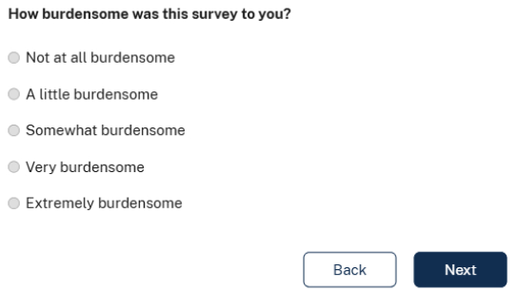
Burden Question

Slide 32
Predicting Response in MIS-3
Predictor | β | SE | p | OR | 95% CI
Intercept | 1.24 | 0.91 | 0.17 | 3.46 | [0.58, 20.59]
Household size | -0.02 | 0.08 | 0.80 | 0.98 | [0.85, 1.14]
High school or less | 0.30 | 0.22 | 0.19 | 1.34 | [0.87, 2.08]
College or higher | 0.60 | 0.21 | 0.01 | 1.82 | [1.20, 2.75]
Age category | 0.21 | 0.11 | 0.05 | 1.23 | [1.00, 1.52]
Business ownership | -0.11 | 0.26 | 0.68 | 0.90 | [0.54, 1.50]
Employed | -0.49 | 0.65 | 0.46 | 0.62 | [0.17, 2.21]
Not in the labor force | -0.19 | 0.67 | 0.78 | 0.83 | [0.22, 3.09]
Difficulty | -0.16 | 0.15 | 0.27 | 0.85 | [0.64, 1.13]
Burden | -0.08 | 0.11 | 0.46 | 0.92 | [0.75, 1.14]
Completion mode | 0.91 | 0.56 | 0.10 | 2.50 | [0.83, 7.53]
Burden * Completion mode | -0.65 | 0.26 | 0.01 | 0.52 | [0.31, 0.87]
Difficulty * Completion mode | 0.66 | 0.39 | 0.09 | 1.93 | [0.91, 4.11]

Slide 33
Predicting Response in MIS-4
Predictor | β | SE | p | OR | 95% CI
Intercept | -1.14 | 0.91 | 0.21 | 0.32 | [0.05, 1.89]
Household size | 0.03 | 0.09 | 0.70 | 1.03 | [0.88, 1.22]
High school or less | 0.21 | 0.25 | 0.40 | 1.23 | [0.76, 1.99]
College or higher | 0.31 | 0.24 | 0.19 | 1.36 | [0.86, 2.17]
Age category | 0.23 | 0.12 | 0.06 | 1.25 | [0.99, 1.58]
Business ownership | 0.29 | 0.22 | 0.18 | 1.34 | [0.88, 2.06]
Employed | 0.85 | 0.66 | 0.20 | 2.35 | [0.64, 8.60]
Not in the labor force | 0.89 | 0.67 | 0.19 | 2.44 | [0.65, 9.11]
Difficulty | 0.15 | 0.22 | 0.49 | 1.16 | [0.76, 1.77]
Burden | -0.05 | 0.14 | 0.72 | 0.95 | [0.73, 1.24]
Completion mode | 1.81 | 0.60 | 0.002 | 6.11 | [1.89, 19.71]
Burden * Completion mode | -0.67 | 0.30 | 0.03 | 0.51 | [0.28, 0.93]
Difficulty * Completion mode | -0.15 | 0.43 | 0.73 | 0.86 | [0.37, 2.00]

