Slide 1
GenAI for QA in Questionnaire Development and Instrument Programming
FedCASIC 2026
April 21, 2026
Weihuang Wong, Lilian Huang, Ting Yan

Slide 2

Presenter bio
  Large-scale data collection, data integration, and data analysis projects across early care and education, higher ed, health care, and traffic safety
  Main theme of my work: making tools and building processes to improve data quality and enhance research productivity
Weihuang Wong
  Principal Data Scientist
    Methodology & Quantitative Social Sciences

Slide 3
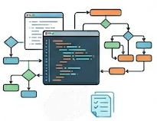

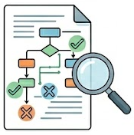
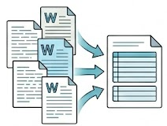
Overview
Focus of today’s talk
Questionnaire Development & Instrument Programming Pipeline
2.
3.
4.
1.
2.
3.
4.
1.
Questionnaire design
Write the questionnaire, perform cognitive testing, etc.
Spec review
Correct typos, verify validation rules, confirm skip logic etc., before handoff to programmers
Questionnaire programming
Translate specs into code, program skip patterns and fills
Code review
Ensure that programmed instrument is faithful to questionnaire specs
Questionnaire design
Write the questionnaire, perform cognitive testing, etc.
Spec review
Correct typos, verify validation rules, confirm skip logic etc., before handoff to programmers
Questionnaire programming
Translate specs into code, program skip patterns and fills
Code review
Ensure that programmed instrument is faithful to questionnaire specs

Slide 4
Spec Review

Slide 5
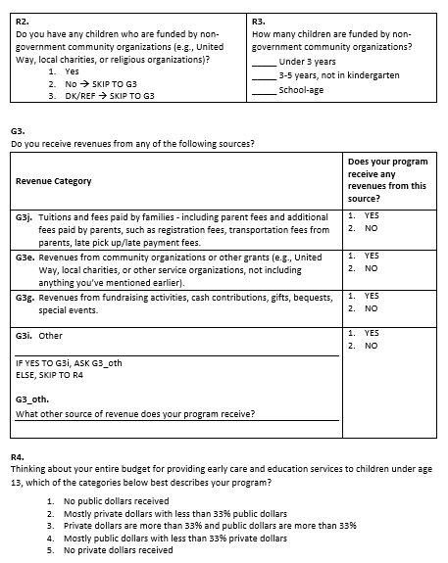
Spec Review
Spec Review
  Spec review: pre-programming QC for written questionnaire: part copyedit, part logic audit
  Ensures questions, skip patterns, validation rules are complete, consistent, ready to program
  Conventionally: Done manually by methodologist or analyst carefully reading through questionnaire document line by line
  Opportunity for GenAI to complement human review by adding another pair of eyes
  Challenge: Questionnaires are authored for human readability: formatting conventions vary, instructions may be implicit, logic expressed narratively rather than formally

Slide 6
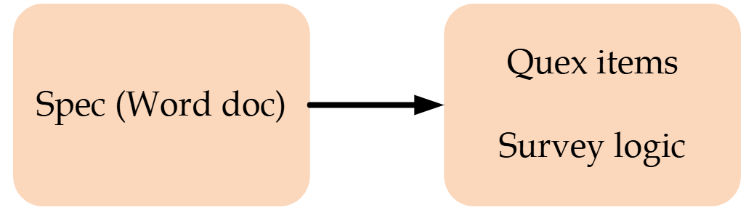
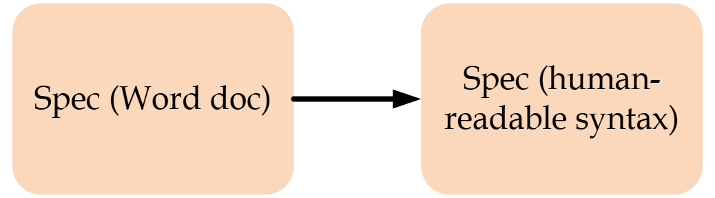
Spec Review
Spec Review
AI
AI reviews parsed spec
  Convert questionnaire in Word into a custom, lightweight syntax. Intermediate syntax helps computer parse the spec, but retains readability for human review
  Challenge: Parser has to be created for conversion. Generalized parser is significant effort, specialized parser less so but still a lift.
GenAI: LLM plus workflows and tooling built around it, e.g., prompts, context, output validation, computer use
Item definitions: Question text, response type, response options, validation rules, etc.
Survey flow: Sequence of items and skip patterns/eligibility
  Opportunity: GenAI assists in both parsing of Word spec and spec review.
  Split the spec into questionnaire item definitions and survey flow: easier for humans and computer to review

Slide 7
Spec Review
Spec Review Setup and Workflow
Quex items syntax examples Syntax can be specific to your questionnaire and designed to highlight priority elements to review Provide examples for how to parse complex items, e.g. tables, grids | # SECTION_R_INTRO These next questions are about your program's sources of revenue for providing early care and education services to children under age 13. # C12A How many children in your program are funded by dollars from the following government programs? ## C12A_1 State pre-kindergarten such as [STATE PRE-K NAME] @NUMERIC 0-999 | @CODE "I don't know but at least one" ___ Number of children
Flow syntax examples | ## Flow ### Module: Intro - Q1, Q2 ### Module: ChildCare [IF Q2 == "Yes"] - Q3, Q4

Slide 8
Spec Review
Spec Review Setup and Workflow
Prompt for quex items | Parse survey-qa/docs/Questionnaire.docx into the format given in survey-qa/docs/quex-items-syntax-examples.md. Write the output md file to /output. Every item, including sub-items, should have an item ID, even if no response is needed. Every item, including sub-items, should have an item type if a response is needed. For this task, ignore skip logic, whether it appears in a distinct skip logic box, or as part of response options. Skip logic will be parsed in a different task.
Prompt for survey flow | Now parse survey-qa/docs/Questionnaire.docx again, but only do the skip logic. Use the item numbers in survey-qa/output/parsed-quex-items.md. Follow the format given in survey-qa/docs/quex-flow-examples.md. Write the output md file to /output.
Prompt for spec review | Now provide feedback on both the parsed questionnaire items and the parsed survey flow. Use the markdown files in /output. Write output to a markdown file in /docs. Do not comment on the substance of the items: the checks should be technical in nature. For items, check for typos, duplicated response options, incorrect or vague types. For flow, check for logic errors or vague logic.

Slide 9
Spec Review
Spec Review Example Feedback
Items | ### Inconsistent response option capitalization Some items use uppercase "YES/NO" (R13, R14, R15, G3 sub-items, R7 sub-items, R19, R12, R20, R21) while others use title case "Yes/No" (C12C sub-items, R2, R9, R16, R17). ### R3 sub-items missing numeric range R3_UNDER3, R3_3TO5, and R3_SCHOOLAGE use `@NUMERIC` without a range. Similar count-of-children items under C12A all specify `@NUMERIC 0-999`. The source document does not show an explicit range for R3, but the omission should be verified — it may be an oversight in the source instrument. ### C12C sub-item numbering gap Sub-items jump from C12C_1 to C12C_3 — there is no C12C_2. This matches the source instrument. Verify that C12C_2 was intentionally omitted from the questionnaire and is not a parsing error.
Survey flow | ### Conditions reference parent items that have no response type The flow conditions reference C12A_2 and C12A_4 (lines 6, 12, 30, 33, 39), but these are parent/grouping items in the items file — they have no `@type` and collect no direct response. The flow conditions should reference the sub-items explicitly, e.g., `any(C12A_4_UNDER3, C12A_4_3TO5, C12A_4_SCHOOLAGE) > 0 OR == -2` ### `any(...) > 0 OR == -2` syntax is ambiguous On lines 6 and 12, `any(C12A_1, C12A_2, C12A_3, C12A_4, C12A_5, C12A_8) > 0 OR == -2` is unclear. Consider: `any(C12A_1, ..., C12A_8) > 0 OR any(C12A_1, ..., C12A_8) == -2`.

Slide 10
Code Review

Slide 11
Overview
Questionnaire Development & Instrument Programming Pipeline
1.
2.
3.
4.
Questionnaire design
Write the questionnaire, perform cognitive testing, etc.
Spec review
Correct typos, verify validation rules, confirm skip logic etc., before handoff to programmers
Questionnaire programming
Translate specs into code, program skip patterns and fills
Code review
Ensure that programmed instrument is faithful to questionnaire specs

Slide 12
Code Review
Code Review
  Conventionally: Analysts test instrument and compare against questionnaire to check that instrument is programmed to spec. Instrument testing complements other technical QA activities undertaken by programmers
  Challenge: Analysts may not be able to test instrument exhaustively, because of complexity of instrument; programming errors may be subtle and well-hidden
  Alternative: Review code to ensure instrument is programmed to spec.
    Challenge: Programming syntax is unfamiliar to analysts.
    Solution: Convert both spec and code into a common structured format, then compare the two

Slide 13
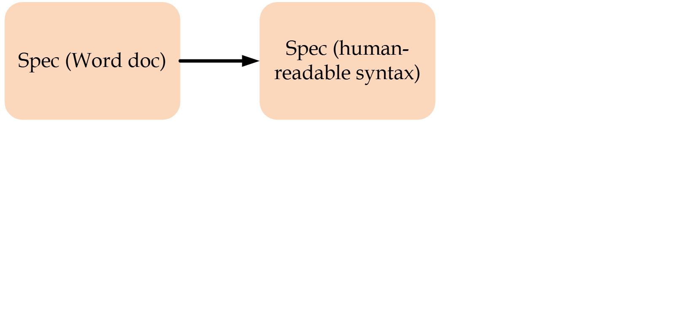
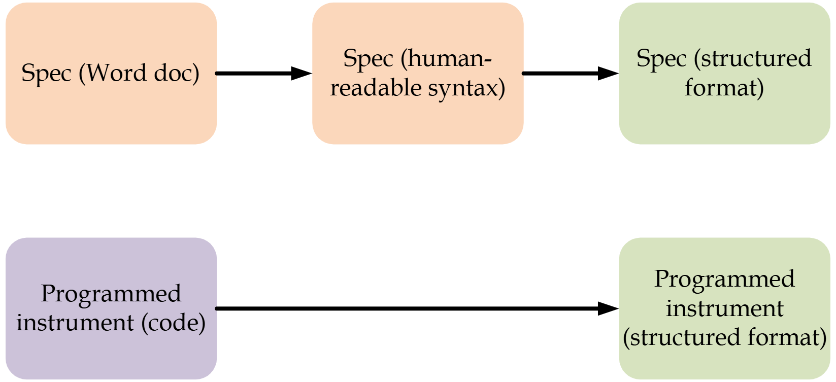
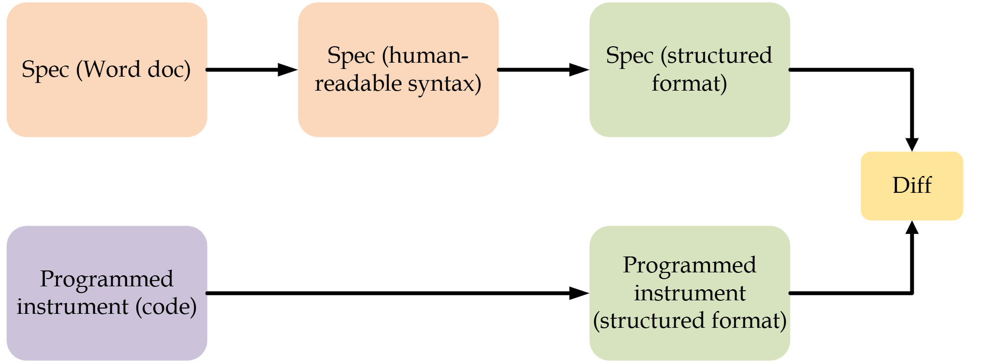
Code Review
Code Review
Convert spec and code into common format, then compare

Slide 14
Code Review
Code Review
GenAI assists with creating parsers, reviewing diff
AI
AI review diff
AI

Slide 15
Code Review
Code Review
Common structured format | { "instrument": { "id": “SURVEY_2024_CB", "items": [ { "id": "C12A", "text": "How many children in your program are funded by dollars from the following government programs?", "type": "text", "items": [ { "id": "C12A_1", "text": "State pre-kindergarten such as [STATE PRE-K NAME]", "type": "numeric", "range": {"min": 0, "max": 999}, "special_codes": ["DK_ATLEAST1"] } // more subitems... ] }, { "id": "R13", // details... "eligible_if": "any(C12A_1, C12A_2_UNDER3, C12A_2_3TO5, C12A_3, C12A_4_UNDER3, C12A_4_3TO5, C12A_4_SCHOOLAGE, C12A_5, C12A_8) > 0 OR any(...) == -2" } ] } }

Slide 16
Code Review
Code Review
Prompt for comparison | ### Perform diff of the two standardized JSON files Now, compare the two standardized JSON files. Check that the programmed instrument is faithful to the Word questionnaire. Check item text fidelity, response options, eligibility conditions, ordering. One source may use numeric codes where the other uses labels (e.g., 1 vs. 'Yes'). Treat these as equivalent unless the mapping appears wrong. The output should be a xlsx table with the following columns: - Row number - Item ID - Check outcome: OK, Difference and review needed, Difference and likely ok - Word: What's in the Word doc - Instrument: What's in the programmed instrument 'Likely ok' = cosmetic wording difference or known coding convention; 'Review needed' = substantive change in meaning, missing response option, or logic difference.

Slide 17
Code Review
Code Review Example Output
Row | Item ID | Check outcome | Word | Instrument
29 | G3I | OK
30 | G3_OTH | OK
31 | R4 | OK
32 | R7 | Difference and review needed | [eligible_if] any(C12A_4_UNDER3, C12A_4_3TO5, C12A_4_SCHOOLAGE) > 0 OR any(...) == -2 | [eligible_if] C12A_4_UNDER3 > 0 or C12A_4_UNDER3 == -2
33 | R7E | OK
34 | R7B | OK
35 | R7C | OK
36 | R7F | OK
37 | R9 | Difference and likely ok | [eligible_if] NOT (any(C12A_4_UNDER3, C12A_4_3TO5, C12A_4_SCHOOLAGE) > 0 OR any(...) == -2) | [eligible_if] (C12A_4_UNDER3 empty or C12A_4_UNDER3 <= 0) and C12A_4_UNDER3 != -2 and (C12A_4_3TO5 empty or C12A_4_3TO5 <= 0) and C12A_4_3TO5 != -2 and (C12A_4_SCHOOLAGE empty or C12A_4_SCHOOLAGE <= 0) and C12A_4_SCHOOLAGE != -2

Slide 18
Discussion

Slide 19
Discussion
Discussion
  Workflow is fully implementable without GenAI: GenAI lowers barriers, reduces cost, and adds another pair of eyes, but underlying process stands on its own
  Schema approach is format-flexible, accommodating questionnaires across a range of source document conventions
  Workflow is also platform-agnostic – structured schema/comparison approach works regardless of whether instrument is programmed in Voxco, Qualtrics, proprietary software
  GenAI handles "logical equivalence" in skip and validation expressions, reducing false positives from superficially different but functionally identical specs

Slide 20

Thank you.
Weihuang Wong
  Principal Data Scientist
  wong-weihuang@norc.org
  @weihuang.bsky.social

