Slide 1
Leveraging REDCap for Managing Respondent Driven Sampling and Longitudinal Data in a Community Wound Study of Illicit Opioid Users in Rural NC
Deirdre Middleton, MPH
FedCASIC: April 22, 2026

Slide 2

Presentation Lineup
Background & Study Goals
Methodological Approach (What data we need REDCap to wrangle)
REDCap Implementation and Customization
Initial Results

Slide 3
Background and Study Rationale

Slide 4
Emergence of Deep Necrotic (X) Wounds Among Fentanyl Users
There is a growing crisis of deep, necrotic wounds developing among people who use fentanyl in the US
These wounds are a growing cause of morbidity and can cause sepsis, amputations, and even death
Xylazine, an adulterant in fentanyl, is believed to be driving cause of these novel wounds.

Slide 5
The next slide displays pictures of wounds.

Slide 6
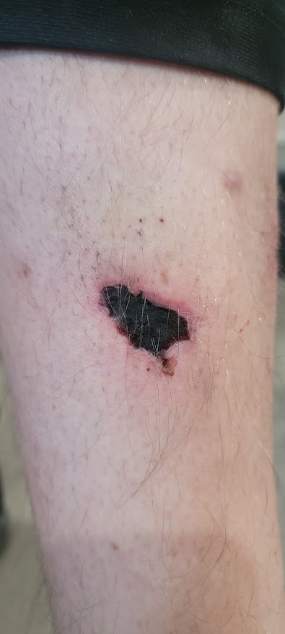
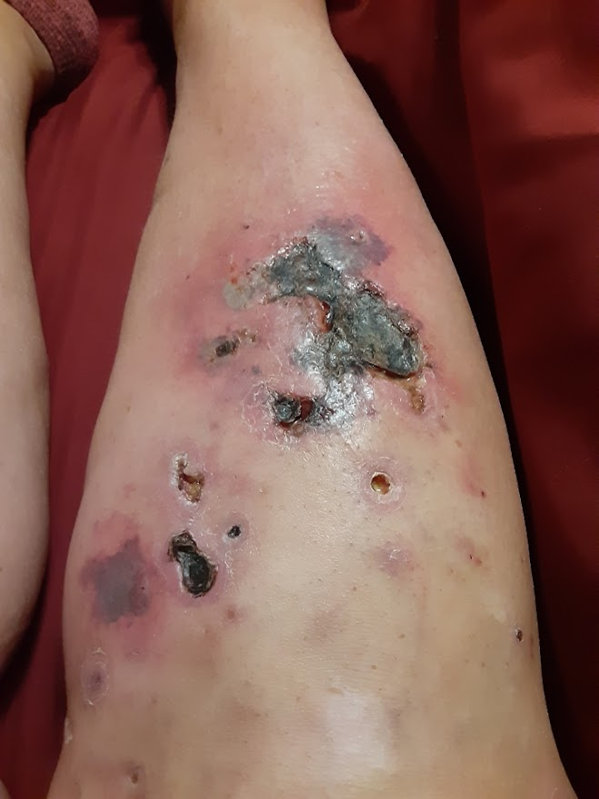
Source: Jason Bienert
Notes:
These are 2 different people showing different presentations. Grape Jelly like appearance. It’s not clear why some have multiple vs one spot.
Believed to be an autoimmune type reaction. There is some sort of interaction with receptors.
These do not only appear at the injection sites, but are often distal. A person can inject in their arm and have the wound on their leg.

Slide 7
Why This Study Matters
Rural health is a federal priority
This study was designed to address the specific challenges of a rural population
Epidemiological investigation is needed to detect emerging substances & adverse consequences
    Emerging sedative-adulterants (e.g., xylazine) are not captured by existing surveillance systems
    Rural drug markets are harder to monitor compared to urban drug markets
    Need community‑based epidemiologic studies to identify associations between the illicit drug supply and adverse health
    Community‑based studies generate evidence needed to improve federal data systems and public health surveillance.
Notes:
HHS has made rural health a priority
Rural communities are experiencing unique health impacts from the opioid epidemic
Rural populations face limited access to primary care, harm‑reduction services, and evidence-based treatment
Findings can inform federal policy to address rising morbidity.
This study was designed to address the specific challenges of a rural population

Slide 8

Study Goals
  Investigate the epidemiology of the wound crisis
  Understand supply-side drivers of the epidemic (Looking beyond self-report)
  Develop strategies for typologizing X wounds; need to distinguish from abscesses
  Disseminate real-time information to inform community response

Slide 9
Study Methods and Data Types

Slide 10

Recruitment via RDS Methodology
Seed Participants Initial participants, known as seeds, start the recruitment process by engaging peers in their social networks.
Chain-Referral Sampling Recruitment occurs through a chain- referral process with dual incentives, reaching this hard-to-access populations effectively.
Approximate a Probability Sample Allows us greater confidence in our prevalence estimates

Slide 11
Understanding RDS: Seeds
Seeds are participants recruited by the researchers
Each seed is given 5 recruitment coupons
Seeds are given dual incentives
For participating in first study visit
For each successful recruit

Slide 12
Understanding RDS: Recruits
New recruits return with coupons given to them by previous participants
If the recruits are eligible, they can participate and become recruiters too.
Each non-seed participant is given 3 coupons to recruit.
Like the seeds, recruits receive dual incentives for
Participation in the survey
Each eligible recruit who chooses to participate

Slide 13
Study Design for Community-Based Study of X-Wounds
Data Types
Behavioral Health
Surveys
Drug Samples
Test submission and results
Medical Wound Data
Photos and Surveys
RDS
Recruitment & Incentives
Longitudinal Data Collection Baseline + 4 follow-up visits

Slide 14
REDCap Implementation and Customization

Slide 15

Configuring Modules for Survey, Wound, and Drug Sample Data
Behavioral Health Survey
  Modules were set up to capture self-reported behavioral health measures through surveys.
Wound Questionnaire
  Wound Modules allow linkage of photos with associated data for physician review and classification
Drug Sample
  Samples of drugs identify the presence or absence of adulterants that may be linked to wounds

Slide 16
Integrating RDS Workflow with REDCap
Custom Modules in REDCap
  Custom REDCap modules facilitate managing complex recruitment chains efficiently within the study workflow.
Link Recruiters and Recruits
  Modules enable seamless linking between recruiters and recruits, ensuring clear tracking of recruitment progress and incentive payments.

Slide 17
Record Status Dashboard
Shows each coupon distributed and whether it has been redeemed
Shows eligibility status at a glance, and colored dots indicate each component of data collection the person has participated in
Follows the flow of data collection, starting with enrollment, eligibility and consent
Includes the baseline visit and up to 4 follow-up visits

Slide 18
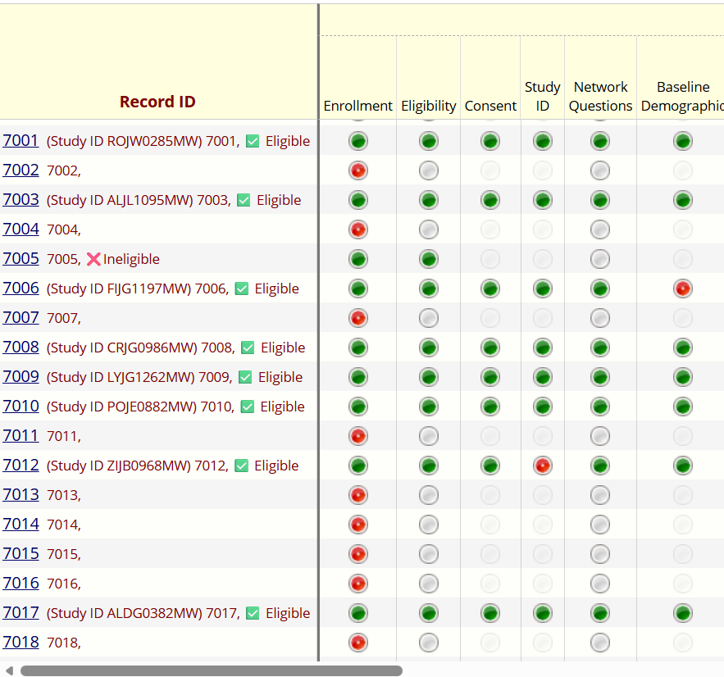
Notes:
Notice Eligibility; coupons not yet redeemed have coupon numbers but no study ID. The dashboard shows enrollment, eligibility, and consent. Network questions and baseline demographics are the first survey modules they complete.

Slide 19
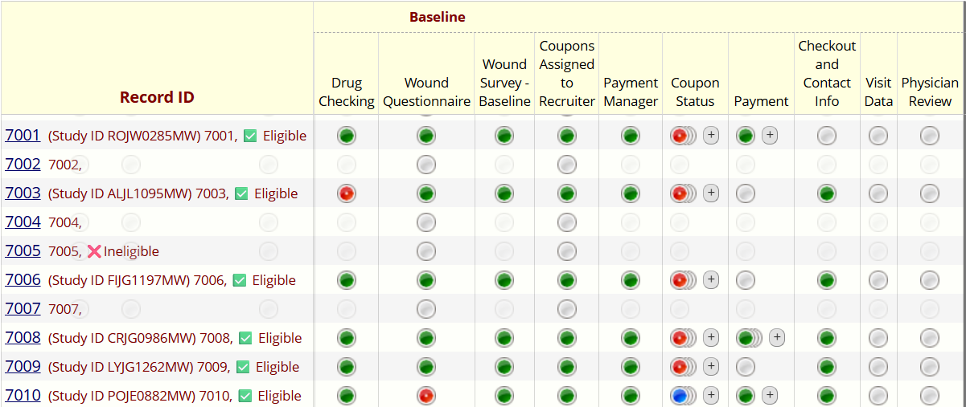
Notes:
Describe baseline data collection

Slide 20
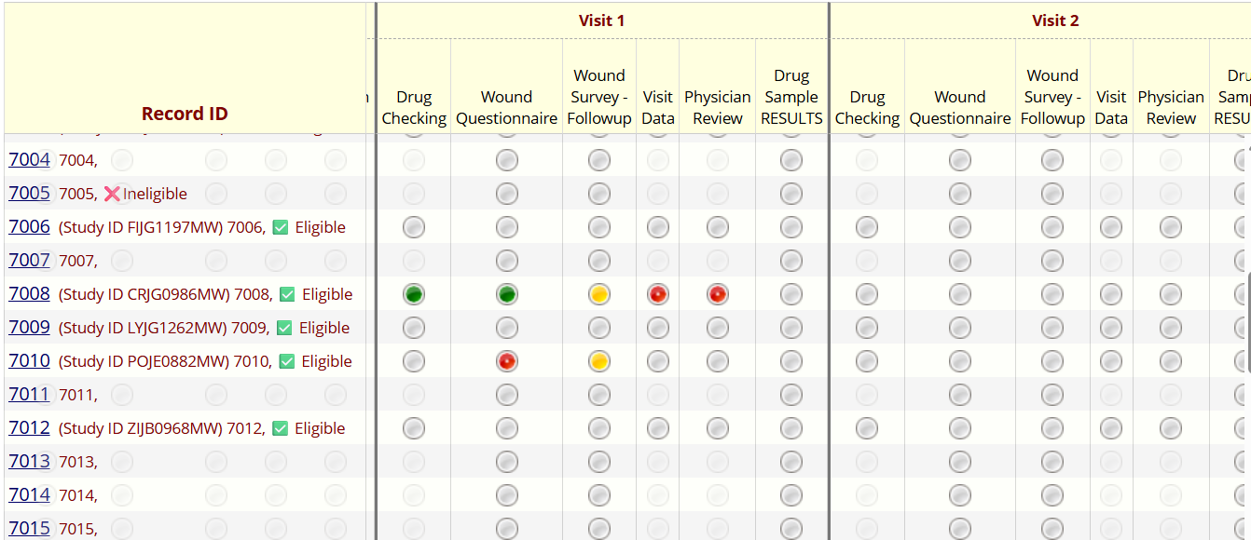

Slide 21
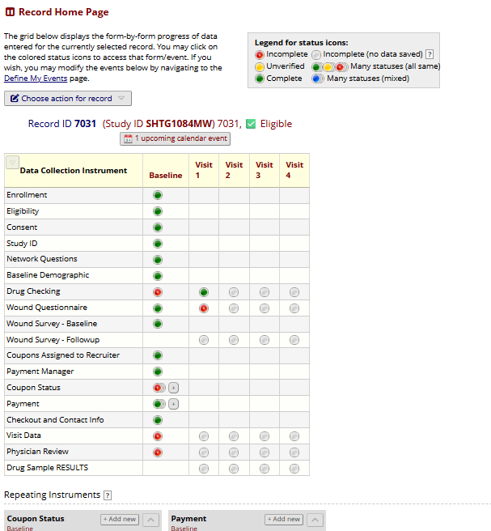
Record HomePage

Slide 22
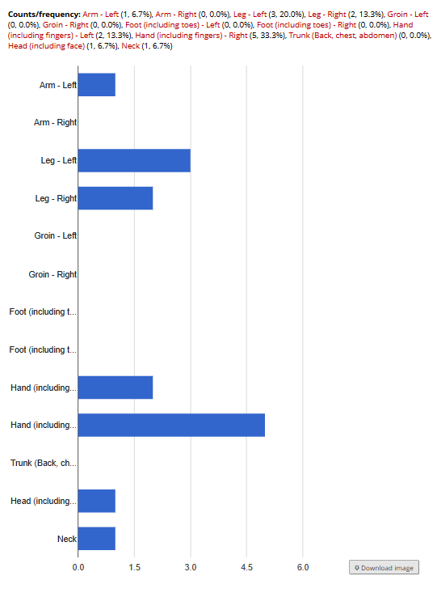
Graphs and Reports for Data Monitoring

Slide 23
RDS Specific Features using Custom Modules
Coupon distribution and redemption
Incentives owed and payments
Study ID Manager

Slide 24
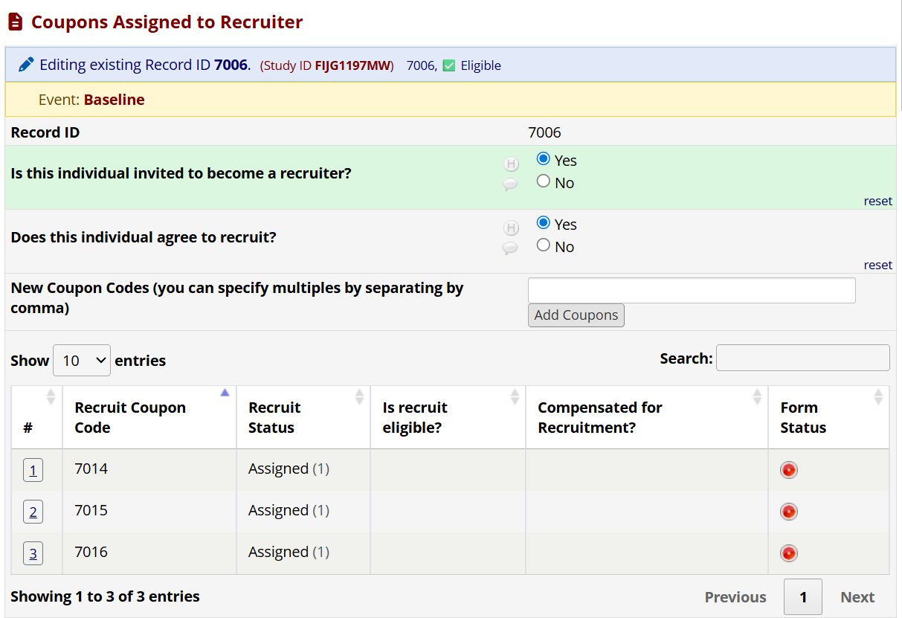
Coupons Assigned to a Recruiter

Slide 25
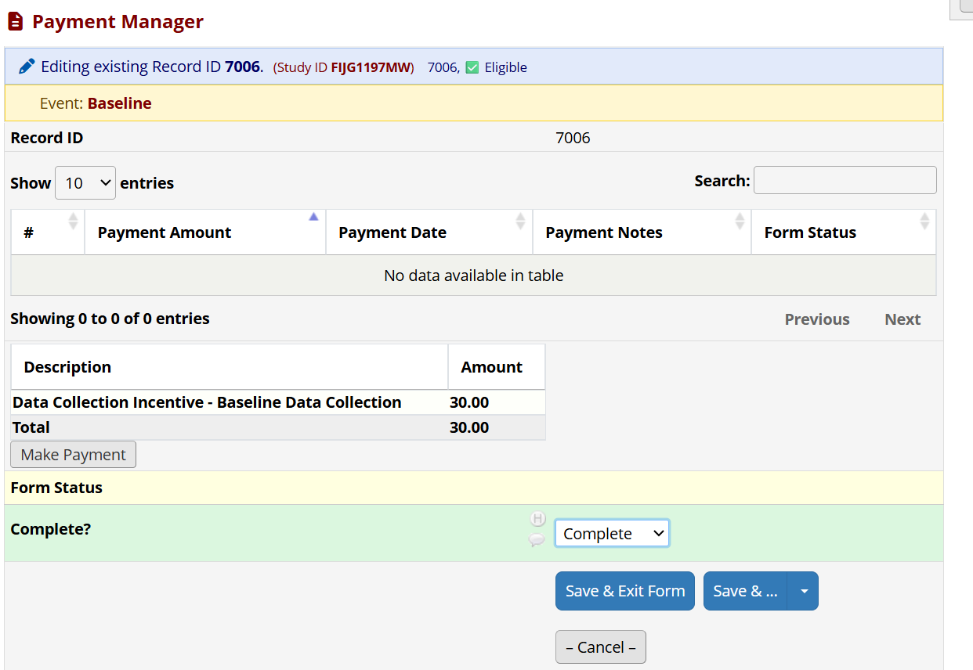
Payment Manager
Notes:
Shows what is owed to the participant based on their current participation

Slide 26
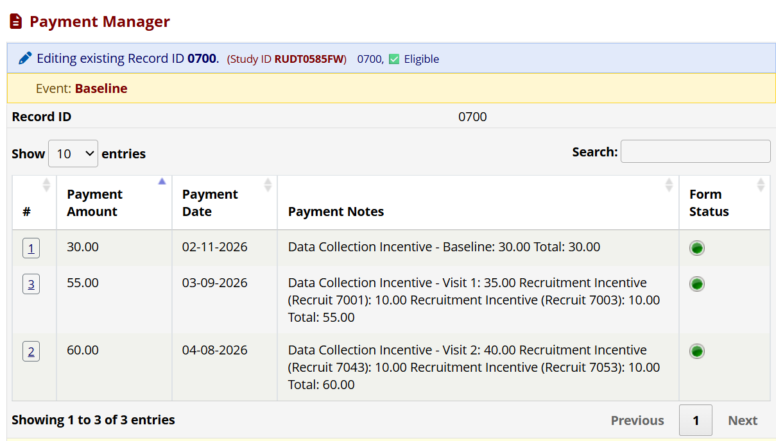
Payment Manager

Slide 27
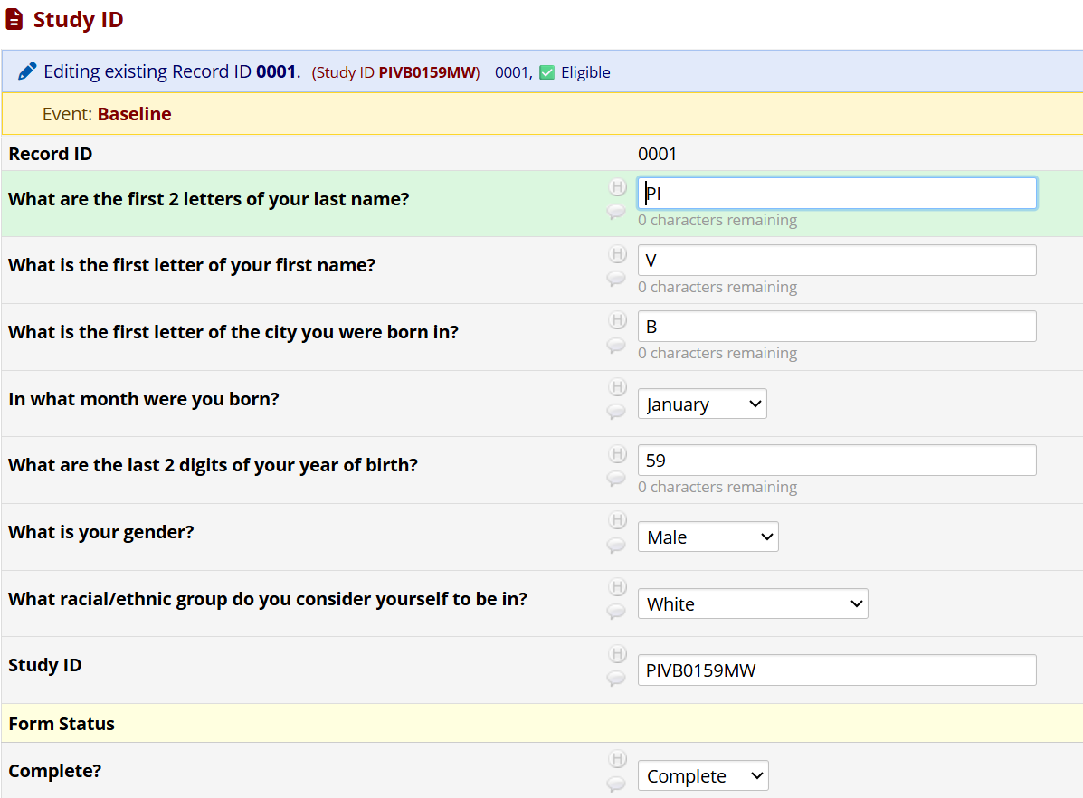
Study ID

Slide 28
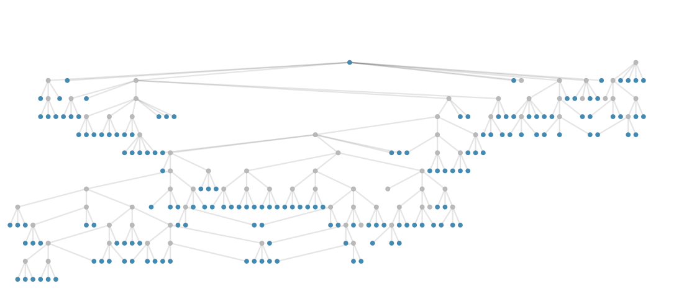
RDS Specific Reports
Recruitment Chain

Slide 29
Initial Results

Slide 30
Participation
Seeds: 2
Coupons returned: 31
  Coupons returned from eligible and consenting participants: 29
Scheduled appointments: 81 total (49 upcoming)
Participants who have completed at least 1 follow-up visit so far: 14
Total drug samples collected: 33
Wounds identified so far : 10

Slide 31

Conclusions
Leveraging REDCap Tools
  REDCap provides efficient data management for research in complex community settings with vulnerable groups.
  Building Custom Modules specific to RDS has led to a user-friendly data collection tool that supports field staff.
Respondent-Driven Sampling (RDS)
  RDS methodology has typically been used in urban settings, but this study shows it may be appropriate for some rural populations as well.

Slide 32
Deirdre Middleton, MPH dmiddleton@rti.org
Thanks to team and coauthors:
Erin Erickson​, RTI
Arnie Aldridge​, RTI
David Leblond​, RTI
Asher Schranz, UNC
Michelle Mathis, Olive Branch Ministry
Jon E. Zibbell, RTI

