Slide 1
Adaptive Three‑Stage Sampling Design
Copyright © 2026 American Institutes for Research®. All rights reserved.
For the National Study of Special Education Spending (NSSES)
Cong Ye, Principal Researcher
cye@air.org
FedCASIC| April 2026
AIR Internal Group Name: Subgroup OR SERVICE LINE OR GRANT NAME

Slide 2
Why This Design Matters
Adaptive sampling to achieve comparable precision across multiple subpopulations while maintaining operational feasibility for participants
The three-stage design to balance operational efficiency and school workload
Simulation-based allocation methods to dynamically optimize sample sizes across districts and schools
13
Disability categories with separate precision targets for each
Real-Time
Adaptation of student selection probabilities during data collection
Multi-Stage
Sampling design balances operational efficiency and workload

Slide 3
Agenda and Sampling Team
Sampling Team
Cong Ye, AIR
Mike Garet, AIR
Tammy Kolbe, AIR
Kirk Wolter, NORC
Don Jang, NORC
Rachel Caroll, AIR
Carol Wan, Former AIR
Agenda
Sample Design
Simulation
Pilot Study

Slide 4
Sample Design
Balancing Statistical Rigor and Operational Constraints

Slide 5
Goal and Challenges
Goal: Produce nationally representative, policy‑relevant estimates of special education spending with reliable student-level disability category-specific estimates
Key challenges:
Uneven distribution of student subpopulations across districts and schools
Large variation in district and school size and composition, overall and by disability category
Significant volatility in the average and variance of spending per pupil across disability categories
Substantial intraclass correlation (ICC) within districts and schools

Slide 6
Design Objectives
Achieve comparable precision across multiple student subpopulations, including 13 IDEA disability categories and aggregated estimates over student and LEA subgroups of interest
Balance sample sizes across key district characteristics
Charter, size, urbanicity, poverty level, urbanicity
Maintain operational feasibility for districts and schools
Control variability in sampling weights and clustering effects

Slide 7
Two-Stage vs. Three‑Stage Sampling Design
Two-Stage Design (LEAs → Students)
Minimizes school-level clustering effects and provides broader pool of eligible students with disabilities, particularly low-incidence categories
Requires participation from larger number of schools, increasing data collection costs and nonresponse risk
Three-Stage Design (LEAs → Schools → Students)
Reduces member of participating schools, reducing operational complexity and costs
Allows for precise management of student sample sizes per school (e.g., enforcing minimum/maximum caps per school)

Slide 8
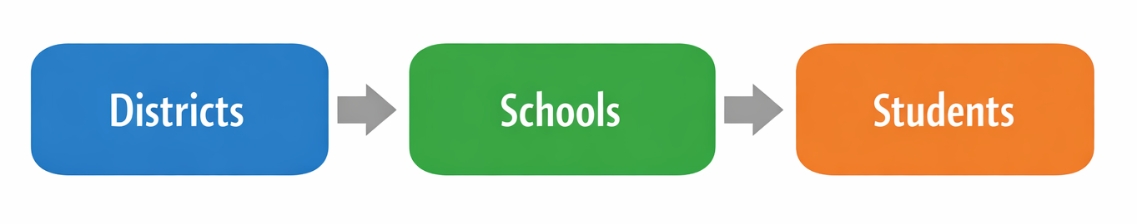
Overview of the Three‑Stage Sampling Design
Stage 1: Select school districts
Stage 2: Select schools within districts
Stage 3: Select students within schools

Slide 9
Stage 1: District Sampling
Primary sampling units (PSUs): school districts
Measure of size: student enrollment
Sampling features:
Probability proportional to size (PPS)
Explicit stratification by key policy‑relevant characteristics
Implicit stratification to ensure representation across additional variables
Result: A district sample that supports broad coverage and analytic flexibility

Slide 10
Stage 2: School Sampling
Secondary sampling units: schools within districts
Schools selected using PPS
With controlled sampling methods for extreme cases
Stage 2 sampling distributes student selection across schools to manage burden and clustering

Slide 11
Stage 3: Student Sampling
Student rosters collected from sampled schools
Students classified into analytic subpopulations:
Disability status and category
Sampling conducted by subpopulation with different sampling rates
Systematic sampling performed on the student roster, sorted by student characteristics

Slide 12
Simulation
Optimizing sampling methodology using data-driven insights

Slide 13
Moving Beyond Fixed Sampling Rates
Problem with fixed rates:
❌Over‑sample common groups, under‑sample rare groups
❌ Inefficient use of field effort
Creating extreme burden across districts and schools
Failing to obtain adequate sample sizes for rare subpopulations
NSSES approach:
✅ Dynamically adjust student selection probabilities
✅ Use simulation to target margins of error for each subpopulation

Slide 14

Simulation‑Based Sample Allocation
Uses prior information from the previous study on:
Subpopulation prevalence
Expected ICCs at district and school levels
Simulations guide:
Initial allocation of students across districts and schools
Ongoing adjustments as sample sizes accrue

Slide 15
Real‑Time Adaptation During Data Collection
Student sampling rates updated as districts, schools, and students are recruited
Allows:
Rebalancing across districts and schools of different sizes
Efficient targeting of underrepresented subpopulations
Supports operational decision‑making without redesigning the sample

Slide 16
Pilot Study
Aligning Design with Reality

Slide 17
The NSSES Pilot Study
Pilot designed to test feasibility of the three‑stage, adaptive design
Objectives from the sampling perspective:
Evaluate roster acquisition and classification
Test simulation‑based allocation in practice
Assess district and school burden

Slide 18

Pilot Design Overview
Multi‑stage sample of districts, schools, and students
Parallel implementation of:
Sampling procedures
Instrument administration
Data processing workflows
Pilot intentionally included districts with varied size and composition

Slide 19
What We Tested in the Pilot
Quality and timeliness of student roster data
Accuracy of subpopulation classification
Performance of adaptive student sampling algorithms
Operational coordination across sampling and data collection teams

Slide 20
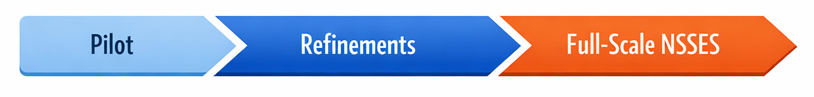
Implications for Full‑Scale NSSES
Pilot results informed refinements to:
Stage‑specific sample sizes
Student caps and allocation rules
Field monitoring protocols
Confirms viability of adaptive, multi‑stage sampling for cost studies

Slide 21
Cong Ye
PLEASE DIRECT QUESTIONS TO:
Principal Researcher +1.202.403.5000 cye@air.org
Notice of Trademark: “American Institutes for Research” and “AIR” are registered trademarks. All other brand, product, or company names are trademarks or registered trademarks of their respective owners.
Copyright © 20XX American Institutes for Research®. All rights reserved. No part of this publication may be reproduced, distributed, or transmitted in any form or by any means, including photocopying, recording, website display, or other electronic or mechanical methods, without the prior written permission of the American Institutes for Research. For permission requests, please use the Contact Us form on AIR.ORG.
XXXXX_MO/YR

