Slide 1
SBA’s 2020 Small Business Exporter of the Year – Strategies for Global Success
Office of International Trade
September 24, 2020
For Audio 1-888-391-6806
Passcode 2 9 9 9 3 5 1
Notes:
Thanks Wendy! Hello all. Thank you so much for joining us today.
We are so pleased that you are taking the time today to help us celebrate SBA’s 2020 Small Business Exporter of the Year. We hope that hearing their story will help you along your path to global sales success.
Normally we would be celebrating our Exporter of the Year in May, but as you well know, this is no normal year. National Small Businesses week was moved to this week. For SBA’s Office of International Trade, this is the highlight of National Small Business Week.
Again I want to thank you for taking the time out of you busy day to make sure that you are aware of some of the support we can offer to help you face the challenges of the times we currently face.
U.S small businesses, taking advantage of support from Federal, state, and local governments will play a significant role in our country emerging from the current crisis stronger than ever. SBA is committed to being a valuable resource for U.S. manufacturers, particularly during the challenging times we currently face.
So let’s take a look at the Agenda for today’s webinar…
NEXT SLIDE please

Slide 2
Agenda
Welcome and Introduction – Michele Schimpp, SBA Deputy Associate Administrator for International Trade
Exporter of the Year Interview – Nick Nicholas, Genesis Water Technologies and Loretta Greene, SBA Associate Administrator for International Trade
SBA Assistance for Exporters – Michele Schimpp, SBA
Growing Global Sales with the help of SBA Export Financing – Mary Hernandez, SBA Regional Export Finance Manager, Miami USEAC
Q & A
Notes:
On the slide you can see the agenda for the call.
I will serve as MC for the webinar as well a presenter. I am the Deputy Associate Administrator for International Trade in SBA’s Office of International Trade. In a moment our Associate Administrator for International Trade Loretta Greene will introduce and interview SBA’s 2020 Exporter of the Year.
Next, I will come back to highlight some of the key support that our manufacturers and supply chains can get from our office before turning it over to Mary Hernandez, our SBA Export Finance Manager based in Miami.
Mary will talk specifically about financing solutions for exporters and global supply chains.
Finally, we will take your questions. Please pose those via email to oit@sba.gov as speakers present and we will address them at the end.
Again, that’s international@sba.gov. If we can’t get to all live we will reach out individually to respond.
Next slide please

Slide 3
SBA’s Small Business Exporter of the Year
Recognizes individuals for their success and dedication to exporting products or services
who received an SBA loan, grant or
assistance from a resource partner
Recent Winners:
EarthQuaker Devices (Ohio)
SeaDek (Florida)
Endoscopy Replacement Parts (Florida)
Sawyer Manufacturing Company (Oklahoma)
Baby Elephant Ears (Minnesota)
Selection Criteria
Increased sales, profits and/or growth of employment because of exporting
Creative overseas marketing strategies
Effective solutions to export-related challenges
Effective use of Federal and/or State government trade promotion or financing
Notes:
Since this webinar is to announce and celebrate our 2020 Exporter of the Year, I wanted to provide a little background on that award. We have had some really interesting companies win over the past few years.
Last year’s winner EarthQuaker, an Ohio company was founded in 2004 by musician Jamie Stillman. Maybe you heard of one of his bands: the Party of Helicopters, Relaxer, Fringe Candidate, Teeth of the Hydra, Drummer, Harriet the Spy, “New” Terror Class.
Jamie parlayed his music expertise to global success in the effects pedals business.
My favorite among recent winners is Baby Elephant Ears out of Minnesota. Mother of four, Alicia Overby, created Baby Elephant Ears to combat a common health challenge one of her own kids was having related to infant neck strain. Her solution has helped babies and parents around the world.
As far as eligibility for this award. Really anyone that has used SBA or one of our resource partners is eligible.
Nominees are scored on increased sales, creative marketing, effective solutions to overcome export challenges, and effective use of available government export promotion programs or services.
And finally, so that you can appreciate how significant this recognition is, we note the process. Each of our 68?? District offices can nominate for a regional competition. Then each of the 10?? Regions selects a winner to compete for the national award.
Our SBA Office of International Trade selects a National Winner from among the regional awardees.
With that brief overview, let’s meet our 2020 SBA Exporter of the Year.
I will turn the mic over to Loretta Greene, SBA’s Associate Administrator for International Trade to introduce and chat with our Winner.
Next slide

Slide 4
SBA 2020 Small Business Exporter of the Year
Genesis Water Technologies, Inc. Using Innovation To Meet The Water Needs of The World
Sustainable Water & Wastewater Solutions
To Ensure A Clean & Safe Water Supply Worldwide
Vision:
A World with Access to a Safe & Clean Water Supply
Mission:
Design, create and supply innovative sustainable water treatment solutions
for drinking water and waste water reuse
to combat the effects of climate change and emerging contaminants
to ensure access to clean water
Notes:
Thank you Michele! I am so happy to be with you today and thrilled to be introducing and interviewing SBA’s 2020 Small Business Exporter of the Year Genesis Water Technologies, Inc.
Genesis Water Technologies is an award-winning leader in specialized drinking water & wastewater reuse solutions.
Genesis assists industrial and commercial clients, as well as municipalities and governments with their drinking water and waste-water challenges with emerging water contaminants and water scarcity.
I am pleased to welcome Genesis Technical Director Nick Nickolas. In this role, Mr. Nicholas has coordinated and led a global team of technical professionals in designing, engineering and building water & waste water treatment system solutions for industrial, commercial, and water utility clients within the USA and across the world.
Nick, thanks so much for joining us!
Next Slide

Slide 5
Meet the 2020 Exporter of the Year
Headquarters: Maitland, FL USA
Incorporated in 2006, GWT is USA based water treatment engineering solutions firm with manufacturing capabilities.
Offices:
- Mooresville, NC USA
- Manila, Philippines
- Santiago, Chile
- Kampala, Uganda
Nick Nicholas
Technical Director
At least 40% of sales achieved through export related business
Started exporting in 2009
Have exported to over 43 countries
Utilized STEP and SBDC assistance
Notes:
I will pose a few questions for Nick to help him tell his story. If you have additional questions for him, please email those to oit@sba.gov
Nick- Before we get started with questions, please tell us about your company.
1. How did you come to be nominated for SBA Exporter of the Year?
2. When did you start exporting, why, and how?
3. What has your global business meant for your company?
4. What have been your greatest challenges for global success and how did you overcome them?
I understand that we have a few pictures from your company, can we go through them now?
Next Slide

Slide 6
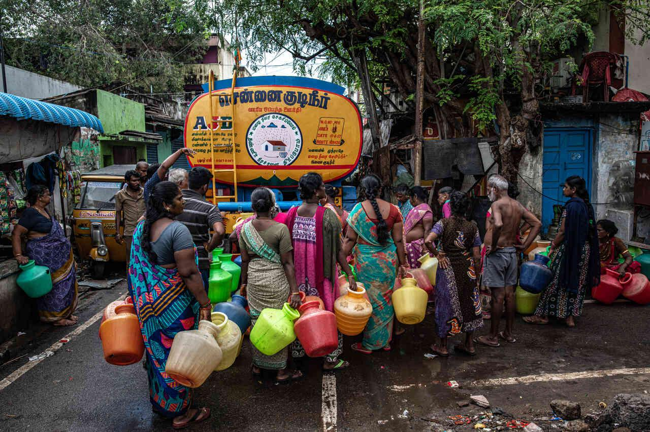
Notes:
Nick to explain

Slide 7
Notes:
Nick to explain

Slide 8
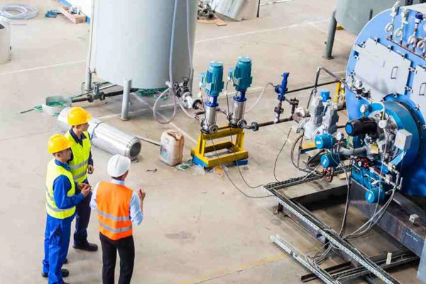
Notes:
Nick to explain

Slide 9
Notes:
Nick to explain

Slide 10
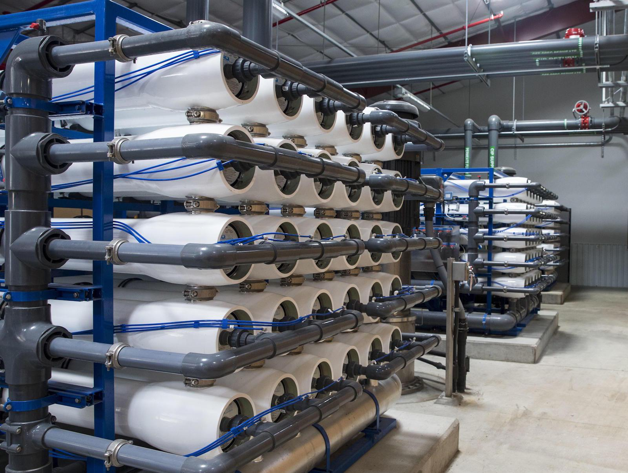
Notes:
Nick to explain

Slide 11
Genesis Water Technologies, Inc. (GWT)
Headquarters: Maitland, FL USA
Incorporated in 2006, GWT is USA based water treatment engineering solutions firm with manufacturing capabilities.
Offices:
- Mooresville, NC USA
- Manila, Philippines
- Santiago, Chile
- Kampala, Uganda
Nick Nicholas
Technical Director
At least 40% of sales achieved through export related business
Started exporting in 2009
Have exported to over 43 countries
Utilized STEP and SBDC assistance
Notes:
Great pictures Nick! Thanks for sharing.
I have a few more questions.
5. How has COVID-19 affected your business?
6. What are you seeing in foreign markets these days? Is business picking up?
7. What do you expect for 2021? Has COVID changed the way you will do business in the future?
8. You mentioned a “new- normal,” what does that mean to you?
9. And finally, what advice do you have for other U.S. businesses that are considering global market opportunities?
Let’s jump to the next slide where you summarized this advice in bullets.

Slide 12
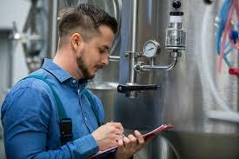
Key Success Factors
Focus on partners that you are working with
Understand/appreciate key market factors (e.g. Global water crisis)
Tap into available resources
Respond to the times
To learn more about GWT visit:
genesiswatertech.com
Notes:
(Nick to answer question)
Thank you so much Nick and congratulations again, not only for your export success but also for doing good in the world. You make us all proud.
I will turn it back to Michele now.

Slide 13
The SBA Can Keep You Competitive
Business Intelligence for Changing Times
Grants to Reach International Buyers
Financing for Your International & Supply Chain Sales
Find a Local Advisor at sba.gov/local
See if your state/territory offers grants at sba.gov/international
Contact your local export finance manager at sba.gov/international
Notes:
Thank you Nick and Loretta.
Again, a reminder, please send any questions for Nick or any other presenters to oit@sba.gov.
Nick shared some of his experience with SBA and our resource partners. I do want to make sure you are all familiar with the variety of assistance available from SBA to small businesses in global markets and supply chains.
95% of the world’s consumers live outside the U.S. yet only a small percentage of our 30 million U.S. small businesses are actively focused on global market growth.
Perhaps not enough small business owners know that exporters are more financially stable, expand faster, and create higher paying jobs than non exporters. Exporters are also more resilient as they reduce their dependency on a single market.
We are constantly asking ourselves, why don’t more small businesses export?: Three main reasons that we consistently see are
They don’t know where to start,
They believe that the regulatory environment is too complex or
They find it difficult to finance global sales
Fortunately, SBA has solutions to each of these obstacles with business intelligence, grants and financing.
We want every business to know that SBA has solutions to obstacles they face in selling to international customers:
Advice and counseling for businesses that don’t know where to start or are worried about complex regulations.
Grants to cover costs associated with finding international buyers or entering new foreign markets.
Loans tailored to provide export working capital, business expansion or other costs associated with international operations.
Next Slide

Slide 14
Business Intelligence for Changing Times
SBA’s Fast Track Service
Meet privately with SBA senior trade and technical staff to discuss unique needs
Quickly access to accurate information, guidance on eligibility requirements
Receive introductions and professional referrals to Federal, State or local resource partners
How to Schedule Fast Track Service and SBA’s International Trade Hotline?
Call SBA toll free at (855) 722-4877 or send an email to international@sba.gov
Notes:
Our newest service, which has gotten increasing attention of late is SBA’s Fast Track Service.
Here, a U.S. small business will meet privately with SBA senior trade and technical leads to discuss their unique challenges and identify potential resource solutions available within SBA or other U.S. government agencies.
The business counseling will provide faster access to accurate information, guidance on eligibility requirements, and insights into how to maximize relevant Federal and State trade related resources for recovery and resilience.
As appropriate, SBA will provide introductions and professional referrals to Federal, State or local resource partners.
COVID-19 has only increased pressures on small business manufacturers to pivot and address new unknowns and risks. Navigating the myriad of resources available need not be an unknown. With so many new issues to confront, let SBA help your business to shorten the research cycle and speed recovery.
To Schedule Fast Track Service Interested small businesses can call SBA toll free at (855) 722-4877 or send an email to international@sba.gov.
SBA’s Office of International Trade will respond within 24 hours on weekdays to requests for an appointment.
Next slide

Slide 15
Grants to Reach International Buyers
The State Trade Expansion Program or STEP provides grants to U.S. states/territories to help small businesses to go international.
Eligible Uses of Funds include:
Training workshops (e.g. ExporTech®)
In-person and Virtual trade missions
Services to support foreign market entry
International Partner Search
Website optimization for global sales
Translate websites to attract foreign buyers
Designing marketing media and more
Visit sba.gov/STEP to find out if your state/territory is participating in STEP.
Notes:
I want to make sure that you are all familiar with the State Trade Expansion Program, a partnership between SBA and the states to support small business global sales growth.
The STEP grant helps U.S. small businesses to begin exporting, find new markets or expand sales in current markets.
Last year, STEP helped over 6,000 businesses with $18 million in grants to 44 States/territories. These businesses, in turn, reported over $550 million in export sales.
Each State/Territory runs the program slightly differently, sometimes focused on distinct strategies, but in general STEP offers grants to help your business:
Take part in export training programs
Participate in foreign and virtual trade missions and trade shows
Obtain services to support foreign market entry including initial market identification and research to determine opportunities
International Partner Search Plus Virtual Introductions for business matchmaking
Translate websites to attract foreign buyers
Design international marketing products or campaigns.
STEP can also cover fees associated with trademark and Intellectual Property protection and more.
To find out if your state has a STEP grant that can support global sales and to get contact information to see how they can help you, visit sba.gov/STEP.
For FY2020, SBA received a $19,000,000 appropriation for STEP grants.
We are very excited about celebrating STEP’s 10th anniversary this year!
Next slide please

Slide 16
Overcome Financing Challenges
SBA can work with your lender to help you overcome financing challenges such as:
Canceled or reduced buyer credit insurance coverage
Reduction in lines of credit or working capital financing
Demand by foreign buyers for performance guarantees on advanced payments
Supply chain issues: extended payment terms from OEMs
Notes:
The SBA Export Loan Program always have been available to help business to finance export sales, export business development, and production capabilities.
In COVID19 health crisis, the SBA Export Loan Program can help you overcoming your challenges with international and U.S.OEM buyers.
Read Slide
Let's talk about the Export Loan Programs
Mike’s notes- Slide 1:
Thank you, (Michele?) and good morning everyone. The SBA Export Loan Programs always have been available to help business to finance export sales, export business development, and production capabilities.
In the COVID19 health crisis, the SBA Export Loan Programs can help you overcoming your challenges with international and U.S. OEM buyers.
*Read Slide*
Let's talk about the Export Loan Programs.
>Next slide, please

Slide 17
Financing Your International & Supply Chain Sales
Loan options for direct and indirect exporters (AKA supply chain):
Export Express for business development
$500,000 limit
Export Working Capital to fulfill your international & supply chain orders
$5 million limit
International Trade Loan for expanding your production capacity, re-financing debt, and reshoring
$5 million limit
Notes:
KEY TAKEAWAY MESSAGE: Get Financing for International Sales with SBA Loan Guarantees
SBA partners with lenders to offer three different export loan products – these loan products address a range of business financing needs
Not only for direct - but also for indirect exporters –
Indirect exporters are - those businesses who sell to other US businesses that then export their products. – Think supply chain.
SBA’s 3 export loan products are helping businesses achieve roughly $2.3 billion in sales per year.
The SBA’s Export Express Loan program allows access to capital quickly for businesses that need financing up to $500,000. You can apply for a line of credit prior to final-i-zing an export sale or even before visiting a foreign market. Getting your financing lined up ensures that adequate financing is in place before you agree to contract terms.
Small Business Exporters can use the Export Working Capital Program to fulfill export orders and finance international sales by providing revolving lines of credit of up to $5 million.
The International Trade Loan program can help if your company has been affected by foreign competition and needs to retool or expand to better compete. It can also help exporting firms seeking to expand international sales.
Let me go into a little more detail on each of these.
Next Slide
Mike’s notes- Slide 2:
I am one of 21 SBA Export Finance Managers spread across the US. Based in Chicago, I help small businesses in Illinois and Wisconsin to tap SBA export loans to finance their export sales through trade.
*KEY TAKEAWAY MESSAGE: Get Financing for International Sales with SBA Loan Guarantee*
SBA partners with lenders to offer three different export loan products – these loan products address a range of business financing needs not only for direct - but also for indirect exporters. Indirect exporters are those businesses who sell to other US businesses that then export their products. – Think supply chain.
SBA’s 3 export loan products are helping businesses achieve roughly $2.3 billion in sales per year.
The SBA’s Export Express Loan program allows access to capital quickly for businesses that need financing up to $500,000. You can apply for a line of credit prior to finalizing an export sale or even before visiting a foreign market. Getting your financing lined up ensures that adequate financing is in place before you agree to contract terms.
Small Business Exporters can use the Export Working Capital Program to fulfill export orders and finance international sales by providing revolving lines of credit of up to $5 million.
The International Trade Loan program can help if your company has been affected by foreign competition and needs to retool or expand to better compete. It can also help exporting firms seeking to expand international sales.
*Reiterate that all three programs qualify for SBA Debt Relief that was mentioned earlier*
>Next slide, please

Slide 18
Financing Your International Sales
Examples of uses:
Offer payment terms to customers to make your bid more competitive
Proactive marketing
Purchase machinery or equipment to meet international demand for your product
Finance international purchase orders
Issue a bid bonds, advanced payment or performance guarantees to secure an international contract.
Contact your local export finance manager at sba.gov/international
Notes:
The value of these loans is to provide you a competitive edge as you seek out new customers and service existing clients.
-- Rather than requiring advance payments from your customers, you can offer payment terms that make you more competitive;
-- Rather than depleting your current resources, you can use loans to proactively market and expand capacity;
-- You can increase your company’s ability to borrow by leveraging your foreign accounts receivable.
If your current bank doesn’t offer these SBA Loan Products - we can help you find a lender that does
I encourage those listening to reach out to one of our Export Finance Managers. You can find a list at sba.gov/international. We would like to have a conversation with you about your business’ export finance needs.
Next Slide
Mike’s Notes- Slide 3:
The value of these loans is to provide you a competitive edge as you seek out new customers and service existing clients.
-- Rather than requiring advance payments from your customers, you can offer payment terms that make you more competitive;
-- Rather than depleting your current resources, you can use loans to proactively market and expand capacity;
-- You can increase your company’s ability to borrow by leveraging your foreign accounts receivable.
If your current bank doesn’t offer these SBA Loan Products - we can help you find a lender that does.
I encourage those in the audience to reach out to me directly at to your regional export finance manager to have a one-on-one conversation about your business’ export finance needs. The full list of contact information for me and colleagues is located at sba.gov/international.
>Next slide, please

Slide 19
SBA Reshoring & Pivoting Assistance
Expand/Build Production Facilities & Warehousing for Export
Build New Supplier Networks
Create In-house Design & Prototyping Capabilities
Change in Ownership
Consulting and Professional Services
Intellectual Property Protection
Notes:
Examples? Reggie blog- ITL
Mike’s Notes- Slide 4:
*Read slide and provide examples*
--Use ITL to expand or rework facilities for social distancing?
--Use Export Express or the Export Working Capital Program to provide terms for buyer support?
>Next slide, please

Slide 20
Get Help From SBA
Search for local help
For export finance, and help navigating SBA resources, find your nearest Export Finance Manager at www.sba.gov/international
For State Trade Expansion Program (STEP) grants visit www.sba.gov/STEP
To find an SBA district office, SBDC, SCORE, VBOC or WBC, please visit www.sba.gov/local-assistance
Call SBA toll free (855) 722-4877 or Email international@sba.gov with your trade questions
Stay Informed with SBA’s OIT’s Newsletter and Webinars: sba.gov/newsroom
Notes:
Thank you Mary!
Before we move on to Q & A, I just wanted to make sure folks know where to turn for assistance.
For more on SBA international trade resources, including a link to contact information for Mary Hernandez and her Export Finance colleagues around the country, please visit sba.gov/international.
To find out if your state has a STEP grant and who to contact for more information go to sba.gov/STEP.
For local assistance with regular business financing, government contracting, counseling, and/or business planning, visit sba.gov/local-assistance to find resource providers in your area.
And again, for Fast Track Assistance or help with trade barriers you are facing, call toll free at 855-722-4877 or email international@sba.gov.
Finally, if you’d like to sign up for our International newsletter and to get news on upcoming webinars, go to sba.gov/newsroom.
Next slide please

Slide 21
Additional Federal Resources
Trade.gov (https://www.trade.gov)
Market research and trade leads
Tariff information
Trade events
www.STOPfakes.gov
Ex-Im Bank (https://www.exim.gov)
Export credit insurance
State Department (https://www.pmddtc.state.gov)
Export licensing
Census (https://usatrade.census.gov)
Census COVID-19 Data Hub
Census Business Builder
Global Market Finder
Notes:
Finally a quick look at
Trade.gov is a complete export assistance portal – bringing together resources from agencies across the U.S. Government. It has everything from market research and trade leads to tariff information and trade events.
www.STOPfakes.gov is an interagency website that offers tools, resources, and access to U.S. government assistance. STOPfakes makes it easy to find information on obtaining and protecting intellectual property rights at home and abroad.
Ex-Im Bank Export Credit Insurance can protect you against the political and commercial risks of a foreign buyer defaulting on payment.
The State Department regulates the export and import of defense articles and services. Some products or services require an export license or an International Traffic in Arms license exemption.
And finally, before we move on to Q & A I want to thank and recognize our virtual host for todays webinar, the Census Department.
You might not think of Census in international trade discussion, but they have some great resources available to small businesses exploring global markets.
The Census Bureau collects, compiles and disseminates official U.S. export and import statistics.
With the COVID-19 pandemic, the Census Bureau developed and Interactive Data Hub and Resource page to help decision makers understand the social and economic impact of the COVID-19 pandemic.
The Census Business Builder is a suite of services that provide selected demographic and economic data in a simple-to- access format, providing key for business planning and market analysis.
Census’s Global Market Finder is an interactive tool that helps companies identify potential export markets for their products and visualize commodity exports globally.
NEXT SLIDE

Slide 22
Q&A For more information, please visit sba.gov/international Sign up for our export newsletter: sba.gov/newsroom

