Slide 1
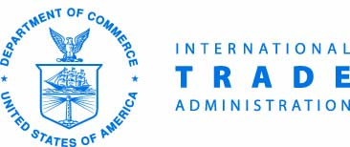
OPPORTUNITIES IN INTERNATIONAL DEVELOPMENT
Webinar #4: May 30, 2019

Slide 2
World Trade Month Go Global Webinar Series
We are here to help you Go Global.
Get answers to your top questions on Opportunities in International Development.
Brought to you by your federal trade partners: the U.S. Agency for International Development, the Overseas Private Investment Corporation, the U.S. Trade and Development Agency, and the Millennium Challenge Corporation.
Access more international trade resources on www.export.gov.

Slide 3
Episode 4: Opportunities in International Development
What do U.S. international development agencies do?
In which parts of the world are U.S. international development agencies active?
How can U.S. businesses work with U.S. international development agencies?
World Trade Month Go Global Webinar Series

Slide 4
Today’s Speakers
Host: Omari Wooden
U.S. Census Bureau
Presenters: Ned Rauch-Mannino
Advisor for Intergovernmental Affairs
U.S. Agency for International Development
Dianne Quebral
Director of Public Engagement
U.S. Trade and Development Agency
Alison Germak
Director for Corporate Development
Overseas Private Investment Corporation
Maxwell Sarpong
Supervisory Contracting Officer
Millennium Challenge Corporation

Slide 5
USAID MISSION
“On behalf of the American people, we promote and demonstrate democratic values abroad, and advance a free, peaceful, and prosperous world. In support of America's foreign policy, the U.S. Agency for International Development leads the U.S. Government's international development and disaster assistance through partnerships and investments that save lives, reduce poverty, strengthen democratic governance, and help people emerge from humanitarian crises and progress beyond assistance.”
World Trade Month Go Global Webinar Series

Slide 6
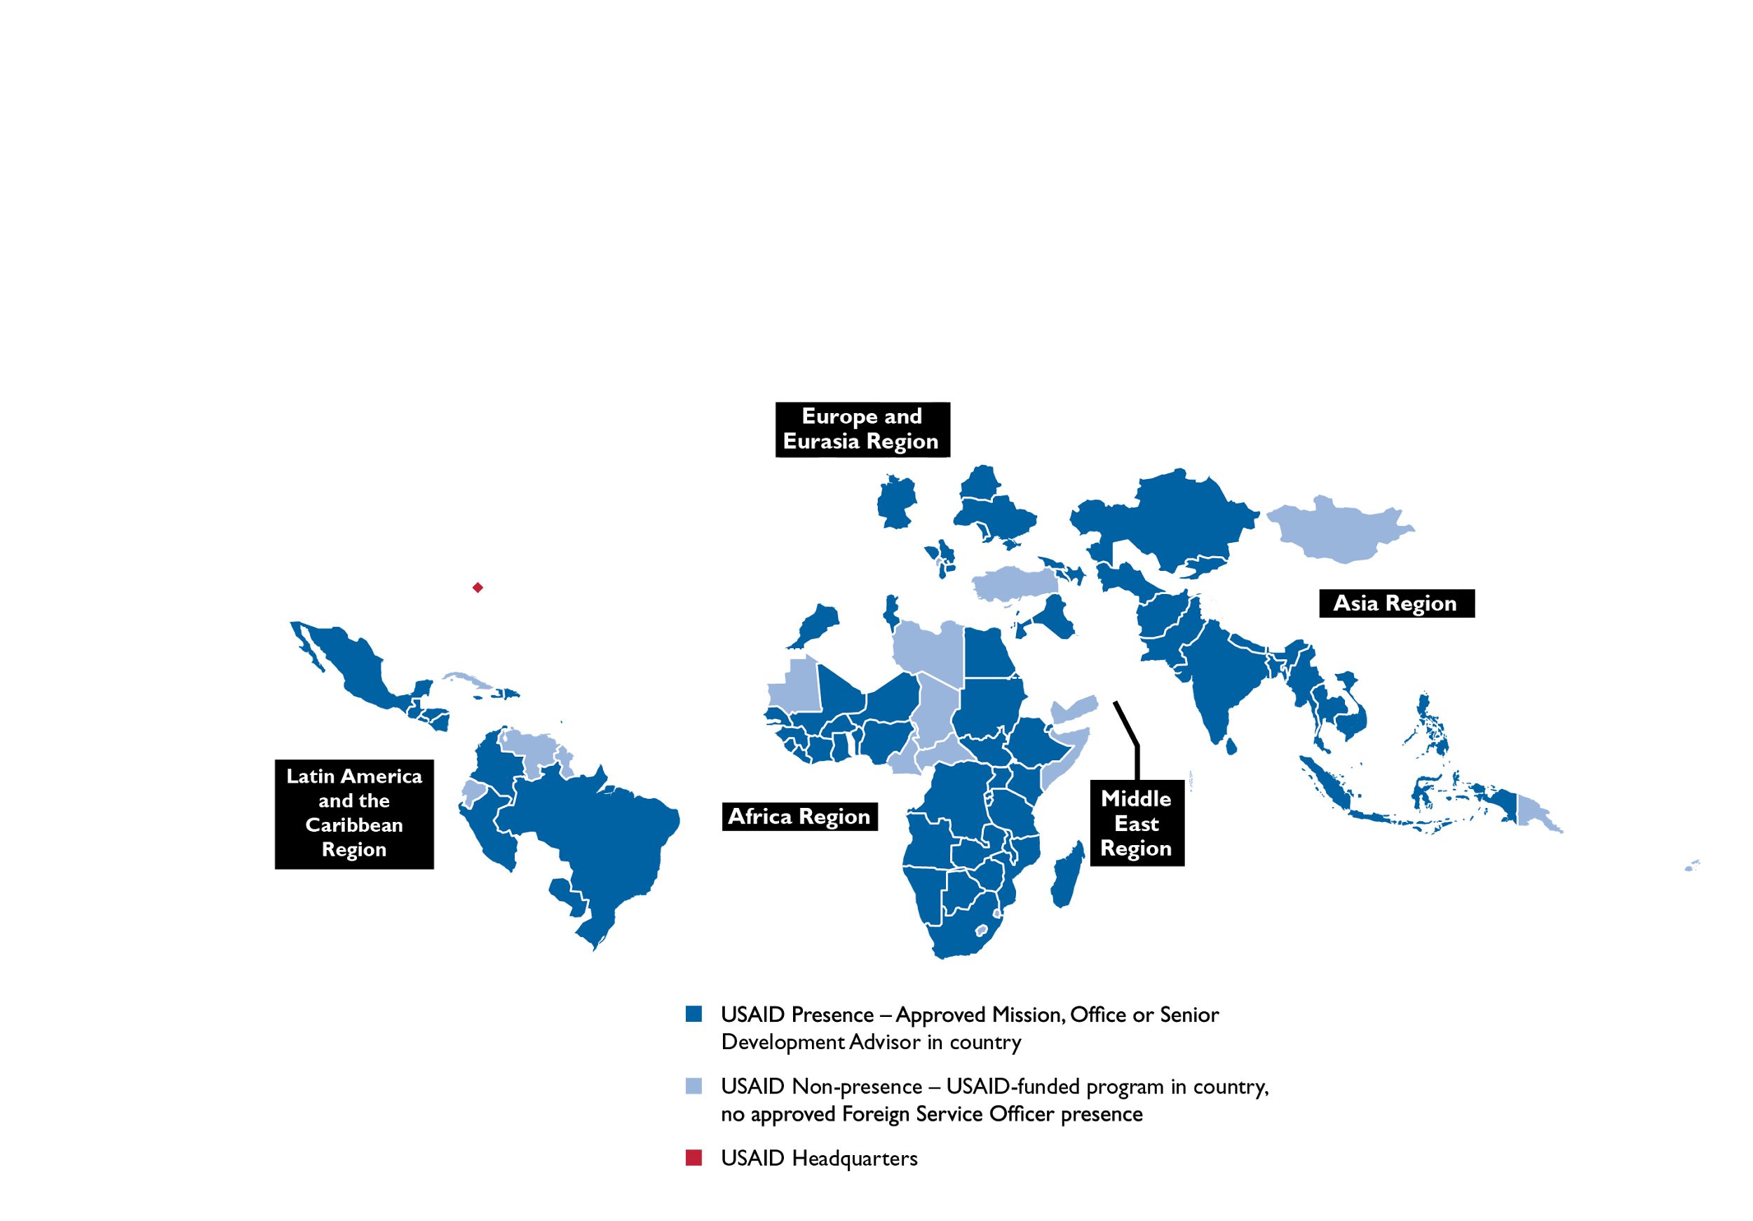
WHERE WE ARE
Our workforce of over 9,000 serves in more than 100 countries around the world. USAID’s workforce and culture serve as a reflection of core American values—values that are rooted in the belief of doing the right thing.
World Trade Month Go Global Webinar Series

Slide 7
WHAT WE DO
USAID is the world's premier international development agency and a catalytic actor driving development results. USAID's work advances U.S. national security and economic prosperity, demonstrates American generosity, and promotes a path to recipient self-reliance and resilience. Through our work we:
Provide Humanitarian Assistance
Promote Global Health
Support Global Stability
Empower Women And Girls
Catalyze Innovation And Partnership
World Trade Month Go Global Webinar Series

Slide 8
USAID TRANSFORMS SECTORS
PROVIDING HUMANITARIAN ASSISTANCE
PROMOTING GLOBAL HEALTH
SUPPORTING GLOBAL STABILITY
EMPOWERING WOMEN AND GIRLS
CATALYZING INNOVATION AND PARTNERSHIP
USAID stands with communities, around the world, when disaster strikes — it is who we are as Americans.
Investments in global health protect Americans at home and abroad, strengthen fragile or failing states, and promote social and economic progress.
Despair is dangerous — while poverty does not cause violent extremism, it creates conditions that extremists can exploit.
USAID is supporting women and girls and protecting life — peace and progress cannot be sustained without women’s equal access to opportunities and participation in their countries’ institutions.
The future of international development is enterprise-driven.
World Trade Month Go Global Webinar Series

Slide 9
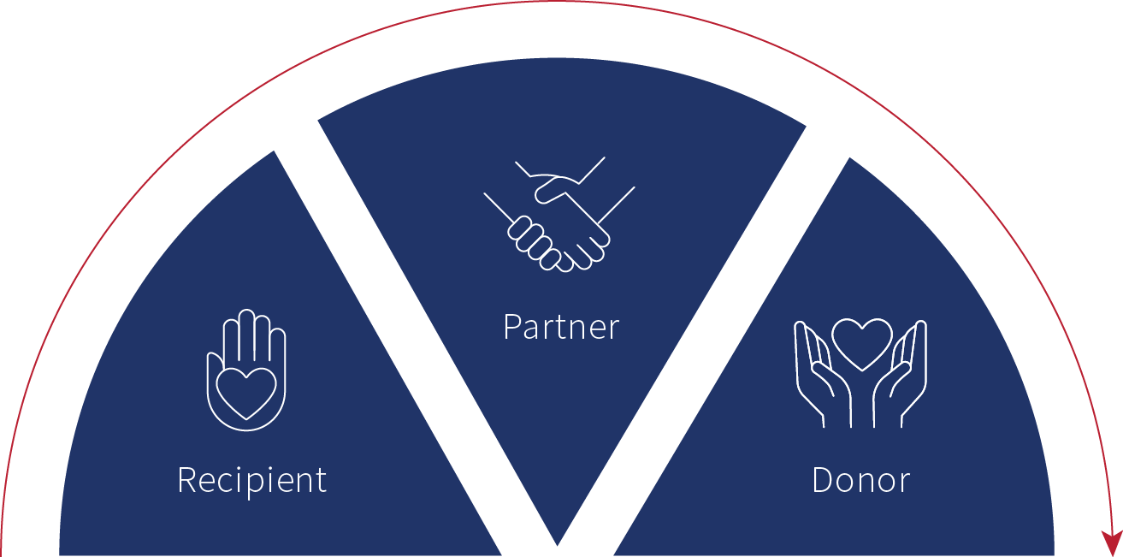
DEVELOPMENT JOURNEY
“We provide development assistance to help partner countries on their own development journey to self-reliance. Over the long run, our goal is to have countries go from being recipients, to partners, to donors.”
- USAID Administrator Mark Green
World Trade Month Go Global Webinar Series

Slide 10
USAID WORKS WITH THE PRIVATE SECTOR
KEY WAYS USAID COLLABORATES WITH THE BUSINESS COMMUNITY
Private Sector Engagement Policy: a strategic approach to international development through which USAID consults, strategizes, aligns, collaborates, and implements with the private sector for greater scale, sustainability, and effectiveness of development or humanitarian outcomes.
The New Partnership Initiative allows USAID to work with a more diverse range of partners and provide more entry points for organizations to work with the Agency.
USAID's Office of Trade and Regulatory Reform works with governments, the private sector and other donors to expand overseas markets, create economic opportunities and build strong, stable partners.
Building Public-Private Partnerships: The Global Development Alliance is USAID’s flagship model for building public-private partnerships, focused on market-based solutions to deepen USAID’s development impact.
Catalyzing Investment: Working with financial institutions, companies and other financial providers, USAID facilitates greater private investment in support of key development objectives in sectors such as energy, agriculture, and health.
The U.S. Global Development Lab provides long-term capital to innovators and entrepreneurs through venture capital style grant competitions; partnering with impact investors, incubators, and accelerators to provide financing and technical assistance to entrepreneurs; and working with corporations and others to take proven innovations to scale.
Support though initiatives: for example, Power Africa brings together technical and legal experts, the private sector, and governments from around the world to work in partnership to increase the number of people with access to power.
World Trade Month Go Global Webinar Series

Slide 11
U.S. Trade and Development Agency
Mission:
Create U.S. jobs through exports
Prepare infrastructure projects
Connect buyers and sellers
USTDA works exclusively in emerging markets
World Trade Month Go Global Webinar Series

Slide 12
USTDA’s Priority Sectors
Transportation
energy
Telecommunications
World Trade Month Go Global Webinar Series

Slide 13
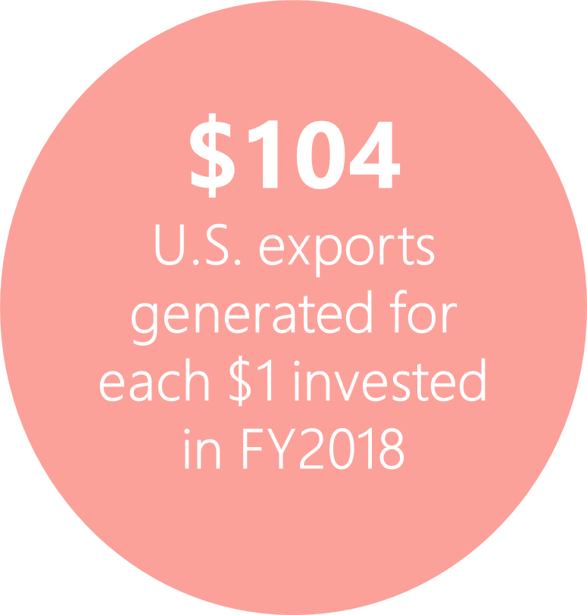
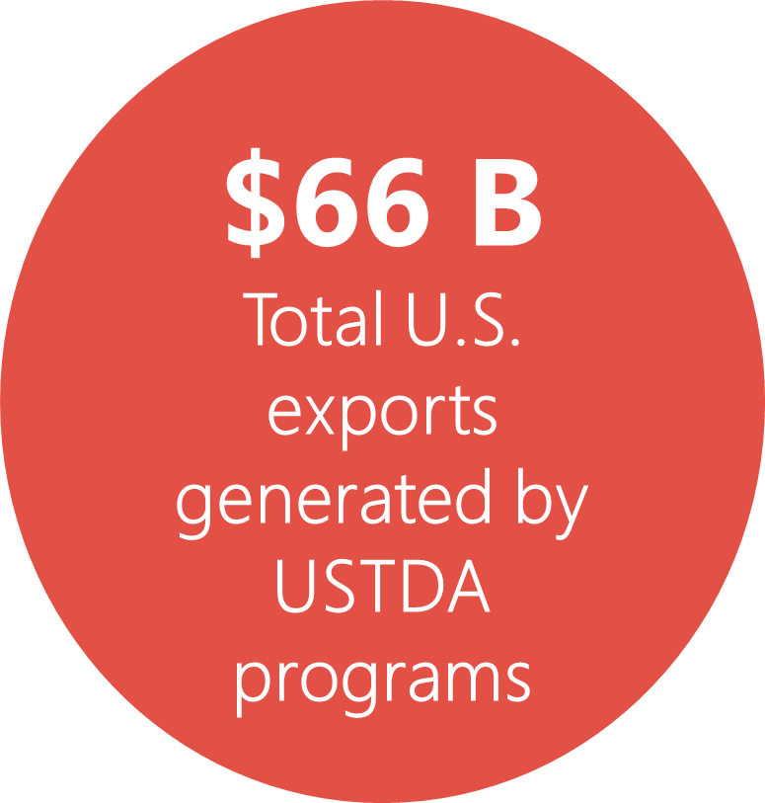
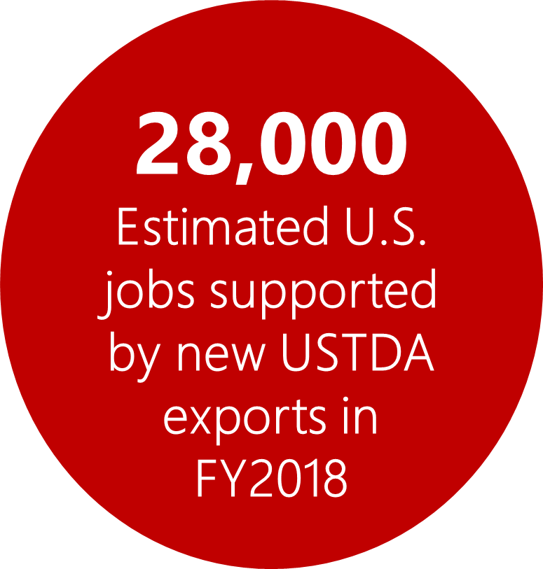
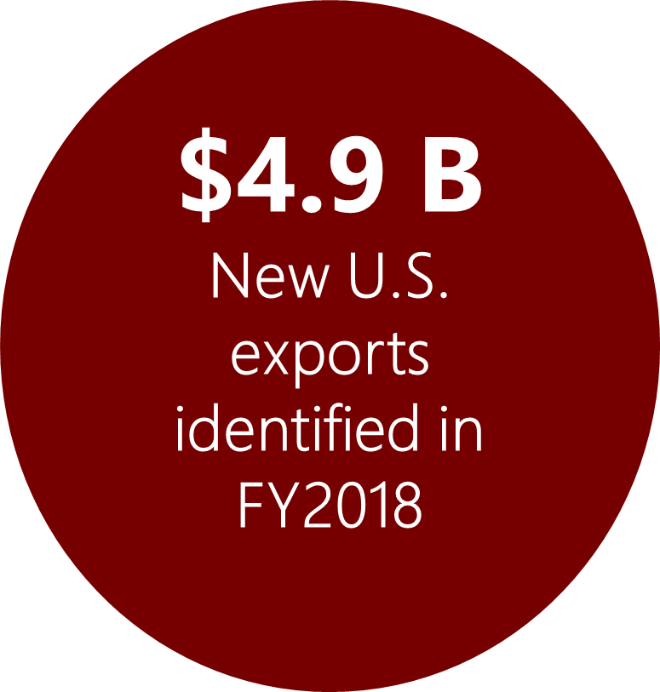
USTDA’s Results
World Trade Month Go Global Webinar Series

Slide 14
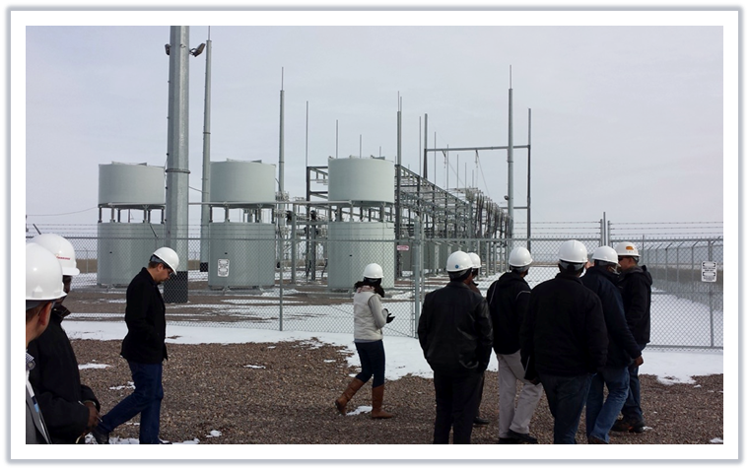
USTDA Focuses on Infrastructure
USTDA links U.S. companies to global opportunities by providing:
Access to foreign buyers through reverse trade missions, conferences and workshops
Use of State Trade Expansion Program (STEP) grants
Opportunities to participate in overseas projects through technical assistance or feasibility studies
World Trade Month Go Global Webinar Series

Slide 15
Reverse Trade Missions
In FY 2018, USTDA hosted 30 Reverse Trade Missions
Almost 2,700 foreign decision makers visited 116 U.S. Cities
Attend a Business Briefing during a Reverse Trade Mission
Upcoming events at USTDA.gov/events/events
World Trade Month Go Global Webinar Series

Slide 16
Connect with USTDA
Small Business: ustda.gov/business-opportunities/small-business-info-getting-started
Trade Leads: https://ustda.gov/business-opportunities/trade-leads
Upcoming Events and Reverse Trade Missions: https://ustda.gov/events/events
World Trade Month Go Global Webinar Series

Slide 17
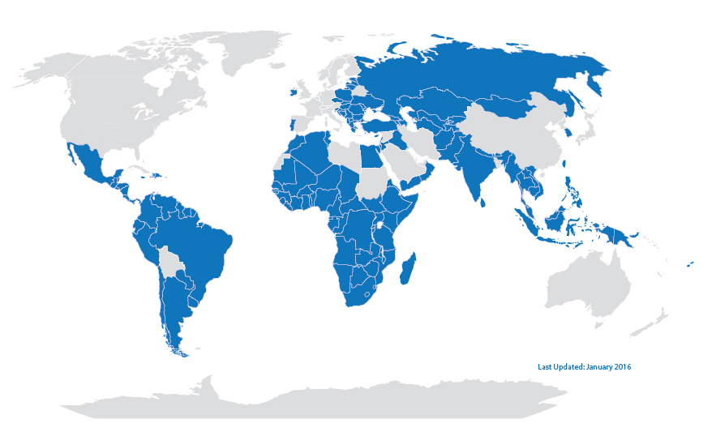
Helping American Businesses Compete
As the primary U.S. Government agency supporting private-sector investments in the developing world, OPIC provides businesses with the tools to manage the risks associated with foreign direct investment.
OPIC currently manages a $22.9 billion portfolio of projects across 90 countries and operates on a self-sustaining basis at no net cost to the American taxpayer.
World Trade Month Go Global Webinar Series

Slide 18
Our Products
OPIC offers innovative financial solutions to support private investors including debt finance, political risk insurance, and support for private equity investment funds.
Products
Current* Portfolio
Based on a $29B statutory capacity
Debt Finance
Limited-recourse, long-term financing for private-sector, commercial projects and lending platforms
Direct loans and guarantees up to $350M per project, up to 20-year term
Specific programs tailored to small and medium-sized enterprises (SMEs)
Political Risk Insurance
Protection against currency inconvertibility, expropriation, and political violence, including terrorism, as well as other specialized coverage
Policy coverage up to $350M per project
Fixed premium, cancellable only by insured
Support for Investment Funds
Senior debt financing for private equity funds selected through competitive process
Investment decisions made independently by selected fund managers
$22.9 billion
Political Risk Insurance
Investment Funds
Debt Finance
*October 2018
World Trade Month Go Global Webinar Series

Slide 19
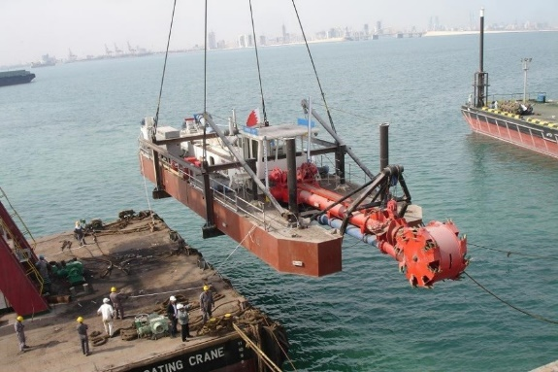
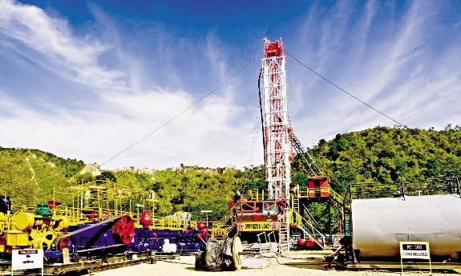
Project Examples
OPIC works with American businesses to stimulate economic development abroad and at home.
San Clemente, CA: Sambazon saw an opportunity to produce juice and other food products from the acai berry that grows in Brazil’s rainforest. But as a small startup, it couldn’t raise financing. OPIC provided a $3.7 million loan to help the company build a processing facility. Today Sambazon has more than doubled in size and now operates a flourishing business selling acai juices nationwide.
Baltimore, MD: Ellicott Dredges is the world’s oldest and largest maker of cutter suction dredges used to control floods and make waterways more passable. But when selling this equipment in Iraq and other conflict regions, it needed to ensure it would receive prompt payment. OPIC political risk insurance supported the sale of Ellicott’s equipment in Iraq, Egypt, and other markets where private insurance wasn’t available. Selling equipment overseas has supported the company’s thriving American manufacturing operation.
Tulsa, OK: Joshi Technologies developed a technology to improve yields from aging oil fields, but struggled to obtain the financing needed to move forward with international production. A $3.8 million loan from OPIC enabled the company to produce oil from the aging Palagua field in Colombia that was thought to be near the end of its producing life. Joshi was able to significantly increase yields by applying its slanted drilling technology.
World Trade Month Go Global Webinar Series

Slide 20
The Future of U.S. Development Finance
In October 2018, President Trump signed the BUILD Act into law to consolidate OPIC and other U.S. Government development finance functions into a new, strengthened federal agency called the U.S. International Development Finance Corporation.
In addition to OPIC’s existing financial capabilities, the new agency will have additional tools to help U.S. businesses invest in emerging markets, including:
Equity Authority
Expanded authority to make limited equity investments.
Additional support for development projects in the form of feasibility studies and technical assistance.
A maximum portfolio value of $60 billion – more than double OPIC’s current $29 billion cap.
Project Assistance
A Higher Portfolio Cap
World Trade Month Go Global Webinar Series

Slide 21
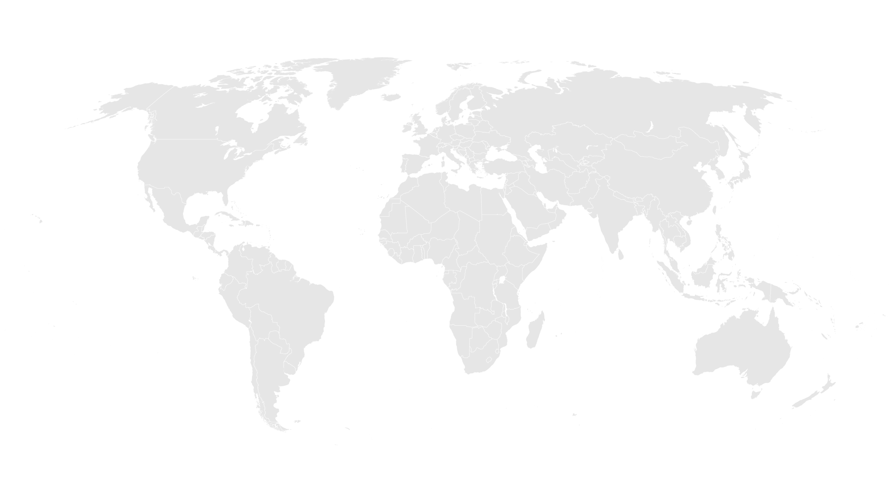
World Trade Month Go Global Webinar Series
Notes:
21
(Introduce yourself.)

Slide 22
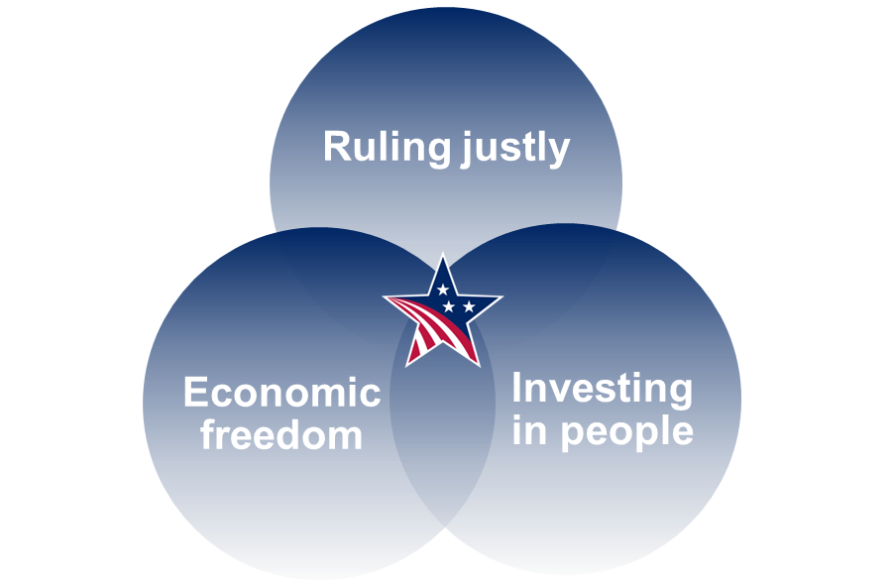
Who is MCC & why are we unique?
Mission | Established with bipartisan support in 2004 with a focused mandate: Reduce poverty through economic growth.
Competitive Selection | MCC measures countries’ policy performance based on 20 independent indicators. Only low-income and lower-middle income countries are considered for MCC funding.
Modernizing Development Assistance
Sustainability | Countries are empowered to tackle their own challenges and are held accountable for achieving results
World Trade Month Go Global Webinar Series

Slide 23
Discovering MCC Headquarters & MCA
Country Procurement Opportunities
Compact procurements
Awarded and Administered by MCA Entities.
Contract opportunities – all untied – are published to:
http://www.mcc.gov/
http://mcc.dgMarket.com/
http://www.devbusiness.com/
MCC Threshold and Corporate procurements
Awarded and Administered by MCC.
Majority awarded to US companies.
Opportunities published to http://www.FedBizOpps.gov
Annually ~$500M
Annually ~$70M
World Trade Month Go Global Webinar Series

Slide 24
Doing Business with MCC & HQ Procurement Methods
Why Do Business with MCC
How to Do Business with MCC
Invoices are paid directly by the U.S. Treasury to the contractor
The procurement process establishes a fair playing field
All money is available up-front
Winning contracts are price-reasonable and best value
International environmental and labor standards are enforced
Compete for contracts, grants, and PPPs
Invest alongside MCC
Inform the focus and design of MCC compacts
Engaging with MCC HQ
Orders against existing MCC contracts/BPAs (see “Contract Vehicles” site)
Orders against Government-wide contracts (e.g., GSA FSS, NASA SEWP, etc.)
Full and open (FedBizOpps)
Interagency Agreements (IAAs)
Grants/cooperative agreements (Grants.gov)
World Trade Month Go Global Webinar Series

Slide 25
MCC Small Business Program Report
MCC & the Small Business Community
Small Business Goal Categories | Federal Goal | FY 2015 Results | FY 2016 Results | FY 2017 Results | Average (FY05-16)
Small Business (SB) | 23% | 60.7% | 34.3% | 33.8% | 44.2%
Small Disadvantaged SB | 5% | 12.9% | 7.9% | 10.5% | 10.3%
Woman-owned SB | 5% | 25.5% | 7.8% | 10.8% | 12.1%
8(a) Procedure | 3% | 6.2% | 1.8% | 0.8% | 7.6%
Hub-Zone SB | 3% | 5.6% | 1.8% | 2.3% | 2.5%
Service-Disabled Veteran-owned SB | 3% | 11.2% | 7.8% | 3.8% | 6.7%
Veteran Owned SB | 3% | 11.4% | 8.1% | 4.3% | 7.6%
Minority Owned Business | -- | 8.1% | 6.8% | 12.3% | 10.6%
Notes:
Authoritative Source for the Small Business Data is the Federal Procurement Data System – Next Generation (FPDS-NG)
Beginning in FY 2016, all overseas contracts count as eligible dollars whereas they did not in previous years, so MCC saw a decline in amounts once those dollars are included
World Trade Month Go Global Webinar Series

Slide 26
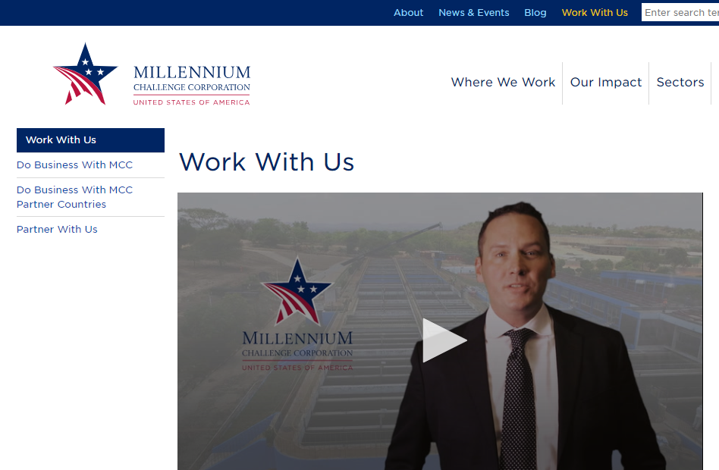
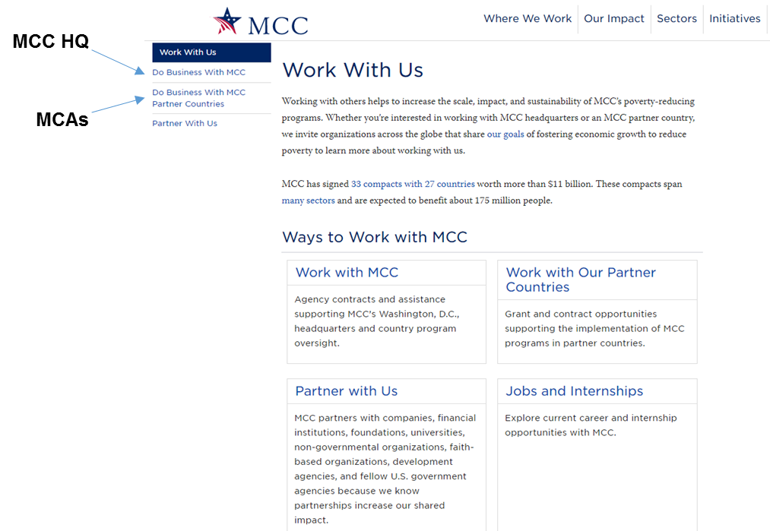
How to Find Opportunities
Visit MCC’s website—a one-stop shop
Includes all live opportunities & 12-month forecasts
www.mcc.gov/work-with-us
World Trade Month Go Global Webinar Series

Slide 27
Stay Engaged and Informed
MCC’s Work With Us page: www.mcc.gov/work-with-us
Quarterly Business Forecast
LinkedIn and MCA websites
Market Outreach Events
Subscribe to MCC’s email list: www.mcc.gov/subscribe
World Trade Month Go Global Webinar Series

Slide 28
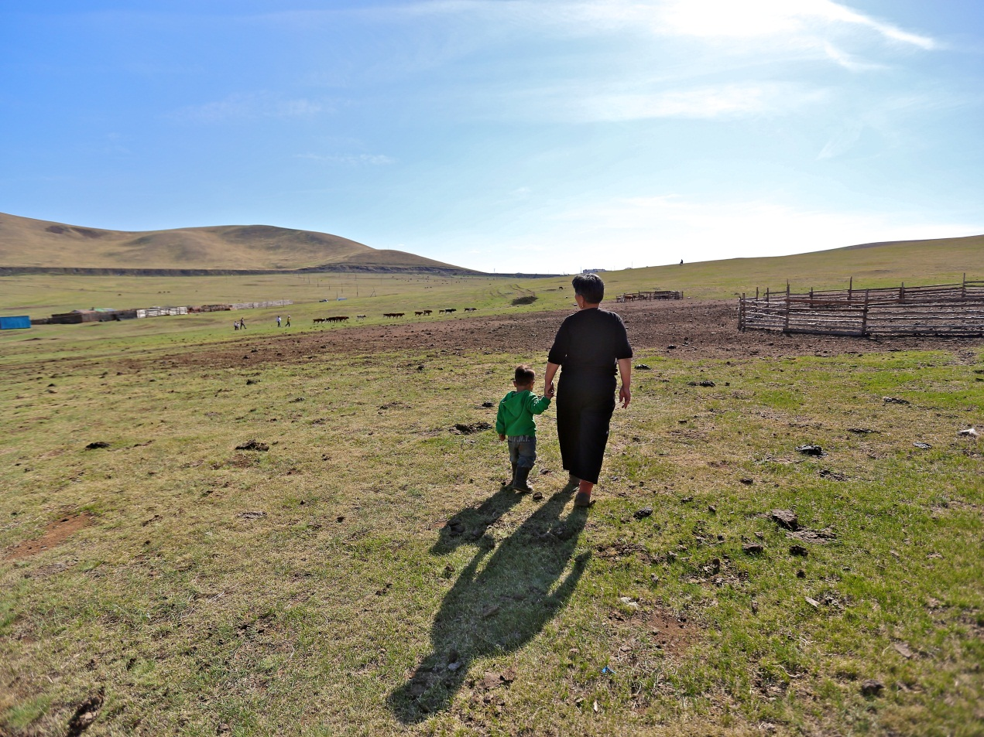
For more information, visit www.mcc.gov/work-with-us

Slide 29
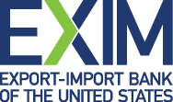
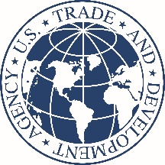
Recorded Webinars
To access all previously recorded webinars go to:
https://www.census.gov/foreign-trade/outreach/index.html
Find Buyers, Finance Deals and Get Paid
Managing Challenges in the Global Marketplace
Online Tools for Finding New Markets
Opportunities in International Development

Slide 30
Questions?
World Trade Month Go Global Webinar Series

Slide 31
FOR MORE INFORMATION
Ned Rauch-Mannino
Advisor for Intergovernmental Affairs
U.S. Agency for International Development
(202) 712-4036
nrauchmannino@usaid.com
www.usaid.gov
Alison Germak
Director, Corporate Development
Overseas Private Investment Corporation
(202) 336-8651
alison.germak@opic.gov
www.opic.gov
Dianne Quebral
Director of Public Engagement
U.S. Trade and Development Agency
(703) 875-4245
dianne.quebral@ustda.gov
www.ustda.gov
Maxwell Sarpong
Supervisory Contracting Officer
Millennium Challenge Corporation
(202) 521-7212
Sarpongmb@mcc.gov
www.mcc.gov
World Trade Month Go Global Webinar Series
Notes:
We are now at the end of our webinar and we thank everyone that logged in. We also would like to thank our experts from the U.S. Agency for Interational Development, the Overseas Private Investment Corporation, the U.S. Trade and Development Agency, and the Millennium Challenge Corporation for their time and expertise. Here is contact information for today’s speakers if you have any further questions. Thank you again and we look forward to working with you to expand your global sales! Thank you!

