Slide 1
DECCS Registration and Licensing Roll-Out
Directorate of Defense Trade Controls Karen Wrege
DDTC CIO
January 14th, 2020

Slide 2
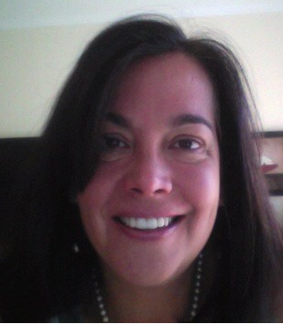
Introduction
About DDTC:
Mission: Ensuring commercial exports of defense articles and defense services advance U.S. national security and foreign policy objectives.
Organizational Structure:
Policy Office (DTCP)
Licensing Office (DTCL)
Compliance Office (DTCC)
Management Office (DTCM)
Key Functions:
Establishing and maintaining defense export regulations (ITAR)
Registering entities and individuals
Adjudicating export licenses
Responding to inquiries
Promoting and enforcing compliance
About the Speaker:
Karen Wrege, CIO
Has 31 years of Information Technology experience in the private and public sectors
Joined DDTC as the CIO in October 2014
Prior to DDTC, spent 10 years in economic consultancy providing auction software and services to global clients in the telecommunications industry
Served as manager of the US Federal Communications Commission's spectrum auctions beginning in 1994 and was promoted to Chief Information Officer of the Wireless Telecommunications Bureau

Slide 3
Agenda
DDTC IT Modernization Overview
What is in the Release
Registration
Licensing
System-wide Improvements
Industry Engagement
How to prepare for DECCS Launch
Enrollment Demo
Q&A

Slide 4
IT Modernization
DDTC is undergoing a major IT Modernization effort to replace legacy systems with modern Cloud technologies. The new platform, the Defense Export Control and Compliance System (DECCS), will provide industry access to a number of DDTC applications through a single online portal.

Slide 5
Release Highlights – Registration
Updated DS-2032 form
New application includes
Up-to-the-minute status feedback
Direct connection to electronic payments
Existing Registrations will be migrated
Registrations in ‘Draft’ status also migrated

Slide 6
Release Highlights – Licensing
No updates to existing forms
New forms
DS-4294 – Brokering License
DS-6004 – Request to Change End User, End Use, or Destination of Hardware
Friendly Reminder - Registration required to submit a new License
New application includes
No more License Repost requests needed!
Historical info readily available

Slide 7
Release Highlights – System
More transparency into processes
More security certificate options

Slide 8
Industry Engagement
Industry Testing
Functional Testing (2 rounds)
Batch Testing
Data Validation
Presentations and Outreach

Slide 9
What you can do to prepare
Ensure that you have a DECCS account
Review information on our website​
Know your company’s registration expiration date​
Identify team members to fill necessary roles​
Corporate Administrators – Full system access
Senior Official(s) - Sign and Submit
Registration Drafters – Generate Registrations
License Groups – Define users that can access specific Licenses
Timeline & Next Steps

Slide 10
SYSTEM DEMO – Enroll in DECCS
DIRECTORATE OF DEFENSE TRADE CONTROLS

Slide 11
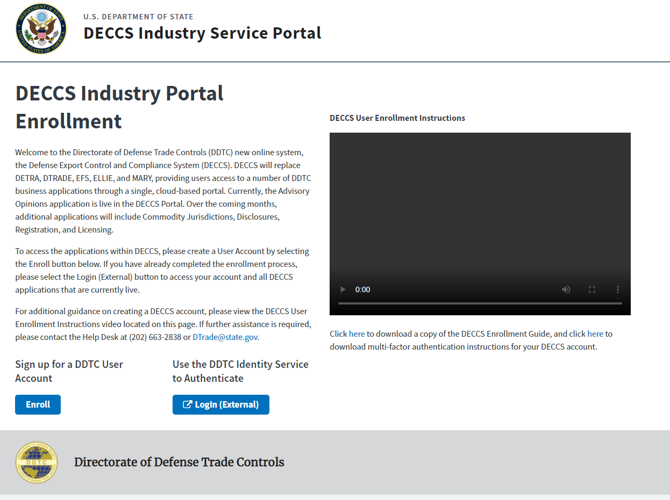
Enroll in DECCS – Getting Started

Slide 12
Enroll in DECCS – Getting Started

Slide 13
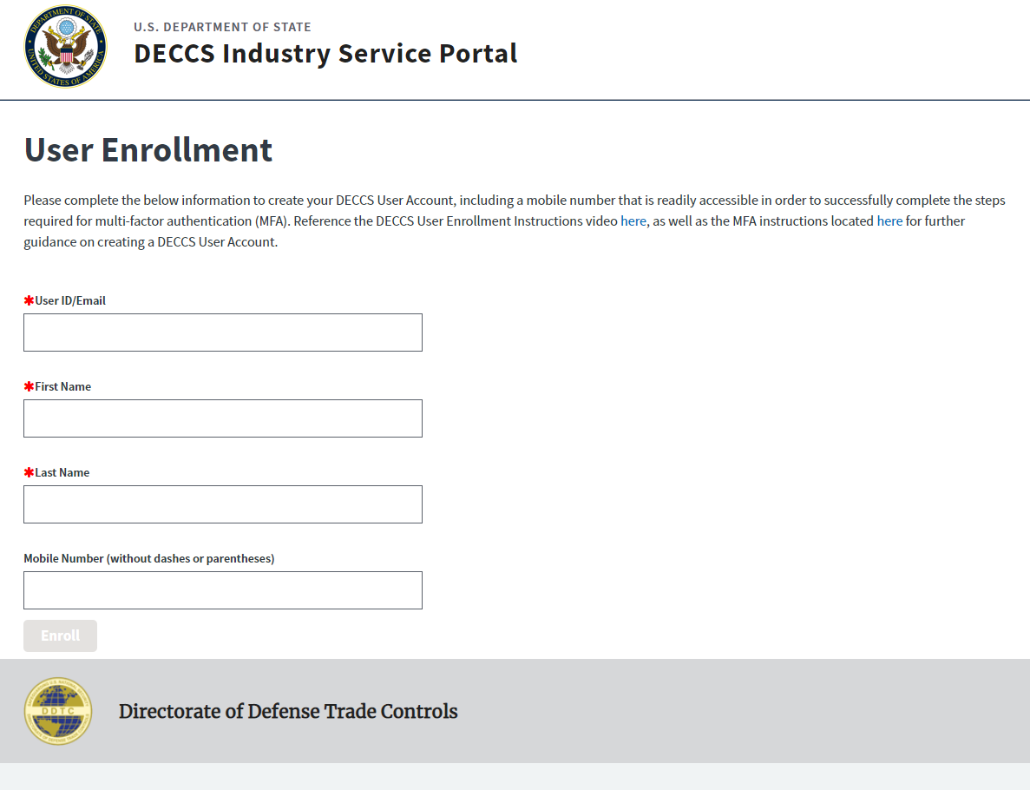
Enroll in DECCS – Getting Started

Slide 14
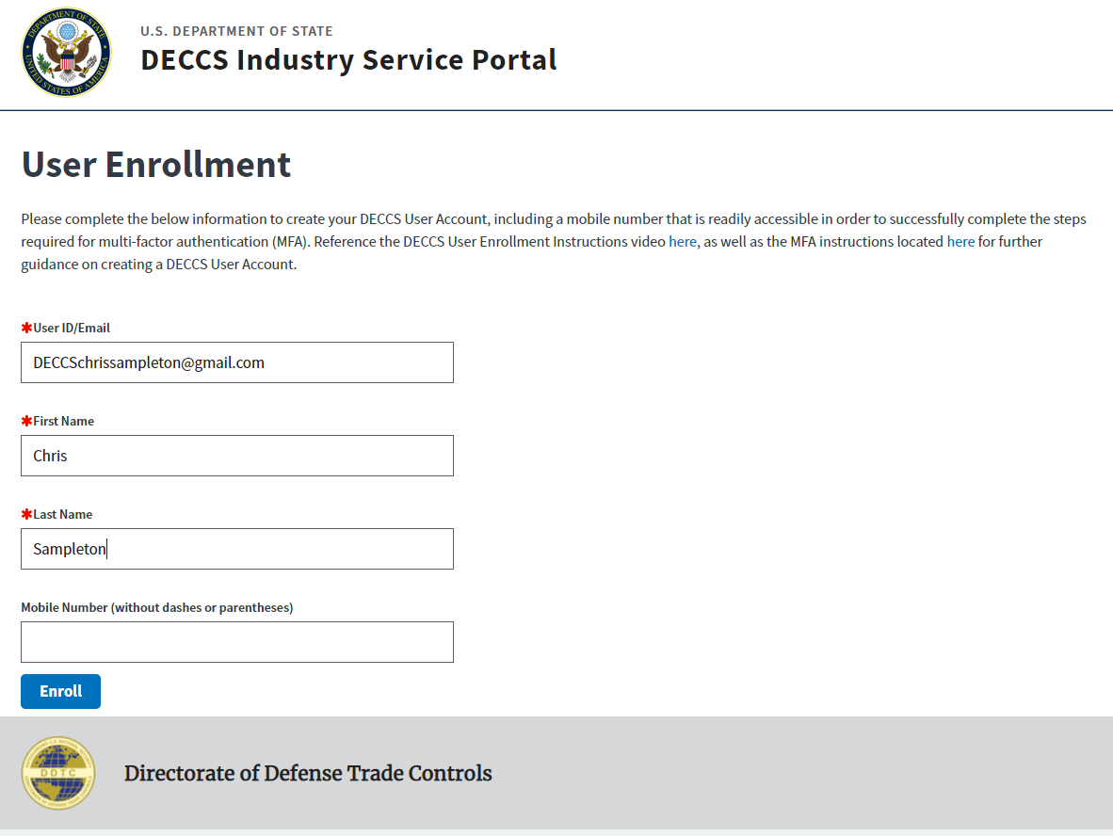
Enroll in DECCS – Getting Started

Slide 15
Enroll in DECCS – Getting Started

Slide 16
Enroll in DECCS – Getting Started

Slide 17
Enroll in DECCS – Getting Started

Slide 18
Enroll in DECCS – Getting Started

Slide 19
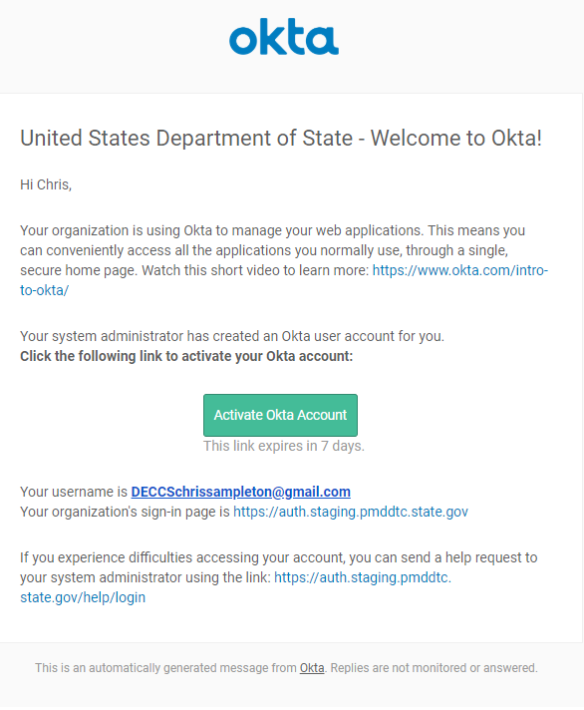
Enroll in DECCS – Getting Started

Slide 20
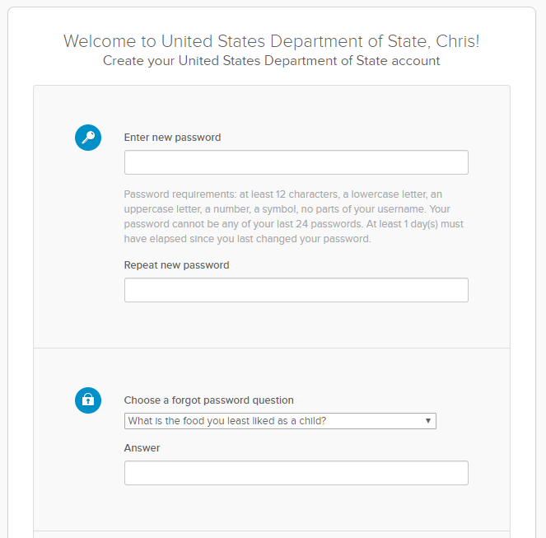
Enroll in DECCS – Getting Started

Slide 21
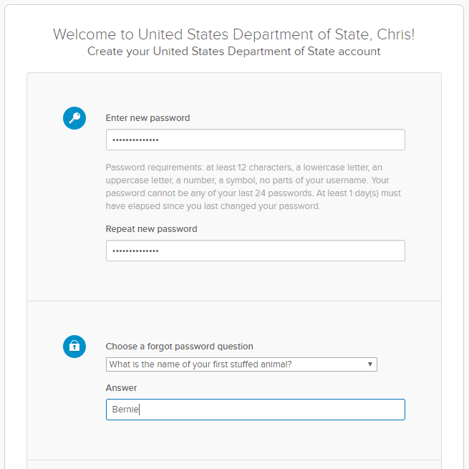
Enroll in DECCS – Getting Started

Slide 22
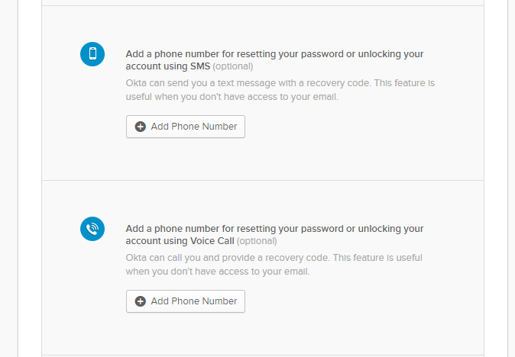
Enroll in DECCS – Getting Started

Slide 23
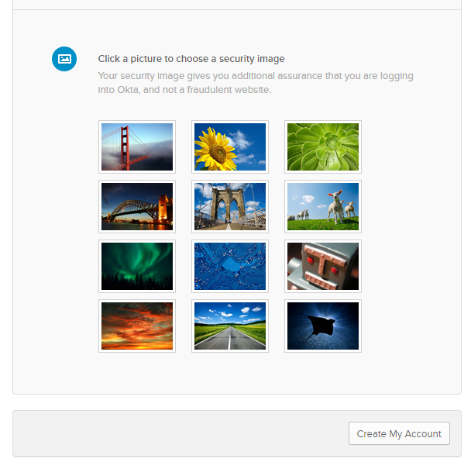
Enroll in DECCS – Getting Started

Slide 24
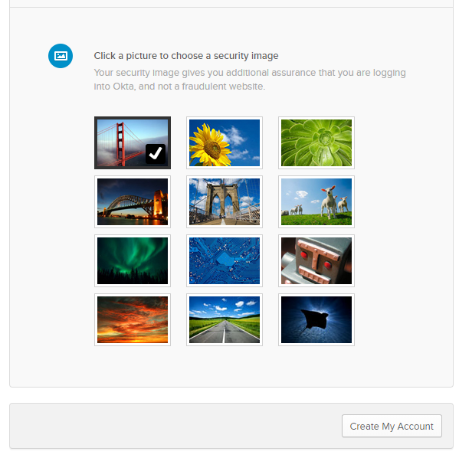
Enroll in DECCS – Getting Started

Slide 25
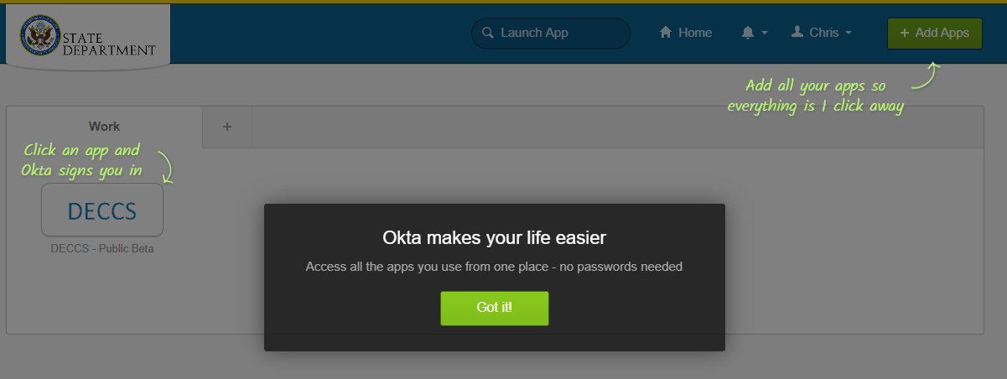
Enroll in DECCS – Multifactor Authentication

Slide 26
Enroll in DECCS – Multifactor Authentication

Slide 27
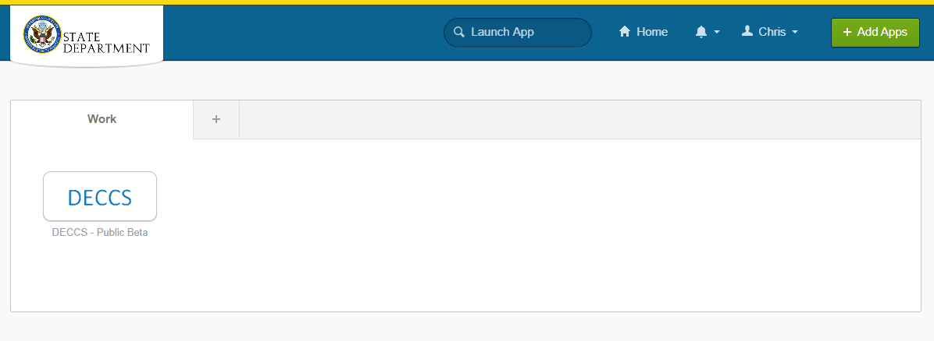
Enroll in DECCS – Multifactor Authentication

Slide 28
Enroll in DECCS – Multifactor Authentication

Slide 29
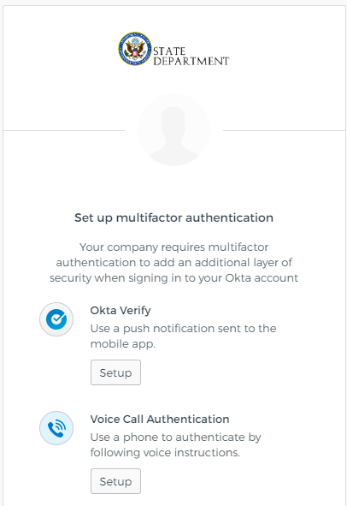
Enroll in DECCS – Multifactor Authentication

Slide 30
Enroll in DECCS – Multifactor Authentication

Slide 31
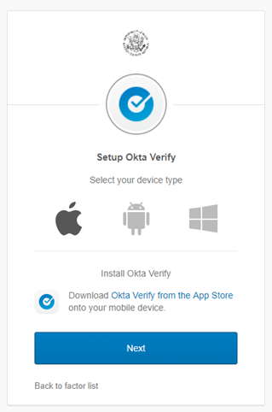
Enroll in DECCS – Multifactor Authentication

Slide 32
Enroll in DECCS – Multifactor Authentication
Notes:
And click “Next”

Slide 33
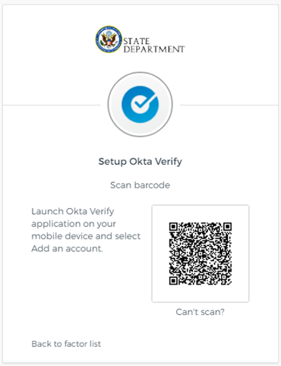
Enroll in DECCS – Multifactor Authentication

Slide 34
Enroll in DECCS – Multifactor Authentication

Slide 35
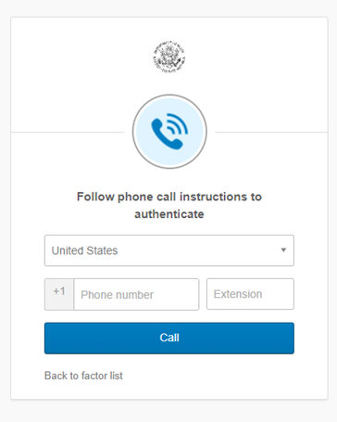
Enroll in DECCS – Multifactor Authentication

Slide 36
Enroll in DECCS – Multifactor Authentication

Slide 37
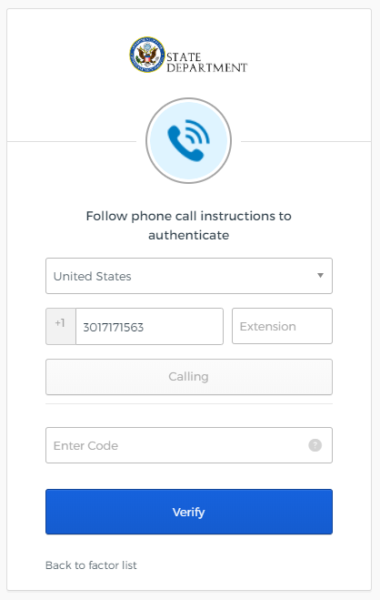
Enroll in DECCS – Multifactor Authentication

Slide 38
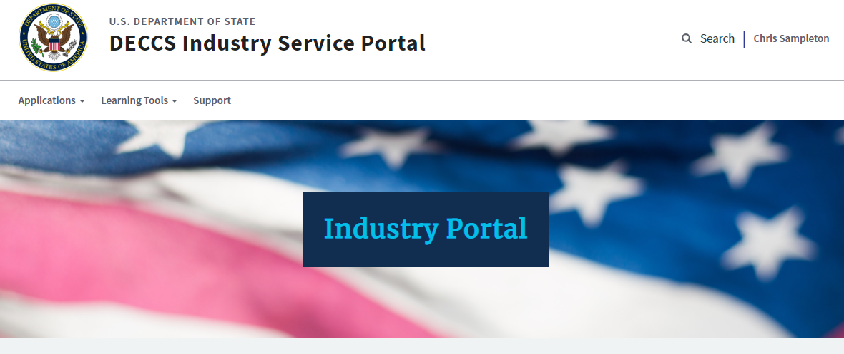
Enroll in DECCS – Success!

Slide 39
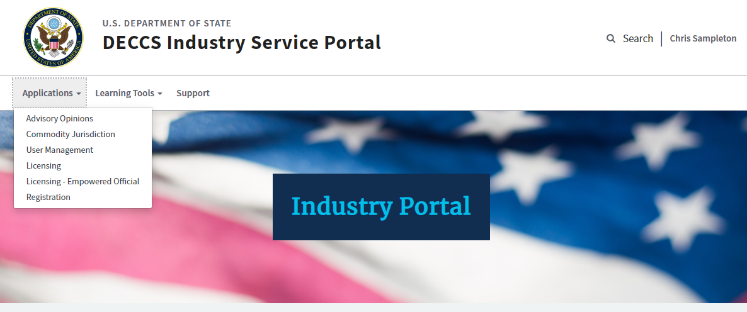
Enroll in DECCS – Success!

Slide 40
Q&a
DIRECTORATE OF DEFENSE TRADE CONTROLS

Slide 41
DDTC Contact Information
For IT Modernization Questions & Updates:
DDTC IT Project Team: PM_DDTCProjectTeam@state.gov
Website: www.pmddtc.state.gov
For General Inquiries:
DDTC Response Team
Tel: (202)-663-1282
Email: ddtcresponseteam@state.gov
For Technology Assistance:
DDTC HelpDesk
Tel: (202)-663-2838
Email: dtradehelpdesk@state.gov

