Slide 1
For audio, please dial: 1- 800-857-5152 | 4 2 2 9 7 0 5# To submit questions, go to Slido.com & enter event #DDTCDECCS

Slide 2
Census Resources

Slide 3
DECCS Hot Topics Webinar
Directorate of Defense Trade Controls Karen Wrege, DDTC CIO
Tim Duffy, Licensing Division Chief
September 9, 2020

Slide 4
Introduction
About DDTC:
Mission: Ensuring commercial exports of defense articles and defense services advance U.S. national security and foreign policy objectives.
Organizational Structure:
Policy Office (DTCP)
Licensing Office (DTCL)
Compliance Office (DTCC)
Management Office (DTCM)
Key Functions:
Establishing and maintaining defense export regulations (ITAR)
Registering entities and individuals
Adjudicating export licenses
Responding to inquiries
Promoting and enforcing compliance
About the Speakers:
Karen Wrege, CIO
Joined DDTC as the CIO in October 2014, Prior to DDTC, spent 10 years in economic consultancy providing auction software and services to global clients in the telecommunications industry
Served as manager of the US Federal Communications Commission's spectrum auctions beginning in 1994 and was promoted to Chief Information Officer of the Wireless Telecommunications Bureau
Tim Duffy, Licensing Division Chief
Served as a U.S Army Officer for 30-years, retiring as the rank of Lieutenant Colonel.
Joined DDTC in 2015 as Agreements officer for the Electronics and Training Division until 2018, then worked as an industry compliance consultant until returning to DDTC in 2019 as Chief of the Space, Missile and Sensor Division.

Slide 5
Agenda
Licensing Application in DECCS
Getting Started
DS-6004
Empowered Officials & Submitting to DDTC
How to get more help/information from DDTC
Commonly Asked Questions from the Help Desk and Response Team
Questions and Answers

Slide 6
Getting started with deccs licensing
DIRECTORATE OF DEFENSE TRADE CONTROLS

Slide 7
Getting Started with DECCS Licensing
Are you enrolled as a user in your company?

Slide 8
Getting Started with DECCS Licensing
Are you enrolled as a user in your company?

Slide 9
Getting Started with DECCS Licensing
Do you have an active Registration Code?

Slide 10
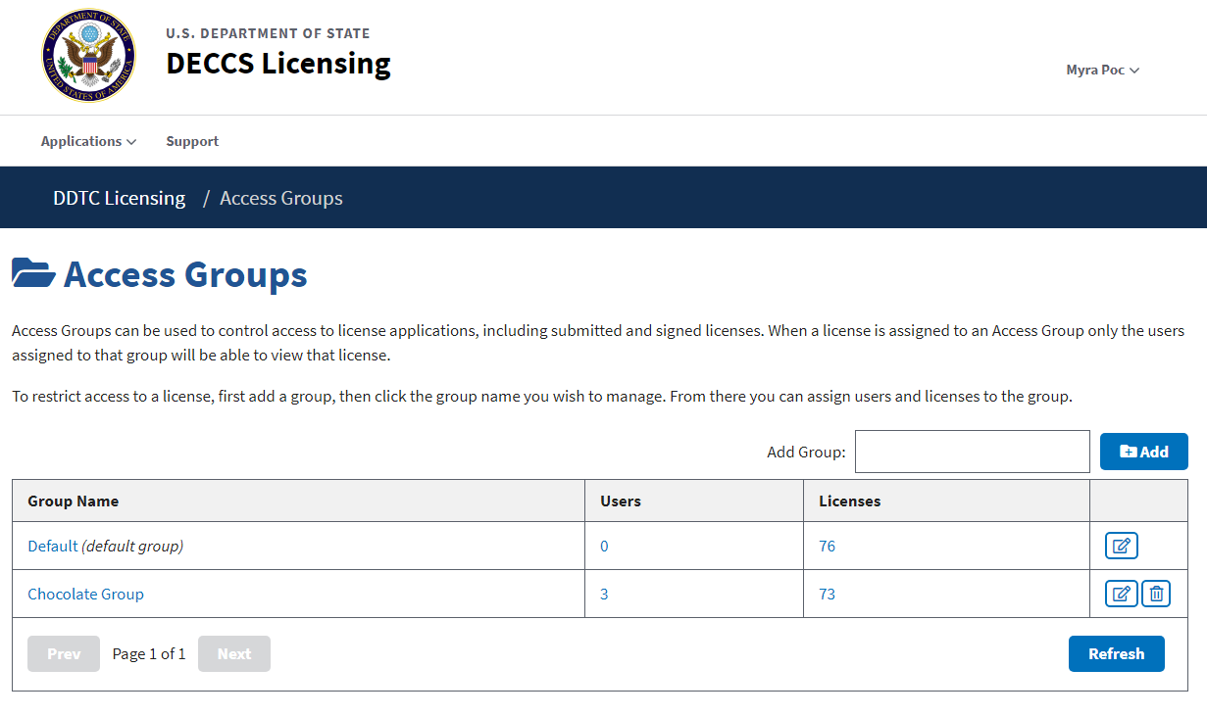
Getting Started with DECCS Licensing
Are you a member of the right licensing group?

Slide 11
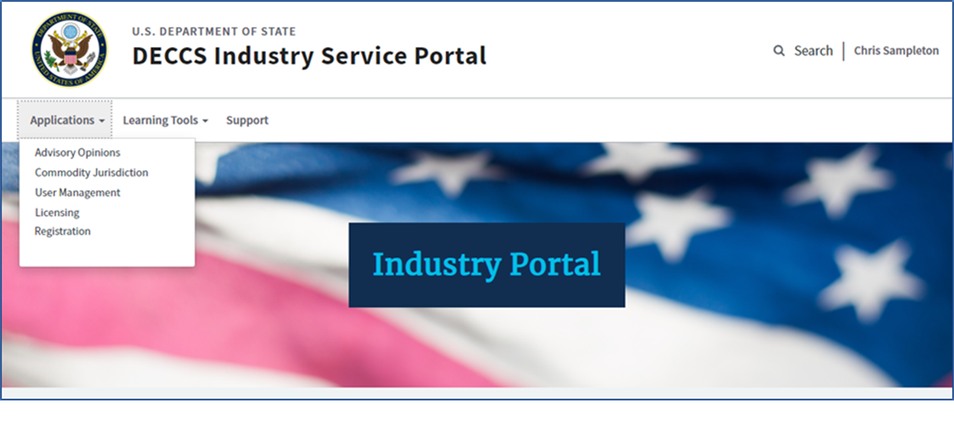
Getting Started with DECCS Licensing

Slide 12
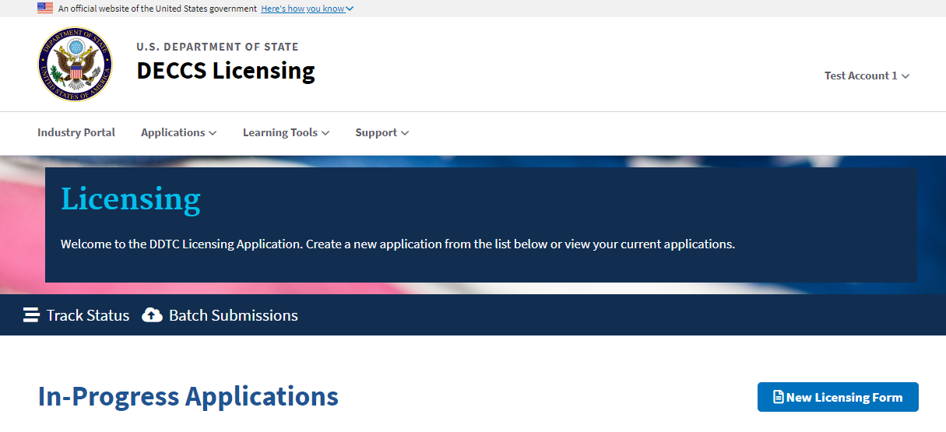
Getting Started with DECCS Licensing

Slide 13
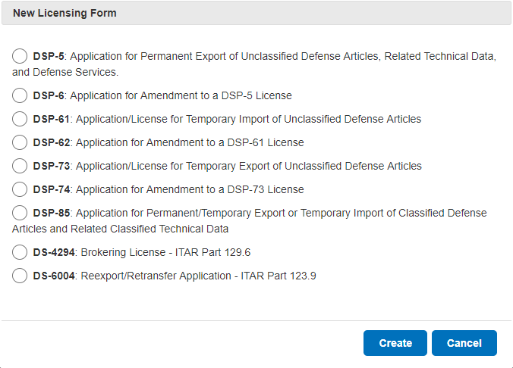
Getting Started with DECCS Licensing

Slide 14
DS-6004
DIRECTORATE OF DEFENSE TRADE CONTROLS

Slide 15
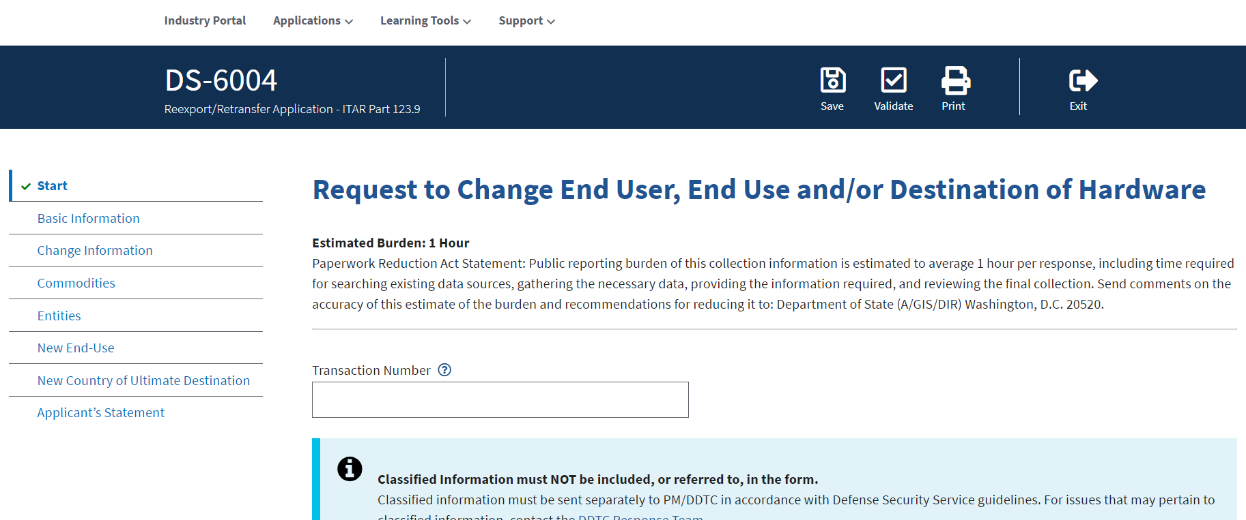
DS-6004

Slide 16
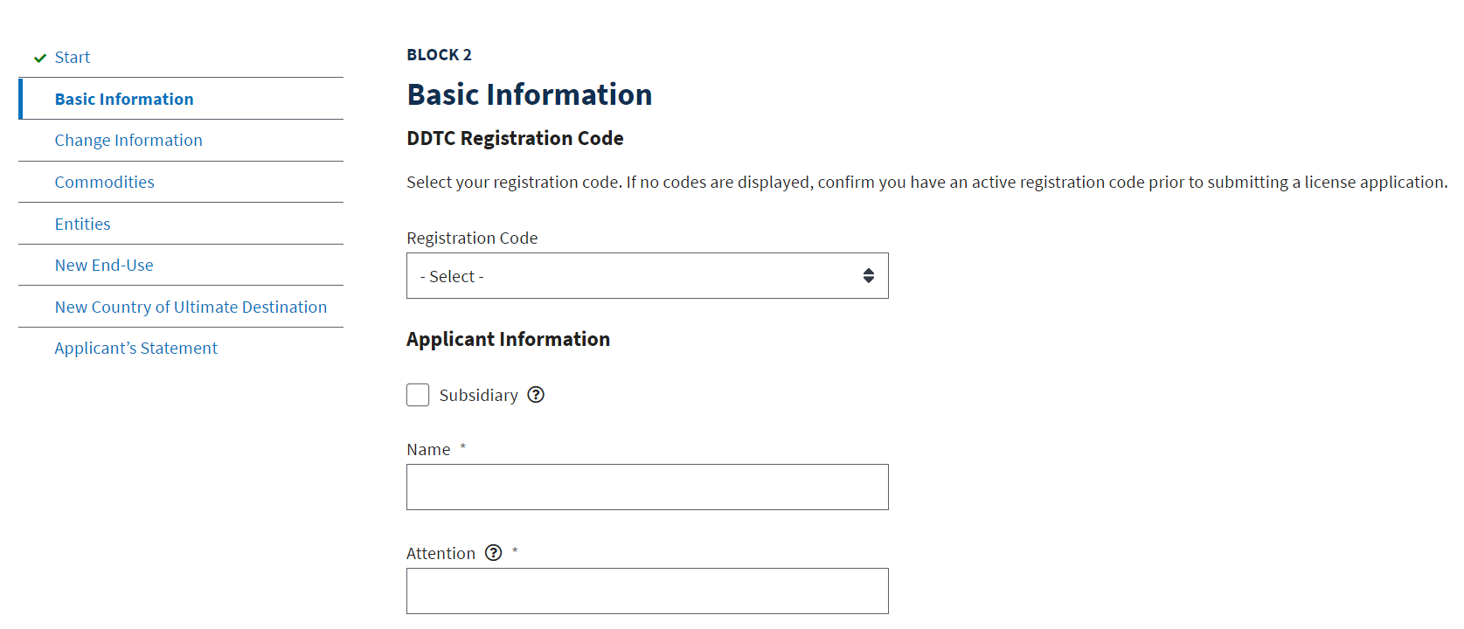
DS-6004

Slide 17
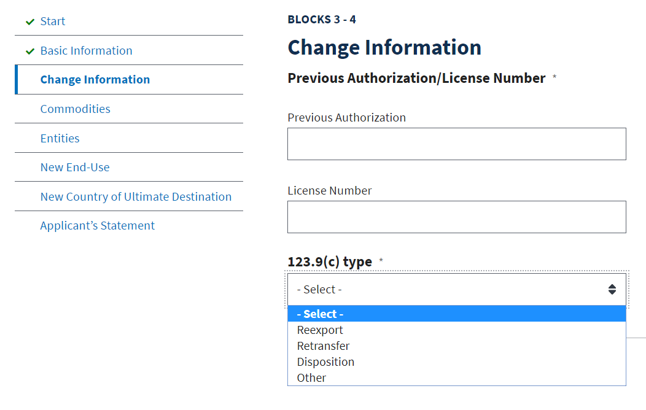
DS-6004

Slide 18
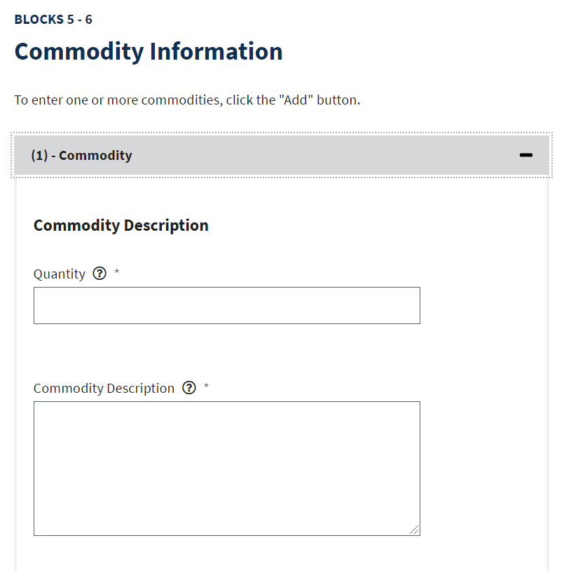
DS-6004

Slide 19
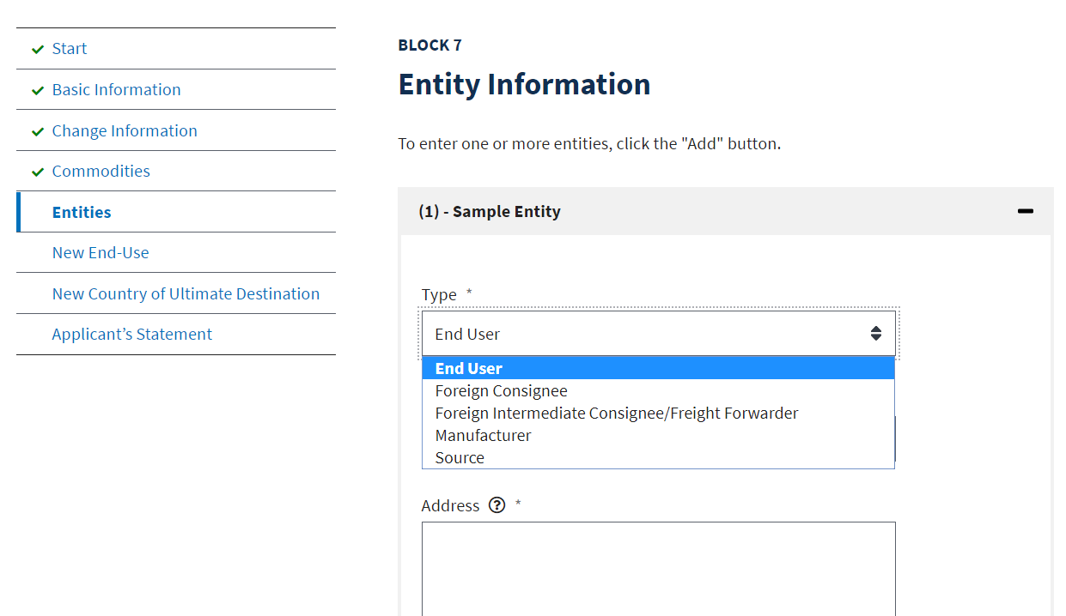
DS-6004

Slide 20
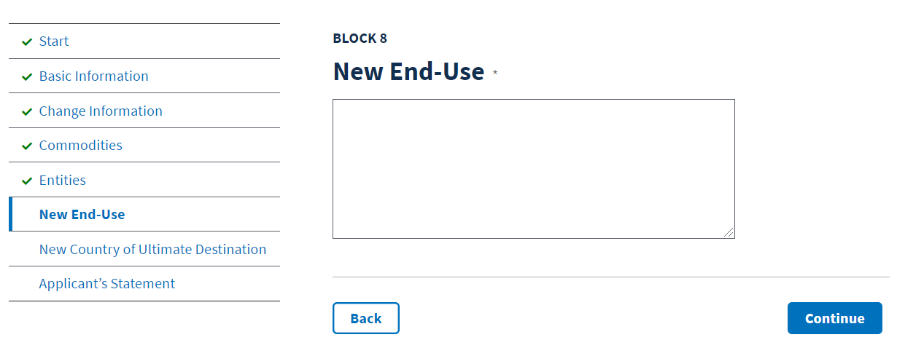
DS-6004

Slide 21
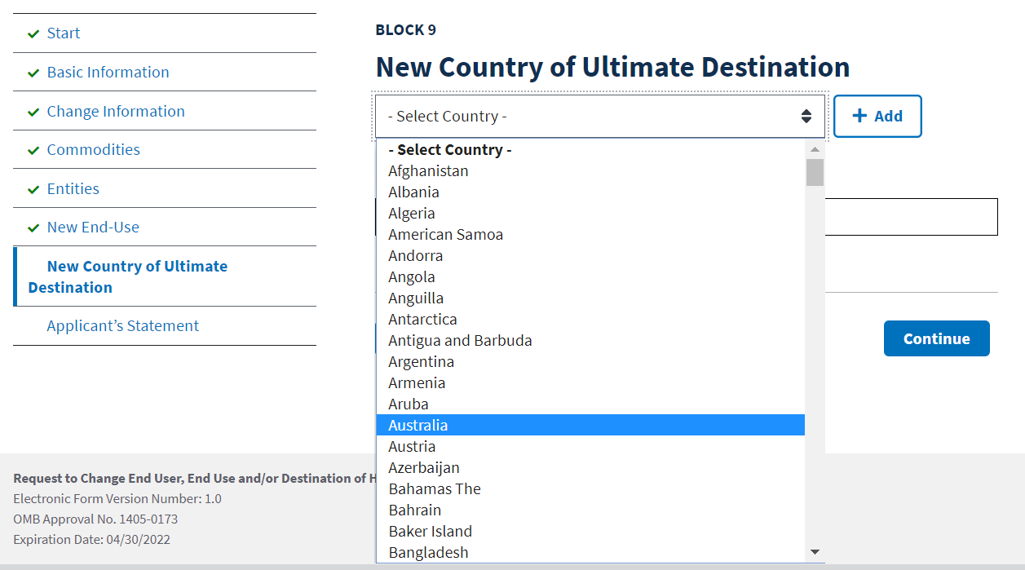
DS-6004

Slide 22
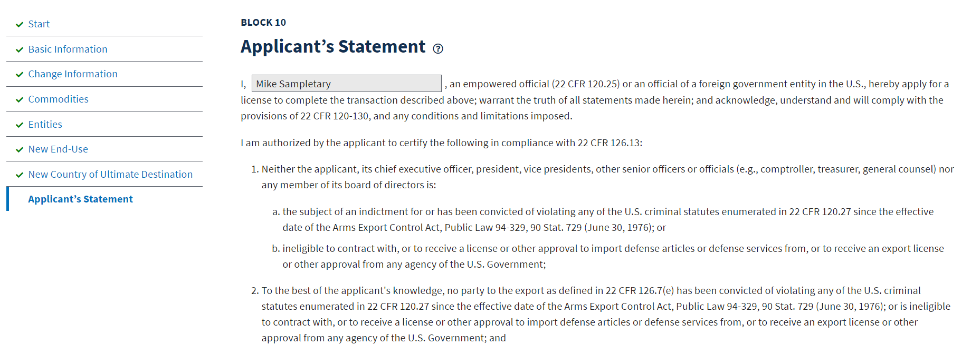
DS-6004

Slide 23
Submitting licenses to ddtc
DIRECTORATE OF DEFENSE TRADE CONTROLS

Slide 24
Submitting Licenses to DDTC
To protect both your company and DDTC, an Empowered Official in your company need one of the following Digital Certificates:
IdenTrust ECA
Widepoint ECA
To submit a license to DDTC, Empowered Officials need:
The drafter must select them as the EO for their license
The Corporate Administrator must set up the individual with the Empowered Official role for Licensing
The Empowered Official must be in the correct Licensing Group
A Digital Certificate associated with the email address used for DECCS logon
The Digital Certificate must be installed on the workstation that the individual is using

Slide 25
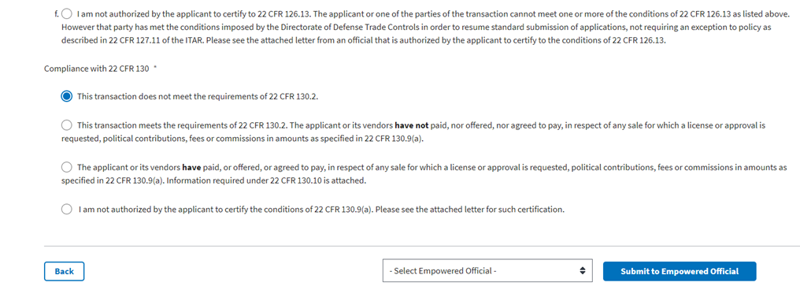
Submitting Licenses to DDTC

Slide 26
Submitting Licenses to DDTC
John Smith

Slide 27
Submitting Licenses to DDTC
John Smith

Slide 28
Submitting Licenses to DDTC
WidePoint

Slide 29
Submitting Licenses to DDTC

Slide 30
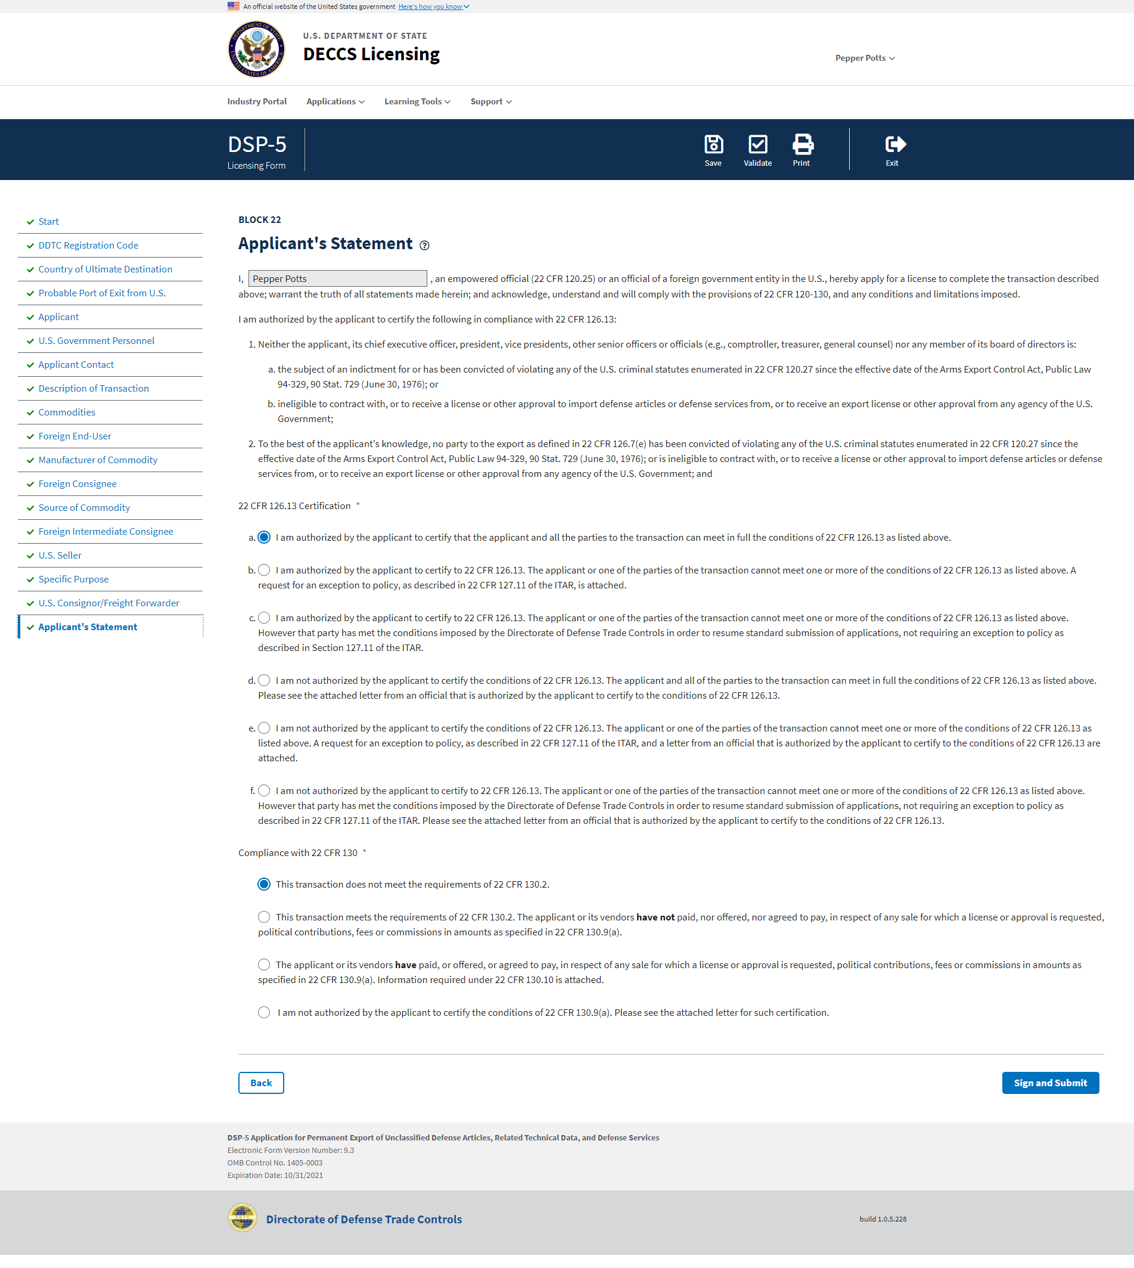
Submitting Licenses to DDTC

Slide 31
Submitting Licenses to DDTC

Slide 32
Submitting Licenses to DDTC

Slide 33
Submitting Licenses to DDTC

Slide 34
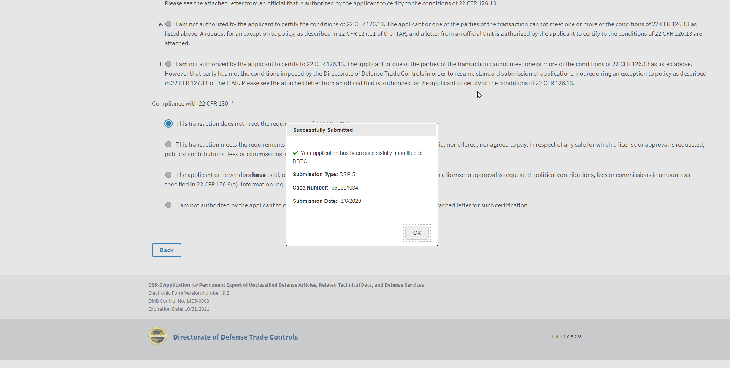
Submitting Licenses to DDTC
34

Slide 35
What if I need help?
DIRECTORATE OF DEFENSE TRADE CONTROLS

Slide 36
DECCS FAQs & Help Guides
Visit our website: https://www.pmddtc.state.gov/ddtc_public

Slide 37
DECCS FAQs & Help Guides

Slide 38
DECCS FAQs & Help Guides

Slide 39
DECCS FAQs & Help Guides

Slide 40
DECCS FAQs & Help Guides

Slide 41
DECCS FAQs & Help Guides

Slide 42
Learning Tools

Slide 43
Learning Tools

Slide 44
Learning Tools

Slide 45
Self Service

Slide 46
Self Service

Slide 47
Self Service

Slide 48
Self Service

Slide 49
Self Service

Slide 50
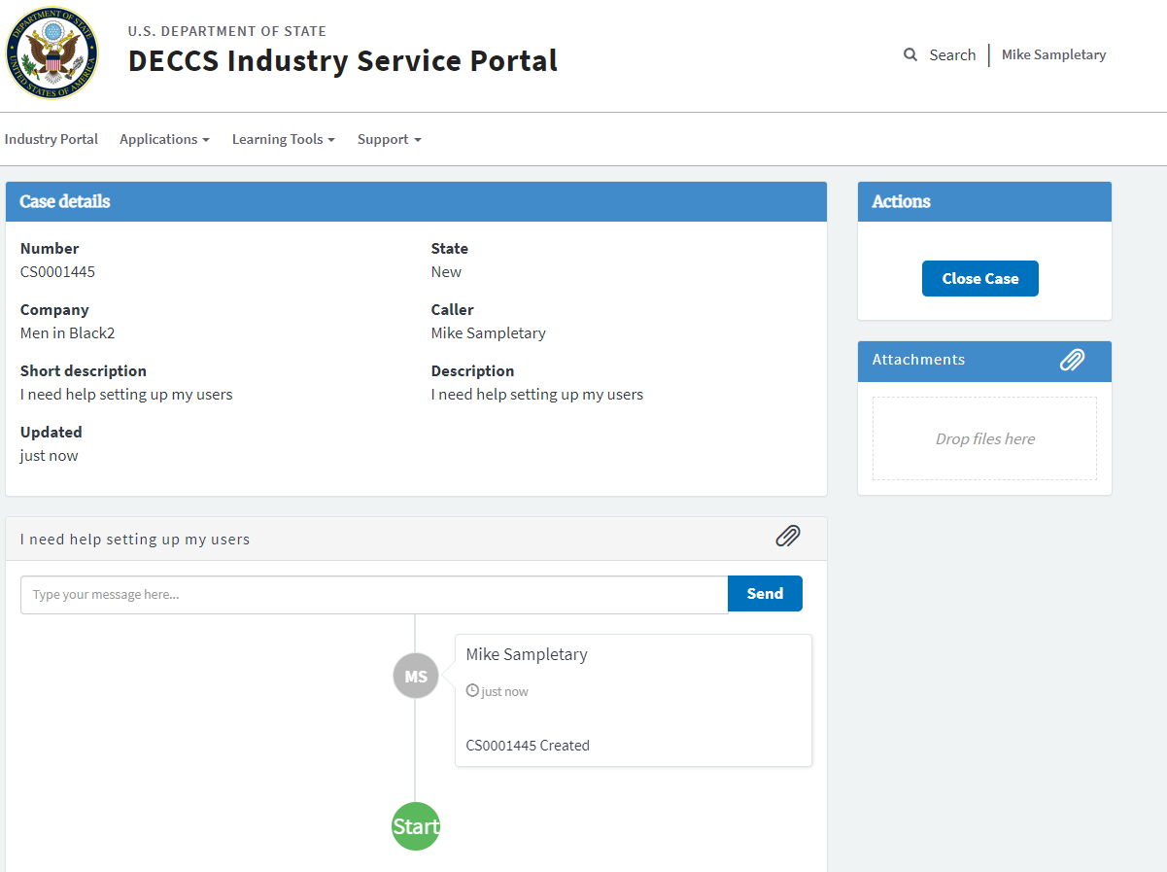
Self Service

Slide 51
Self Service

Slide 52
Self Service

Slide 53
Commonly asked questions
DIRECTORATE OF DEFENSE TRADE CONTROLS
Submit questions to Slido.com, event #DDTCDECCS

Slide 54
What’s My Registration Status?

Slide 55
How Can I Check my License Status?
For detailed case status, visit: https://elisa.dtsa.mil/
Enter your Case # and hit Submit

Slide 56
What’s Next for DECCS?

Slide 57
Q&a
DIRECTORATE OF DEFENSE TRADE CONTROLS
Submit questions to Slido.com, event #DDTCDECCS

Slide 58
Thank you!
DIRECTORATE OF DEFENSE TRADE CONTROLS
Website: www.pmddtc.state.gov

