Slide 1
We Value Your Feedback
Please take a moment to complete our quick evaluation
Tell us what we could improve AND what we did well!
*Check the webinar “Chat” box to easy access to the link!*
If you don’t see the Chat box, you can find the evaluation on your browser at https://questionweb.com/59212/
Notes:
Good afternoon. My name is James Ackerman. I’m a Compliance Specialist with the Office of Defense Trade Controls Compliance.
Earlier today you heard about DDTC and some of our key responsibilities in the policy sphere: USML, updating ITAR, and enhancing DDTC systems.
I’m going to talk to you about compliance. I’m going to provide a quick overview of the way my office works and how we approach the topic, and then I’m going to turn to specific challenges and opportunities faced by NASA.
In order to prepare for this, I took a look at recent NASA-related disclosures to our office, compliance issues reported by related groups (particularly universities and other government agencies), and several recent public reports regarding NASA’s export controls.
To level-set. We all know that NASA faces significant ITAR compliance challenges.
Candidly, it is not clear to me that “business as usual” with respect to those challenges is going to cut it. I highlight this because, in a changing export compliance world, there are increasing direct and indirect risks associated with AECA/ITAR violations.

Slide 2
Commodity Jurisdiction and Classification
February 22, 2018
U.S. Department of State
Office of Defense Trade Controls Policy
Travis W. Schultz
Notes:
Good afternoon. My name is James Ackerman. I’m a Compliance Specialist with the Office of Defense Trade Controls Compliance.
Earlier today you heard about DDTC and some of our key responsibilities in the policy sphere: USML, updating ITAR, and enhancing DDTC systems.
I’m going to talk to you about compliance. I’m going to provide a quick overview of the way my office works and how we approach the topic, and then I’m going to turn to specific challenges and opportunities faced by NASA.
In order to prepare for this, I took a look at recent NASA-related disclosures to our office, compliance issues reported by related groups (particularly universities and other government agencies), and several recent public reports regarding NASA’s export controls.
To level-set. We all know that NASA faces significant ITAR compliance challenges.
Candidly, it is not clear to me that “business as usual” with respect to those challenges is going to cut it. I highlight this because, in a changing export compliance world, there are increasing direct and indirect risks associated with AECA/ITAR violations.

Slide 3
Agenda
Brief introduction of the Directorate of Defense Trade Controls
The Commodity Jurisdiction and Classification Process
Notes:
Here are the topics I’ll be addressing. I’m happy to make this more of a back-and-forth, so please don’t hesitate to ask questions or raise issues you might care about that aren’t on the agenda.

Slide 4
DDTC Background
The Directorate of Defense Trade Controls (DDTC) is a civil regulatory body within the Department of State, whose mission is to ensure commercial exports of defense articles and defense services are consistent with U.S. national security and foreign policy objectives
DDTC is within the Bureau of Political-Military Affairs (PM); PM reports to the Under Secretary for Arms Control and International Security Affairs
Authority comes from the Arms Export Control Act (AECA; 22 U.S.C. 2778) and implementing International Traffic in Arms Regulations (ITAR; 22 CFR Parts 120-130)
Broadly speaking, the ITAR governs the export, and temporary import, of defense articles (including technical data) and defense services
Notes:
You probably heard this earlier today, but it bears repeating. Export controls serve important national security and foreign policy objectives.
There are very clear cases where technical data and defense articles have escaped control to disastrous result.
Some of you may have seen the Homeland Security presentation that highlights US equipment that was diverted and used in the Iranian nuclear program.
Just in the last year, there’s also been a lot of press regarding the connection between the rapid development of Chinese stealth fighters, including the J-20, and the theft of joint strike fighter technical data.
Loss of control over USML items also limits our ability to use such sales to bolster alliances.
It also hurts American businesses. This should be of particular interest in this room, with the development of commercial space flight.

Slide 5
The Law
§ 2778 (a) (1) of the Arms Export Control Act (AECA)
“In furtherance of world peace and the security and foreign policy of the United States, the President is authorized to control the import and the export of defense articles and defense services and to provide foreign policy guidance to persons of the United States involved in the export and import of such articles and services.
The President is authorized to designate those items which shall be considered as defense articles and defense services for the purpose of this section and to promulgate regulations for the import and export of such articles and services. The items so designated shall constitute the United States Munitions List.”
This authority is delegated to the Secretary of State by Executive Order 13637

Slide 6
The Implementing Regulations
International Traffic in Arms Regulations
“ITAR”
22 Code of Federal Regulations 120-130

Slide 7
DDTC Organization
Deputy Assistant Secretary
Of Defense Trade Controls
Michael Miller (A)
Managing Director
Tony Dearth (A)
Senior Advisors
and
Staff
Office of Defense
Trade Controls
Compliance
(Vacant)
Office of Defense
Trade Controls
Licensing
Terry Davis (A)
Office of Defense
Trade Controls
Policy
Sarah Heidema (A)
Office of Defense
Trade Controls
Management
Notes:
You probably heard this earlier today, but it bears repeating. Export controls serve important national security and foreign policy objectives.
There are very clear cases where technical data and defense articles have escaped control to disastrous result.
Some of you may have seen the Homeland Security presentation that highlights US equipment that was diverted and used in the Iranian nuclear program.
Just in the last year, there’s also been a lot of press regarding the connection between the rapid development of Chinese stealth fighters, including the J-20, and the theft of joint strike fighter technical data.
Loss of control over USML items also limits our ability to use such sales to bolster alliances.
It also hurts American businesses. This should be of particular interest in this room, with the development of commercial space flight.

Slide 8
DTCP Organization
Director
Sarah J. Heidema (A)
Deputy Director
Richard Koelling (A)
Commodity Jurisdiction and Classification Division
Nicholas Memos (A)
Regional Affairs and Analysis Division
Richard Koelling (A)
Regulatory and Multilateral Affairs Division
Robert Hart (A)
Notes:
You probably heard this earlier today, but it bears repeating. Export controls serve important national security and foreign policy objectives.
There are very clear cases where technical data and defense articles have escaped control to disastrous result.
Some of you may have seen the Homeland Security presentation that highlights US equipment that was diverted and used in the Iranian nuclear program.
Just in the last year, there’s also been a lot of press regarding the connection between the rapid development of Chinese stealth fighters, including the J-20, and the theft of joint strike fighter technical data.
Loss of control over USML items also limits our ability to use such sales to bolster alliances.
It also hurts American businesses. This should be of particular interest in this room, with the development of commercial space flight.

Slide 9
Commodity Jurisdiction
(Almost) all items are controlled for export under the ITAR or the Export Administration Regulations (EAR), but not both
ITAR controls exports of items on the U.S. Munitions List (USML)
EAR (administered by the Commerce Department) controls exports of dual-use items as well as certain “military items” (CCL)
Determining the jurisdiction and classification of a product, data, or service is the process of understanding how it is controlled under the ITAR or the EAR

Slide 10
Commodity Jurisdiction
Two fundamental questions:
Is my item controlled under the ITAR? (Jurisdiction)
If yes, which USML Category? (Classification)
If no, is it subject to the EAR? (Jurisdiction)
If yes, which ECCN? (Classification)
If no, is it controlled by another regulation?

Slide 11
Commodity Jurisdiction
Why does the jurisdiction matter?
If you get this wrong, every export-related decision going forward will also be wrong
This determination will dictate:
Controlling agency
Registration requirement (ITAR)
License requirements
Available license exemptions/exceptions
Brokering requirements (ITAR)

Slide 12
Commodity Jurisdiction
The review of jurisdiction and classification should be an established part of company procedures
Certain information will be required before you can review an item’s jurisdiction and classification, and will likely come from different functional areas within your company:
Engineering/Research & Development
Business Development/Sales
Contracts
Legal
Determining jurisdiction and classification should be a
team effort

Slide 13
Commodity Jurisdiction
You must have a complete understanding of the product:
Product description
Source of product
Understanding of product capabilities
Understanding of product end-uses
Product specifications and drawings
Real and anticipated customers for the product
Any past jurisdiction or export history
Comparable products, including foreign availability

Slide 14
Commodity Jurisdiction
The jurisdiction and classification process is governed by an “Order of Review”
ITAR §121.1(b)
Online Decision Tool:
http://pmddtc.state.gov/licensing/dt_OrderofReview.htm
EAR 774 Supplement No. 4
Online Decision Tool:
http://www.bis.doc.gov/index.php/export-control-classification-interactive-tool
The Order of Review defines the steps for reviewing the ITAR and then the EAR to assess jurisdiction and classification

Slide 15
USML Structure
USML Structure
The USML is divided into 21 categories
Each USML category includes paragraphs for articles, technical data, and defense services
Review each category to determine if your item is described in an entry under that category
Items may be described by multiple entries
Entries are either “enumerated” or “catch-all”
A “catch-all” control does not refer to specific types of items; rather, it controls unspecified “specially designed” items (Note to ITAR §120.41(b))

Slide 16
USML Structure
“Catch-all” example
USML Category VIII(h)(1) – “Parts, components, accessories, and attachments specially designed for the B-1B”
“Enumerated” examples
USML Category VIII(a)(1) – “Bombers”
USML Category VIII(a)(5) – “Unmanned Aerial Vehicles (UAVs) specially designed to incorporate a defense article
“Specially designed” ≠ “catch-all”
some enumerated entries use specially designed as a control criterion

Slide 17
Order of Review
If described by only one USML entry that does not use the term “specially designed,” then your analysis is complete and the item is ITAR-controlled under that USML category
ITAR USML
ITAR USML Specially Designed*
EAR CCL 600/500 Series
EAR CCL Specially Designed*
EAR CCL
EAR EAR99

Slide 18
Order of Review
If described in multiple paragraphs, any paragraph that is designated as Significant Military Equipment (SME) takes precedence over a non-SME paragraph
If described in an enumerated entry that uses “specially designed” control text, a “specially designed” analysis is required

Slide 19
Order of Review
If not described by an enumerated entry on the USML, your next step is to see if the item is described in a “catch-all” paragraph
“Catch-all” paragraphs all require a “specially designed” analysis
ITAR USML
ITAR USML Specially Designed*
EAR CCL 600/500 Series
EAR CCL Specially Designed*
EAR CCL
EAR EAR99

Slide 20
Order of Review
Is the item described by a paragraph that uses the phrase “specially designed”?
Example: USML Category VII(g)(3) - Composite armor parts and components specially designed for USML Category VII vehicles;
If yes, perform the ITAR §120.41 “specially designed” analysis
If the item is not described in any USML paragraph, then it is not ITAR-controlled and the review moves to the EAR

Slide 21
Specially Designed ITAR § 120.41
“Specially designed” controls are structured as a “catch and release”
There are two “catches”
A commodity or software may be specially designed if:
§120.41(a)(1) As a result of development, it has properties peculiarly responsible for achieving or exceeding the controlled performance levels, characteristics, or functions described in the relevant USML paragraph

Slide 22
Specially Designed ITAR § 120.41
As a result of development:
Even if a commodity or software is capable of use with a defense article, it is not captured by paragraph (a)(1) unless someone did something during the commodity’s development for it to achieve or exceed the performance levels, characteristics, or functions described in a referenced USML paragraph

Slide 23
Specially Designed ITAR § 120.41
A commodity may also be specially designed if it:
§120.41(a)(2) - is a part, component, accessory, attachment, or software for use in or with a defense article
While this is a very broad catch, there are five potential “releases” from a “specially designed” control provided by §§120.41(b)(1) through (5)

Slide 24
Specially Designed ITAR § 120.41
A part, component, accessory, attachment, or software is not “specially designed” if it meets one of the release criteria:
§120.41(b)(1) - is subject to the EAR pursuant to a CJ determination
§120.41(b)(2) - is, regardless of form or fit,
a fastener, washer, spacer, insulator, grommet, bushing, spring, wire, or solder

Slide 25
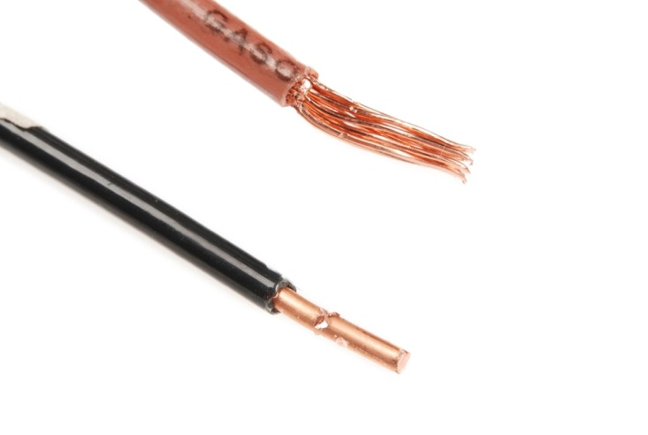
Specially Designed ITAR § 120.41 (cont.)
Subsequent to promulgation of the specially designed definition, we defined some of the terms used in paragraph (b)(2)
For example, wire: single conductor and stranded conductor, with or without insulation

Slide 26
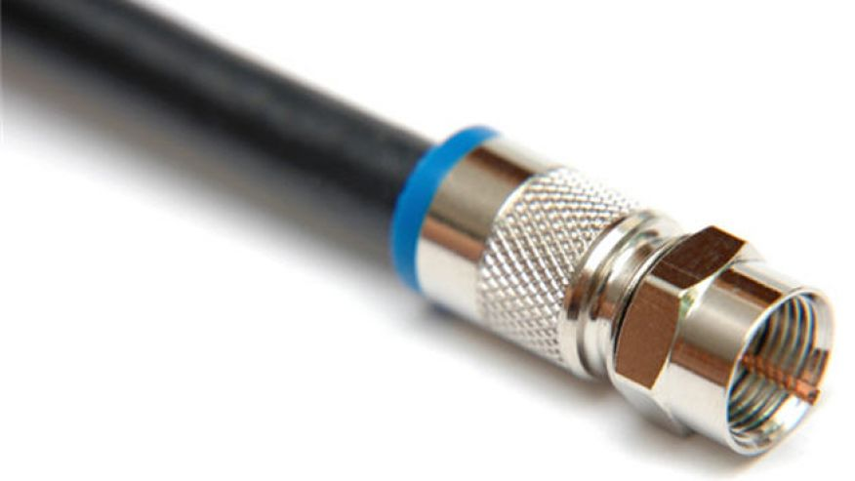
Specially Designed ITAR § 120.41 (cont.)
This, on the other hand, is not “wire.” So, do not stretch the meaning of the terms in paragraph (b)(2)

Slide 27
Specially Designed ITAR § 120.41
Bear in mind that the paragraph (b) releases do not apply to end-items, systems, equipment, firmware, or technical data directly related to defense articles
See ITAR §120.45 for definitions of these terms

Slide 28
Specially Designed ITAR § 120.41
A part, component, accessory, attachment, or software is also not “specially designed” if it:
§120.41(b)(3) - has the same function, performance capabilities, and the same or “equivalent” form and fit as a commodity or software used in or with a commodity that:
is or was in production (i.e., not in development); and
is not enumerated on the USML

Slide 29
Specially Designed ITAR § 120.41
Defined terms in the definition:
Function - action or actions a commodity is designed to perform
Performance capability - the measure of a commodity's effectiveness to perform a designated function in a given environment
Equivalent - form has been modified solely for fit purposes
Form – configuration (including the geometrically measured configuration), material, and material properties that uniquely characterize a commodity
Fit – the ability of a commodity to physically interface or connect with or become an integral part of another commodity

Slide 30
Specially Designed ITAR § 120.41
Defined terms in the definition:
Production means all production stages, such as product engineering, manufacture, integration, assembly (mounting), inspection, testing, and quality assurance
Development is related to all stages prior to serial production, such as: design, design research, design analyses, design concepts, assembly and testing of prototypes, pilot production schemes, design data, process of transforming design data into a product, configuration design, integration design, and layouts

Slide 31
Specially Designed ITAR § 120.41
For software:
Form means the design, logic flow, and algorithms
Fit means its ability to interface or connect with a defense article
Function means the action or actions the software performs directly related to a defense article or as a standalone application
Performance capability is the measure of the software's effectiveness to perform a designated function

Slide 32
Specially Designed ITAR § 120.41
A part, component, accessory, attachment, or software is also not “specially designed” if it:
§120.41(b)(4) - was or is being developed with knowledge that it is or would be for use in or with both defense articles and commodities not on the USML
§120.41(b)(5) - was or is being developed as a general purpose commodity or software, with no knowledge for use in or with a particular commodity or type of commodity (e.g., an aircraft or machine tool)

Slide 33
Specially Designed ITAR § 120.41
Note to §120.41(b)(4) and (b)(5)
Must have documents contemporaneous with development that establish that the commodity was or is being developed as a general purpose commodity, or for use in or with both defense articles and commodities not on the USML. Such documentation includes concept design information, marketing plans, declarations in patent applications, or contracts

Slide 34
Specially Designed ITAR § 120.41
Specially designed has been discussed at length by State and Commerce:
State’s rule: 78 Federal Register 22740
Commerce’s rule: 78 Federal Register 22660
TIP: Try out the specially designed tool at:
http://pmddtc.state.gov/licensing/dt_SpeciallyDesigned.htm

Slide 35
ITAR Order of Review Example
Washer for a tail boom folding system
This is a part for an aircraft system, so review USML Category VIII(h):
(h) Parts, components, accessories, attachments, associated equipment and systems, as follows:
(3) Tail boom folding systems, stabilator folding systems or automatic rotor blade folding systems, and specially designed parts and components therefor;

Slide 36
ITAR Order of Review Example
“Specially designed” is a control criterion for tail boom parts, so proceed to §120.41 and continue your analysis:
§120.41(a)(2) applies: it is a part used in a defense article
Washer is caught
But, we also see that §120.41(b)(2) applies: for purposes of the ITAR, washers are not specially designed
Washer is released

Slide 37
ITAR Order of Review Example
Static-line anchor cable for a CH-47 Chinook
Review USML Category VIII (Military Aircraft)
USML Category VIII(h) Parts, components, accessories, attachments, associated equipment and systems
Not described in any paragraph (h) subparagraph
Proceed to the EAR (starting at 600 series control)

Slide 38
When Does Requesting a CJ Determination Make Sense?
The ITAR does not require the submission of CJ determination requests. Self-determination is warranted when there is no doubt as to both the commodity’s jurisdiction and classification
When doubt exists, submit a CJ request to DDTC using form DS-4076 via the automated Defense Export Control and Compliance System (DECCS)

Slide 39
Commodity Jurisdiction
ITAR §120.4 Commodity Jurisdiction:
(d)(2) A designation that an article or service meets the criteria of a defense article or defense service, or provides equivalent capabilities of a defense article on the USML, is made on a case-by-case basis by the Department of State taking into account:
(i) the form and fit of the article; and
(ii) the function and performance capability of the article.
(d)(3) A designation that an article or service has a critical military or intelligence advantage such that it warrants control is made, on a case-by-case basis, by the Department of State taking into account:
(i) The function and performance capability of the article; and
(ii) The nature of controls imposed by other nations on such items.

Slide 40
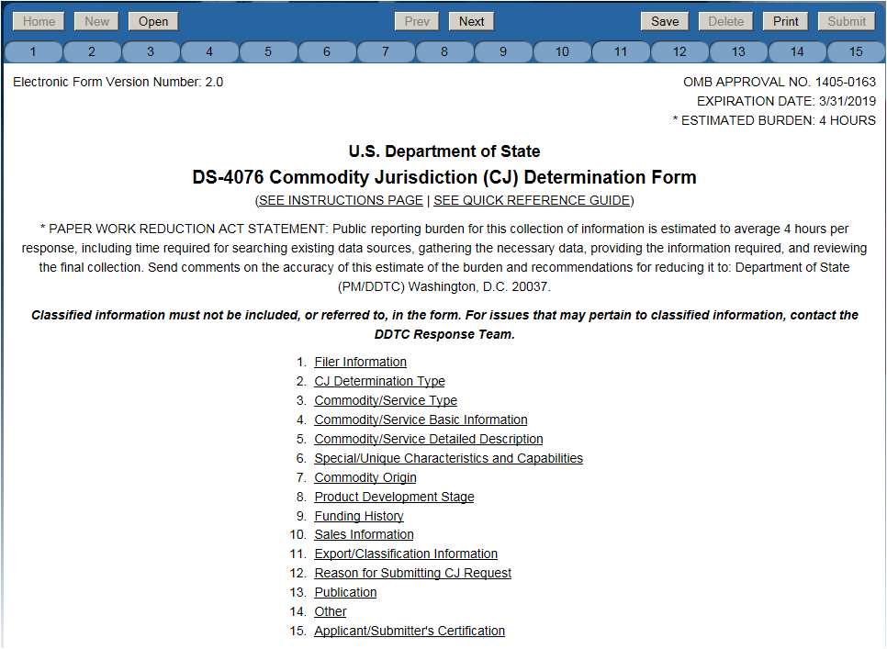
Submitting a CJ Determination Request
Submit a CJ request online via DECCS: Link: https://cj.pmddtc.state.gov/
DECCS Webinar: Link: https://www.pmddtc.state.gov/outreach/itmod.html

Slide 41
Submitting a CJ Determination Request
Applicant should be the original equipment manufacturer (OEM)
While there are exceptions, if you’re not the OEM you must have authorization to submit the CJ
An example authorization is on the CJ home page
Review the FAQs and the online instructions on the DDTC website under the CJ link:
http://www.pmddtc.state.gov/commodity_jurisdiction/index.html

Slide 42
CJ Determination Process
After applicant submits CJ through DECCS
CJ request is assigned a case number:
CJ XXXX-18; “18” indicates the year
A State Department analyst conducts a preliminary analysis and staffs to the interagency for review
Interagency review participants:
Department of Commerce
Department of Defense
Department of Homeland Security
As necessary:
NASA
Department of Energy
Other U.S. government agencies

Slide 43
CJ Determination Process
Unanimous jurisdiction recommendations from the reviewing agencies result in a final determination letter
State is responsible for resolving differing recommendations among the reviewing agencies and has final authority on the determination
Disagreement on the jurisdiction can significantly slow down conclusion of the CJ request

Slide 44
CJ Determination Process
When review is completed, State will issue a jurisdictional determination (ITAR-controlled, EAR-controlled, or neither)
ITAR results will include classification
EAR results may include classification
A CJ determination issued by State is the only legal document issued by the government regarding the jurisdiction of a commodity
CJ determination letter is sent to the e-mail address provided in DS-4076

Slide 45
Commodity Jurisdiction Web Page
You will find:
Link to DECCs
Tips for completing a successful CJ application
CJ Status via ELISA (http://elisa.dtsa.mil/Elisa_Results.aspx)
For informational purposes, the DS-4076 data collection
FAQs
Final determinations database
Contact information
Visit: http://pmddtc.state.gov/commodity_jurisdiction/index.html
For questions regarding the CJ application, contact the DDTC Response Team:
(202) 663-1282 DDTCResponseTeam@state.gov

Slide 46
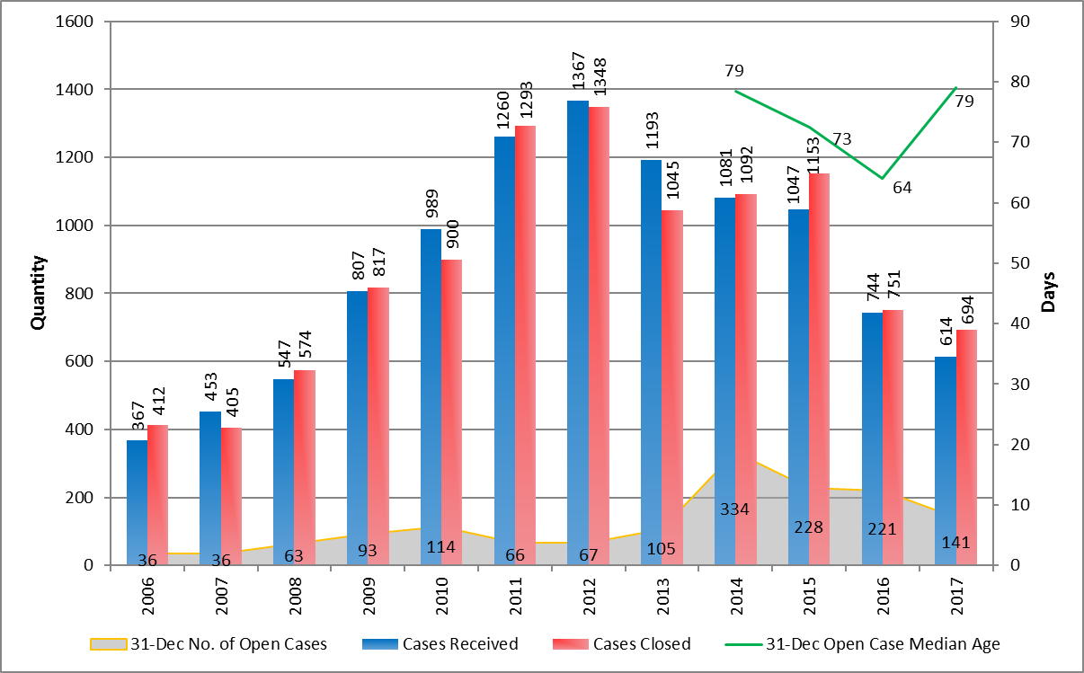
Commodity Jurisdiction Determinations

Slide 47
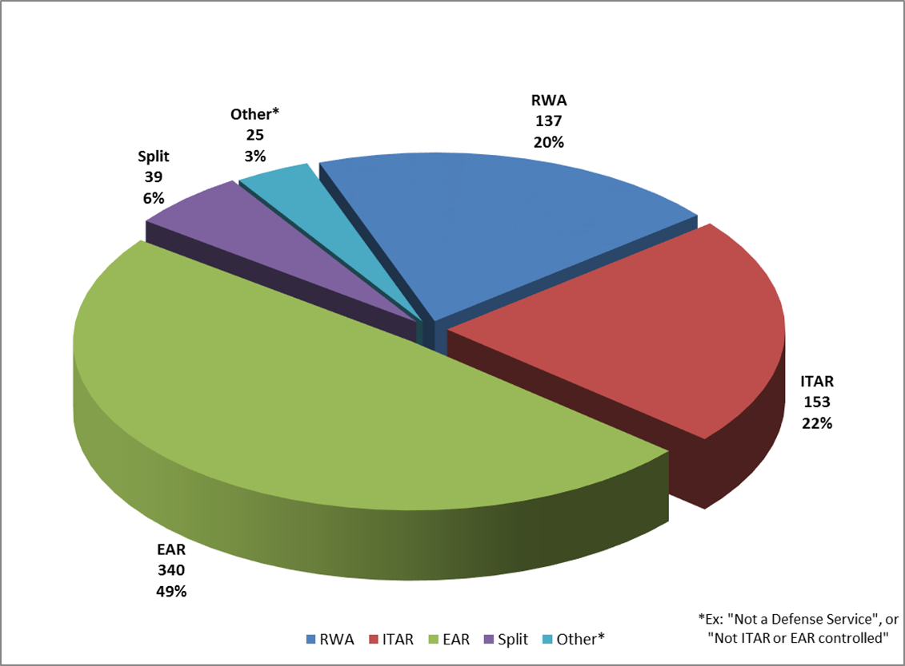
CJ Determinations CY 2017

Slide 48
We Value Your Feedback
Please take a moment to complete our quick evaluation
Tell us what we could improve AND what we did well!
*Check the webinar “Chat” box to easy access to the link!*
If you don’t see the Chat box, you can find the evaluation on your browser at https://questionweb.com/59212/
Notes:
Good afternoon. My name is James Ackerman. I’m a Compliance Specialist with the Office of Defense Trade Controls Compliance.
Earlier today you heard about DDTC and some of our key responsibilities in the policy sphere: USML, updating ITAR, and enhancing DDTC systems.
I’m going to talk to you about compliance. I’m going to provide a quick overview of the way my office works and how we approach the topic, and then I’m going to turn to specific challenges and opportunities faced by NASA.
In order to prepare for this, I took a look at recent NASA-related disclosures to our office, compliance issues reported by related groups (particularly universities and other government agencies), and several recent public reports regarding NASA’s export controls.
To level-set. We all know that NASA faces significant ITAR compliance challenges.
Candidly, it is not clear to me that “business as usual” with respect to those challenges is going to cut it. I highlight this because, in a changing export compliance world, there are increasing direct and indirect risks associated with AECA/ITAR violations.

