Slide 1
Main Title of Presentation
Sub-heading
Export Competitively and Boost Sales Using Accounts Receivable Insurance
ACE Exports Webinar
January 11, 2018
Stephen Maroon, Director of Marketing Communications
Elizabeth Thomas, Director of Sales and Marketing
Name of Presenter
Title of Presenter
Date

Slide 2

OBJECTIVES TODAY
Understand EXIM Bank
Learn how its products can increase the sales of U.S.-based companies
Q&A

Slide 3
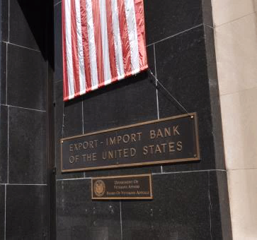
WHO IS EXIM BANK?
EXIM is an official independent agency of the U.S. Government
Mission: Maintain and create U.S. jobs by supporting the growth of U.S. exports
Established in 1934 with HQ in Washington, DC
Self-sustaining
Supports all U.S.-based companies

Slide 4
WE ARE SMALL BUSINESS FOCUSED
About 90% of EXIM Bank transactions supported small business exports.
No company or transaction is too small.
EXIM has supported sales of just a few thousand dollars.

Slide 5
FOUR PRIMARY PRODUCTS
Export Credit Insurance
Working Capital Guarantees
Loan Guarantees
Direct Loans (few and rare)

Slide 6
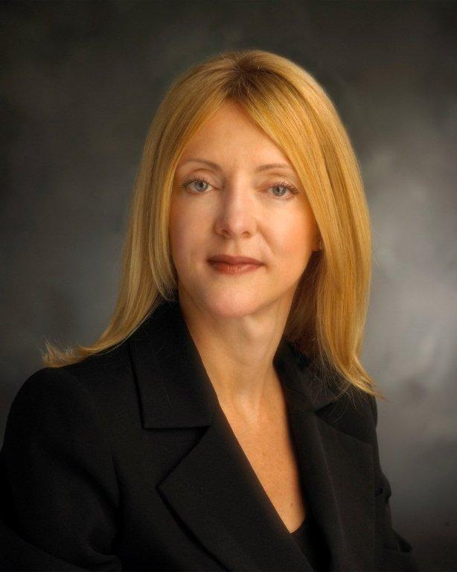
Elizabeth Thomas, EXIM Director of Sales and Marketing
Joined EXIM in 2016
Experienced international business executive working in the U.S., Europe and Asia
Sales, marketing and health-policy leadership with
Hewlett-Packard, InTouch Health and other high-tech firms
MBA, Emory University Goizueta Business School

Slide 7

GROWING INTERNATIONAL SALES WITH LESS WORRY
Should I enter that new market?
When will I get paid?
How can I match my foreign competitors who are offering credit terms?
Where will I get funds to fulfill the sales order?

Slide 8
SMALL BUSINESSES EXPORT WITH CONFIDENCE
Export Credit Insurance
  Reduce your risk of nonpayment by foreign buyers
  Offer competitive “open account” credit terms to your foreign buyers
Working Capital Loan Guarantee
  Obtain working capital loan funds to finance U.S.-made goods and services for export

Slide 9
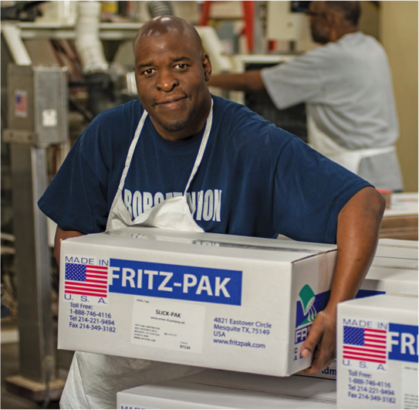
MADE IN THE USA!
High quality, durable, and safe
Flexible and prepared to modify products and services
Reputation for excellent after-sales service and warranty coverage
Honest end-to-end solutions that create long-term value

Slide 10
What if my buyer doesn’t pay?
Export Credit Insurance
Protects against nonpayment
Extends terms
Monetizes receivables
Accelerate cash flow

Slide 11
EXIM SOLUTION: EXPORT CREDIT INSURANCE
Risk Protection
Protects against nonpayment by foreign buyers due to commercial and political risks
Sales Tool
Offers competitive terms to foreign buyers (generally up to 180 days, some products may qualify for 360 day terms)
Financing Aid
Enables additional financing to fulfill sales orders. Insured foreign receivables may be added to your borrowing base

Slide 12
EXIM HAS YOU COVERED!
Political Risks:
War, Revolution, Insurrection
Currency Transfer Risk
Cancellation of an Import or Export License
Commercial Risks:
Insolvency
Bankruptcy
Protracted Default

Slide 13
EXTEND “OPEN ACCOUNT” COMPETITIVE CREDIT TERMS
  Up to 180 days for consumable products, as well as sales to distributors
  Up to 360 days for some bulk agricultural products and sales to end-users of capital equipment
  Note: EXIM also has medium-term buyer finance insurance

Slide 14
HOW EXPORT CREDIT INSURANCE WORKS
1
2
3
Exporter chooses Insurance policy, and applies (2 to 10 days)
Exporter offers credit terms to buyer for products/services to be performed
Contract states payment schedule and terms, and buyer accepts
6
5
4
Buyer pays.
If buyer fails to do so, Exporter claims payment with EXIM.
Exporter reports export to EXIM and pays premium to insure the invoice(s)
Exporter performs and bills buyer.

Slide 15
EXAMPLE: EXPRESS INSURANCE RATES
  Sell to a foreign buyer on terms up to 60 days open account
  Premium cost is $0.65 per $100 of the gross invoice value …
  Gross invoice is covered to 95%
  … on a $30,000 sale, $28,500 is covered for a $195 premium
  No application fee, no deductible, pay-as-you-ship premium

Slide 16
ELGIBITLITY CRITERIA
Exporters Must:
Be in business – selling – at least one year (unless otherwise noted)
Have a DUNS number and financial statements or tax returns:
50+ percent U.S. content including labor, but excluding mark-up

Slide 17

JUST A FEW RESTRICTIONS
No military or defense-related products or obligors (exceptions apply)
Restricted countries (Country Limitation Schedule)
Shipping from U.S. port

Slide 18
RESOURCES
Get a DUNS number to establish your credit file
US Department of Commerce https://export.gov
SBA Export Business Planner
EXIM Country Limitation Schedule
Elizabeth.Thomas@exim.gov

Slide 19
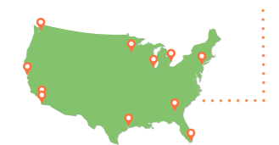
CONTACT A REGIONAL OFFICE NEAR YOU
Miami: 305-526-7436
New York: 212-809-2650
Atlanta: 404-815-1497
Chicago: 312-353-8093
Houston: 281-721-0470
Minneapolis: 612-348-1213
Detroit: 313-230-8832
Dallas-area: 214-551-4959
Orange County: 949-660-1341
San Diego: 858-467-7035
San Francisco: 415-705-2280
Seattle: 206-728-2264

Slide 20
QUESTIONS?
EXIM Contact:
Elizabeth Thomas, Director of Sales and Marketing
Phone: 202.565.3488
Email: Elizabeth.Thomas@EXIM.gov
exim.gov
800.565.3946 (EXIM)

