Slide 1

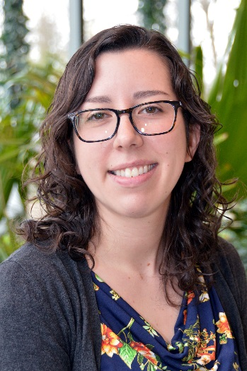
Roadmap to a Successful Voluntary Self-Disclosure
Jessica Mangubat
Trade Regulations Branch
International Trade Management Division
January 25, 2018

Slide 2
Today’s Topics
Fundamentals of the VSD Process:
  What is a Voluntary Self-Disclosure (VSD) and why submit one?
  Who can submit a VSD?
  When should you submit a VSD?
  What information is required for a VSD to be considered complete by the U.S. Census Bureau?
  Where do you submit a VSD?
Q&A
VSD Roadmap:
  Submit, Audit, Close-out
Q&A

Slide 3
What is a VSD and why submit one?
(30.1 and 30.74(a))
A VSD is…
  A narrative account with supporting documentation that describes violations or suspected violations of the Foreign Trade Regulations.
Benefits for the Company:
  Reflects a company’s due diligence.
  Stronger export compliance.
  Shipments can be mitigated.
Benefits for the U.S. Census Bureau:
  Export statistics are accurate.
Limitations

Slide 4
Who can submit a VSD?
(30.74(b)(4))
Parties in violation of the FTR:
  U.S. Principal Party in Interest (USPPI)
  Authorized Agent
  Carrier
Please remember…
  Senior management must authorize the VSD submission.

Slide 5
When should a company submit a VSD?
(30.74(a))
When known or suspected violations of the FTR occur.
What does the Census Bureau advise?
  Systematic errors
  Failure to file
  Corrections related to:
    A large number of shipments
    High value shipments
    Licensed shipments

Slide 6
What information is required for a VSD?
(30.74(c)(3))
Initial Notification
  Name and contact information of individual submitting the VSD and main point of contact for the VSD.
  Describe general nature, circumstances, and extent of the violations.
Narrative Account
  Follows the initial notification, review of a 5-year period, and corrections and filings in the AES.
  Should sufficiently describe the nature of the review and measures taken to minimize the likelihood the violations will occur again in the future.

Slide 7
What information is required for a VSD?
(30.74(c)(3)(i-vii) & 30.74(c)(4))
The kind of violation involved.
  What is the violation?
Describe all data required to be reported under the FTR that was either not reported or reported incorrectly.
  What was reported incorrectly?
  What should have been reported?

Slide 8
What information is required for a VSD?
(30.74(c)(3)(i-vii) & 30.74(c)(4))
An explanation of when and how the violations occurred.
  When did these violations happen?
  How did these violations happen?
The complete identities and addresses of all individuals and organizations, whether foreign or domestic, involved in the activities giving rise to the violations.
  Who are the parties involved?

Slide 9
What information is required for a VSD?
(30.74(c)(3)(i-vii) & 30.74(c)(4))
A description of any mitigating circumstances.
  First violation? First VSD?
  Have any employees attended export compliance seminars?
Corrective measures taken.
  What is the company doing to ensure this error does not happen again?

Slide 10
What information is required for a VSD?
(30.74(c)(3)(i-vii) & 30.74(c)(4))
Internal Transaction Numbers (ITNs) of the missed and/or corrected shipments.
  File the EEI and/or make corrections to the EEI in the AES.
  Provide the actual number of shipments affected.
  Provide the ITNs.
  If more than 10 shipments are involved, we ask that you submit the requested information in a password-protected Excel spreadsheet.

Slide 11
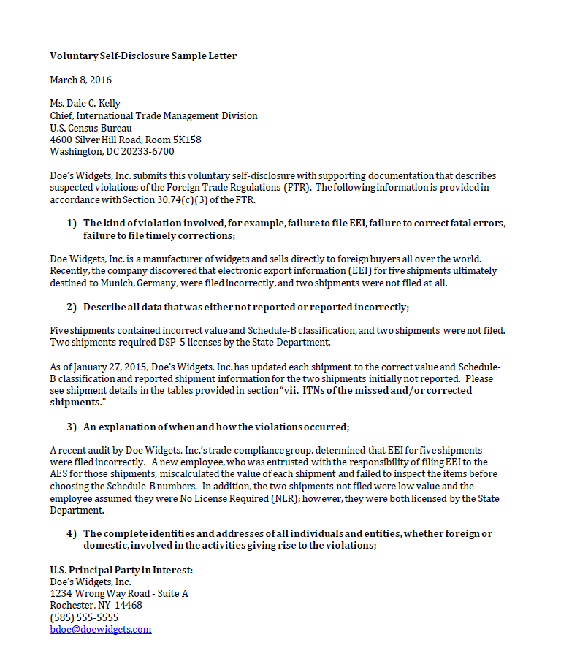
Example: Narrative Account

Slide 12
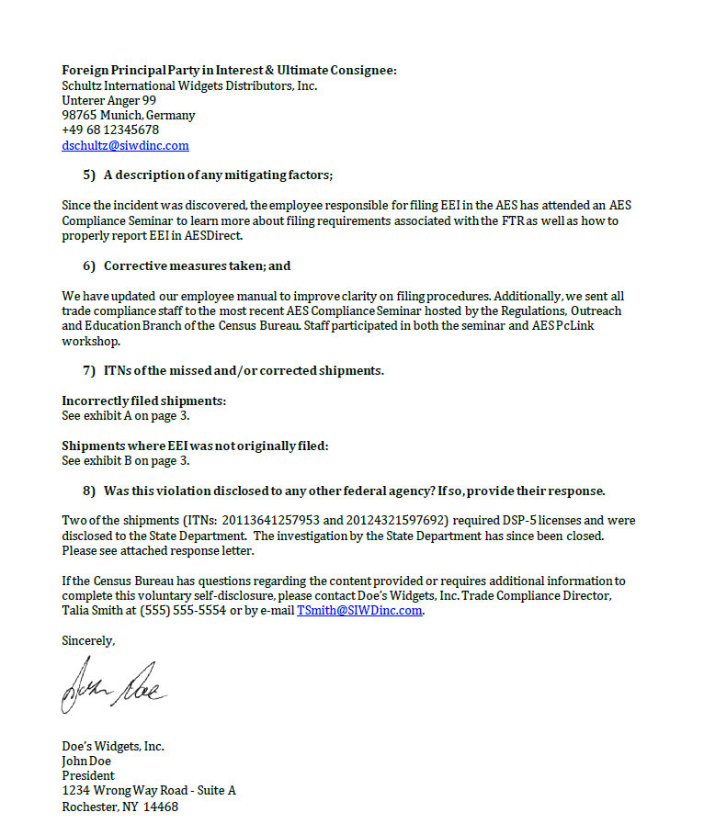
Example: Narrative Account (continued)

Slide 13
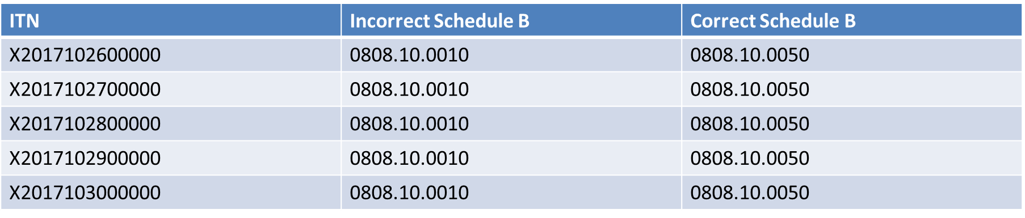
Example: Spreadsheet of ITNs
More than 10 shipments – submit a password-protected Excel spreadsheet to your assigned TRB analyst.

Slide 14

Where do you submit a VSD?
(30.74(c)(5))
Mail/Courier:
Email: itmd.askregs@census.gov
Fax: (301) 763-8835
  Chief, International Trade Management Division
  U.S. Census Bureau
  4600 Silver Hill Road
  Washington, DC 20233 (by USPS)
  or
  Suitland, MD 20746 (by courier)

Slide 15

Questions?

Slide 16
VSD Roadmap
Submit
Audit
Close-out

Slide 17
VSD Roadmap: Submit
Company determines violations occurred and submits to ITMD an initial notification letter or a full narrative account.
TRB analyst is assigned and reaches out to point of contact through email.
Company works with the TRB analyst to ensure all information is submitted by the due date for the Audit stage.

Slide 18
VSD Roadmap: Submit
Responsibilities of the…
  Company:
    Determine if a violation has occurred.
    Submit to ITMD an Initial Notification letter or a full Narrative Account.
    Communicate with the TRB analyst assigned.
    Make corrections or file the EEI in the AES.
  Trade Regulations Branch:
    Contact the company.
    Process Initial Notification letter or Narrative Account.
    Request additional information, if necessary.

Slide 19
VSD Roadmap
Submit
Audit
Close-out

Slide 20
VSD Roadmap: Audit
TRB analyst submits the ITNs and corrected data to the Data Analytics Branch (DAB) for audit.
The DAB reviews the ITNs and corrected data in the AES and informs TRB analyst if the company passed or failed the audit.
If the company failed the audit, TRB analyst informs the contact of what failed. Audit stage restarts. If the company passes, move on to Close-out stage.

Slide 21
VSD Roadmap: Audit
Responsibilities of the…
  Trade Regulations Branch:
    Submit data to the Data Analytics Branch.
    Contact the company if the audit fails.
  Data Analytics Branch:
    Audit the data.
    Determine if the data passes or fails.
  Company:
    If the audit fails, make corrections and resubmit the data.

Slide 22
VSD Roadmap
Submit
Audit
Close-out

Slide 23
VSD Roadmap: Close-out
TRB analyst submits the draft response letter and other supporting documentation to ITMD management for review.
ITMD management reviews and Chief of ITMD signs off on final response letter.
TRB analyst sends the final response letter to the company.

Slide 24
VSD Roadmap: Close-out
Responsibilities of the…
  Trade Regulations Branch:
    Draft a close-out letter.
    Submit draft to ITMD management for review.
    Send final close-out letter to company.
  ITMD management:
    Review draft and supporting documentation.
    Chief of ITMD signs off on final close-out letter.

Slide 25
VSD Roadmap
Submit
Audit
Close-out

Slide 26
Main Takeaways
When mistakes are made, VSDs can be beneficial to the company and the Census Bureau.
The VSD process is as simple as:
  Submit
  Audit
  Close-out
Prevent the need to submit a VSD:
  Take a look at the Foreign Trade Regulations (FTR).
    A PDF version of the FTR is available at www.census.gov/trade under the “Regulations” tab.
  Have a strong export compliance program.

Slide 27



Tools for Continued Compliance
AES Compliance Review Program
Webinars
Global Reach Blog

Slide 28
ITMD Outreach
Past Webinars:
Available at www.census.gov/foreign-trade/outreach and under the “Export Training” box on the right side of the webpage.
Includes:
  Advanced Export Reports – advanced tutorial to export reports feature in the Automated Commercial Environment (ACE).
  Exporting Vehicles to Canada – how to properly file vehicle exports through a step-by-step walkthrough. Useful for vehicle exports to Canada and abroad.
  ACE AESDirect Demonstration – step-by-step demonstration of filing Electronic Export Information in the Automated Export System.
Future Webinars:
Find a list of future webinars at www.census.gov/foreign-trade/outreach/index.html
Newsletter:
Check out ITMD’s Newsletter, Trade Source.
Available at www.census.gov/foreign-trade/outreach and at the “Newsletters” link in the “Important Links” box on the left.

Slide 29
Questions?

Slide 30

TRB’s Contact Information
Phone: 1-800-549-0595 (Option 3)
Fax: 301-763-8835
Email: itmd.askregs@census.gov
Website: census.gov/trade
Blog: globalreach.blogs.census.gov

